Slide 1
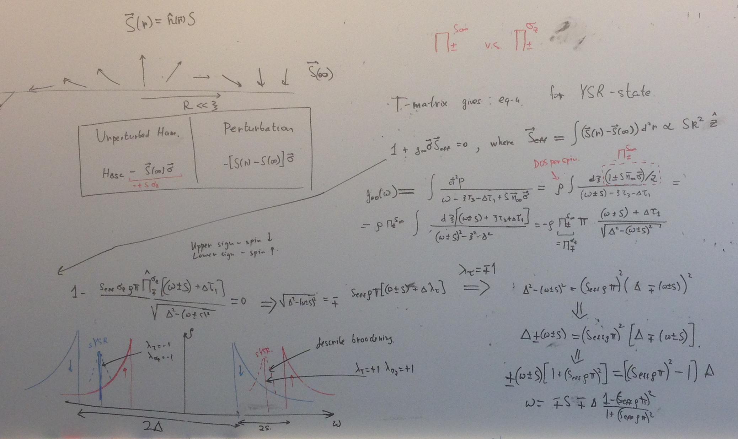
T- matrix

Slide 2
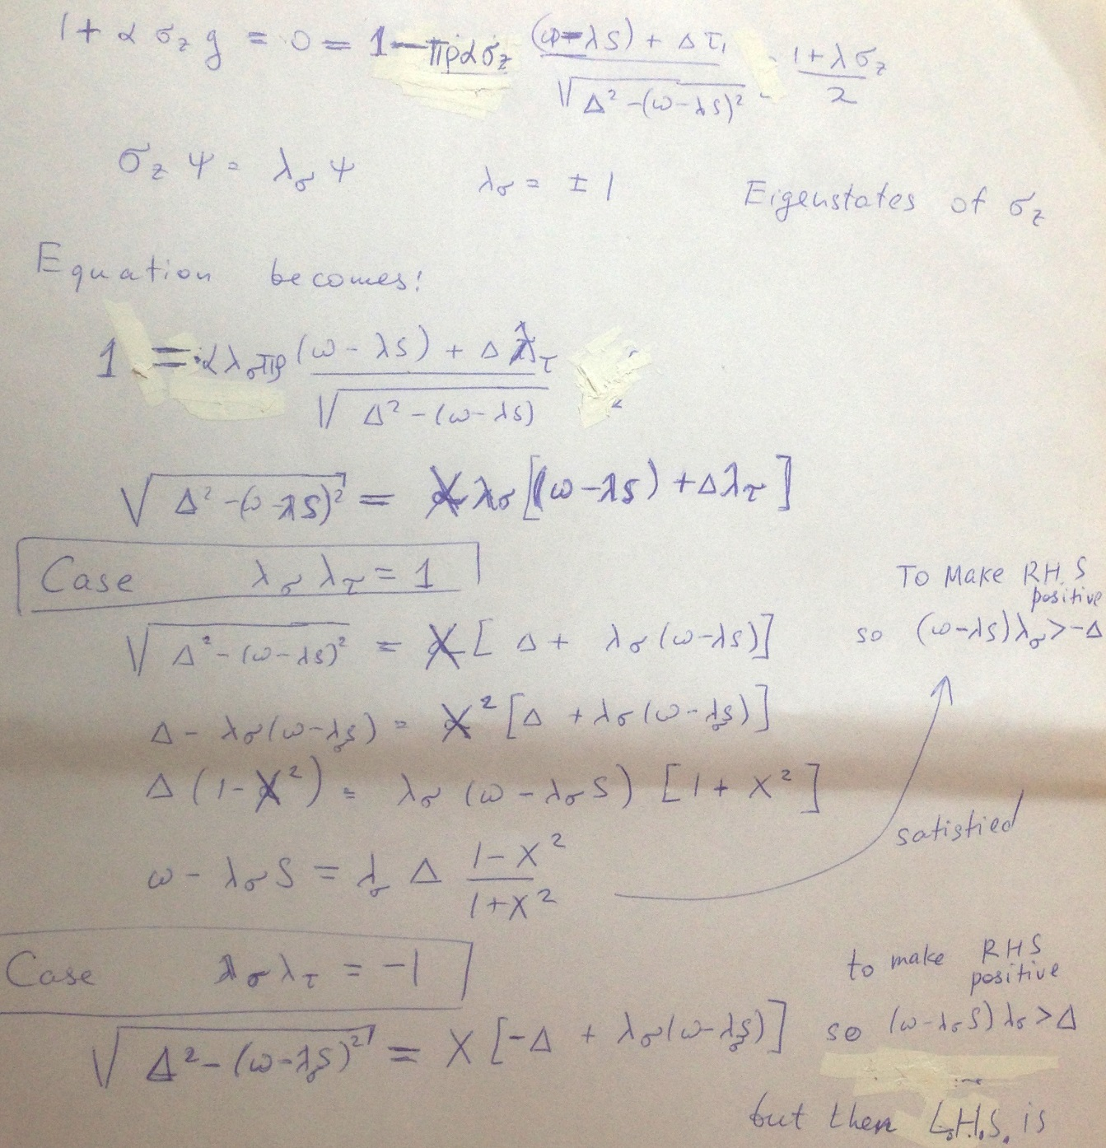
Standard solution for the YSR energy
But LHS is then complex. So equation is not satisfied

Slide 3
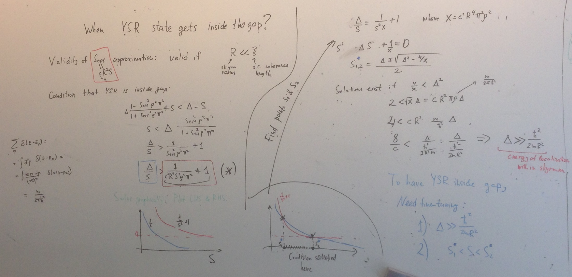
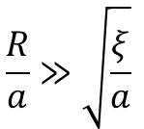
Usually YSR state is inside continuum of opposite spin.
Derive the condition that YSR state is inside the gap.
Define average distance between electrons $a=\frac{ℏ}{{ p}_{F}}$, then condition becomes
$$\frac{R}{a}≫\sqrt{\frac{ξ}{a}}$$

Slide 4
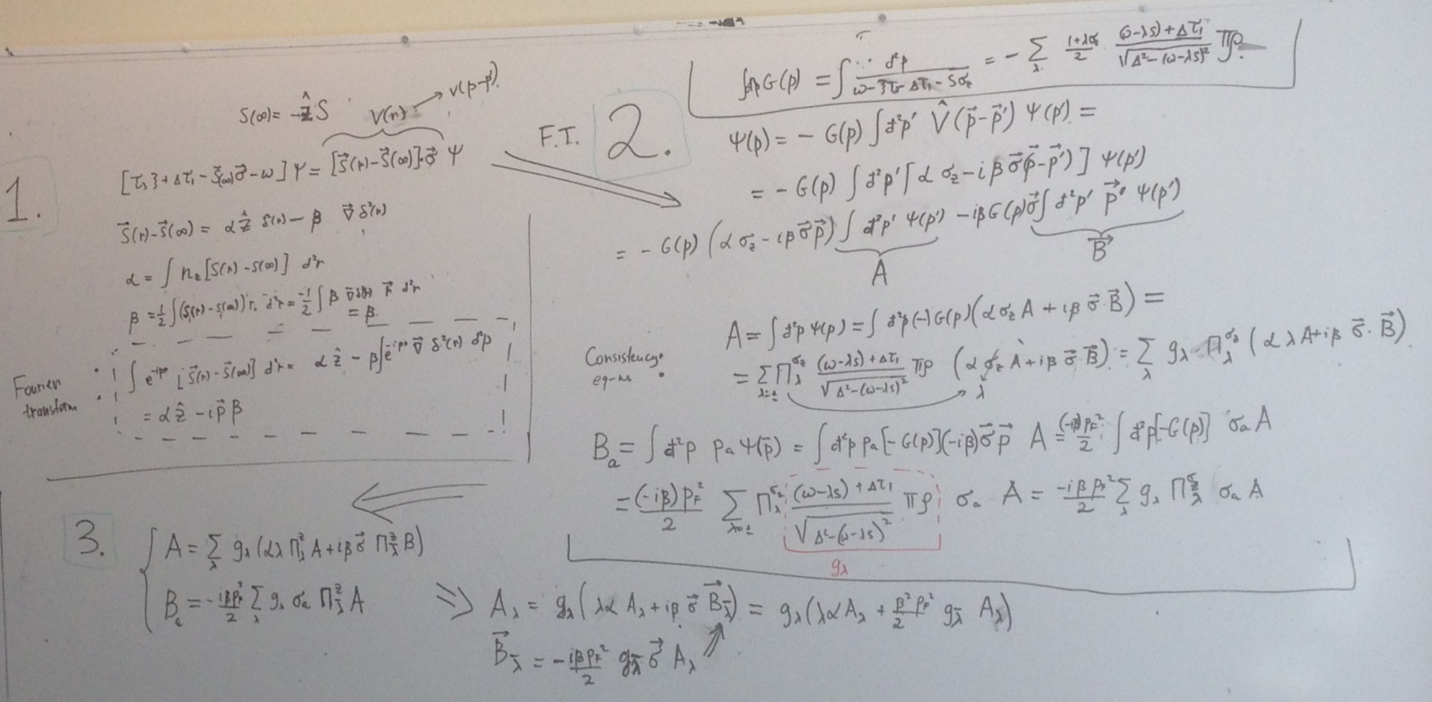
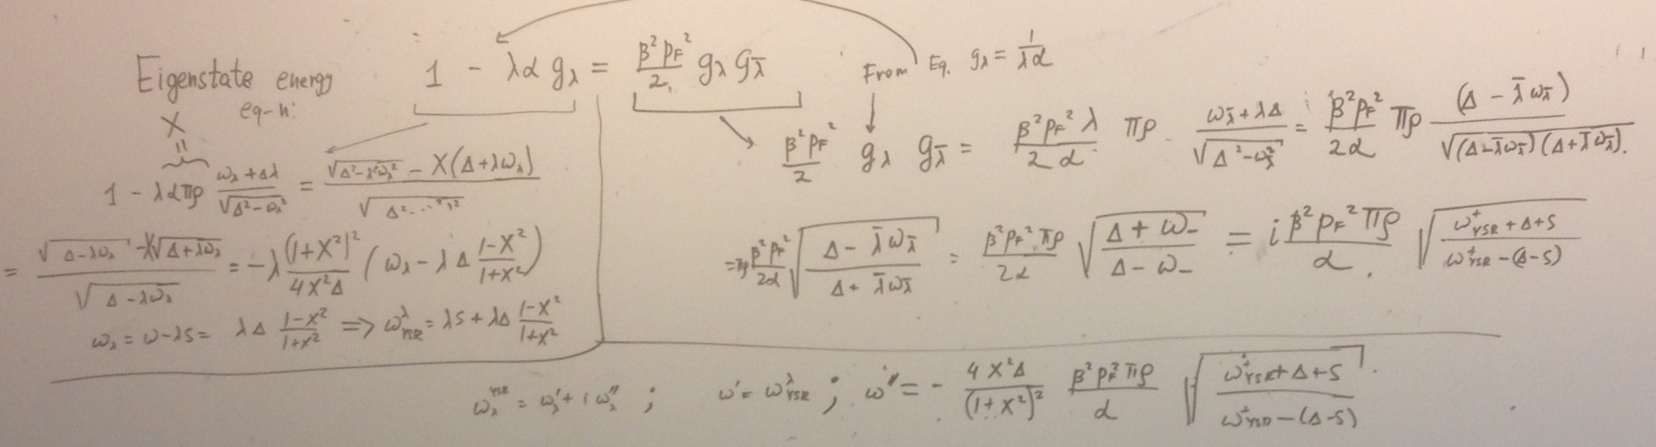
Include (ana) monopole moment and find the solution again.
The energy acquires imaginary part (YSR becomes a resonance)

Slide 5
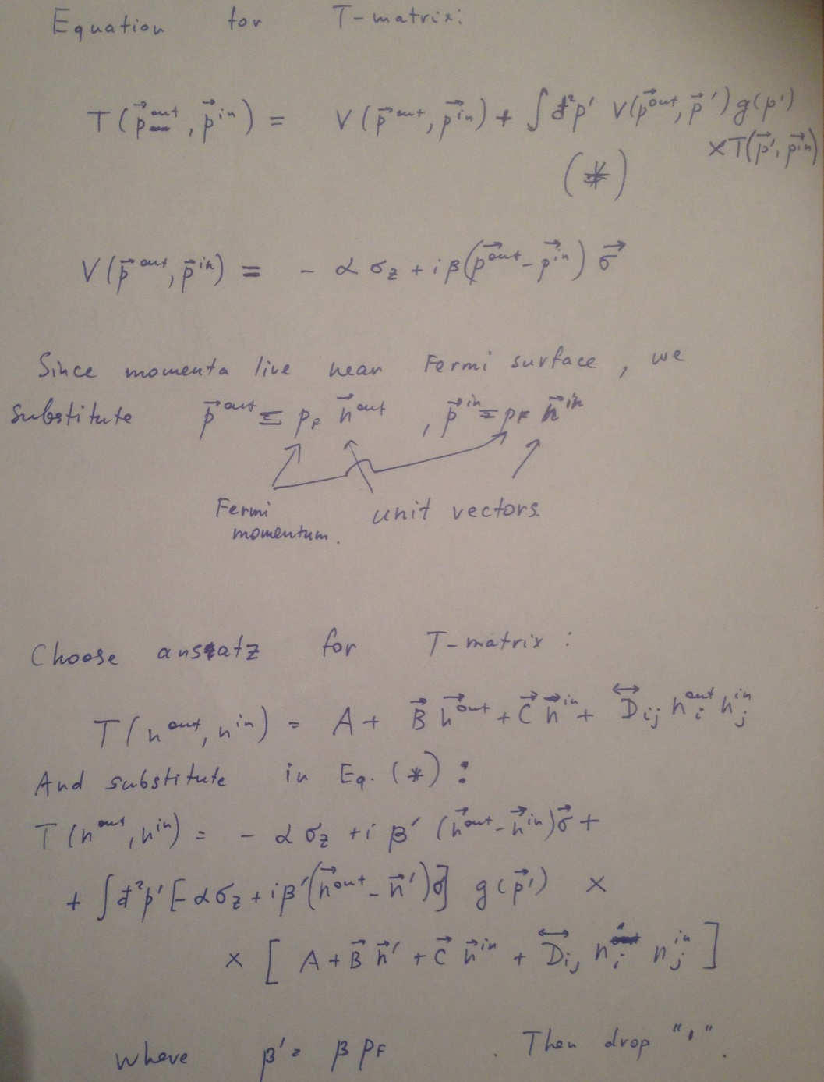
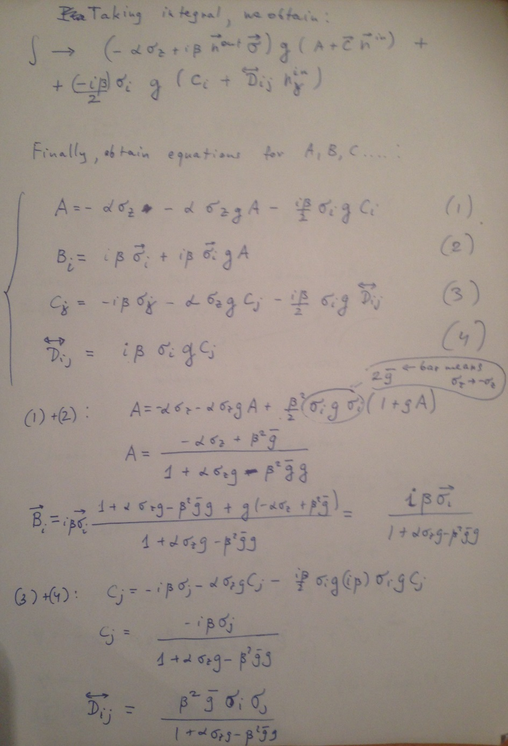
T-matrix solution
$$T\left(n^{out},n^{in}\right)=\frac{−ασ_{z}+β^{2}p_{F}^{2}\overline{g}+i βp_{F}\vec{σ}⋅\left({\vec{n}}^{out}−{\vec{n}}^{in}\right)+{p_{F}^{2}β}^{2}\overline{g}(\vec{σ}⋅{\vec{n}}^{out})(\vec{σ}⋅{\vec{n}}^{in})}{1+ασ_{z}g−{p_{F}^{2}β}^{2}g\overline{g}}$$

Slide 6
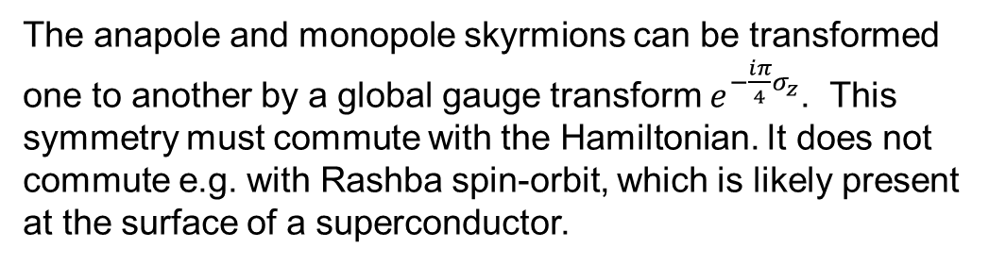
Anapole vs monopole skyrmions
The anapole and monopole skyrmions can be transformed one to another by a global gauge transform $e^{−\frac{iπ}{4}σ_{z}}$. This symmetry must commute with the Hamiltonian. It does not commute e.g. with Rashba spin-orbit, which is likely present at the surface of a superconductor.

Slide 7
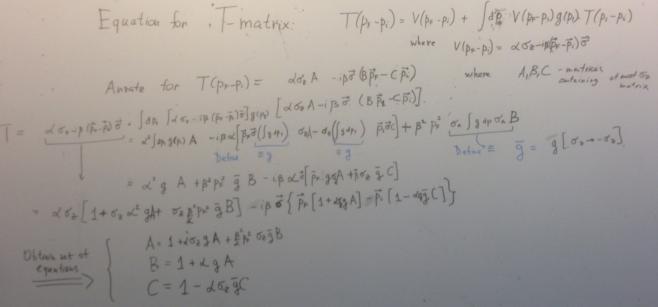
(OLD) Attempt to solve T-matrix equation. Actually incorrect, because one term is missed. But has good ideas.

Slide 8
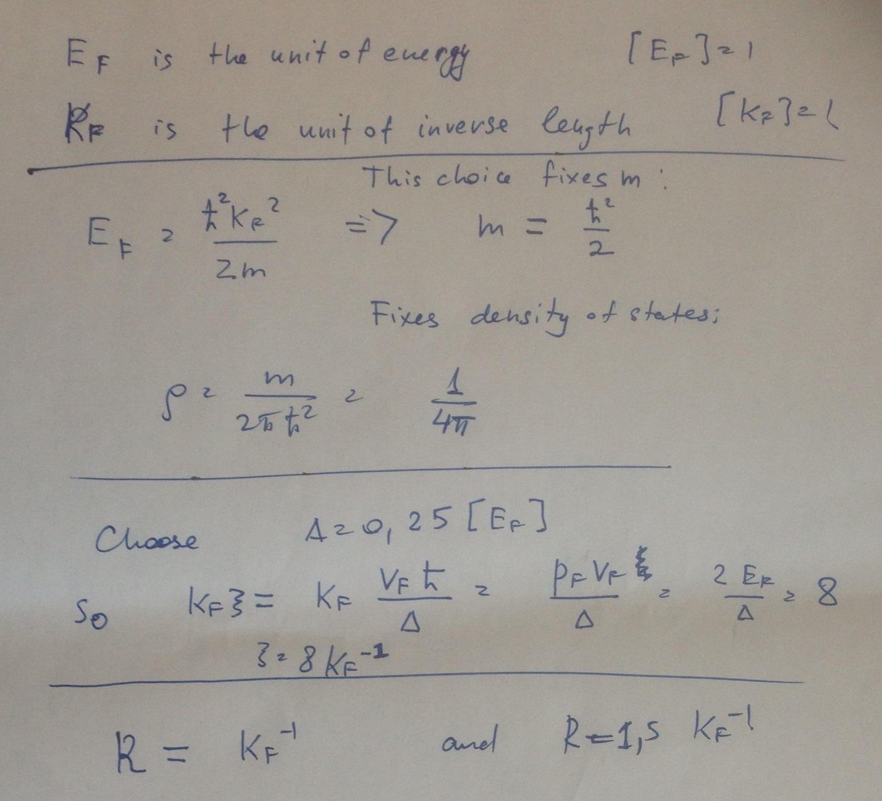
UNITS. Set Ef and Pf as units of energy and momentum, express everthing else through them.

