Slide 1
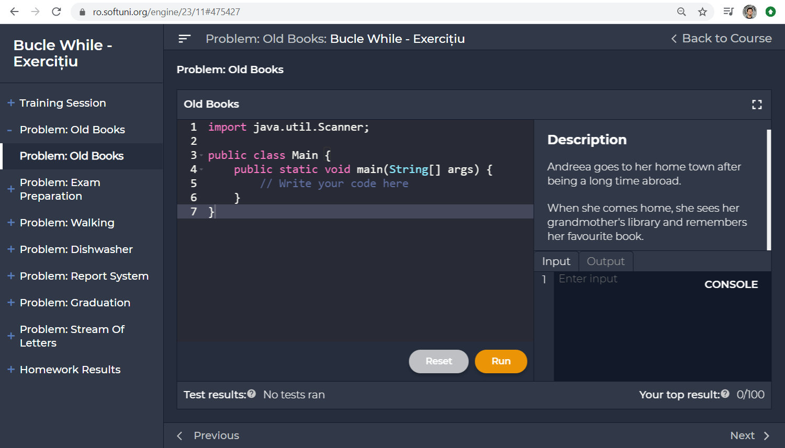

SoftUni Unified Support System
Questions plugin attributes:
Course: Intro Java – Romania – Jan 2020
Lesson: While Loops – Exercises
Section: Problem "Old Books"
<script>
window.uss = {
course: "Intro Java Romania – Jan 2020",
lesson: "While Loops",
section: "Problem: Old Books",
author: { id: "01949fd9-cdde-422f-884b-da3028fe0597",
name: "Simina Tabac"
}
url: document.location,
createQuestionsButton: { title: "Questions",
class: "…",
style: "…",
locationAfter: "#title"
}
};
</script>
<script src="https://localhost/unified-support-system/embed.js">
</script>

Slide 2
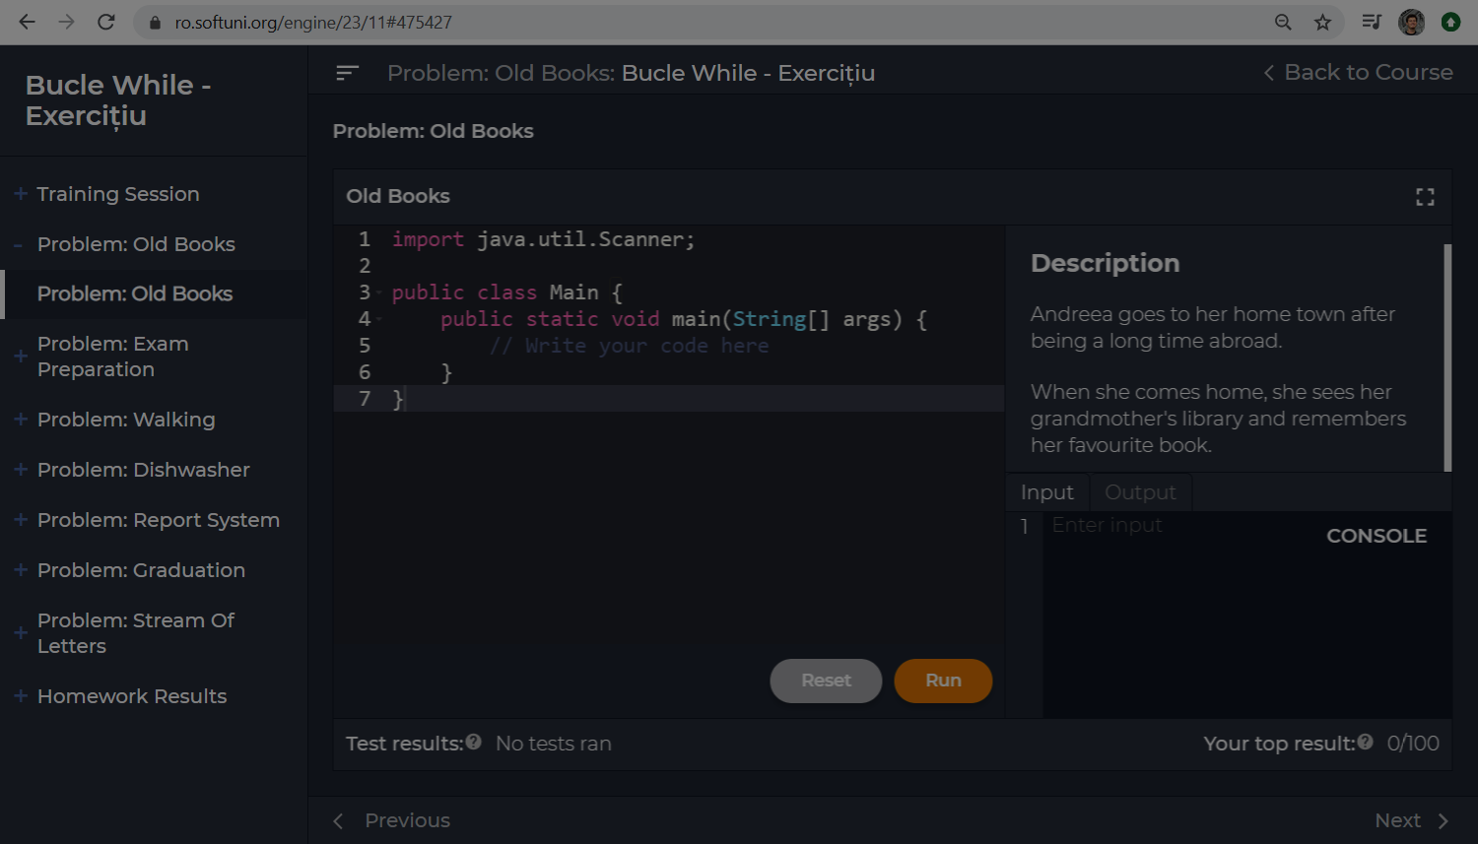


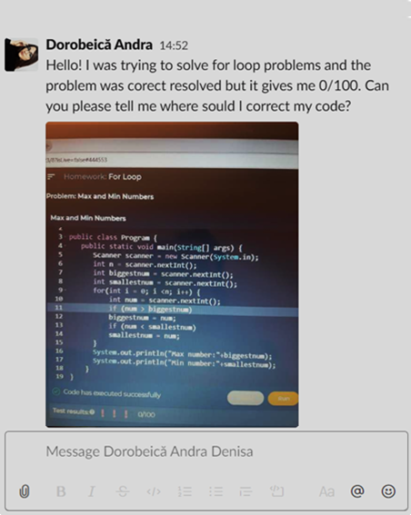






Questions: While Loops Exercises >> Problem "Old Books"
x
Dorobeica Andra
# 52531
Help with Old Books problem
26-Feb-2020 21:33
Help with Old Books problem
Hello! I was trying to solve for loop…
Ionut Vasile
# 52527
26-Feb-2020 22:07
Question
Hi, I don't know what is not correct …
Ema Utiu
# 52518
26-Feb-2020 22:07
Read number
Hello. How do I read a number?
+ New Question
Section
Lesson
My
All

Slide 3
Questions: While Loops Exercises >> Problem "Old Books"
x
Question attributes:
Dorobeica Andra
# 52531
Help with Old Books problem
Question ID: 52532
Date: 26-Feb-2020 21:33
Author (tag): 01949fd9-cdde-422f-884b-da3028fe0597
Title: Help with Old Books problem
Text: Hello! I was trying to solve the …
URL: https://ro.softuni.org/engine/23/11#469576
Course instance (GitHub project): Intro-Java-Romania-Jan-2020
Lesson (milestone): While Loops Exercises
Section (tag): Problem "Old Books"
Votes Up: 2
Votes Down: 0
26-Feb-2020 21:33
Help with Old Books problem
Hello! I was trying to solve for loop…
Ionut Vasile
# 52527
26-Feb-2020 22:07
Question
Hi, I don't know what is not correct …
Ema Utiu
# 52518
26-Feb-2020 22:07
Read number
Hello. How do I read a number?
Message attributes:
Message ID: 2982993
Question ID (foreign key): 52532
Date: 26-Feb-2020 21:33
Author (tag): 01949fd9-cdde-422f-884b-da3028fe0597
Text: …
+ New Question
Section
Lesson
My
All

Slide 4
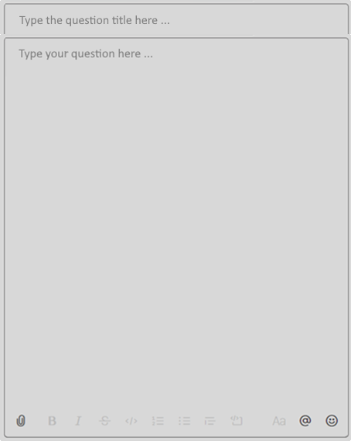
Questions: While Loops Exercises >> Problem "Old Books"
x
Supported features:
Dorobeica Andra
# 52531
Text with simple formatting (bold, italic)
Inline code blocks: `a = 5`
Long code blocks (up to 500 lines):
```
function print(str) { … }
```
Paste images (like in Gitter.im)
Lists (bullets, numbered)
26-Feb-2020 21:33
Help with Old Books problem
Hello! I was trying to solve for loop…
Ionut Vasile
# 52527
26-Feb-2020 22:07
Question
Hi, I don't know what is not correct …
Extra functionality:
Simple emoticons
File attachments (e.g. PDF file)
Delete own messages
Edit own messages
Ema Utiu
# 52518
26-Feb-2020 22:07
Read number
Hello. How do I read a number?
All these features are already available from GitHub Issues
+ New Question
https://github.com/nakov/Unified-Support-System/issues/2
Section
Lesson
My
All

Slide 5






Questions:
My
Open
Taken
Closed
All
Sort by:
Date
Closed
From: Albert Ionut Vasile | @alb3rtsk.2002
URL: https://ro.softuni.org/engine/23/10#while-loops-vid...
Date: 26-Feb-2020 19:02 (4.5 hours ago)
Answers: 3
View in Gitter
# 52531
Hello! May you help me again with this problem? (image.png)
Take
Taken by: @nakov
Close
Course: Intro Java – Romania – Jan 2020
Lesson: While Loops
Slide: While Loop >> Video
Open
From: Simina Tabac | @stabac
URL: https://ro.softuni.org/engine/23/10#354624
Date: 26-Feb-2020 19:04 (4.5 hours ago)
Answers: 0
View in Gitter
# 52519
Hello! May you help me again with this problem? (image.png)
Take
Taken by: @anna.s
Close
Course: Intro Java – Romania – Jan 2020
Lesson: While Loops
Slide: Homework >> Problem: Find Min a…
Taken
From: Dorobeica Andra | @dorobeica
URL: https://ro.softuni.org/engine/23/10#354624
Date: 26-Feb-2020 21:33 (2 hours ago)
Answers: 0
View in Gitter
# 52502
Hello! I was trying to solve for loop problems and the problem was correct resolved but it gives me 0/100. Can you please tell me where should I correct my code?
Untake
Taken by: @anna.s
Close
Course: Intro Java – Romania – Jan 2020
Lesson: While Loops – Exercises
Slide: Problem "Old Books"

Slide 6
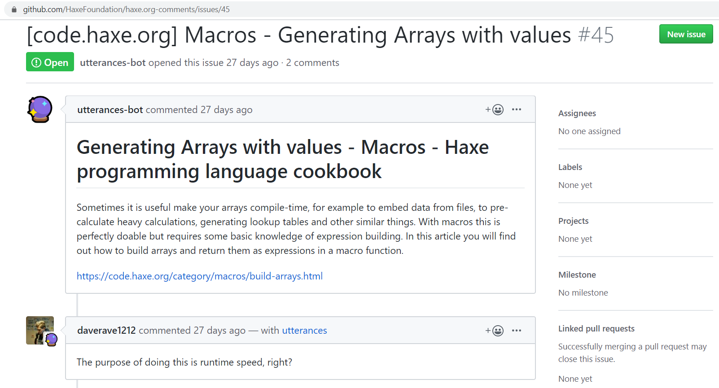
GitHub Issues as Backend
GitHub Issues match the Questions in the Unified Support System
Issues can be open / closed
Issues can be taken (assigned to someone)
Issues have author, date, text
Issues do not have the special fields: Course, Lesson, Slide, Author Name, …
Issues have comments
Field mappings:
Course instance → GitHub Project
Lesson → Milestone
Section → tag section:problem-nums
AuthorId → tag author:id
URL: # URL in the body text
Author Name: # Author in the body text
Webhooks: subscribe for issues

Slide 7
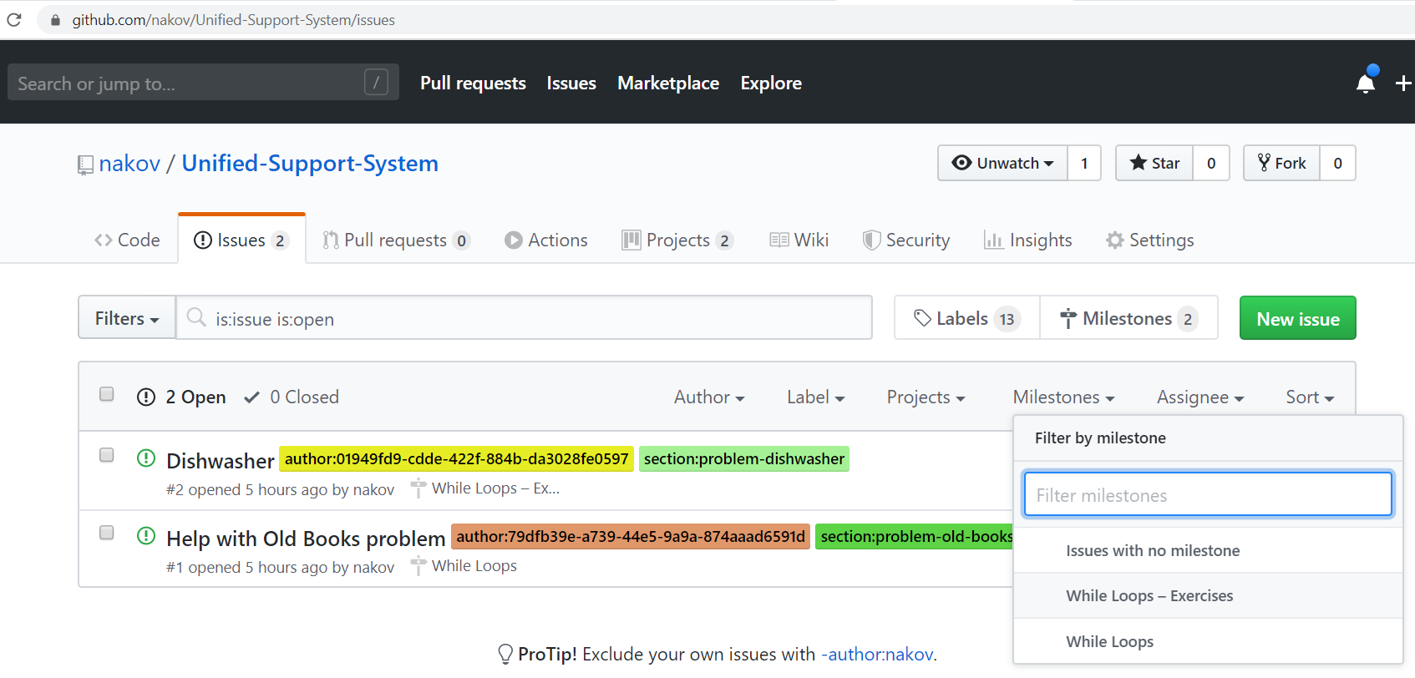
GitHub Issues as Admin App
https://haxe.org/manual/introduction-hello-world.html
https://github.com/HaxeFoundation/haxe.org-comments/issues/45
https://github.com/nakov/Unified-Support-System/issues/2
https://api.github.com/repos/nakov/Unified-Support-System/issues/2

Slide 8
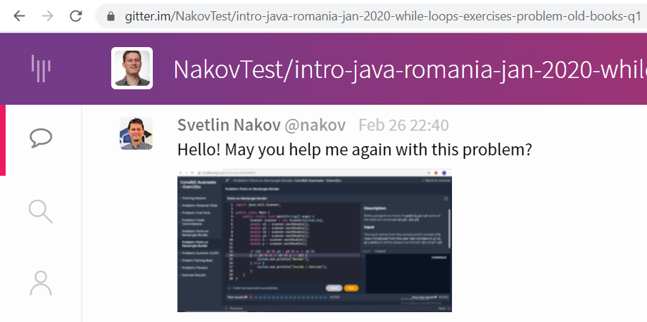
Gitter.im as Backend (Canceled)
Each question might be a Gitter.im chatroom (holds a sequence of chat messages).
We embed the Gitter chatroom. See the demo from https://sidecar.gitter.im.
Users either login at Gitter (with a GitHub / Twitter account) or use a default (anonymous account) – see https://github.com/xMartin/anonymous-gitter-chat.

