Slide 1
TODO
[done] Search Box
[done] Unread Messages on the [Questions] box
[done] New Question -> Choose а Category
[done] My Questions -> Move to [Technical]
[done] Sorter for the Questions: by Likes / by Date
[done] Sli.do Screen + Example
Administrative:
FAQ (GitHub Questions, tagged "FAQ")
Email Form (like in https://softuni.bg/contacts)
Community -> FB Groups:
https://developers.facebook.com/docs/plugins/group-plugin/#example
Program Group (e.g. SoftUni Java)
Course Group (e.g. Programming Fundamentals Java)

Slide 2
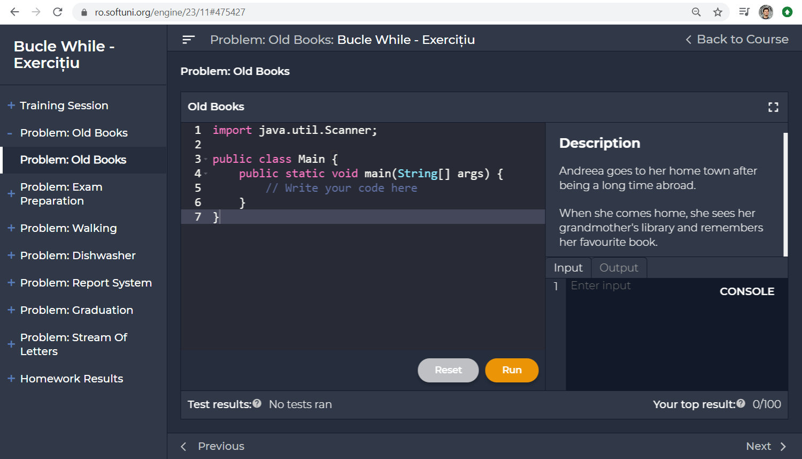

SoftUni Help Center
Questions plugin attributes:
Course: Intro Java – Romania – Jan 2020
Lesson: While Loops – Exercises
Section: Problem "Old Books"
<script>
window.helpCenter = {
course: "Intro Java Romania – Jan 2020",
lesson: "While Loops",
section: "Problem: Old Books",
author: { id: "01949fd9-cdde-422f-884b-da3028fe0597",
name: "Simina Tabac"
}
url: document.location,
createQuestionsButton: { title: "Questions",
class: "…",
style: "…",
domLocationAfter: "#title"
}
};
</script>
<script src="https://localhost/help-center.js">
</script>

Slide 3
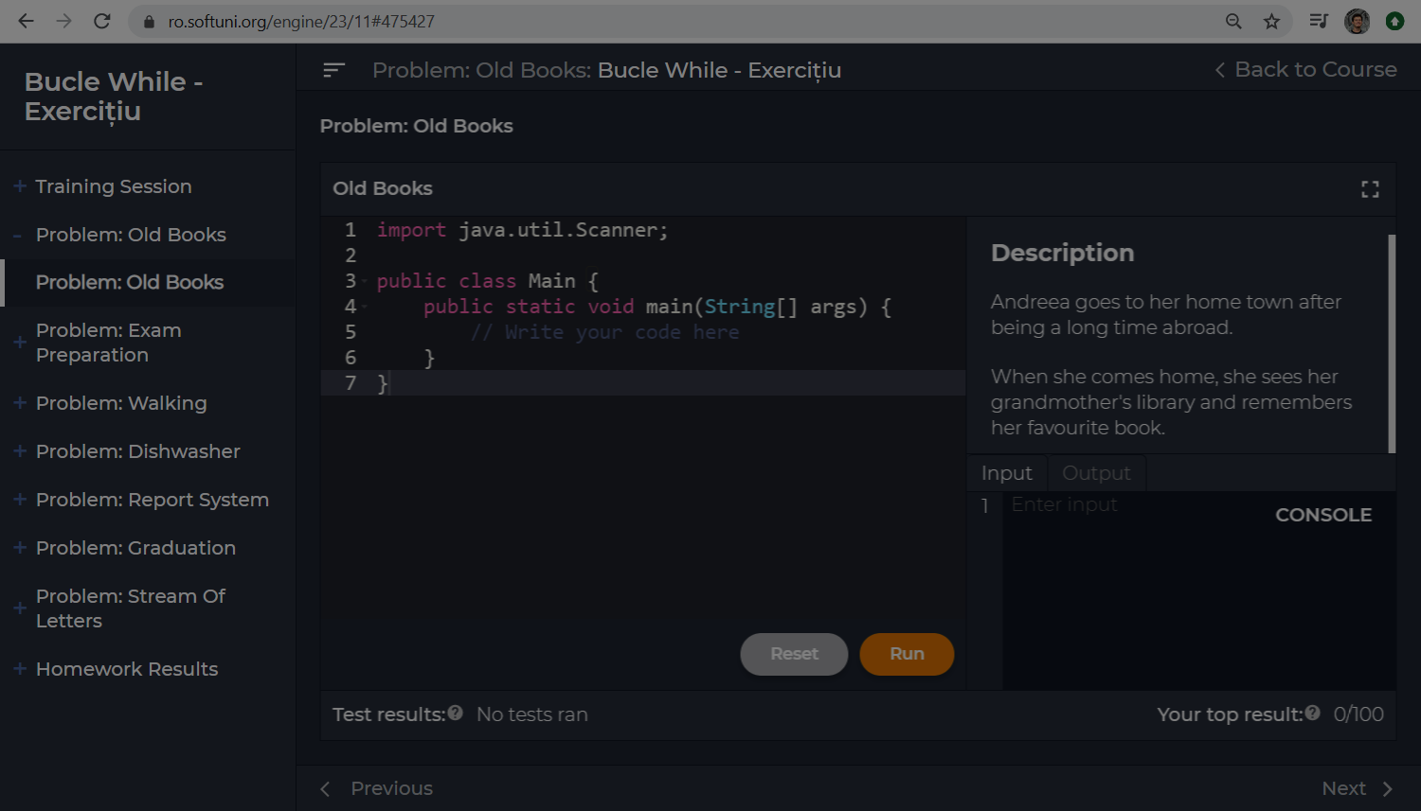




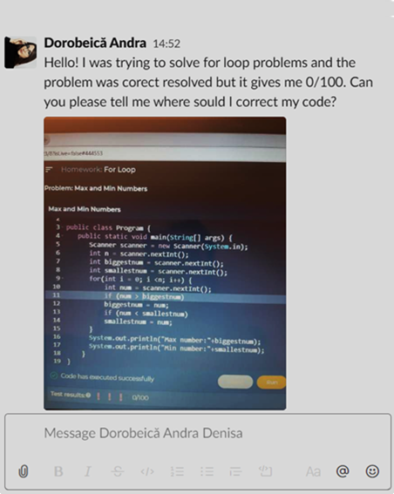










Help Center
Technical Questions: While Loops Exercises >> Problem "Old Books"
x
Technical
Search …
Help with Old Books problem
Dorobeica Andra
3 answers
26-Feb-2020 21:33
My
Help with Old Books problem
Section
Hello! I was trying to solve for loop…
Resolved
1
Lesson
Ionut Vasile
2 answers
26-Feb-2020 22:07
Course
Question
Resolved
Hi, I don't know what is not correct …
Administrative
Ema Utiu
0 answers
26-Feb-2020 22:07
Read number
Community
Hello. How do I read a number?
New Question
1

Slide 4

Technical Questions

Slide 5
Help Center: Technical Questions
Question attributes:
Help Center
Technical Questions: While Loops Exercises >> Problem "Old Books"
x
Technical
Help with Old Books problem
Question ID: 52532
Date: 26-Feb-2020 21:33
Author (tag): 01949fd9-cdde-422f-884b-da3028fe0597
Title: Help with Old Books problem
Text: Hello! I was trying to solve the …
URL: https://ro.softuni.org/engine/23/11#469576
Course instance (GitHub project): Intro-Java-Romania-Jan-2020
Lesson (milestone): While Loops Exercises
Section (tag): Problem "Old Books"
Votes Up: 2
Votes Down: 0
Search …
Dorobeica Andra
3 answers
26-Feb-2020 21:33
My
Help with Old Books problem
Section
Hello! I was trying to solve for loop…
Lesson
Ionut Vasile
2 answers
1
26-Feb-2020 22:07
Course
Question
Resolved
Hi, I don't know what is not correct …
Administrative
Ema Utiu
0 answers
26-Feb-2020 22:07
Read number
Message attributes:
Community
Hello. How do I read a number?
Message ID: 2982993
Question ID (foreign key): 52532
Date: 26-Feb-2020 21:33
Author (tag): 01949fd9-cdde-422f-884b-da3028fe0597
Text: …
New Question

Slide 6




Help Center: New Question → Choose Category
Help Center
Technical Questions: While Loops Exercises >> Problem "Old Books"
x
Technical
Search …
Ask a technical question
Dorobeica Andra
3 answers
26-Feb-2020 21:33
E.g. Where is the problem in this code ... / Help me with this error message … / How to use this library …
My
Help with Old Books problem
Section
Hello! I was trying to solve for loop…
1
Ask an administrative question
Lesson
Ionut Vasile
2 answers
26-Feb-2020 22:07
Course
Question
Resolved
E.g. I cannot access my course content … / My payment failed … / Can I use in Java at the exam …
Hi, I don't know what is not correct …
Administrative
Ema Utiu
0 answers
Share with the community
26-Feb-2020 22:07
Read number
E.g. Apple created a new AI tool, what do you think … / JS is the most active language in StackOverflow …
Community
Hello. How do I read a number?
New Question

Slide 7
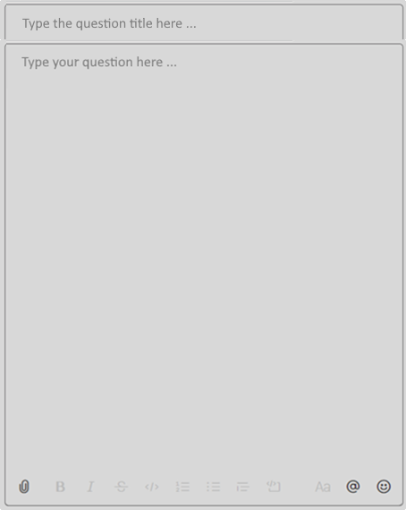
Help Center: New Question → Write the Question
Supported features:
Help Center
Technical Questions: While Loops Exercises >> Problem "Old Books"
x
Text with simple formatting (bold, italic)
Inline code blocks: `a = 5`
Long code blocks (up to 500 lines):
```
function print(str) { … }
```
Paste images (like in Gitter.im)
Lists (bullets, numbered)
Technical
Search …
Dorobeica Andra
3 answers
26-Feb-2020 21:33
My
Help with Old Books problem
Section
Hello! I was trying to solve for loop…
Lesson
Ionut Vasile
2 answers
1
26-Feb-2020 22:07
Extra functionality:
Course
Question
Resolved
Hi, I don't know what is not correct …
Simple emoticons
File attachments (e.g. PDF file)
Delete own messages
Edit own messages
Administrative
Ema Utiu
0 answers
26-Feb-2020 22:07
Read number
Community
Hello. How do I read a number?
All these features are already available from GitHub Issues
New Question
https://github.com/nakov/Unified-Support-System/issues/2

Slide 8

Help Center: Technical Questions → Sort
Help Center
Technical Questions: While Loops Exercises >> Problem "Old Books"
x
Technical
Search …
Help with Old Books problem
Latest
Dorobeica Andra
3 answers
26-Feb-2020 21:33
Most liked
My
Help with Old Books problem
Most commented
Section
Hello! I was trying to solve for loop…
Unread
Lesson
Ionut Vasile
2 answers
1
26-Feb-2020 22:07
Course
Question
Resolved
Hi, I don't know what is not correct …
Administrative
Ema Utiu
0 answers
26-Feb-2020 22:07
Read number
Community
Hello. How do I read a number?
New Question

Slide 9
Live Questions

Slide 10
Live Questions: Sli.do Mode (Popup Style)
Live Questions: While Loops
x
Search …
Help with Old Books problem
Dorobeica Andra
# 52531
26-Feb-2020 21:33
Help with Old Books problem
Hello! I was trying to solve for loop…
Ionut Vasile
# 52527
1
26-Feb-2020 22:07
Question
Resolved
Hi, I don't know what is not correct …
Ema Utiu
# 52518
26-Feb-2020 22:07
Read number
Hello. How do I read a number?
New Question

Slide 11

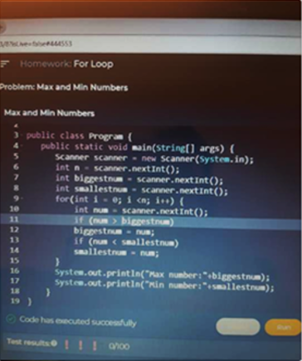

Live Questions: Sli.do Mode (Embedded Style)
Live Questions
View Live Question
Back
Ask a Live Question
Back
Dorobeica Andra
3 answers
Dorobeica Andra
3 answers
26-Feb-2020 21:33
26-Feb-2020 21:33
Hello! I was trying to solve for loop…
Hello! I was trying to solve for loop problem and the problem was correctly resolved but it gives me 0/100. Can you please tell me where I should correct my code?
Ionut Vasile
2 answers
1
26-Feb-2020 22:07
Hi, I don't know what is not correct …
Ema Utiu
0 answers
26-Feb-2020 22:07
Hello. How do I read a number?
Search …
Ask

Slide 12
Administrative Questions

Slide 13




Help Center: Administrative Questions → Contact Support
Help Center
Administrative Questions
x
Technical
Subject
Search FAQ …
Your Email
Optimal Hours Per Week
20-March-2020 11:38
Describe your problem / inquiry here….
What is the optimal hours per week to spend on learning programming?
Administrative
Holidays: Dec 2019 - Jan 2020
10-Dec-2020 09:23
Community
During the New Year's holidays our technical support team will …
Profession Change
23-Feb-2020 17:56
Can I change my profession? I want Java, but I started with Python …
Send Question
Share User Account
27-Feb-2020 06:11

Slide 14


Help Center: Administrative Questions → Contact Support
Help Center
Administrative Questions
x
Technical
Search FAQ …
Thank you for contacting us!
Optimal Hours Per Week
20-March-2020 11:38
What is the optimal hours per week to spend on learning programming?
Administrative
Holidays: Dec 2019 - Jan 2020
10-Dec-2020 09:23
Community
During the New Year's holidays our technical support team will …
Your question was received and is currently being processed. You will receive a response by email in the next few hours.
Profession Change
23-Feb-2020 17:56
Can I change my profession? I want Java, but I started with Python …
Browse the Frequently Asked Questions (FAQ)
Share User Account
27-Feb-2020 06:11

Slide 15
Help Center: Administrative Questions → Read FAQ
Help Center
Administrative Questions
x
Technical
Holidays: Dec 2019 - Jan 2020
Search FAQ …
Q
Shall SoftUni provide technical support during the holidays (Dec 2019 – Jan 2020)?
Optimal Hours Per Week
During the New Year's holidays our technical support team will work with limited resources, so you can expect answers to technical questions within 48 hours. Note: questions in English are usually answered faster than questions in your local language.
20-March-2020 11:38
A
What is the optimal hours per week to spend on learning programming?
Administrative
Holidays: Dec 2019 - Jan 2020
10-Dec-2020 09:23
Community
During the New Year's holidays our technical support team will …
Profession change
23-Feb-2020 17:56
Can I change my profession? I want Java, but I started with Python …
New Question

Slide 16
Help Center: FAQ
Help Center
Administrative Questions
x
Technical
Search FAQ …
Holidays: Dec 2019 - Jan 2020
Q
Shall SoftUni provide technical support during the holidays (Dec 2019 – Jan 2020)?
Optimal Hours Per Week
20-March-2020 11:38
During the New Year's holidays our technical support team will work with limited resources, so you can expect answers to technical questions within 48 hours. Note: questions in English are usually answered faster than questions in your local language.
What is the optimal hours per week to spend on learning programming?
A
Administrative
Holidays: Dec 2019 - Jan 2020
10-Dec-2020 09:23
Community
During the New Year's holidays our technical support team will …
Profession change
23-Feb-2020 17:56
Can I change my profession? I want Java, but I started with Python …
New Question

Slide 17


Help Center: Administrative Questions
Help Center
Administrative Questions
x
Technical
Search …
Payment failed
Dorobeica Andra
Deadline
Waiting for an answer
26-Feb-2020 21:33
27-Feb-2020 23:58
Hello! I am trying to pay for the exam with my debit card VISA yesterday. I received an error message "500 Internal Server Error". Can you help?
Can you extend the homework deadline?
Administrative
Payment failed
ES
Eva Svilarova @ SoftUni Support
2 answers
26-Feb-2020 21:36
Questions
26-Feb-2020 21:33
We checked your payment attempt from 26 February 2020, and it ws a temporary failure of the payment processor. Your card was not charged. Please try again tomorrow.
Hello! I am trying to pay for the exam with my debit card VISA …
FAQ
Profession change
1
Dorobeica Andra
Community
1 answers
23-Feb-2020 17:56
26-Feb-2020 21:33
Can I change my profession? I want Java, but I started with Python …
Thank you. Now it works correctly.
New Question

Slide 18
Help Center: FAQ
Help Center
Administrative Questions
x
Technical
Search …
Holidays: Dec 2019 - Jan 2020
Q
Shall SoftUni provide technical support during the holidays (Dec 2019 – Jan 2020)?
Optimal Hours Per Week
20-March-2020 11:38
During the New Year's holidays our technical support team will work with limited resources, so you can expect answers to technical questions within 48 hours. Note: questions in English are usually answered faster than questions in your local language.
What is the optimal hours per week to spend on learning programming?
A
Administrative
Holidays: Dec 2019 - Jan 2020
Questions
10-Dec-2020 09:23
During the New Year's holidays our technical support team will …
FAQ
Community
Profession change
23-Feb-2020 17:56
Can I change my profession? I want Java, but I started with Python …
New Question

Slide 19
Help Center: Administrative Questions → New Question
Help Center
Administrative Questions
x
Technical
Search …
Deadline
Waiting for an answer
27-Feb-2020 23:58
Can you extend the homework deadline?
Administrative
Payment failed
26-Feb-2020 21:33
2 answers
Questions
Hello! I am trying to pay for the exam with my debit card VISA …
FAQ
Profession change
1
Community
1 answers
23-Feb-2020 17:56
Can I change my profession? I want Java, but I started with Python …
New Question

Slide 20
Community Questions

Slide 21



Help Center: Community Discussions
Help Center
Community Discussions
x
Technical
Administrative
Community

Slide 22
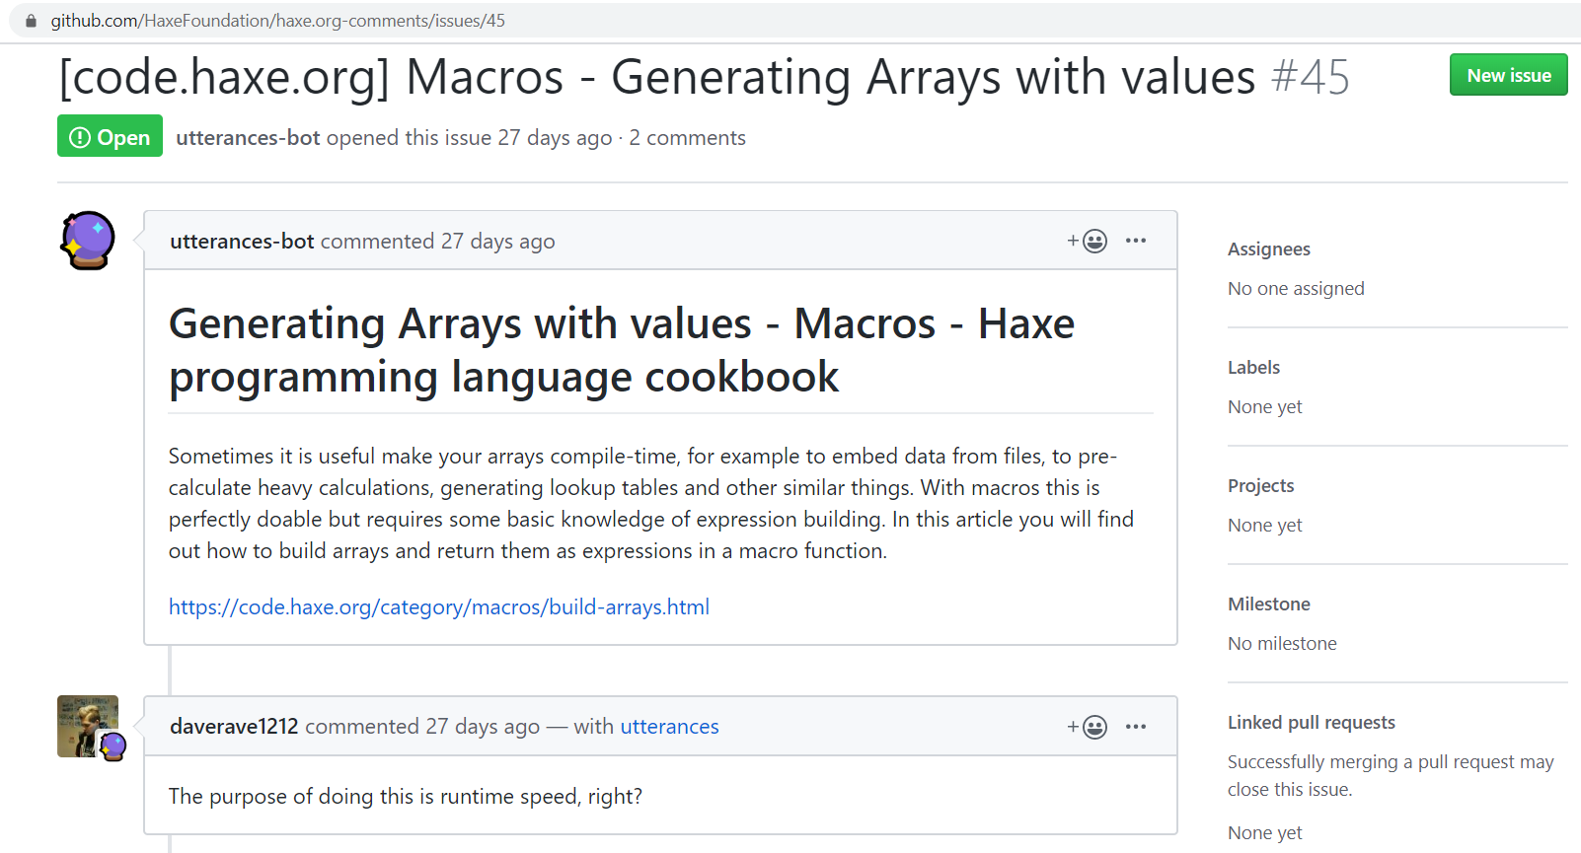
GitHub Issues as Backend
GitHub Issues match the Questions in the SoftUni Help Center
Issues can be open / closed
Issues can be taken (assigned to someone)
Issues have author, date, text
Issues do not have the special fields: Course, Lesson, Slide, Author Name, …
Issues have comments
Field mappings:
Course instance → GitHub Project
Lesson → Milestone
Section → tag section:problem-nums
AuthorId → tag author:id
URL: # URL in the body text
Author Name: # Author in the body text
Webhooks: subscribe for issues

Slide 23
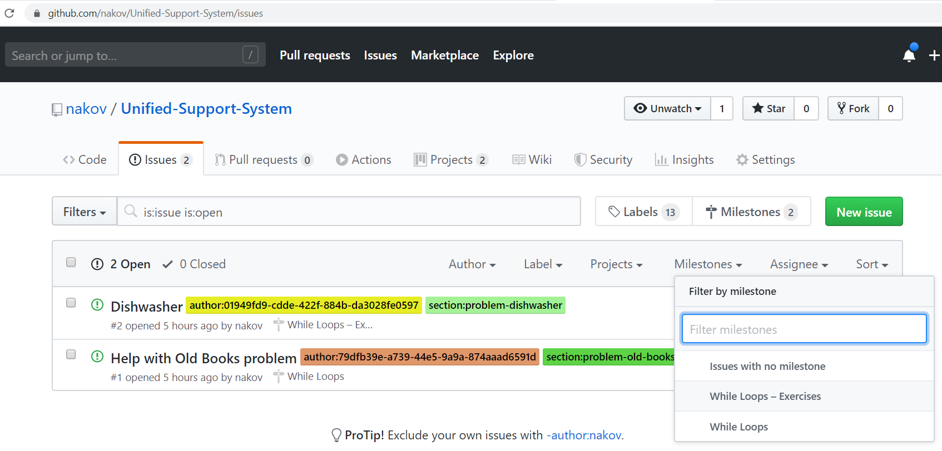
GitHub Issues as Admin App
https://haxe.org/manual/introduction-hello-world.html
https://github.com/HaxeFoundation/haxe.org-comments/issues/45
https://github.com/nakov/Unified-Support-System/issues/2
https://api.github.com/repos/nakov/Unified-Support-System/issues/2

Slide 24
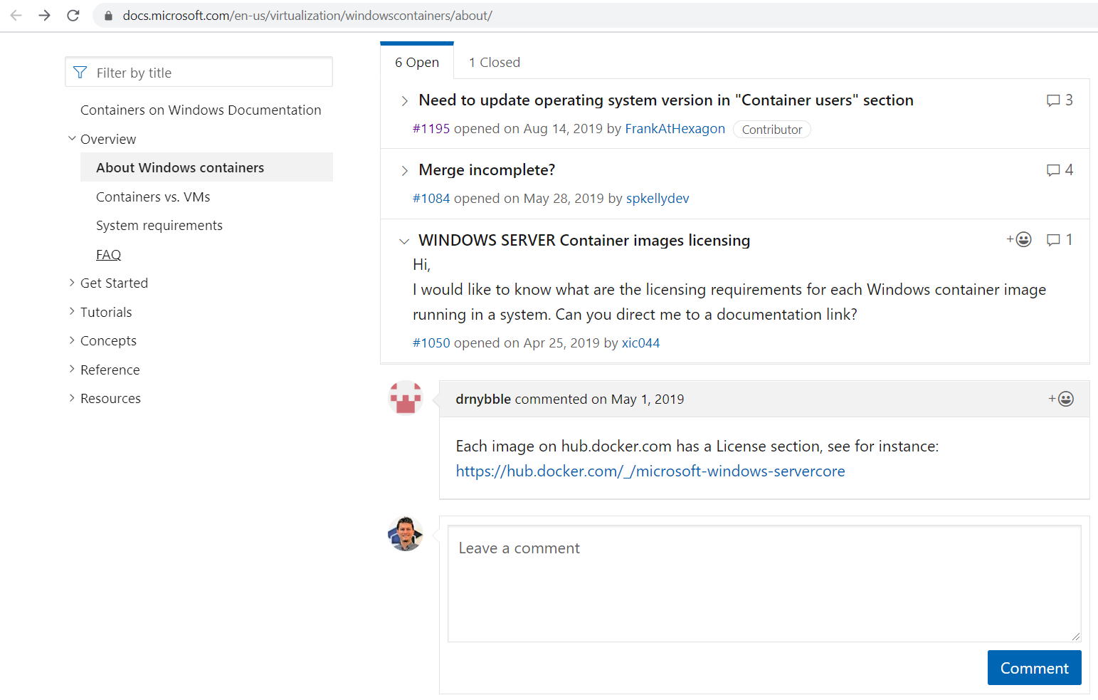
GitHub Issues as Help Center Plugin – Example
https://docs.microsoft.com/en-us/virtualization/windowscontainers/about/

Slide 25
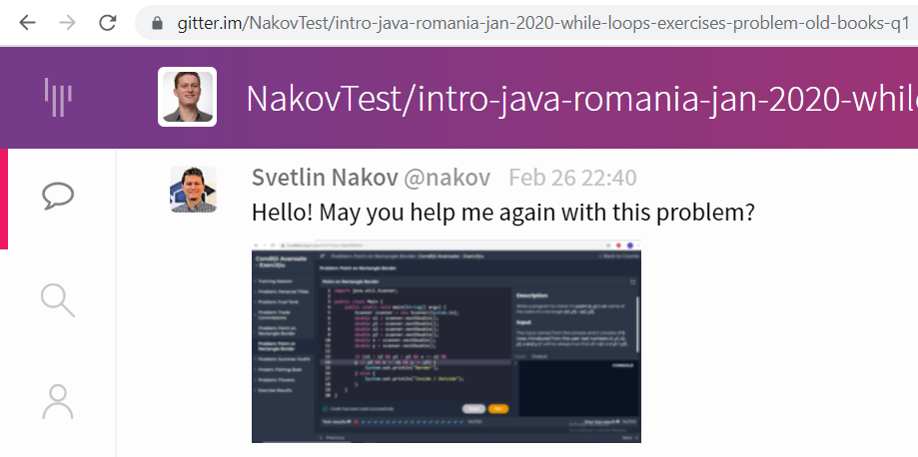
Gitter.im as Backend (Canceled)
Each question might be a Gitter.im chatroom (holds a sequence of chat messages).
We embed the Gitter chatroom. See the demo from https://sidecar.gitter.im.
Users either login at Gitter (with a GitHub / Twitter account) or use a default (anonymous account) – see https://github.com/xMartin/anonymous-gitter-chat.

Slide 26






Help Center Issue Tracker UI (Canceled)
Questions:
My
Open
Taken
Closed
All
Sort by:
Date
Closed
From: Albert Ionut Vasile | @alb3rtsk.2002
URL: https://ro.softuni.org/engine/23/10#while-loops-vid...
Date: 26-Feb-2020 19:02 (4.5 hours ago)
Answers: 3
View in GitHub
# 52531
Hello! May you help me again with this problem? (image.png)
Take
Taken by: @nakov
Close
Course: Intro Java – Romania – Jan 2020
Lesson: While Loops
Slide: While Loop >> Video
Open
From: Simina Tabac | @stabac
URL: https://ro.softuni.org/engine/23/10#354624
Date: 26-Feb-2020 19:04 (4.5 hours ago)
Answers: 0
View in GitHub
# 52519
Hello! May you help me again with this problem? (image.png)
Take
Taken by: @anna.s
Close
Course: Intro Java – Romania – Jan 2020
Lesson: While Loops
Slide: Homework >> Problem: Find Min a…
Taken
From: Dorobeica Andra | @dorobeica
URL: https://ro.softuni.org/engine/23/10#354624
Date: 26-Feb-2020 21:33 (2 hours ago)
Answers: 0
View in GitHub
# 52502
Hello! I was trying to solve for loop problems and the problem was correct resolved but it gives me 0/100. Can you please tell me where should I correct my code?
Untake
Taken by: @anna.s
Close
Course: Intro Java – Romania – Jan 2020
Lesson: While Loops – Exercises
Slide: Problem "Old Books"

