Slide 1
TODO
[done] Search Box
[done] Unread Messages on the [Questions] box
[done] New Question -> Choose а Category
[done] My Questions -> Move to [Technical]
[done] Sorter for the Questions: by Likes / by Date
[done] Sli.do Screen + Example
Administrative:
FAQ (GitHub Questions, tagged "FAQ")
Email Form (like in https://softuni.bg/contacts)
Community -> FB Groups:
https://developers.facebook.com/docs/plugins/group-plugin/#example
Program Group (e.g. SoftUni Java)
Course Group (e.g. Programming Fundamentals Java)

Slide 2
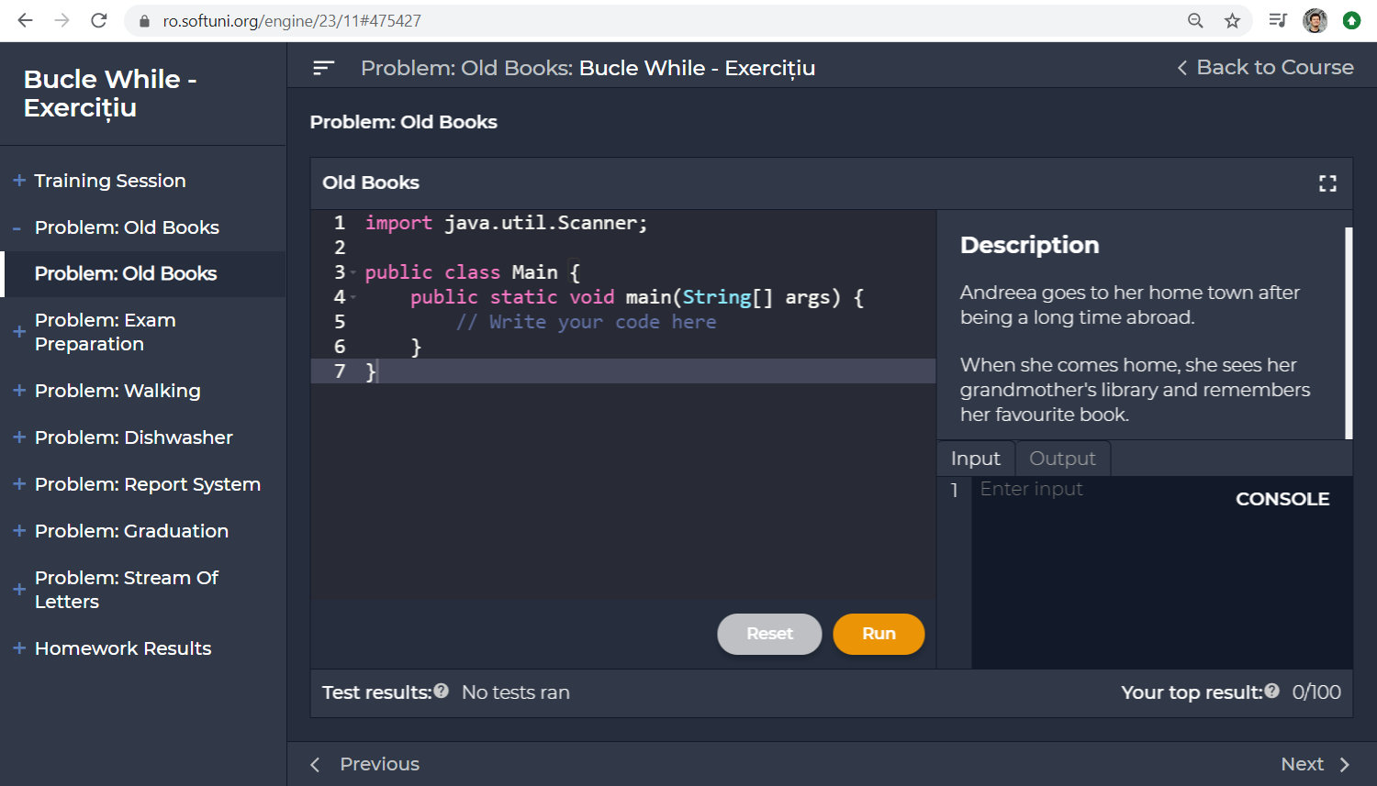

SoftUni Help Center
Questions plugin attributes:
Course: Intro Java – Romania – Jan 2020
Lesson: While Loops – Exercises
Section: Problem "Old Books"
<script>
window.helpCenter = {
course: "Intro Java Romania – Jan 2020",
lesson: "While Loops",
section: "Problem: Old Books",
author: { id: "01949fd9-cdde-422f-884b-da3028fe0597",
name: "Simina Tabac"
}
url: document.location,
createQuestionsButton: { title: "Questions",
class: "…",
style: "…",
domLocationAfter: "#title"
}
};
</script>
<script src="https://localhost/help-center.js">
</script>

Slide 3
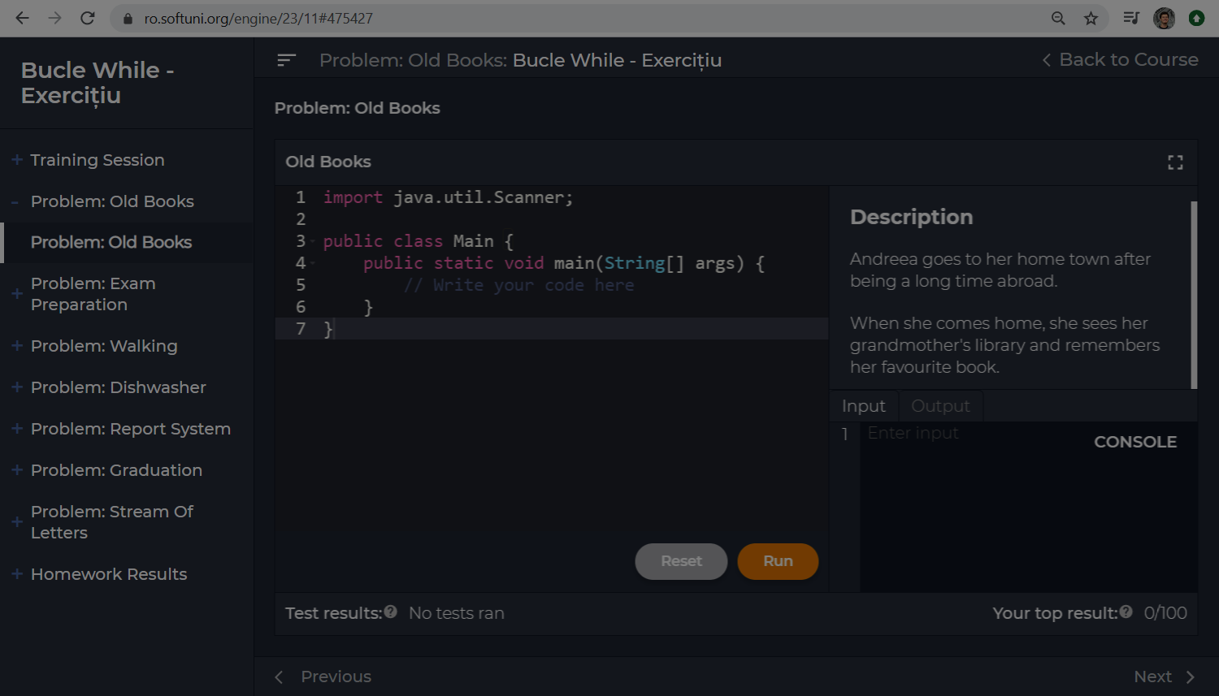




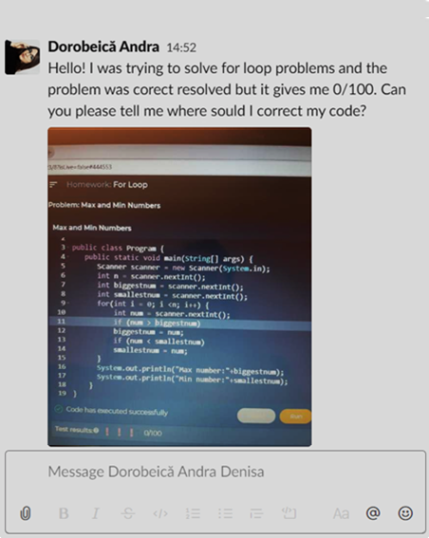










Help Center
Technical Questions: While Loops Exercises >> Problem "Old Books"
x
Technical
Search …
Help with Old Books problem
Dorobeica Andra
3 answers
26-Feb-2020 21:33
My
Help with Old Books problem
Section
Hello! I was trying to solve for loop…
Resolved
1
Lesson
Ionut Vasile
2 answers
26-Feb-2020 22:07
Course
Question
Resolved
Hi, I don't know what is not correct …
Administrative
Ema Utiu
0 answers
26-Feb-2020 22:07
Read number
Community
Hello. How do I read a number?
New Question
1

Slide 4

Technical Questions

Slide 5
Help Center: Technical Questions
Question attributes:
Help Center
Technical Questions: While Loops Exercises >> Problem "Old Books"
x
Technical
Help with Old Books problem
Question ID: 52532
Date: 26-Feb-2020 21:33
Author (tag): 01949fd9-cdde-422f-884b-da3028fe0597
Title: Help with Old Books problem
Text: Hello! I was trying to solve the …
URL: https://ro.softuni.org/engine/23/11#469576
Course instance (GitHub project): Intro-Java-Romania-Jan-2020
Lesson (milestone): While Loops Exercises
Section (tag): Problem "Old Books"
Votes Up: 2
Votes Down: 0
Search …
Dorobeica Andra
3 answers
26-Feb-2020 21:33
My
Help with Old Books problem
Section
Hello! I was trying to solve for loop…
Lesson
Ionut Vasile
2 answers
1
26-Feb-2020 22:07
Course
Question
Resolved
Hi, I don't know what is not correct …
Administrative
Ema Utiu
0 answers
26-Feb-2020 22:07
Read number
Message attributes:
Community
Hello. How do I read a number?
Message ID: 2982993
Question ID (foreign key): 52532
Date: 26-Feb-2020 21:33
Author (tag): 01949fd9-cdde-422f-884b-da3028fe0597
Text: …
New Question

Slide 6




Help Center: New Question → Choose Category
Help Center
Technical Questions: While Loops Exercises >> Problem "Old Books"
x
Technical
Search …
Ask a technical question
Dorobeica Andra
3 answers
26-Feb-2020 21:33
E.g. Where is the problem in this code ... / Help me with this error message … / How to use this library …
My
Help with Old Books problem
Section
Hello! I was trying to solve for loop…
1
Ask an administrative question
Lesson
Ionut Vasile
2 answers
26-Feb-2020 22:07
Course
Question
Resolved
E.g. I cannot access my course content … / My payment failed … / Can I use in Java at the exam …
Hi, I don't know what is not correct …
Administrative
Ema Utiu
0 answers
Share with the community
26-Feb-2020 22:07
Read number
E.g. Apple created a new AI tool, what do you think … / JS is the most active language in StackOverflow …
Community
Hello. How do I read a number?
New Question

Slide 7
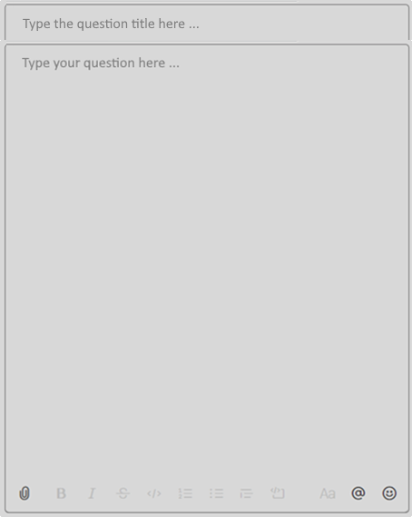
Help Center: New Question → Write the Question
Supported features:
Help Center
Technical Questions: While Loops Exercises >> Problem "Old Books"
x
Text with simple formatting (bold, italic)
Inline code blocks: `a = 5`
Long code blocks (up to 500 lines):
```
function print(str) { … }
```
Paste images (like in Gitter.im)
Lists (bullets, numbered)
Technical
Search …
Dorobeica Andra
3 answers
26-Feb-2020 21:33
My
Help with Old Books problem
Section
Hello! I was trying to solve for loop…
Lesson
Ionut Vasile
2 answers
1
26-Feb-2020 22:07
Extra functionality:
Course
Question
Resolved
Hi, I don't know what is not correct …
Simple emoticons
File attachments (e.g. PDF file)
Delete own messages
Edit own messages
Administrative
Ema Utiu
0 answers
26-Feb-2020 22:07
Read number
Community
Hello. How do I read a number?
All these features are already available from GitHub Issues
New Question
https://github.com/nakov/Unified-Support-System/issues/2

Slide 8

Help Center: Technical Questions → Sort
Help Center
Technical Questions: While Loops Exercises >> Problem "Old Books"
x
Technical
Search …
Help with Old Books problem
Latest
Dorobeica Andra
3 answers
26-Feb-2020 21:33
Most liked
My
Help with Old Books problem
Most commented
Section
Hello! I was trying to solve for loop…
Unread
Lesson
Ionut Vasile
2 answers
1
26-Feb-2020 22:07
Course
Question
Resolved
Hi, I don't know what is not correct …
Administrative
Ema Utiu
0 answers
26-Feb-2020 22:07
Read number
Community
Hello. How do I read a number?
New Question

Slide 9
Live Questions

Slide 10
Live Questions: Sli.do Mode (Popup Style)
Live Questions: While Loops
x
Search …
Help with Old Books problem
Dorobeica Andra
# 52531
26-Feb-2020 21:33
Help with Old Books problem
Hello! I was trying to solve for loop…
Ionut Vasile
# 52527
1
26-Feb-2020 22:07
Question
Resolved
Hi, I don't know what is not correct …
Ema Utiu
# 52518
26-Feb-2020 22:07
Read number
Hello. How do I read a number?
New Question

Slide 11

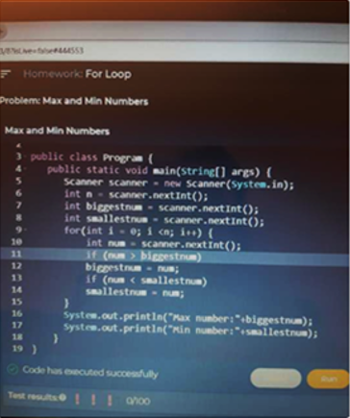

Live Questions: Sli.do Mode (Embedded Style)
Live Questions
View Live Question
Back
Ask a Live Question
Back
Dorobeica Andra
3 answers
Dorobeica Andra
3 answers
26-Feb-2020 21:33
26-Feb-2020 21:33
Hello! I was trying to solve for loop…
Hello! I was trying to solve for loop problem and the problem was correctly resolved but it gives me 0/100. Can you please tell me where I should correct my code?
Ionut Vasile
2 answers
1
26-Feb-2020 22:07
Hi, I don't know what is not correct …
Ema Utiu
0 answers
26-Feb-2020 22:07
Hello. How do I read a number?
Search …
Ask

Slide 12
Administrative Questions

Slide 13





Help Center: Administrative Questions
Help Center
Administrative Questions
x
Technical
Search …
Payment failed
Dorobeica Andra
Deadline
Waiting for an answer
26-Feb-2020 21:33
27-Feb-2020 23:58
Hello! I am trying to pay for the exam with my debit card VISA yesterday. I received an error message "500 Internal Server Error". Can you help?
Can you extend the homework deadline?
Administrative
Payment failed
ES
Eva Svilarova @ SoftUni Support
2 answers
26-Feb-2020 21:36
Questions
26-Feb-2020 21:33
We checked your payment attempt from 26 February 2020, and it ws a temporary failure of the payment processor. Your card was not charged. Please try again tomorrow.
Hello! I am trying to pay for the exam with my debit card VISA …
FAQ
Profession change
1
Dorobeica Andra
Community
1 answers
23-Feb-2020 17:56
26-Feb-2020 21:33
Can I change my profession? I want Java, but I started with Python …
Thank you. Now it works correctly.
New Question

Slide 14

Help Center: FAQ
Help Center
Administrative Questions
x
Technical
Search …
Holidays: Dec 2019 - Jan 2020
Q
Shall SoftUni provide technical support during the holidays (Dec 2019 – Jan 2020)?
Optimal Hours Per Week
20-March-2020 11:38
During the New Year's holidays our technical support team will work with limited resources, so you can expect answers to technical questions within 48 hours. Note: questions in English are usually answered faster than questions in your local language.
What is the optimal hours per week to spend on learning programming?
A
Administrative
Holidays: Dec 2019 - Jan 2020
Questions
10-Dec-2020 09:23
During the New Year's holidays our technical support team will …
FAQ
Community
Profession change
23-Feb-2020 17:56
Can I change my profession? I want Java, but I started with Python …
New Question

Slide 15
Help Center: Administrative Questions → New Question
Help Center
Administrative Questions
x
Technical
Search …
Deadline
Waiting for an answer
27-Feb-2020 23:58
Can you extend the homework deadline?
Administrative
Payment failed
26-Feb-2020 21:33
2 answers
Questions
Hello! I am trying to pay for the exam with my debit card VISA …
FAQ
Profession change
1
Community
1 answers
23-Feb-2020 17:56
Can I change my profession? I want Java, but I started with Python …
New Question

Slide 16
Community Questions

Slide 17



Help Center: Community Discussions
Help Center
Community Discussions
x
Technical
Administrative
Community

Slide 18
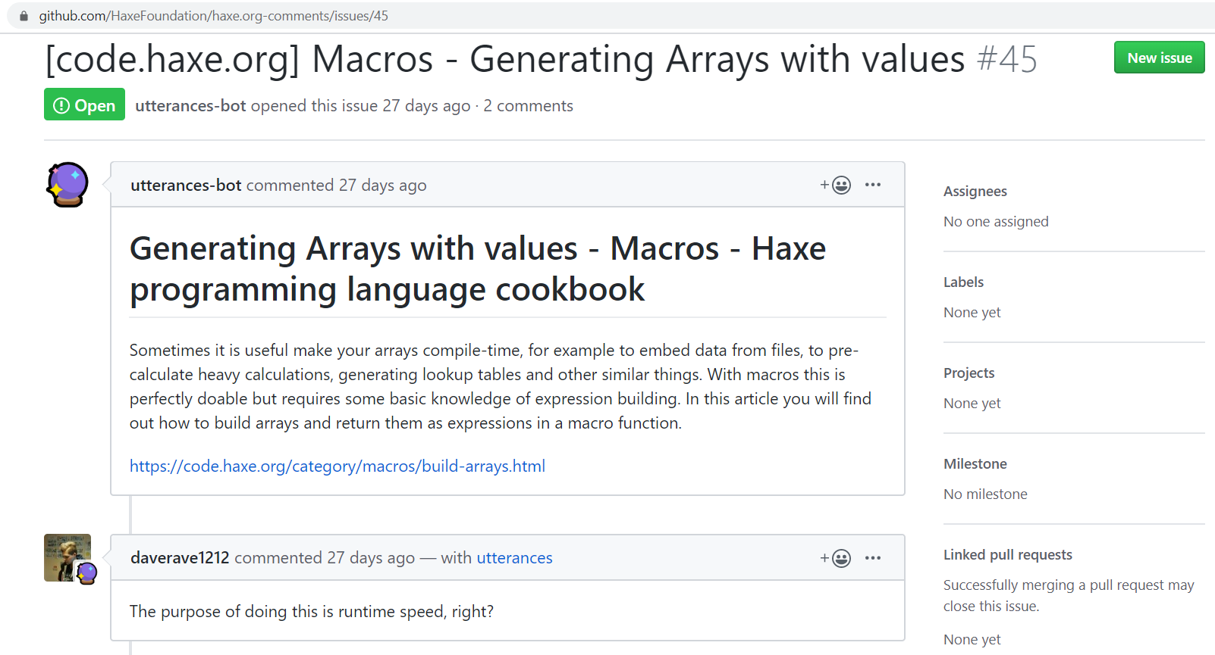
GitHub Issues as Backend
GitHub Issues match the Questions in the SoftUni Help Center
Issues can be open / closed
Issues can be taken (assigned to someone)
Issues have author, date, text
Issues do not have the special fields: Course, Lesson, Slide, Author Name, …
Issues have comments
Field mappings:
Course instance → GitHub Project
Lesson → Milestone
Section → tag section:problem-nums
AuthorId → tag author:id
URL: # URL in the body text
Author Name: # Author in the body text
Webhooks: subscribe for issues

Slide 19
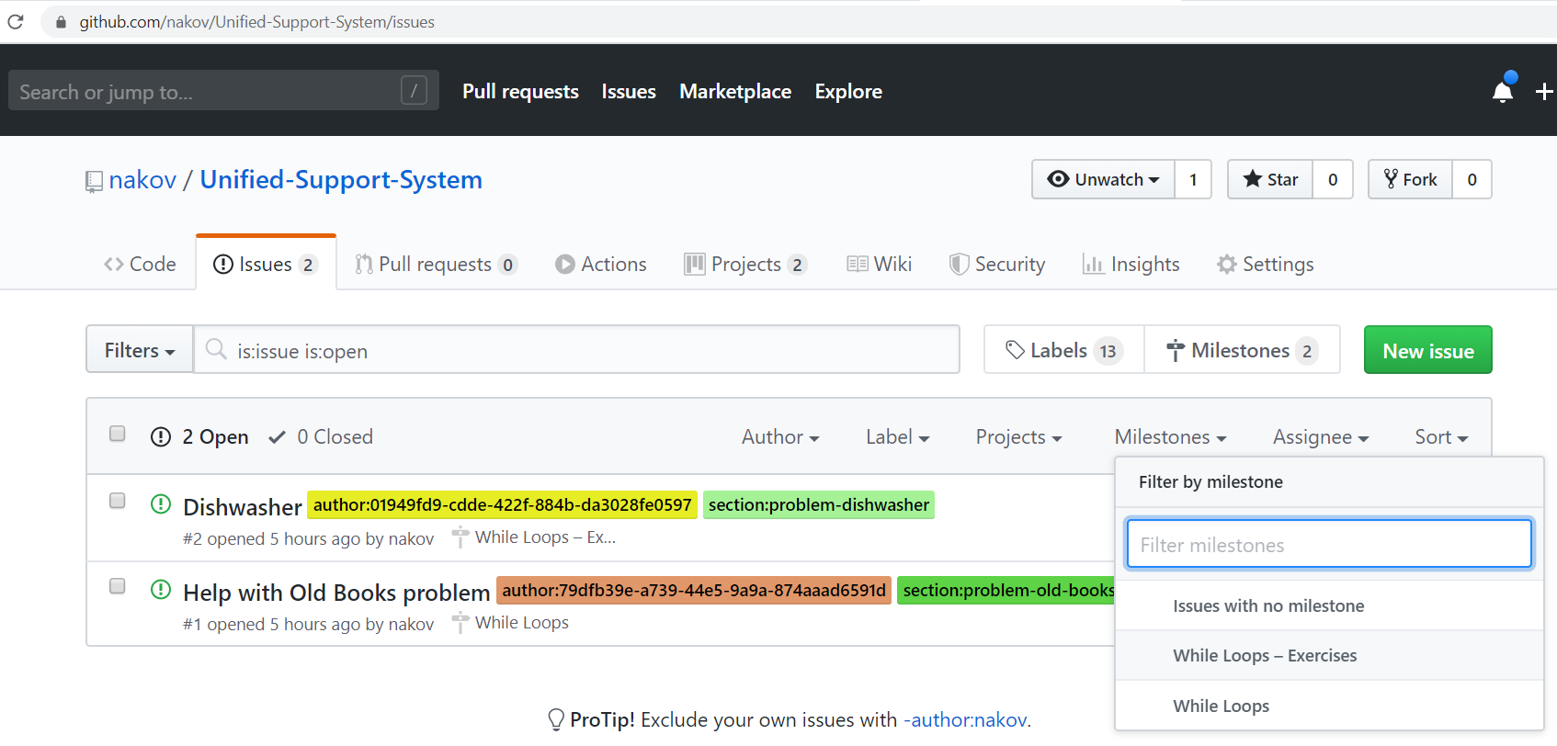
GitHub Issues as Admin App
https://haxe.org/manual/introduction-hello-world.html
https://github.com/HaxeFoundation/haxe.org-comments/issues/45
https://github.com/nakov/Unified-Support-System/issues/2
https://api.github.com/repos/nakov/Unified-Support-System/issues/2

Slide 20
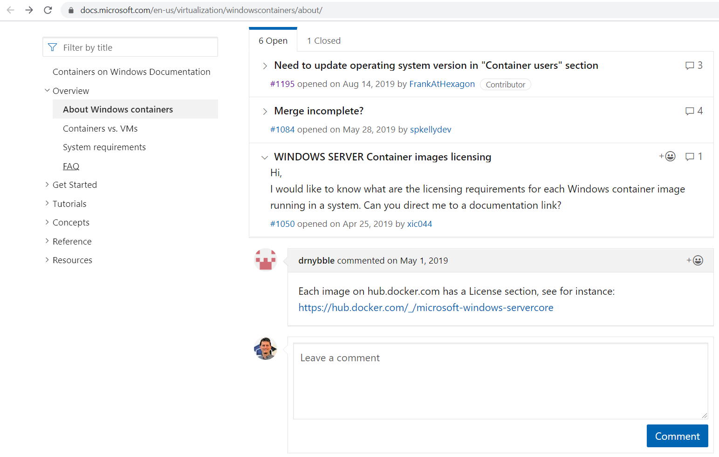
GitHub Issues as Help Center Plugin – Example
https://docs.microsoft.com/en-us/virtualization/windowscontainers/about/

Slide 21
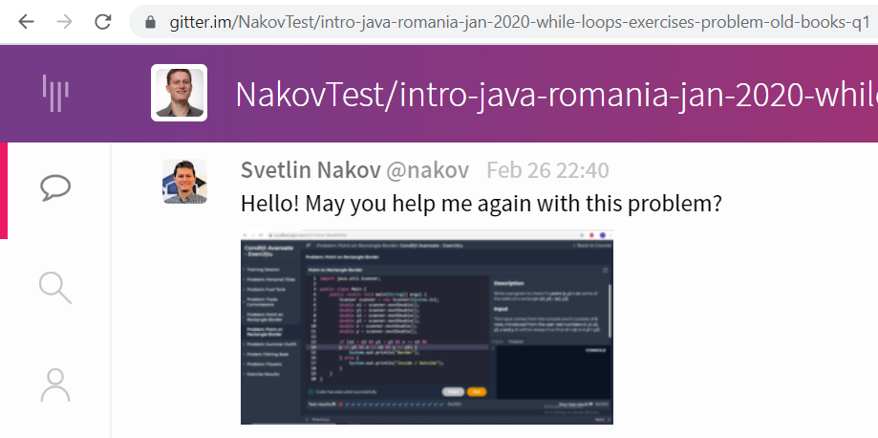
Gitter.im as Backend (Canceled)
Each question might be a Gitter.im chatroom (holds a sequence of chat messages).
We embed the Gitter chatroom. See the demo from https://sidecar.gitter.im.
Users either login at Gitter (with a GitHub / Twitter account) or use a default (anonymous account) – see https://github.com/xMartin/anonymous-gitter-chat.

Slide 22






Help Center Issue Tracker UI (Canceled)
Questions:
My
Open
Taken
Closed
All
Sort by:
Date
Closed
From: Albert Ionut Vasile | @alb3rtsk.2002
URL: https://ro.softuni.org/engine/23/10#while-loops-vid...
Date: 26-Feb-2020 19:02 (4.5 hours ago)
Answers: 3
View in GitHub
# 52531
Hello! May you help me again with this problem? (image.png)
Take
Taken by: @nakov
Close
Course: Intro Java – Romania – Jan 2020
Lesson: While Loops
Slide: While Loop >> Video
Open
From: Simina Tabac | @stabac
URL: https://ro.softuni.org/engine/23/10#354624
Date: 26-Feb-2020 19:04 (4.5 hours ago)
Answers: 0
View in GitHub
# 52519
Hello! May you help me again with this problem? (image.png)
Take
Taken by: @anna.s
Close
Course: Intro Java – Romania – Jan 2020
Lesson: While Loops
Slide: Homework >> Problem: Find Min a…
Taken
From: Dorobeica Andra | @dorobeica
URL: https://ro.softuni.org/engine/23/10#354624
Date: 26-Feb-2020 21:33 (2 hours ago)
Answers: 0
View in GitHub
# 52502
Hello! I was trying to solve for loop problems and the problem was correct resolved but it gives me 0/100. Can you please tell me where should I correct my code?
Untake
Taken by: @anna.s
Close
Course: Intro Java – Romania – Jan 2020
Lesson: While Loops – Exercises
Slide: Problem "Old Books"

