Slide 1
Stack
Heap
dog
name
Dog@a8fe24
kind
dog reference
age
dog object

Slide 2

Stack
Heap
dog
null
null reference
null

Slide 3

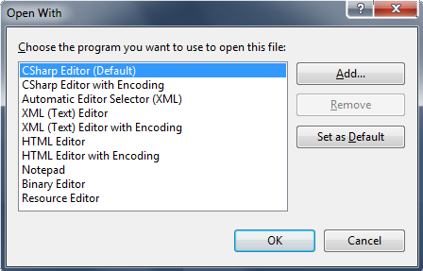

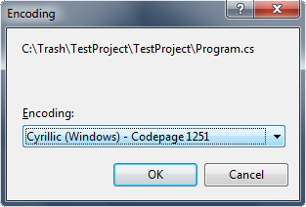

Slide 4
Stack
Heap
point
3
-2
(nothing is stored
in the heap)
Point2D instance
p
4
-1
Point2D (copy)

Slide 5
Stack
Heap
point
3
-2
(nothing is stored
in the heap)
Point2D instance
p
4
-1
Point2D (copy)

Slide 6
Stack
Heap
point (reference variable)
Point2D@a8fe24
p (parameter by reference)
3
-2
Point2D object
Point2D@a8fe24

