Slide 1
arrArg
:
int
[]
[I@e48e1b
1 | 2 | 3
arrParam
:
int
[]
arrArg
:
int
[]
[I@e48e1b
1 | 2 | 3
(copy)
arrParam
:
int
[]
arrArg
:
int
[]
[I@e48e1b
1 | 2 | 3
arrParam
:
int
[]
[I@e48e1b

Slide 2

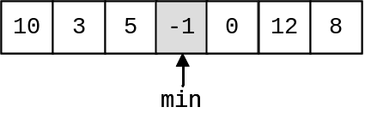
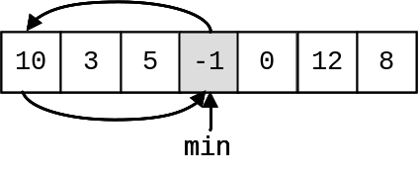
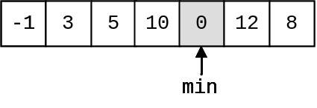
10
10
3
3
5
5
-
-
1
1
0
0
12
12
8
8
10
10
3
3
5
5
-
-
1
1
0
0
12
12
8
8
min
10
10
3
3
5
5
-
-
1
1
0
0
12
12
8
8
min

