Slide 1
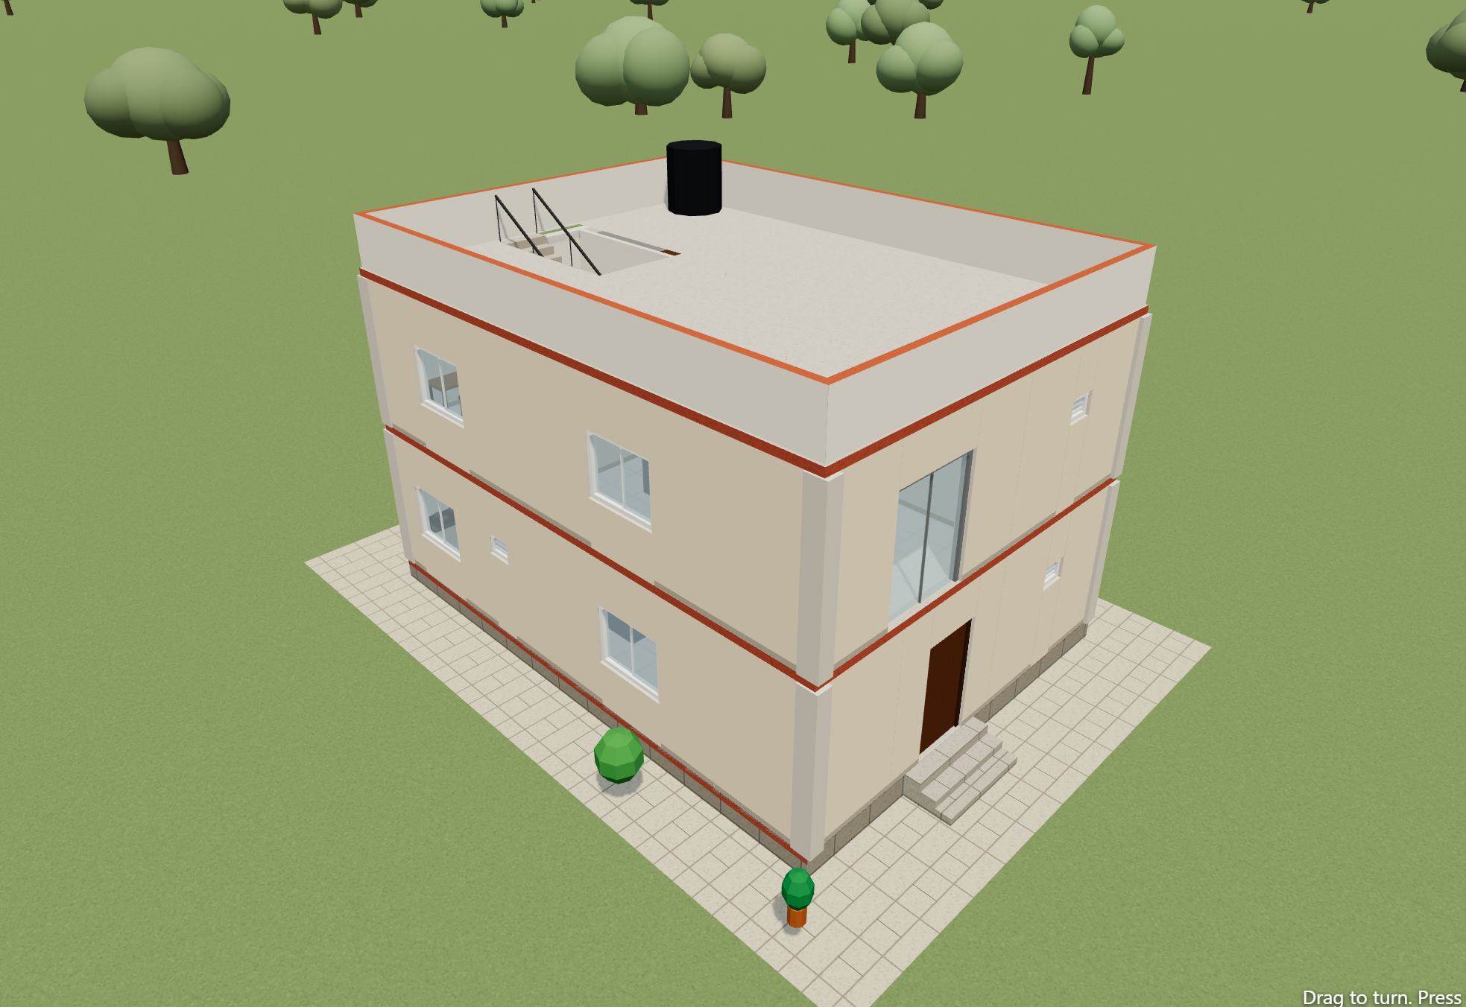
GharNirman
Design your house, walk through it, check Vastu and know the cost. User guide.
Notes:
This guide shows what GharNirman does and how to use it, screen by screen. Every picture is a real screenshot of the app.

Slide 2




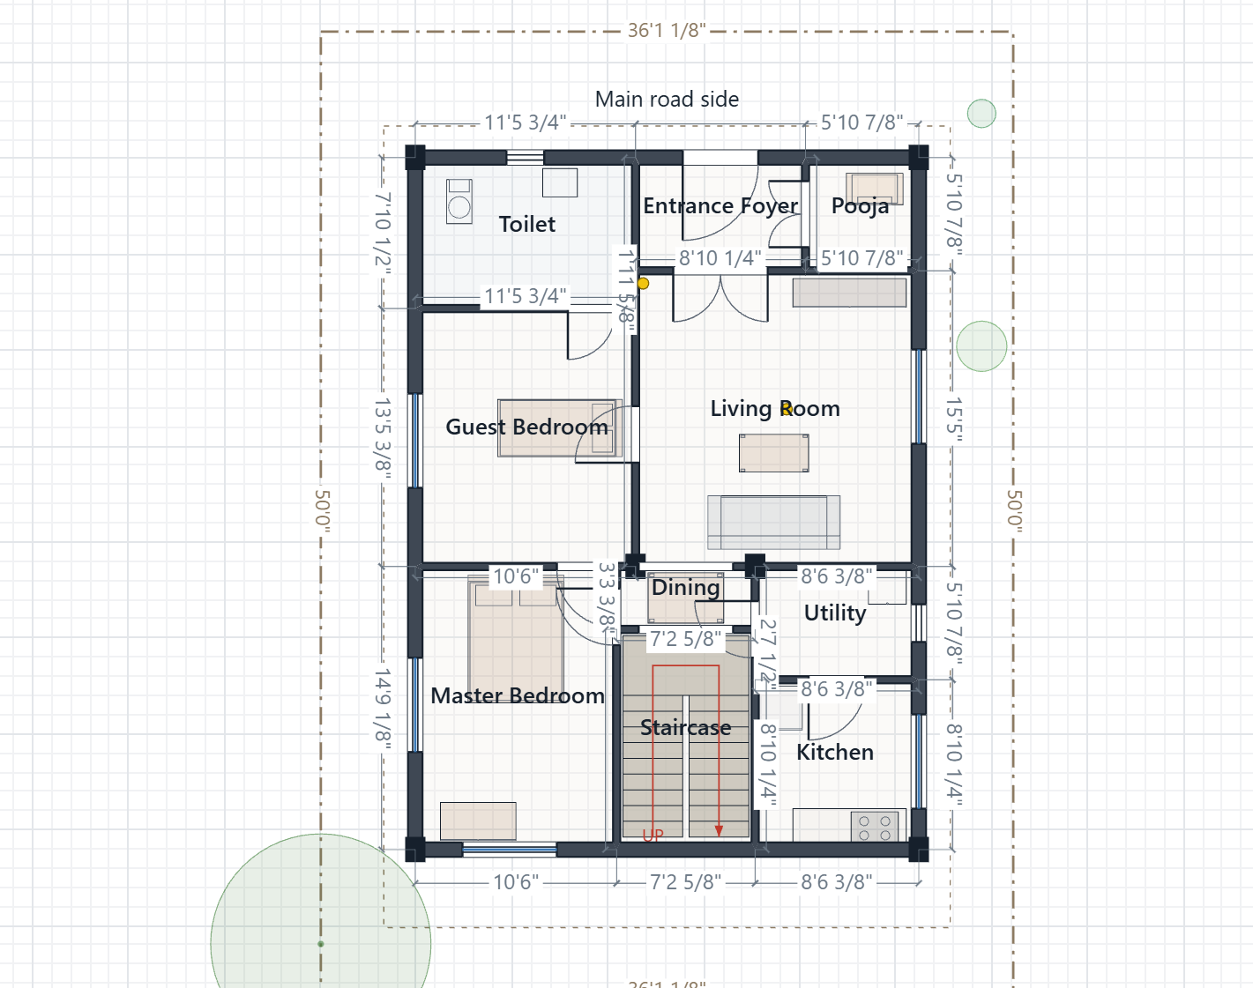
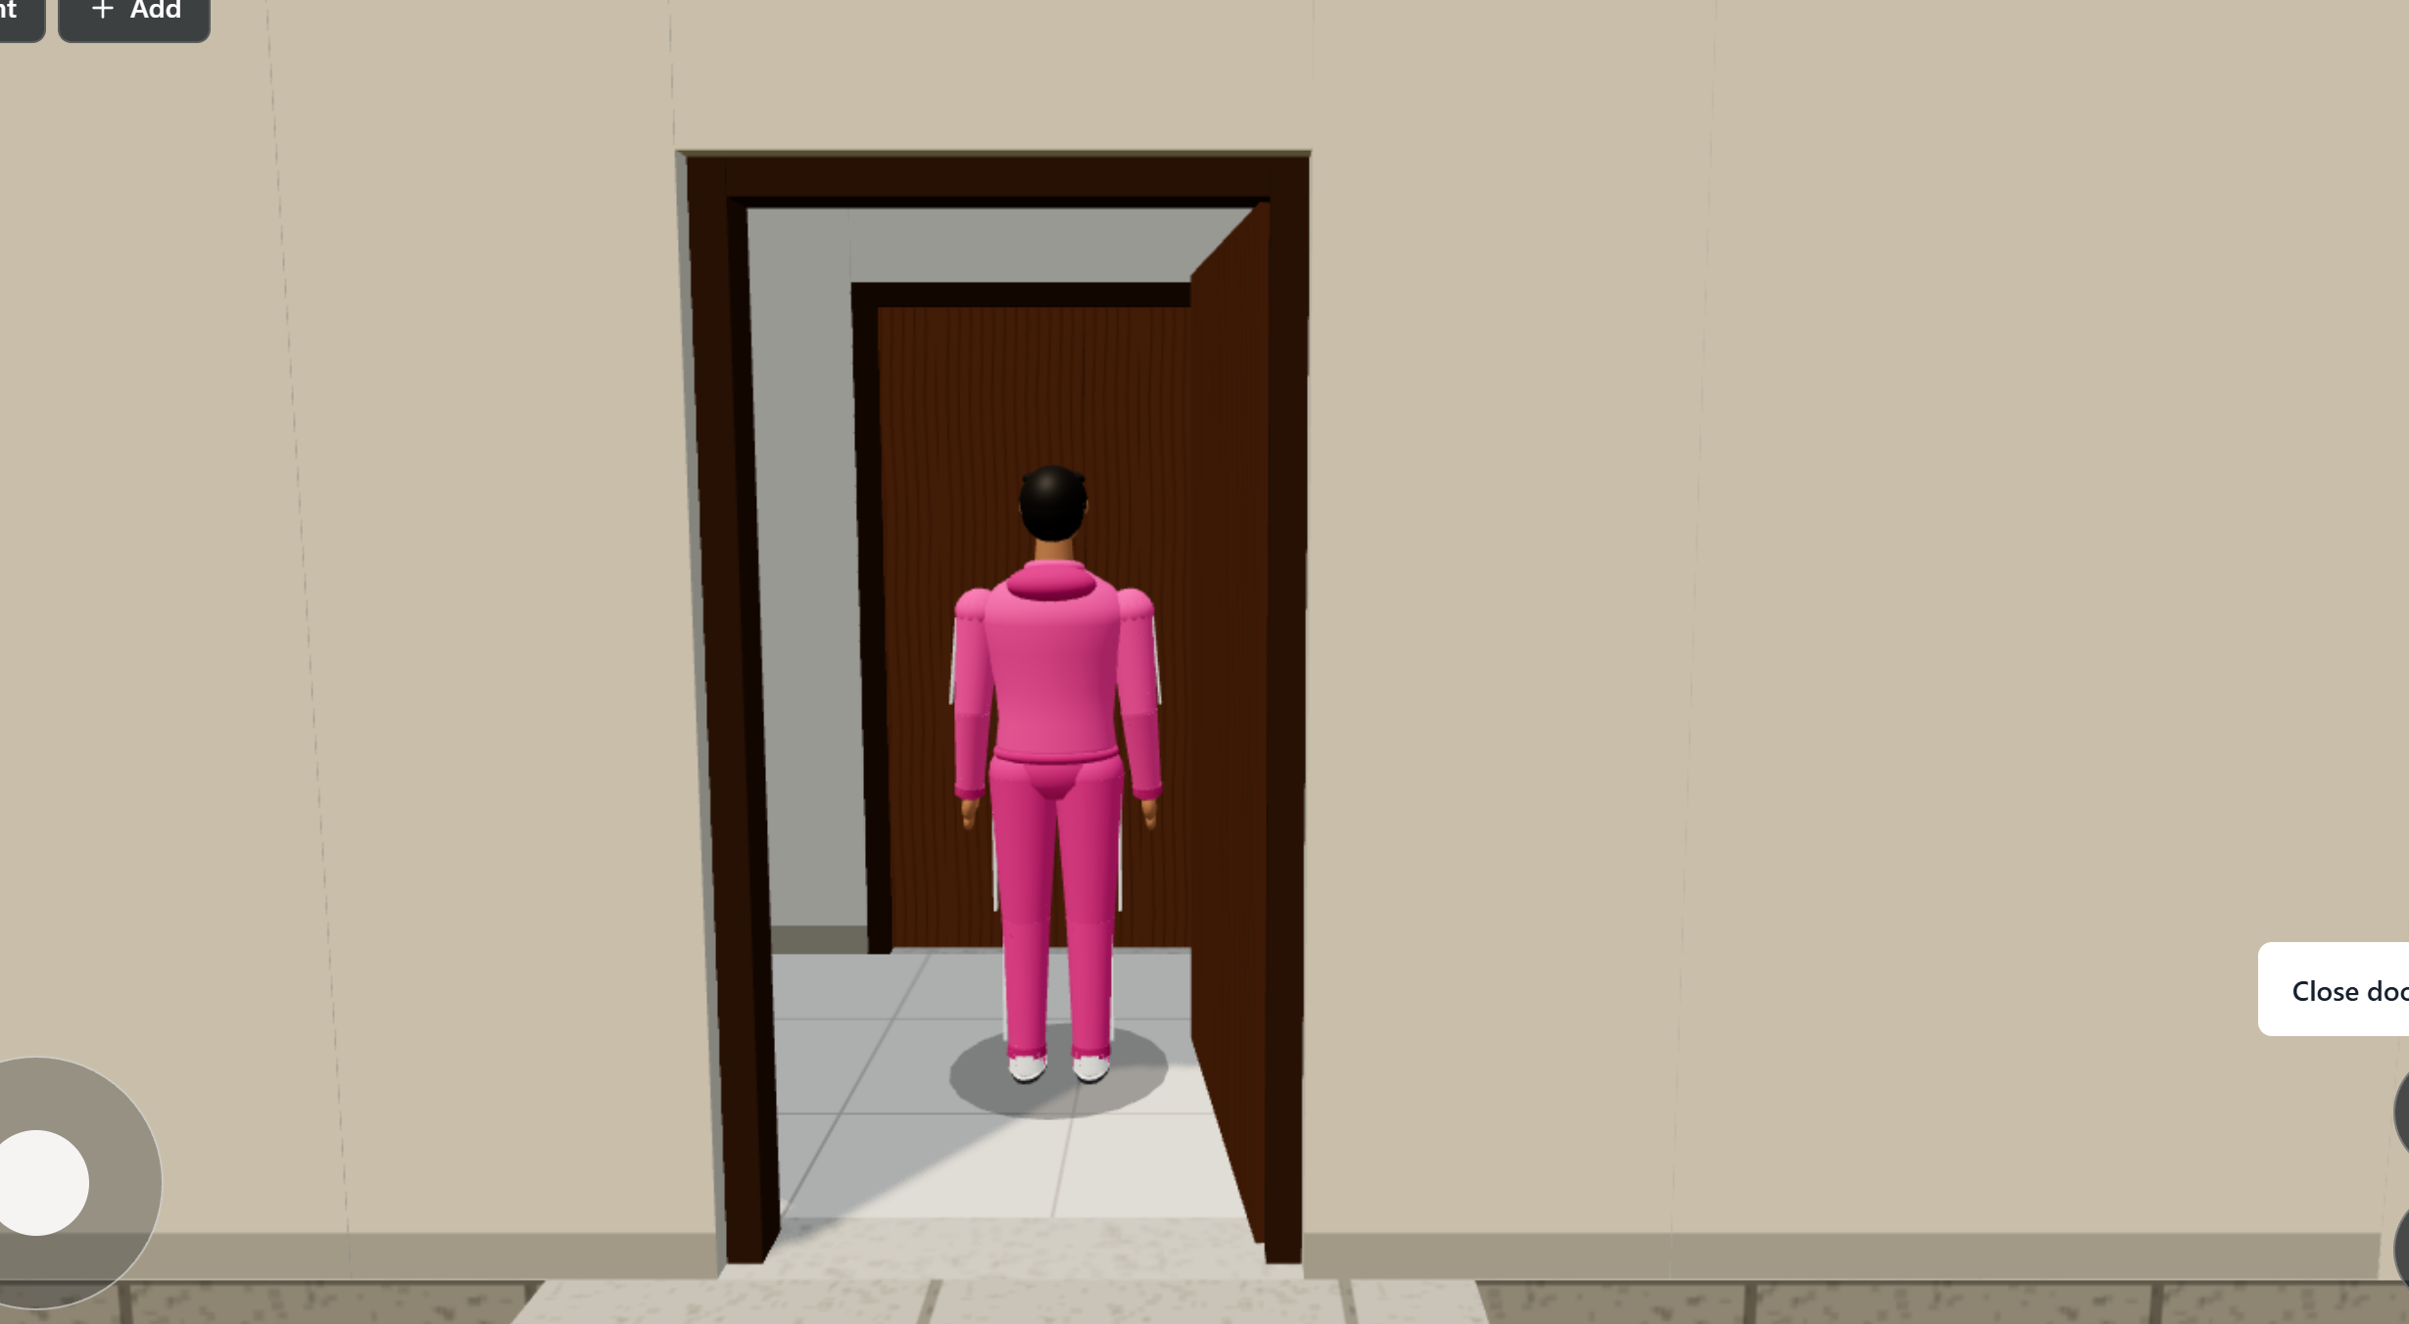
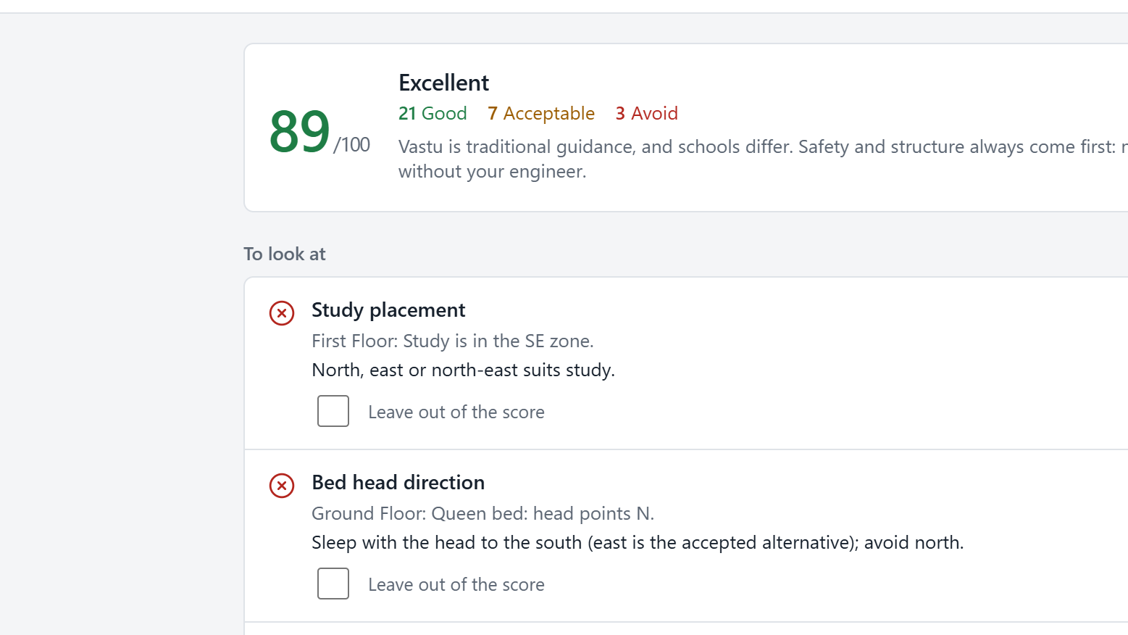
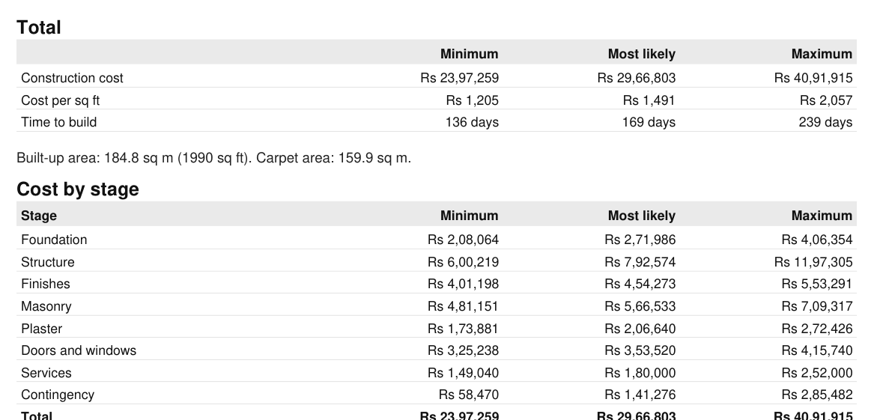
From first wall to final cost, in one app
Draw
Explore
Check Vastu
Cost and print
Type real sizes or draw with your mouse or finger. Rooms and their areas appear on their own.
Walk up to your house as a game, open its doors, and go up the stairs.
Get a score out of 100, with what is good, what to avoid, and what to change.
Get cost, materials and days as minimum, likely and maximum, then print it all.
Notes:
The four things the app does. The rest of the guide covers each in turn.

Slide 3




No account, no internet, and your work stays yours
0
0
2 sec
9
accounts or sign-ups. Open it and start.
internet needed once it is on your device.
at most of work lost if the app is suddenly killed.
languages. English, Hindi and Telugu are complete.
Made for everyone who builds a house
Mestris and site workers
Builders and contractors
Engineers and architects
House owners
Notes:
The two-second figure comes from the autosave design and was tested by killing the app in the middle of editing.

Slide 4
Getting started
Open the app, create a project, and find your way around.

Slide 5
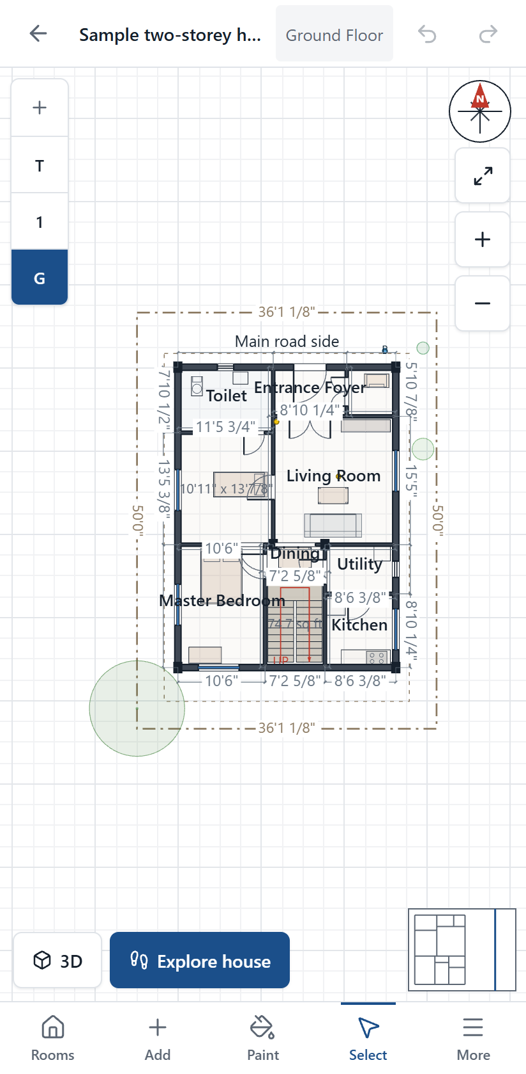




Use it in a browser, or install it
Website
Press Open site. It opens in a new tab, and works offline after the first visit.
Windows
Press Install app and run GharNirman-Setup.exe. If Windows warns you, choose More info, then Run anyway.
Android
Press Install app, download GharNirman.apk and open it. Allow installs from your browser if asked.
iPhone and iPad
Open the site in Safari, tap Share, then Add to Home Screen. There is no App Store version yet.
Notes:
All of these are on the website: Open site and Install app. The Windows installer is not code-signed, so Windows shows a warning. Projects are stored separately on each device and browser; use Export and Import on the home screen to move one.

Slide 6
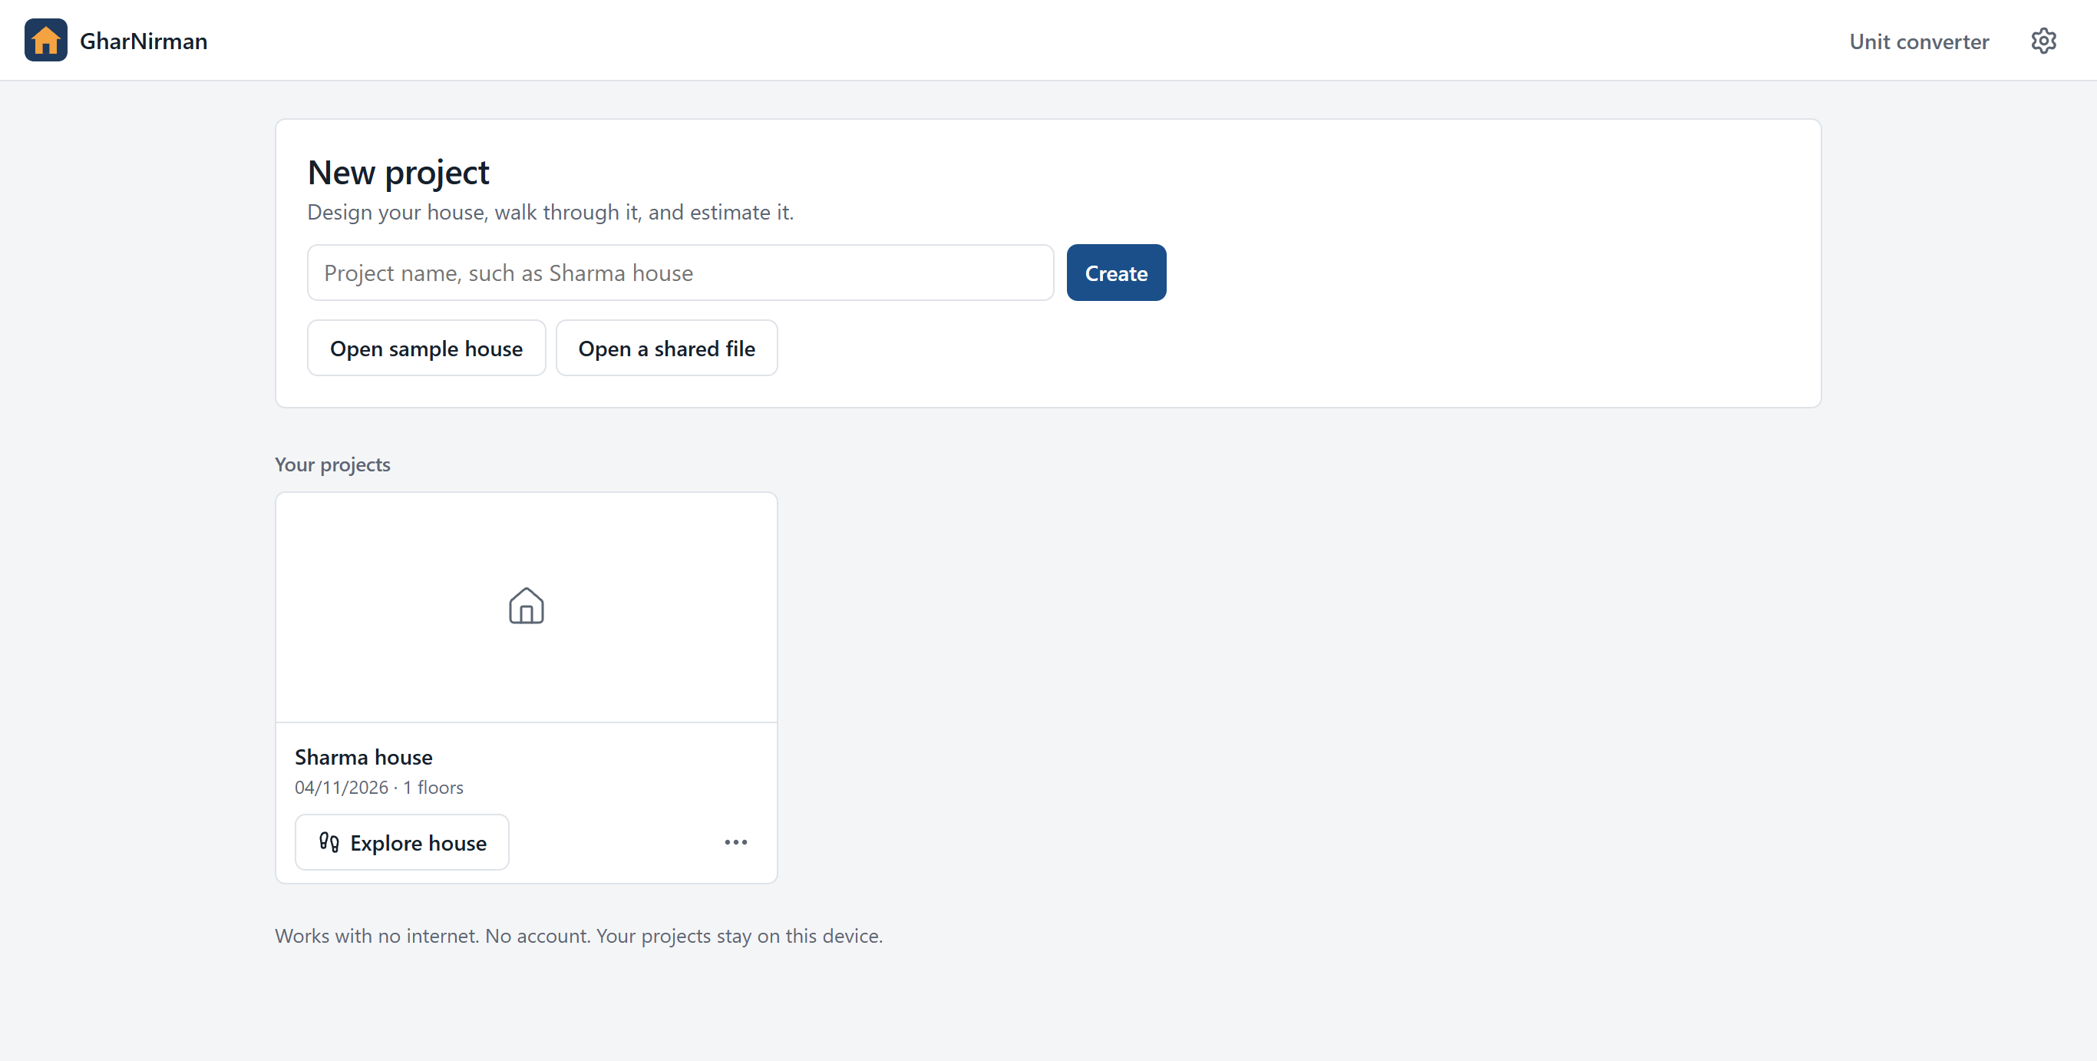
The home screen holds all your projects
1
Start a project
Type a name such as Sharma house, then Create.
4
1
2
Or explore first
Open sample house shows a finished two-storey home.
2
3
Your projects
Click one to open it. Rename, duplicate, export or delete it here too.
3
4
Your settings
Choose your language, theme and units once.
Notes:
Export saves a project as a file, which is how to move it to another device or keep a backup.

Slide 7
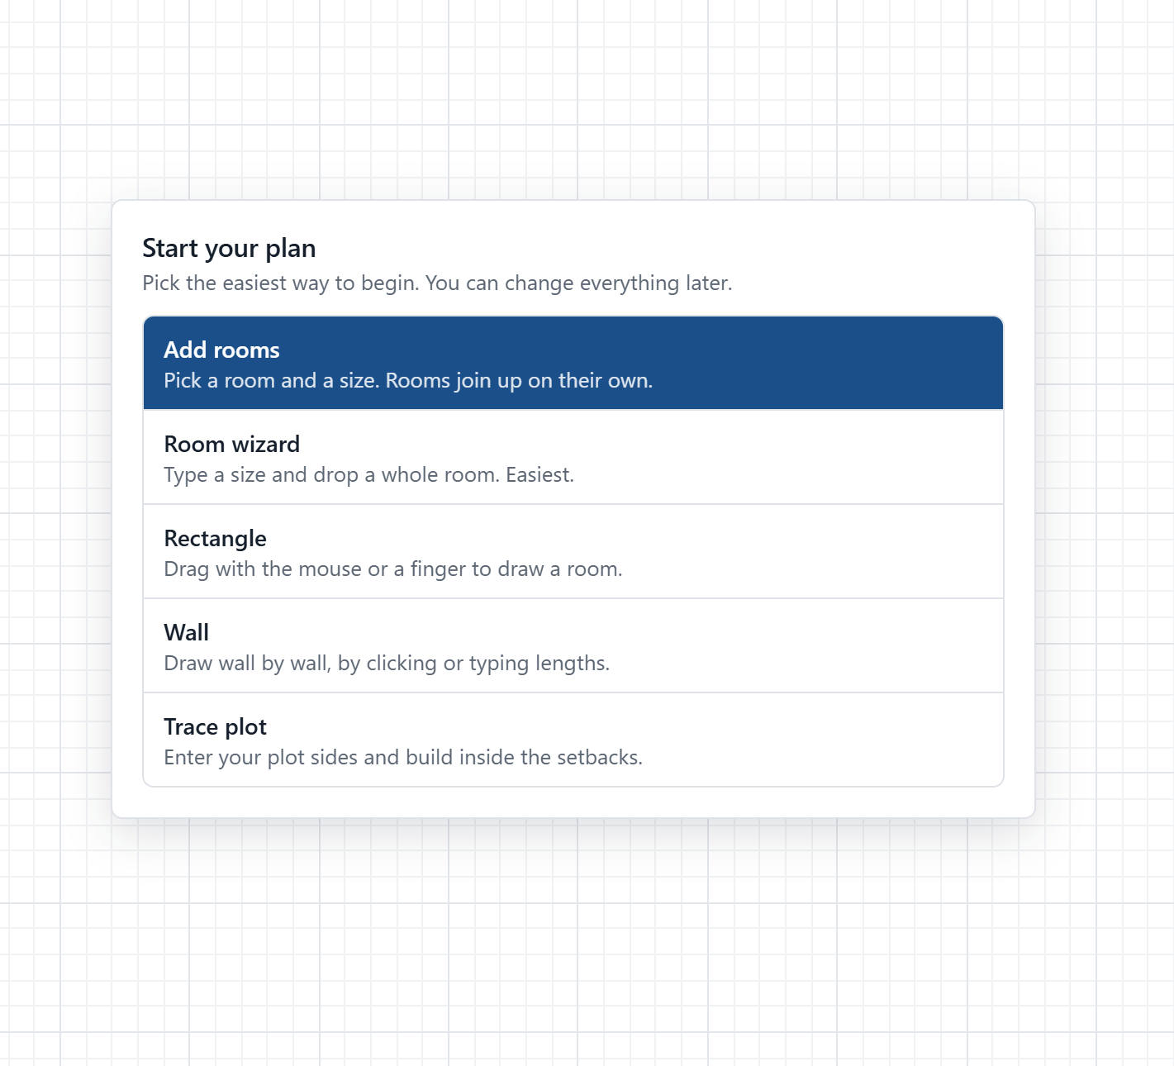



A new plan offers easy ways to begin
Add rooms
Pick a room and a size, then Add. A dashed outline shows where it will go.
Room wizard
Choose a shape by its picture: rectangle, L, U, T, plus, circle and more.
Rectangle or Wall
Drag out a room, or draw wall by wall, by clicking or typing lengths.
Trace plot
Enter your plot sides. The app works out what is left after setbacks.
Notes:
Add rooms is the fastest. Everything can be changed afterwards, so there is no wrong choice here.

Slide 8
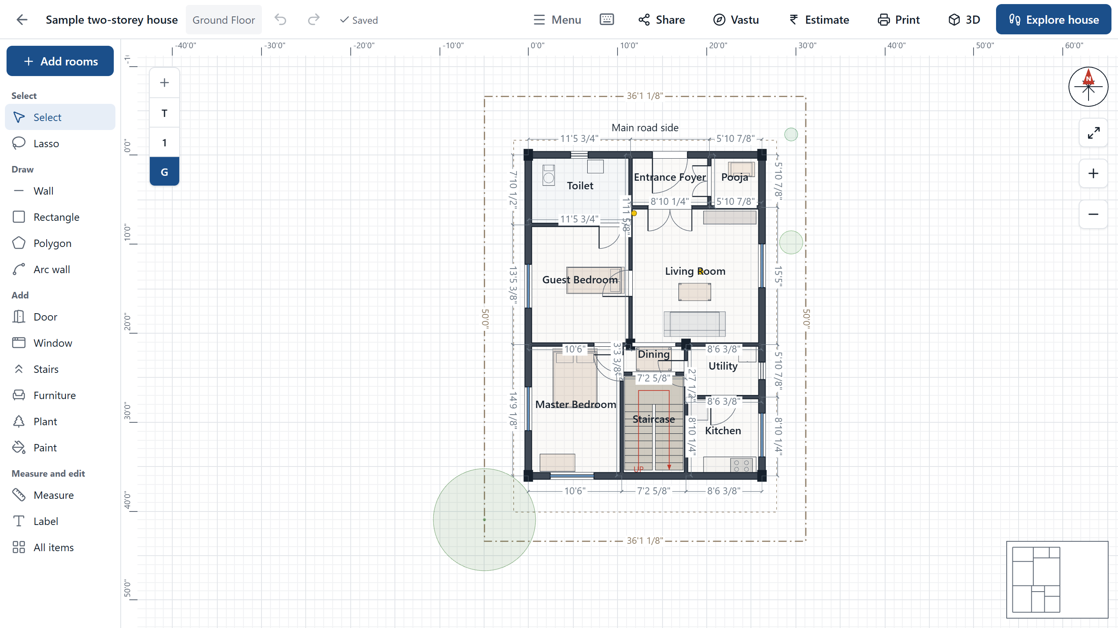
Five areas to know on the drawing screen
1
2
1
Top bar
Undo, floors, 3D, Vastu, cost, print.
5
2
Menu
Wizards, floors, layers, versions.
3
3
Tools
Pick what to draw or add.
4
4
Your plan
Sizes appear as you draw.
5
Compass and zoom
North, fit, zoom in and out.
Notes:
The grouped tool panel sits on the left of a laptop screen. A phone has its own layout, shown on the next slide.

Slide 9
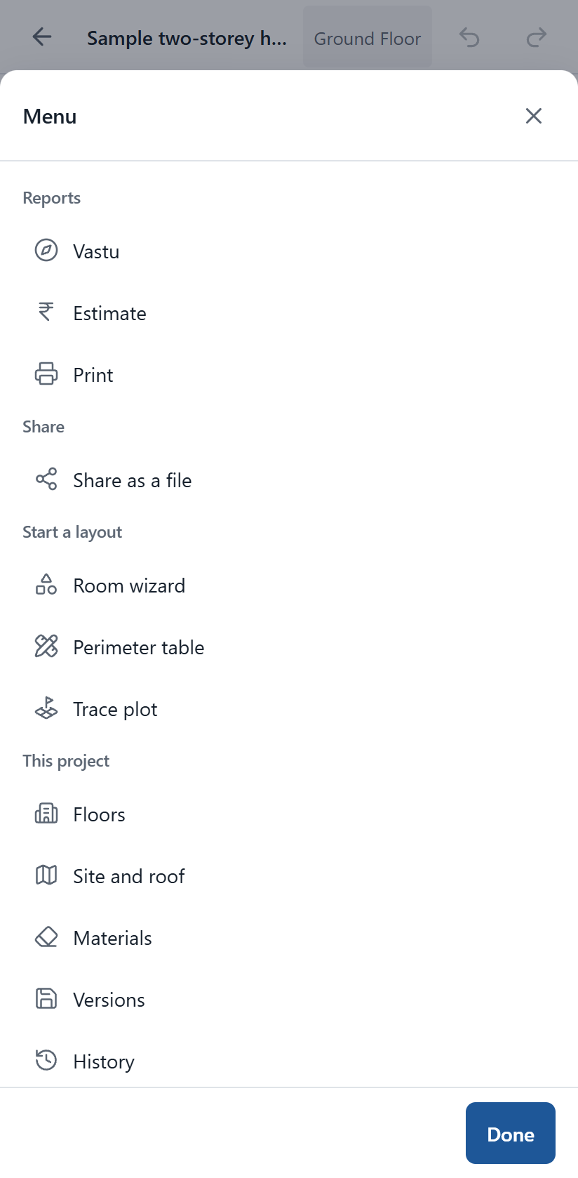
On a phone, five big buttons do everything
1
Rooms
Add room after room.
2
Add
Doors, windows, furniture, plants and more.
3
Paint
Pick a colour and tap.
4
Select
Tap anything to change it.
5
More
Vastu, cost, print, floors and settings.
Notes:
The rulers and side panels are gone on a phone, so the plan gets the whole screen. Tap an item to see its actions along the bottom.

Slide 10
Drawing your house
Walls, sizes, doors, furniture, floors and the roof.

Slide 11
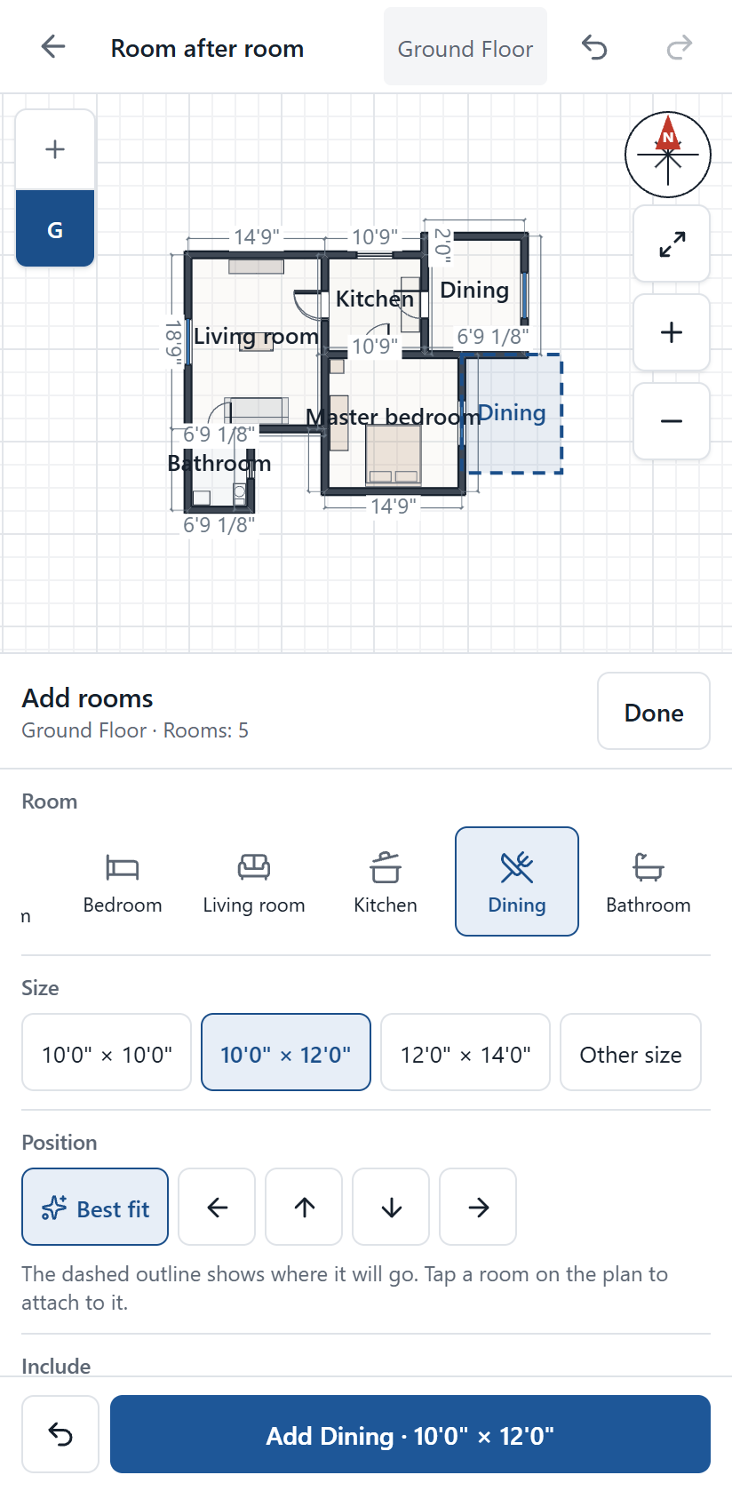
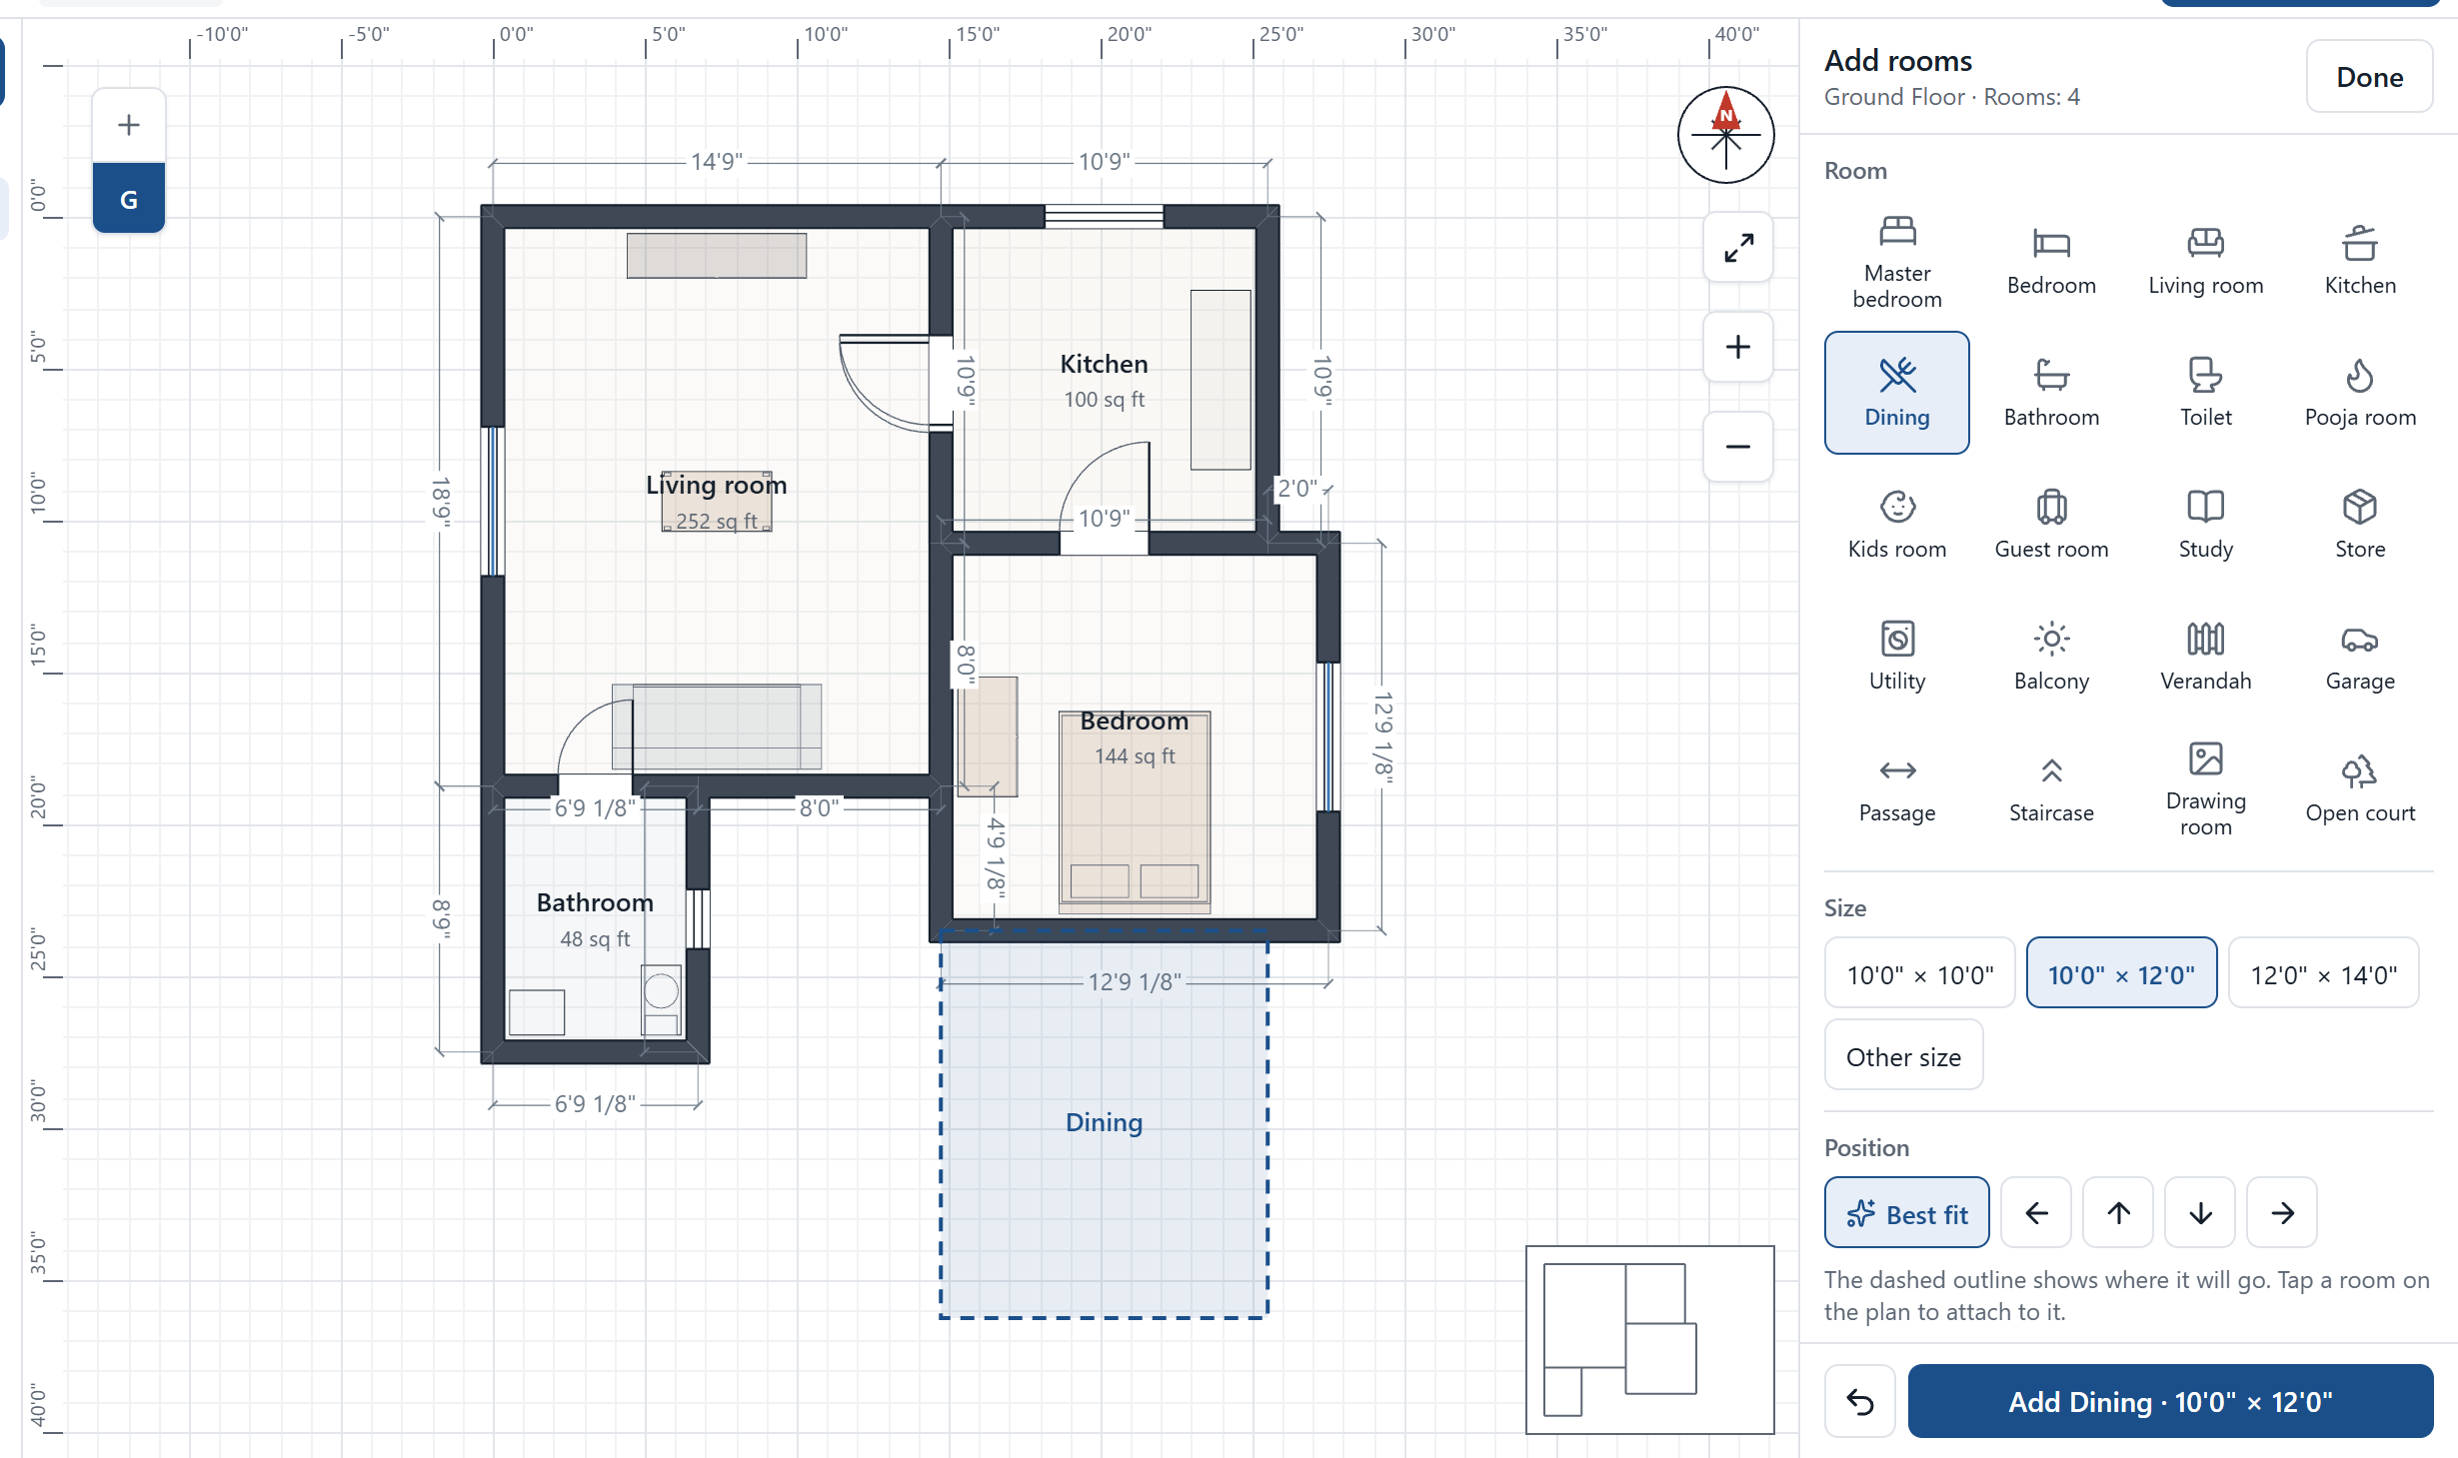
Add room after room in a few taps
1
Pick a room and a size
A dashed outline on the plan shows where it will go.
2
Press Add, or Enter
It joins on with a shared wall, a door, a window and furniture.
Notes:
The panel stays open, so the next room is two taps away. Best fit keeps the house compact, or choose a direction. Tap a room on the plan to attach the next room to that one. Undo removes a room in one step.

Slide 12
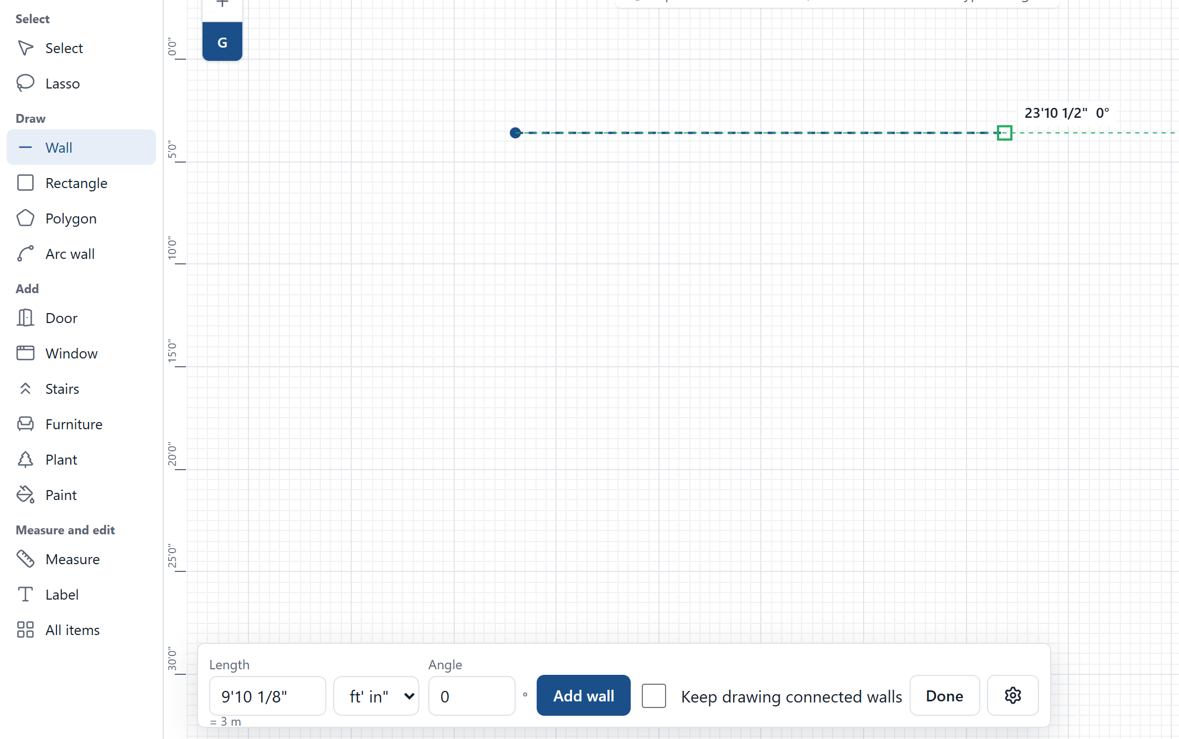
Draw a wall with two clicks
1
Pick Wall
Or press the W key.
1
2
3
2
Click the start
Walls snap to the grid and to other walls.
3
Click the end
The wall is done and the tool goes back to Select.
4
Or type the size
Type a number, then press Enter.
4
More walls
Press Add another, or switch on connected walls with the C key.
+
Notes:
The green square shows a snap: the point will land exactly on the grid, another wall or a straight angle. Hold Shift to force 45 degree steps. With connected walls on, each wall starts where the last one ended, and clicking the first point closes the room.

Slide 13
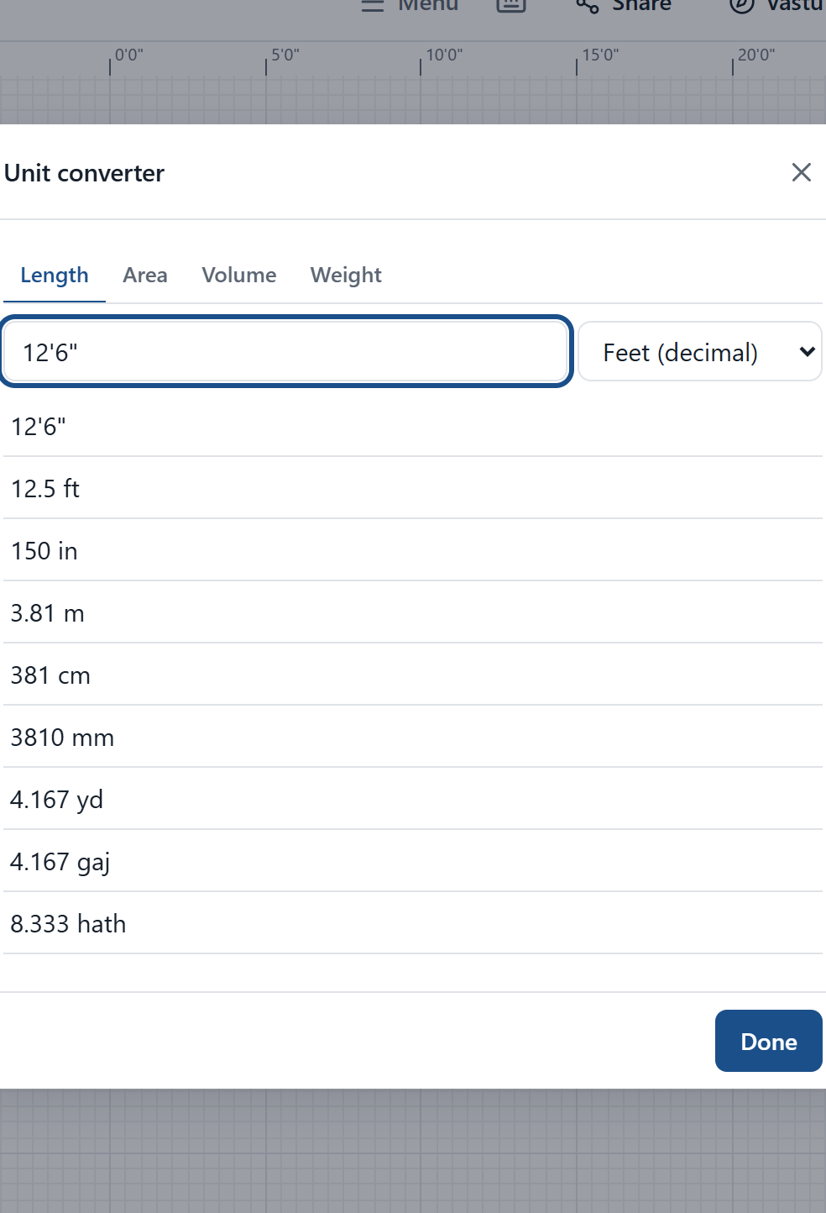
Type sizes the way you say them on site
You type | The app reads
12'6" or 12-6 | 12 feet 6 inches
12 ft 6 in | 12 feet 6 inches
5 1/2 in | 5 and a half inches
3.2m or 320cm | 3.2 metres
2 gaj | 2 gaj, which is 1.83 metres
4 hath | 4 hath, which is 1.83 metres
The converter also handles cent, guntha, ankanam, bigha and more.
Every size box shows the same length in a second unit underneath, so mistakes are easy to spot.
Notes:
You can switch display units at any time without changing the drawing. The unit converter is on the home screen and in the menu.

Slide 14
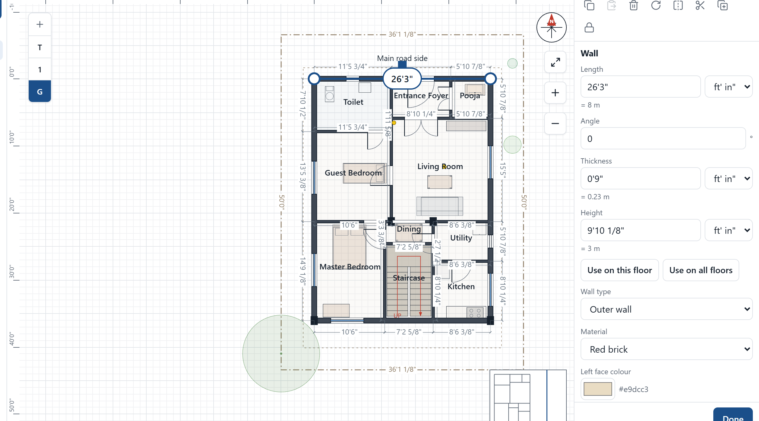
Change anything after you draw it
1
Click the length
Type a new size. The room stays square.
3
1
2
2
Drag a round handle
Moves that corner. Joined walls follow.
4
3
Use the action buttons
Copy, delete, rotate, mirror, lock.
4
See its properties
Thickness, height, material and colour.
Notes:
When you change a length, connected walls move with it, so the room stays square and the corners stay joined.

Slide 15
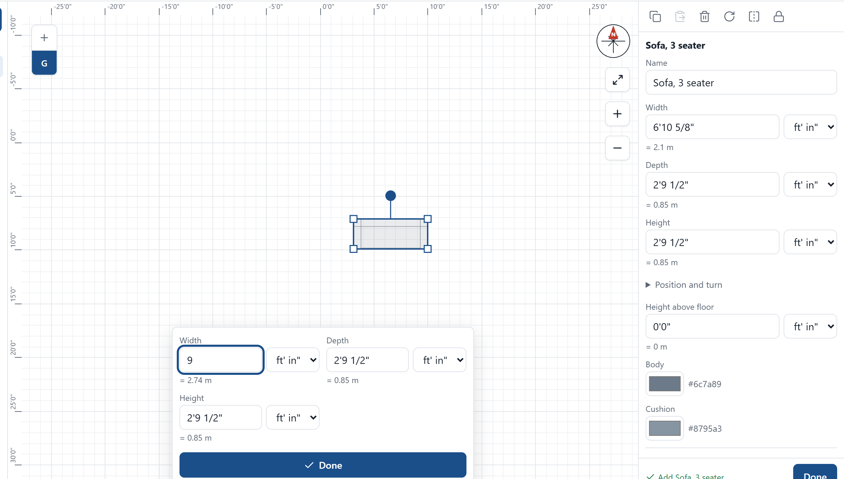
Change the size of anything, any time
1
Select the item
Its size shows right beside it.
2
Tap the size, or start typing
Type a number with the item selected.
3
Or drag a handle
Square corners resize. The round handle turns it.
4
Press Done
Panels and dialogs all have one, so you know it is finished.
Notes:
This works for furniture, fittings, pillars, plants, stairs, doors, windows, beams and slabs. Every change is saved as you make it; Done just closes the panel and tells you so.

Slide 16
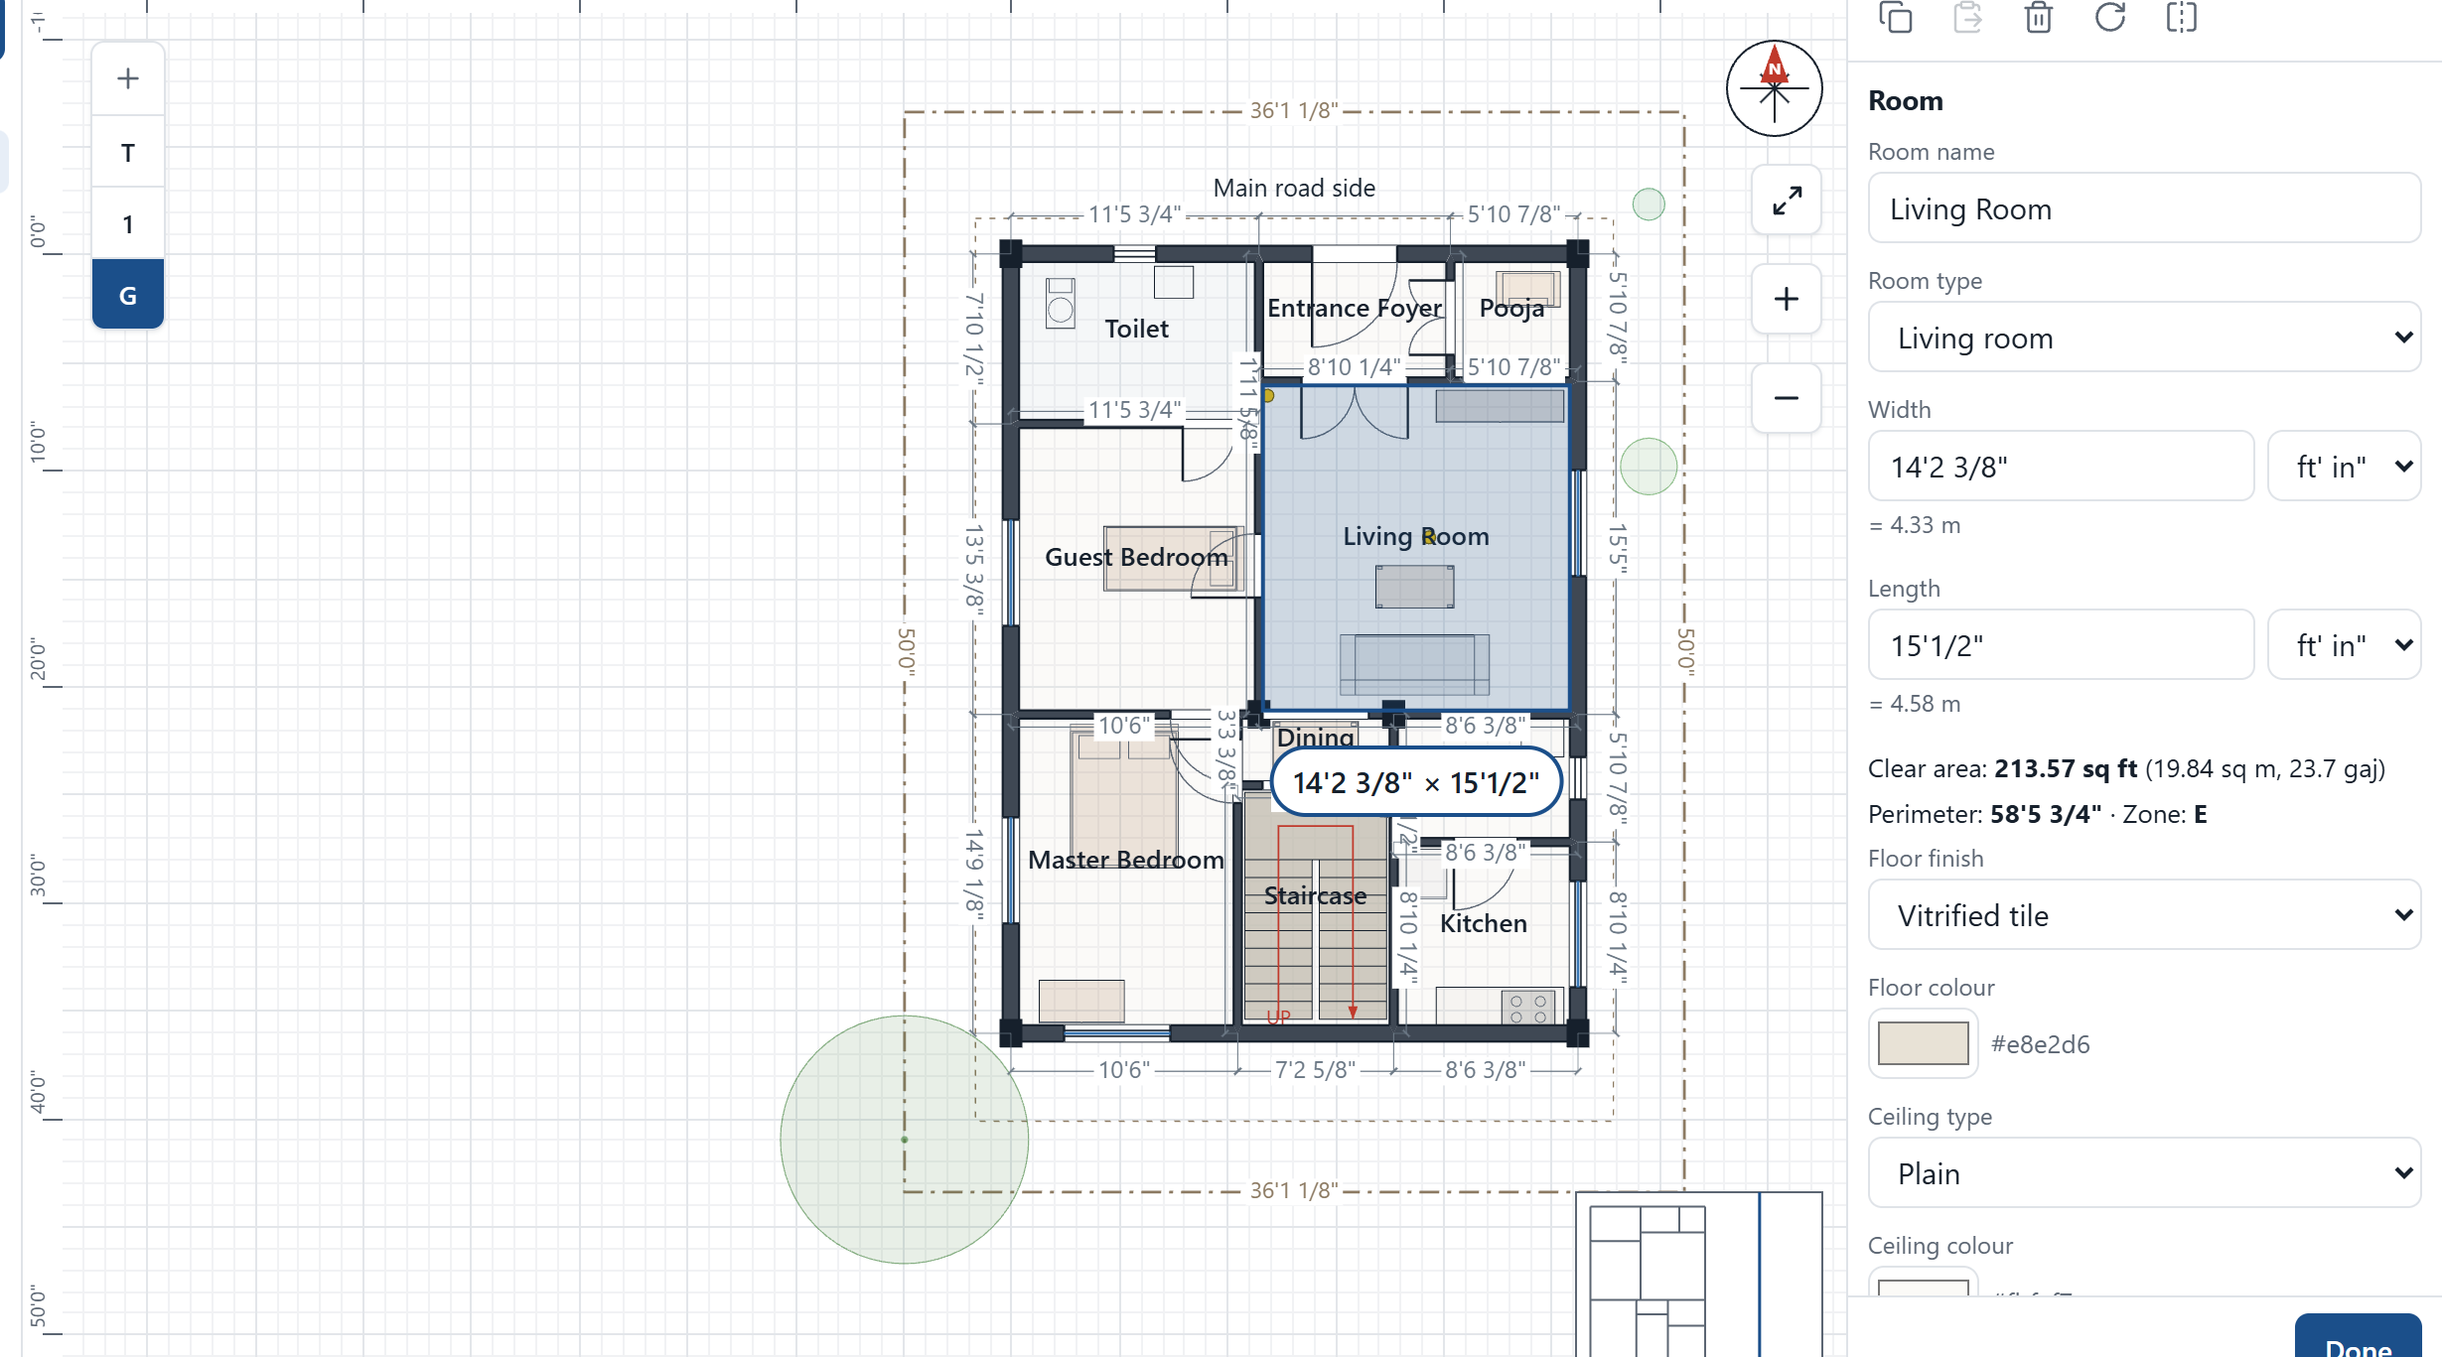
Close the walls and the room appears
1
Click inside a room
Any closed set of walls is a room.
1
2
Name it and set its type
Kitchen, pooja and so on. Vastu needs this.
2
3
Read its size
Area in sq ft, sq m and gaj, plus its zone.
3
4
4
Choose its finishes
Floor, ceiling and wall paint colours.
Notes:
Setting the room type matters: the Vastu check uses it. The area is the clear floor area inside the walls.

Slide 17
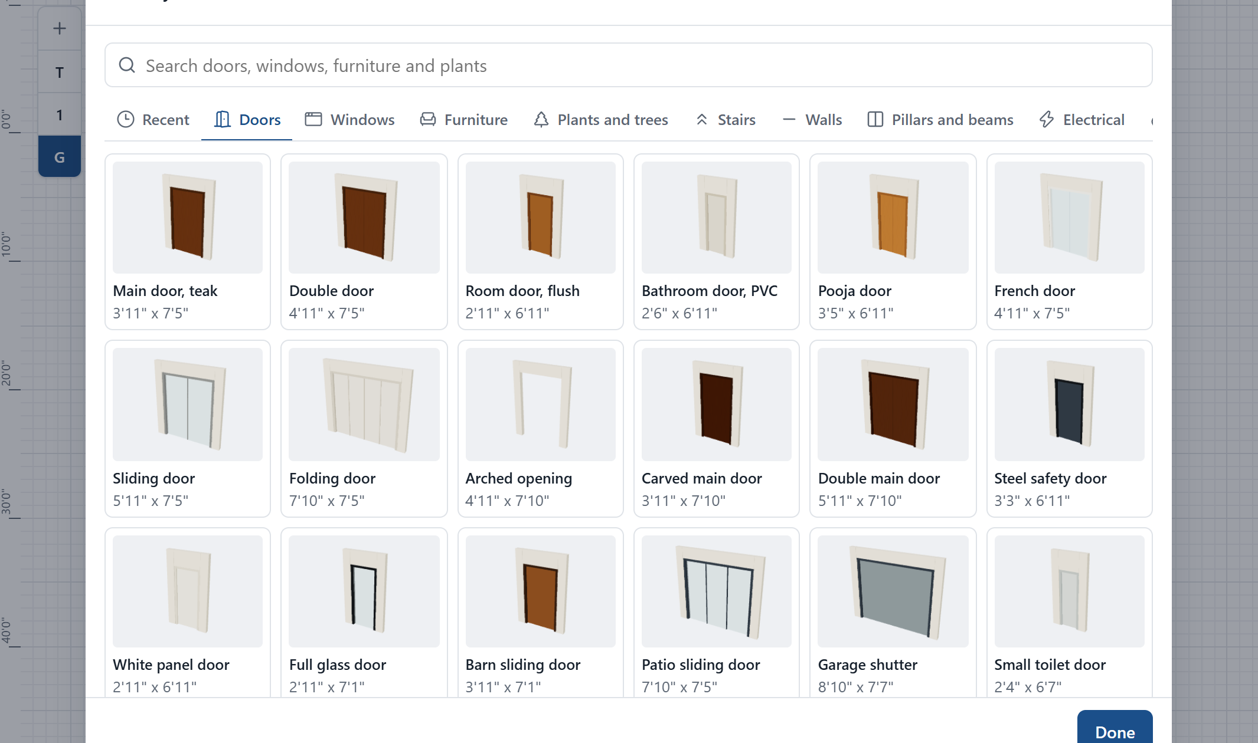
Choose everything by how it looks
124
35
furniture and fittings
door and window types
8
26
stair types
trees and plants
1
Open a section
Doors, windows, furniture, plants, stairs, walls and more.
2
Tap a picture, then the plan
Doors and windows sit on the wall you tap.
+
Add another
One tap places the same item again.
Notes:
Each picture is drawn by the same code as the real 3D model, so what you pick is what you get. Everything you place can be resized by typing and recoloured.

Slide 18
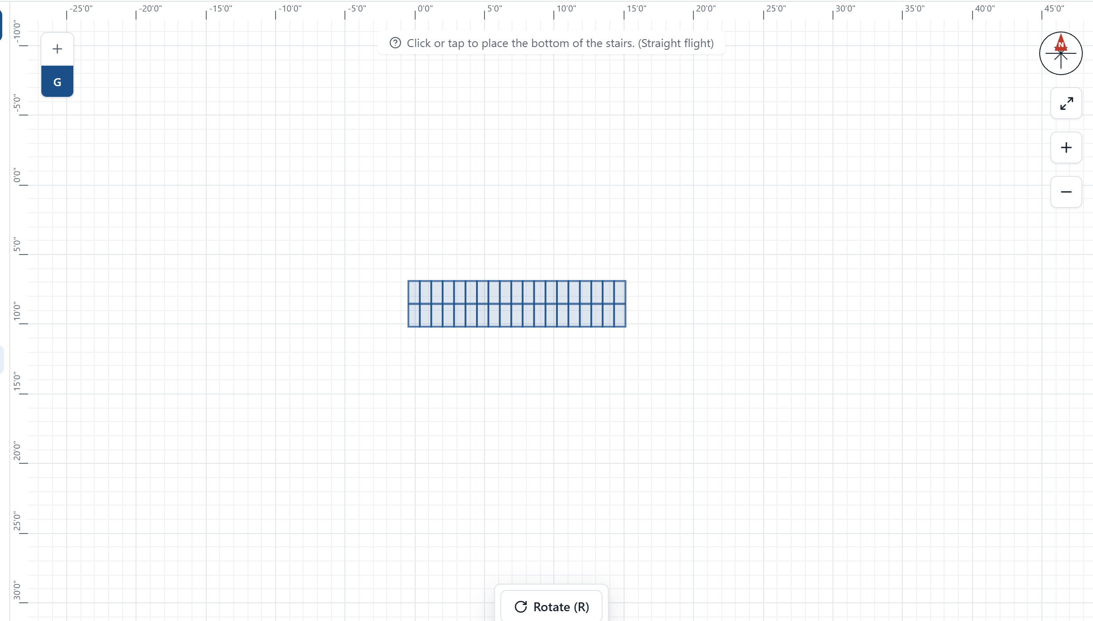
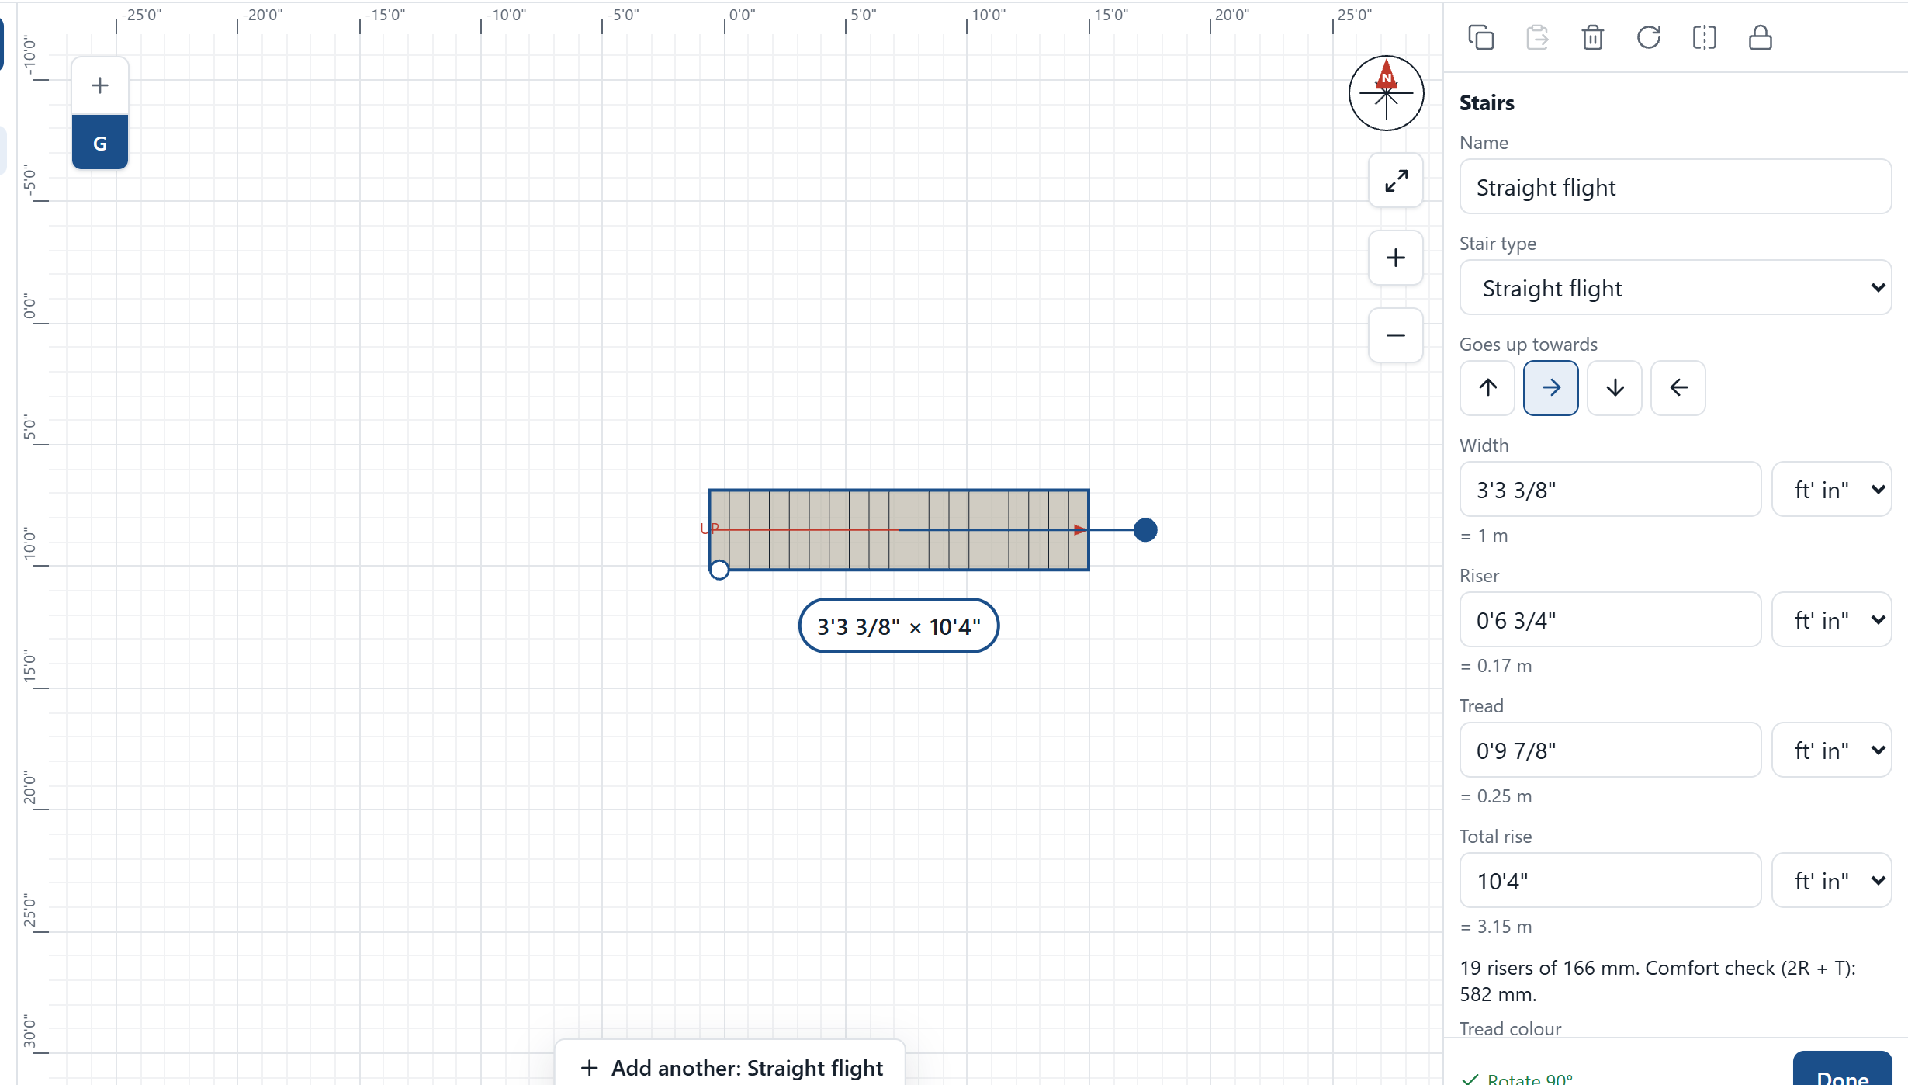
Stairs face any way you want
1
Before placing
Press the R key or the Rotate button.
2
After placing
Choose a direction, turn it left or right, or drag the round handle.
Notes:
A stair turns about its middle, so it stays where you put it. Handrails follow the shape of the stair, in the plan and in 3D.

Slide 19
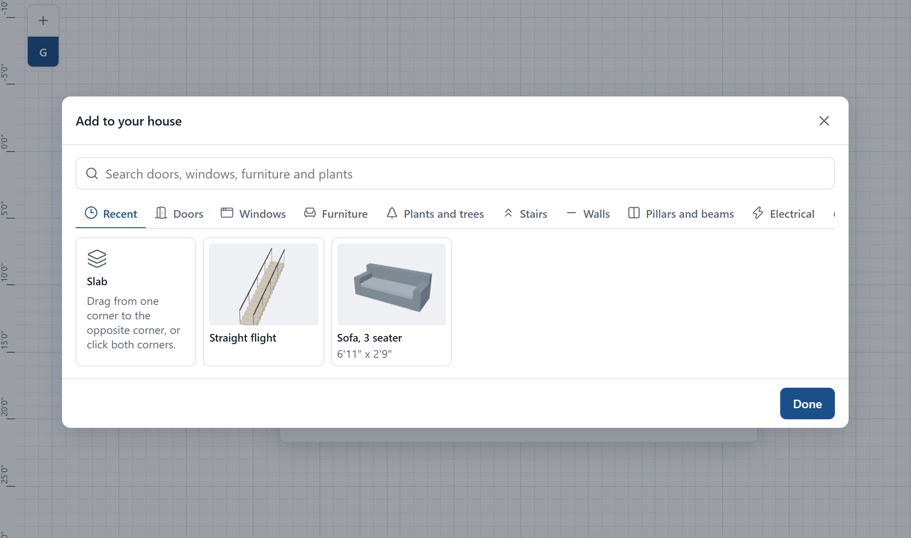
Recent items and floor-by-floor undo
1
Recent comes first
Add opens on what you used last, so the same item is one tap away.
2
Undo stays on your floor
Undo on the Ground Floor leaves your First Floor work alone.
3
Whole-house steps
Adding or moving a floor is undone once the work after it has been.
Notes:
The History list in the menu still shows every step in order, across all floors, if you want to go back further.

Slide 20
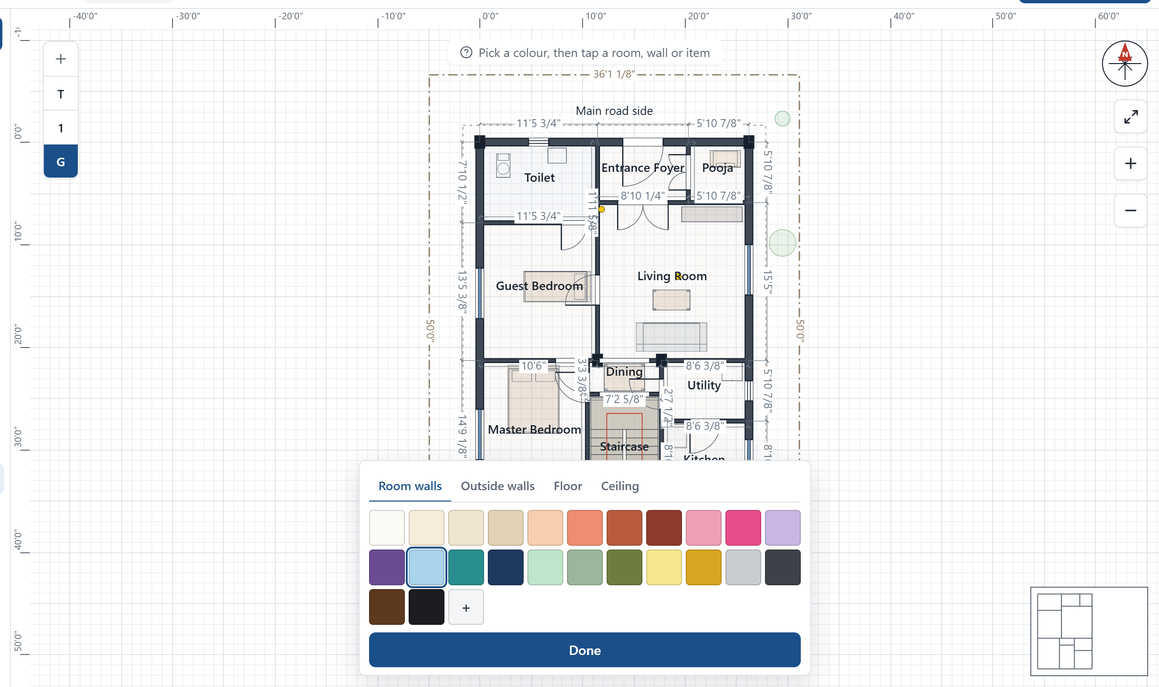
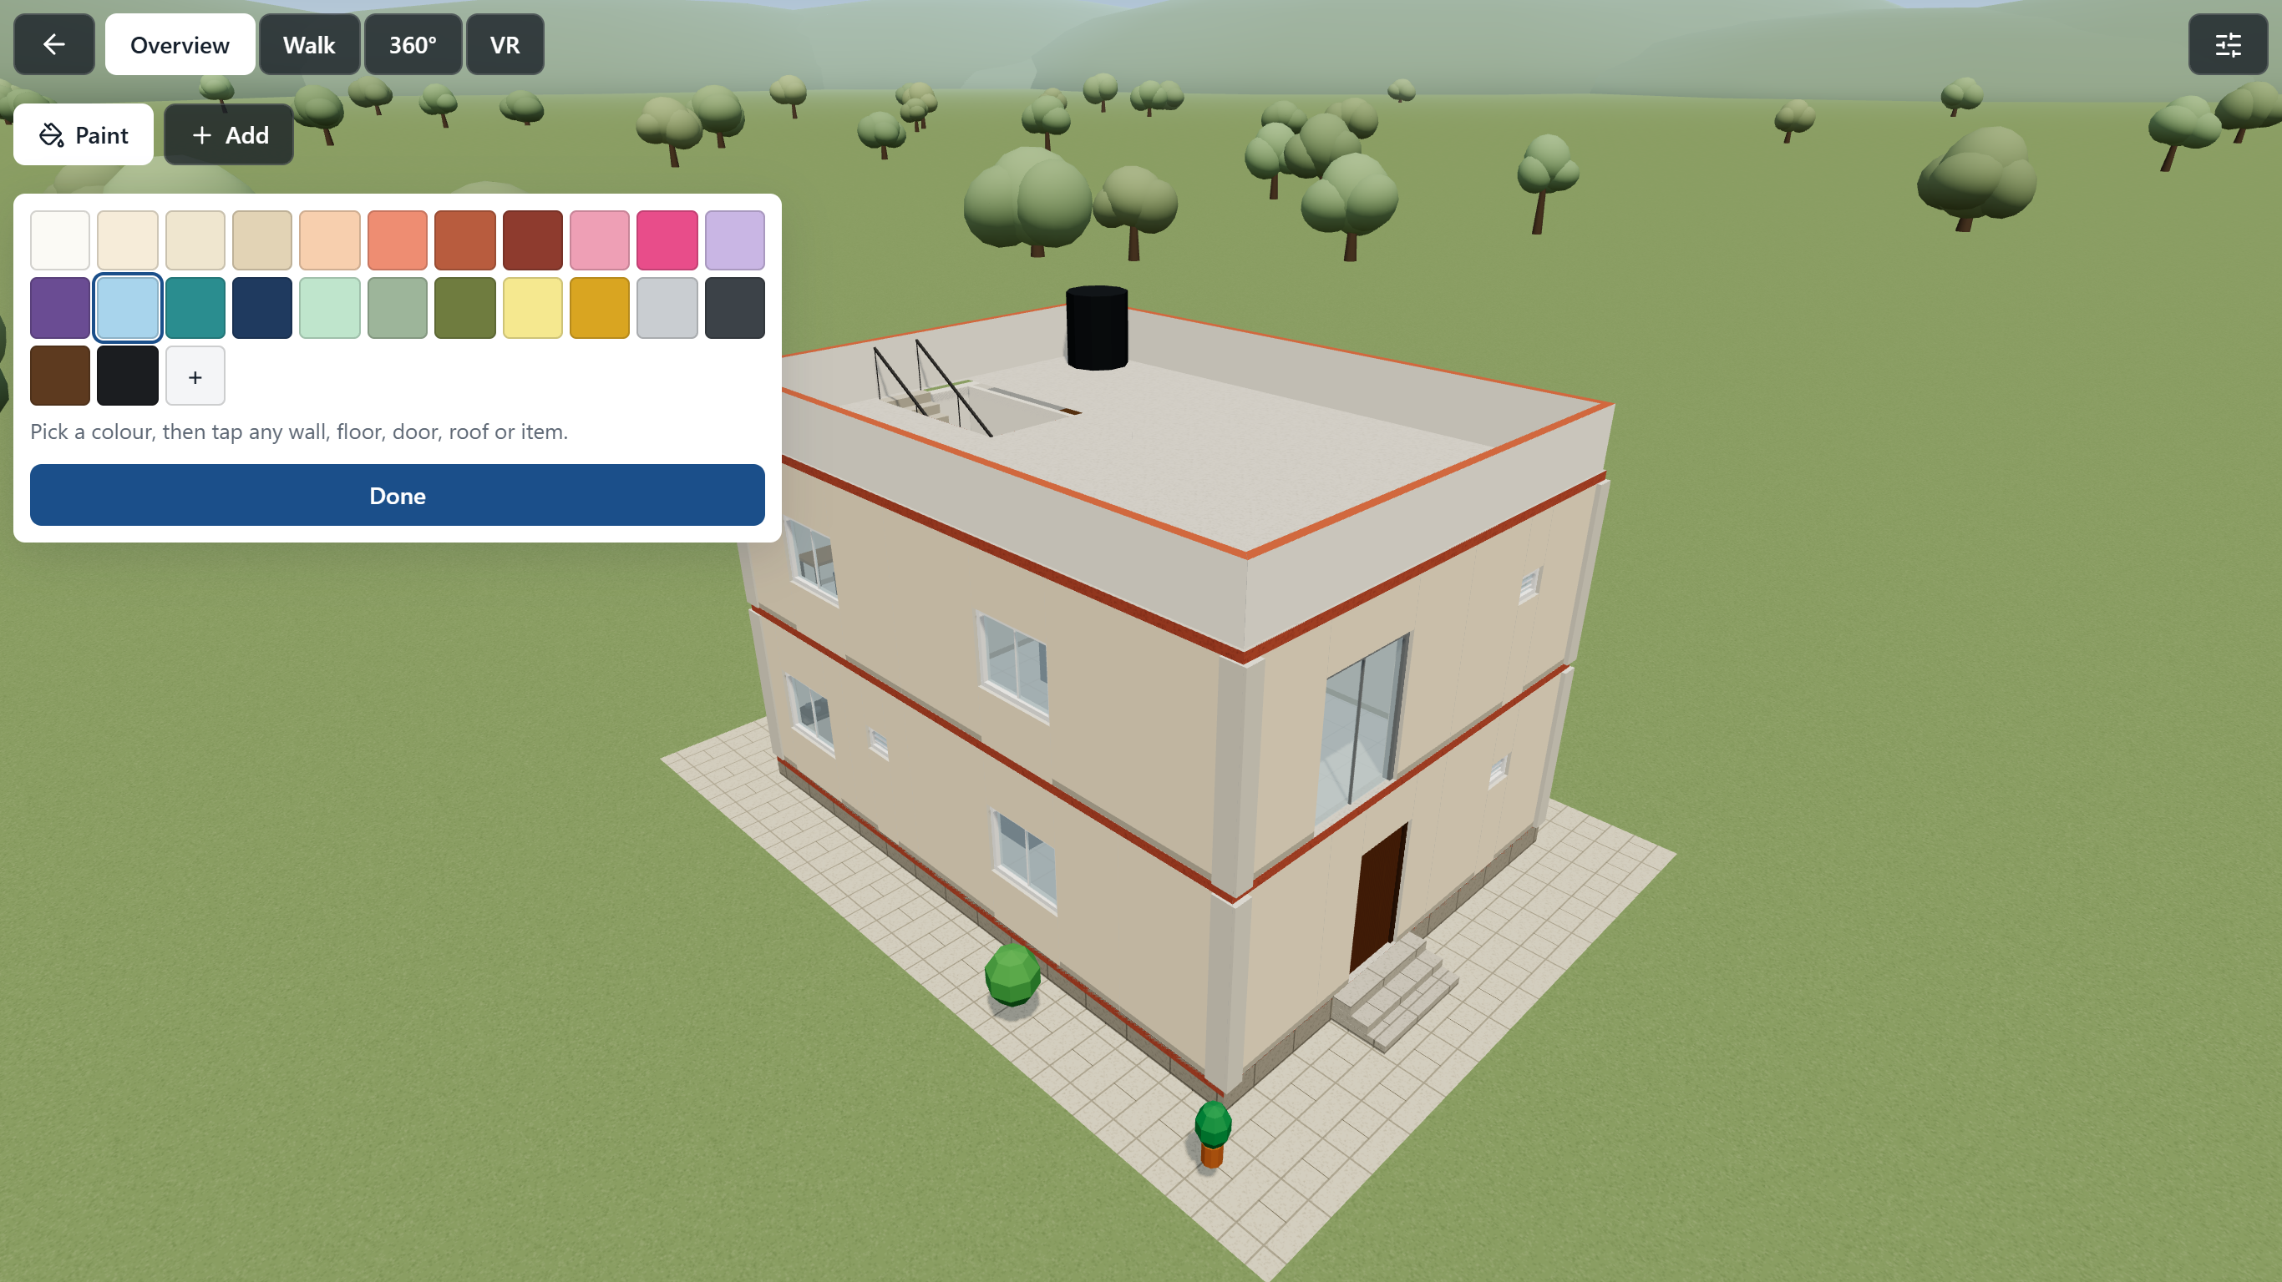
Paint anything, on the plan or in 3D
1
Pick a colour
24 ready colours, or any colour you like.
2
Tap what you want painted
It changes at once, and goes into the design.
Notes:
Choose Room walls, Outside walls, Floor or Ceiling on the plan. In 3D, whatever you tap is what gets painted: a wall, floor, door, roof or sofa. Undo works for paint too.

Slide 21
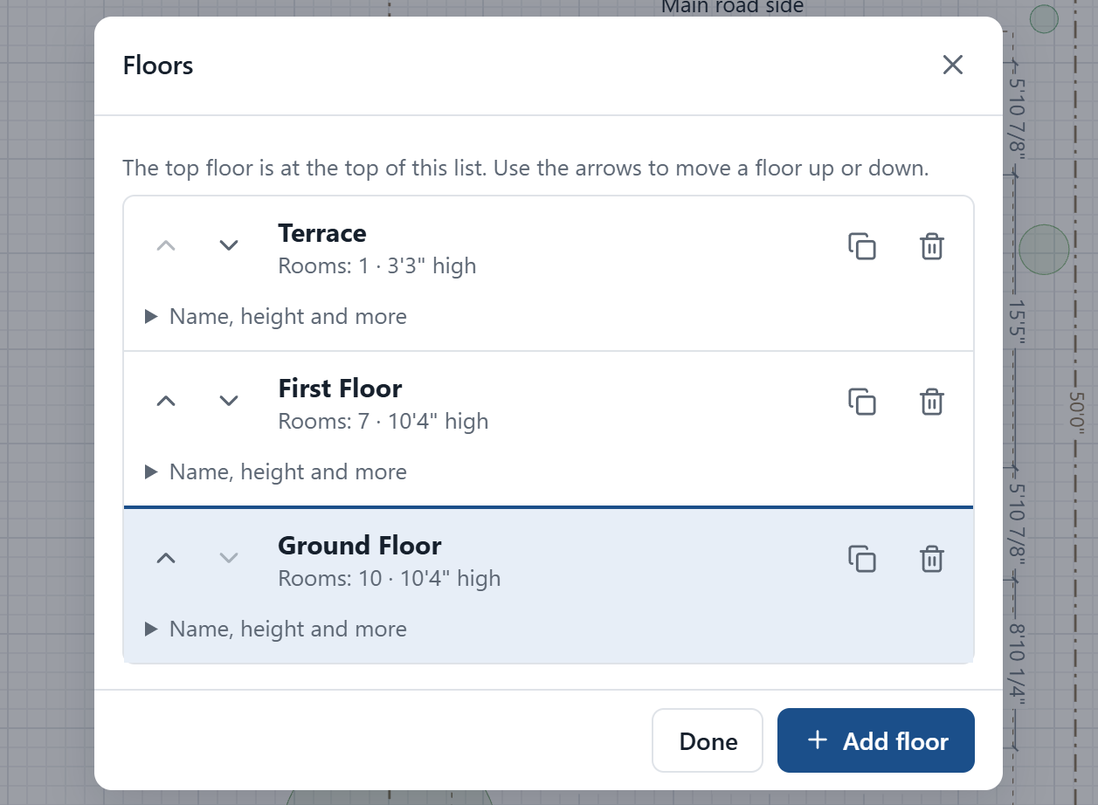
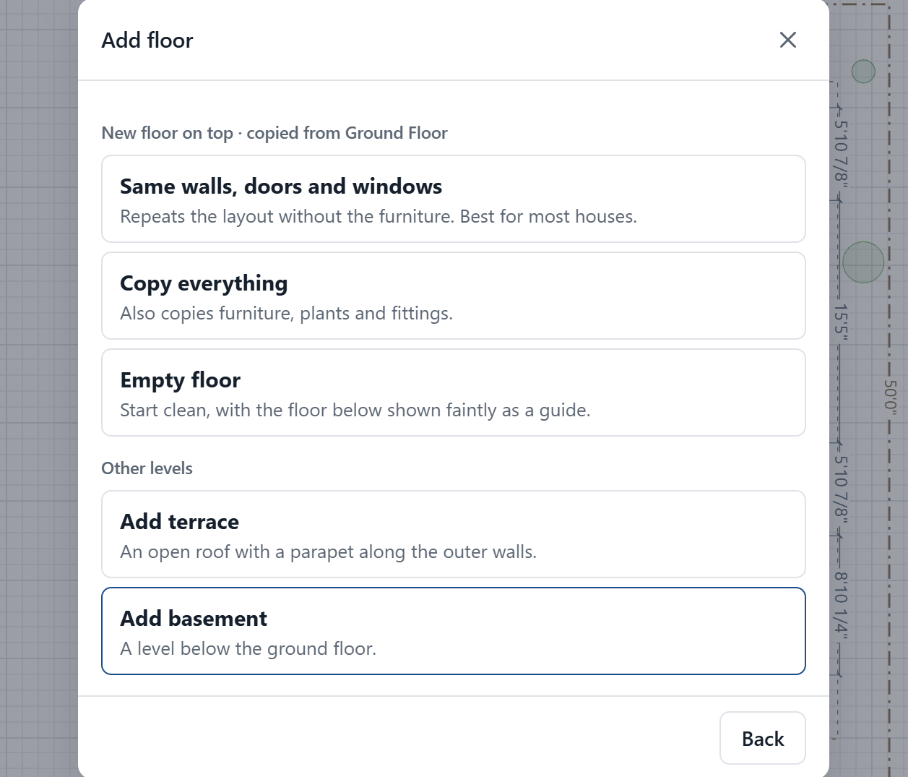
Add floors and change their order
1
Switch floors
Tap G, 1, 2 in the stack on the plan.
2
Add a floor
Press the + on that stack. Same walls is best for most houses.
3
Move a floor
Use the arrows in the list. Ground can go to the top, or top to the bottom.
Notes:
Moving a floor swaps it with its neighbour: its walls and contents go with it, and heights update. A floor with a standard name, such as Ground Floor, is renamed for its new position; a name you typed stays. Page Up and Page Down switch floors.

Slide 22
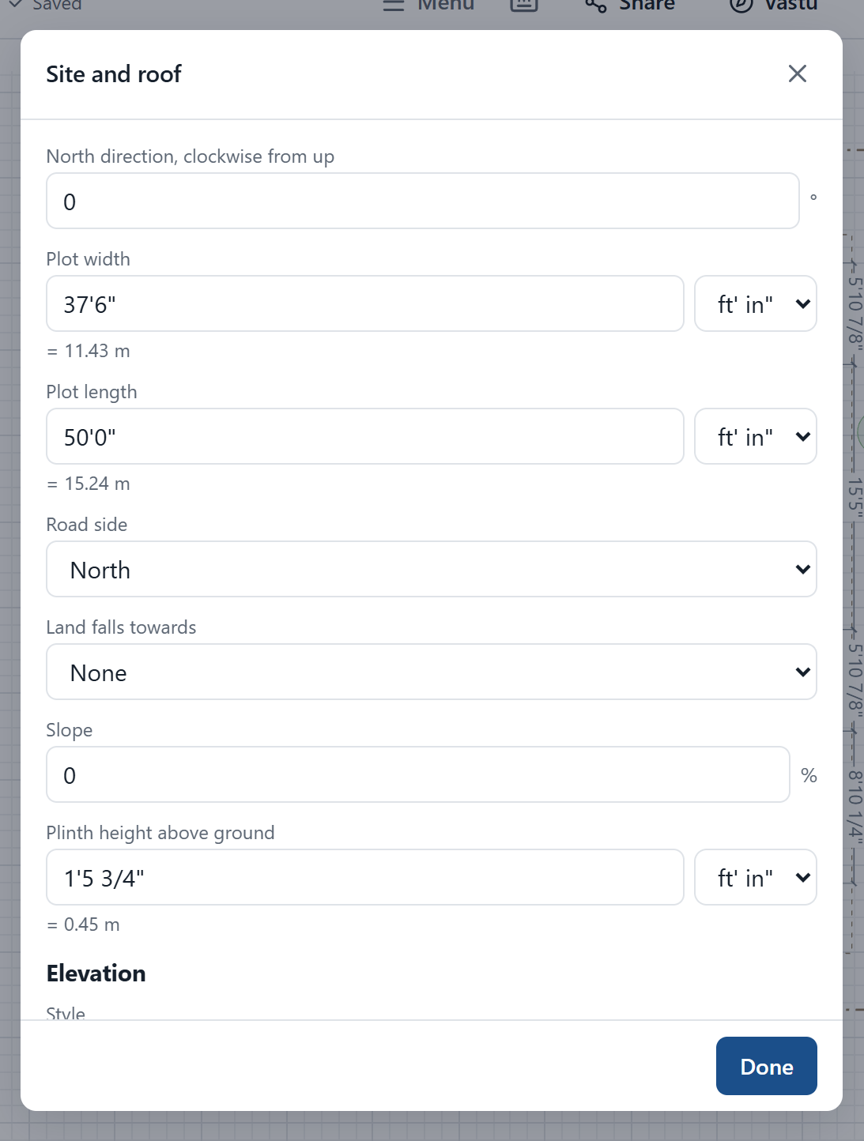
Set the site, the north and the roof
1
North and road side
Tell the app which way is north, and where the road is.
2
Plot and levels
Plot size, slope and how high the plinth stands above the ground.
3
Roof and style
Flat, gable, hip or sloped, with ready-made elevation colours.
4
Layers
Hide furniture or dimensions while you work, from the Layers menu.
Notes:
Set the north direction correctly: Vastu depends on it.

Slide 23
Handy controls for mouse, keyboard and touch
To do this | With a mouse | On a touchscreen
Zoom | Mouse wheel, or + and - buttons | Pinch with two fingers
Move around the plan | Hold Space and drag, or right-drag | Drag with two fingers
See actions on an item | Right-click | Press and hold
Open properties | Double-click | Double-tap
Select several items | Shift-click, or drag a box | Tap to add more, or draw a lasso
Stop drawing | Esc, or double-click | Done button
Undo and redo | Ctrl+Z and Ctrl+Y | Arrows in the top bar
Copy and paste | Ctrl+C and Ctrl+V | Copy and Paste buttons
Type a size | Type a number, then Enter | Tap the length
Nudge an item | Arrow keys, or Shift and arrows for 1 m | Drag it
Pick a tool quickly | W wall, D door, N window, F furniture. Press ? for all | Tool buttons
Notes:
None of the shortcuts are required. Every action also has a button.

Slide 24
See it, check it, cost it
3D walkthrough, Vastu report, estimate and printed plans.

Slide 25
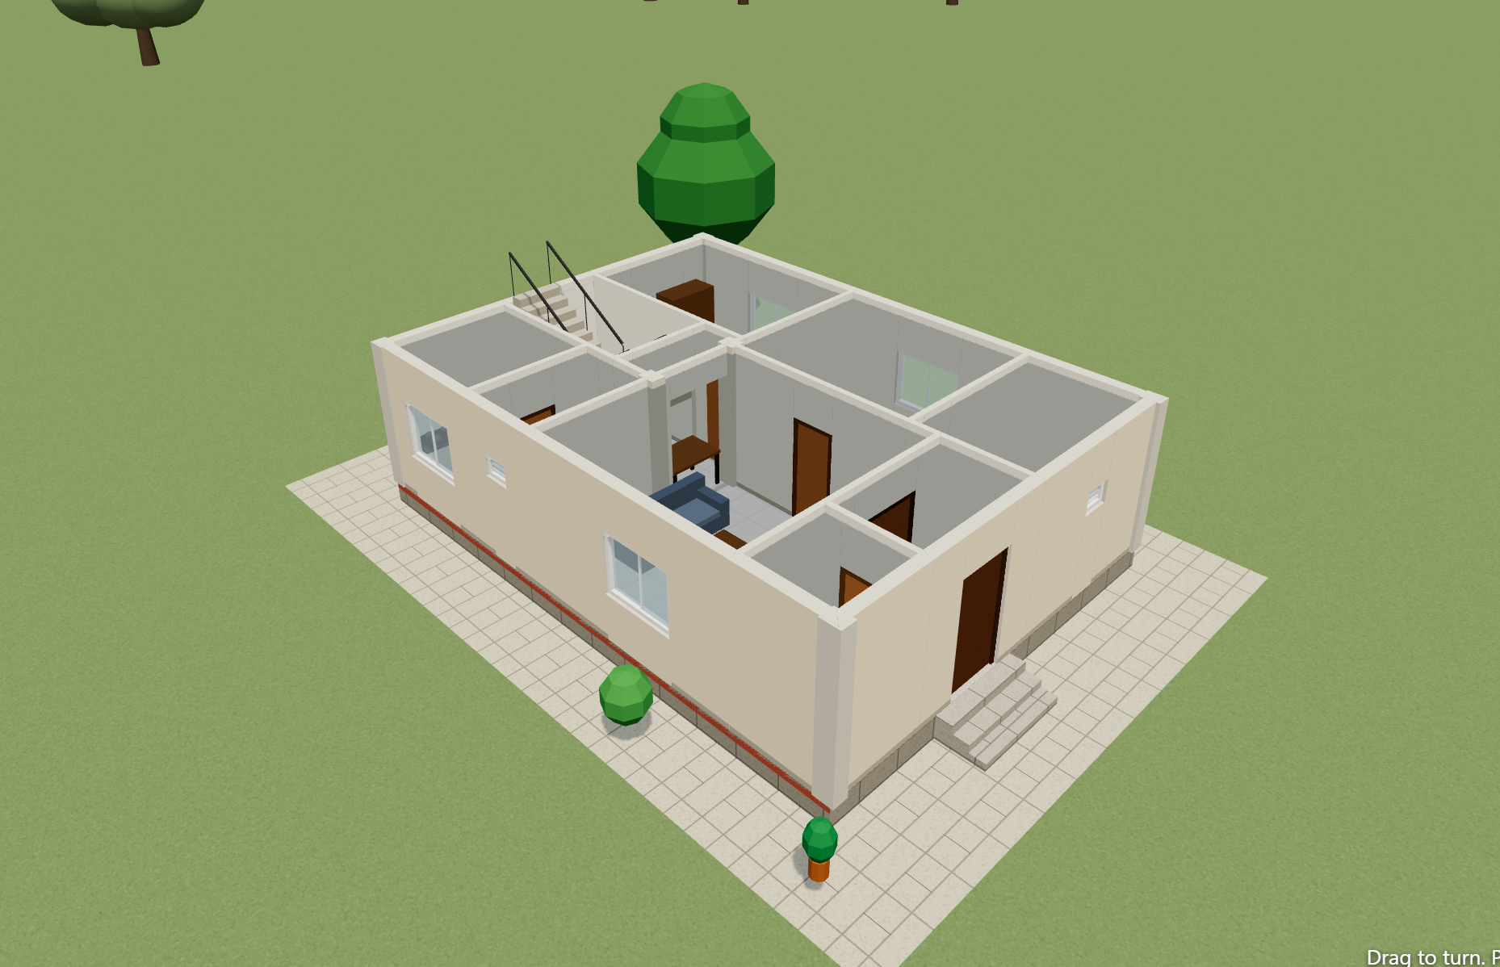
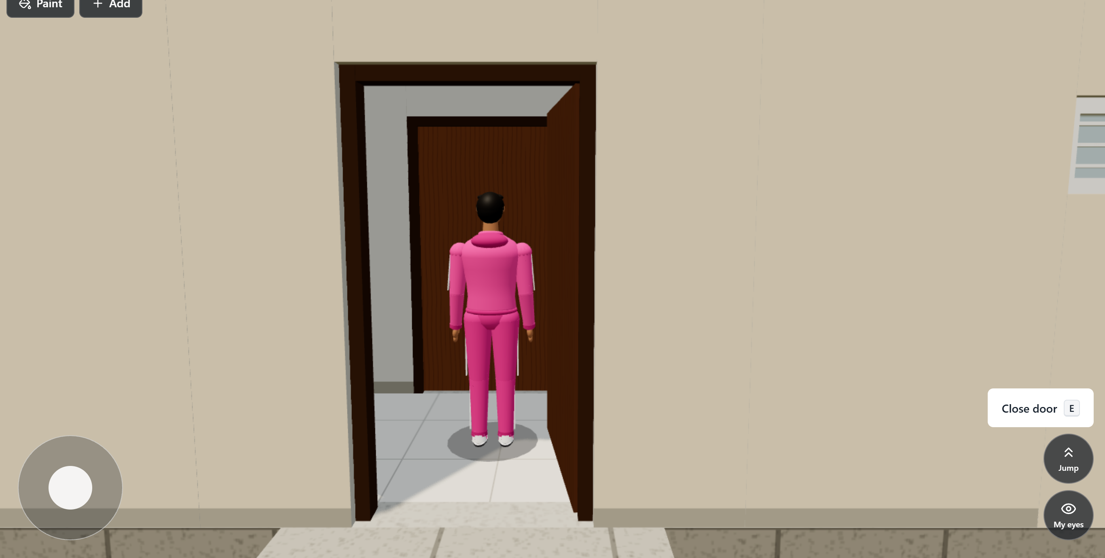



Walk through your house before it is built
Orbit Turn the whole house. Show one floor at a time to look inside.
Walk Press W A S D from any view, or use the stick. Walls stop you, and stairs work.
360° Turn your phone to look around the room.
VR Split view for a phone headset. Tap to start walking.
Notes:
VR uses a simple phone headset and needs a phone with a motion sensor. 3D speed depends on the phone; the app lowers sharpness automatically if it runs slowly.

Slide 26
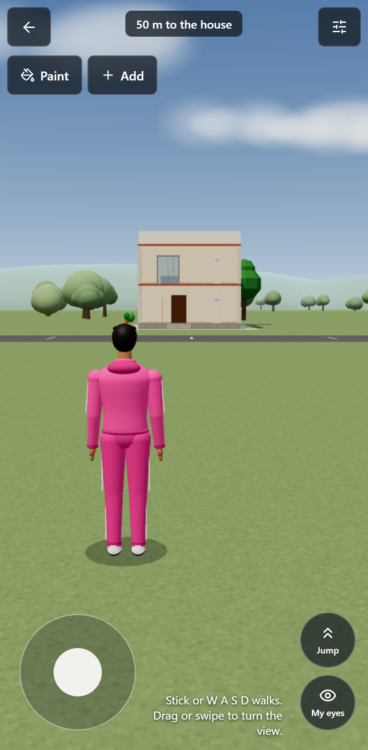
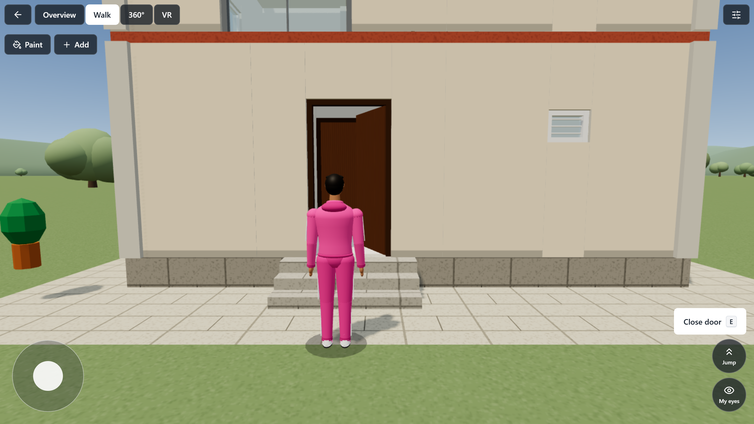
Explore your house as a game
1
Start
50 m from the house.
2
Stick, or W A S D
Moves your body.
3
Swipe or drag
Turns the view.
+
Open and close
Near a door or window, a button appears. Shut doors stop you.
+
Change things
Paint, or add plants and furniture, as you walk around.
Notes:
The character is an original one made for this app. Doors stay open or shut only while you play. On a laptop use W A S D to walk, the mouse to look, Shift to run, Space to jump and E to open a door. Speed depends on the device.

Slide 27
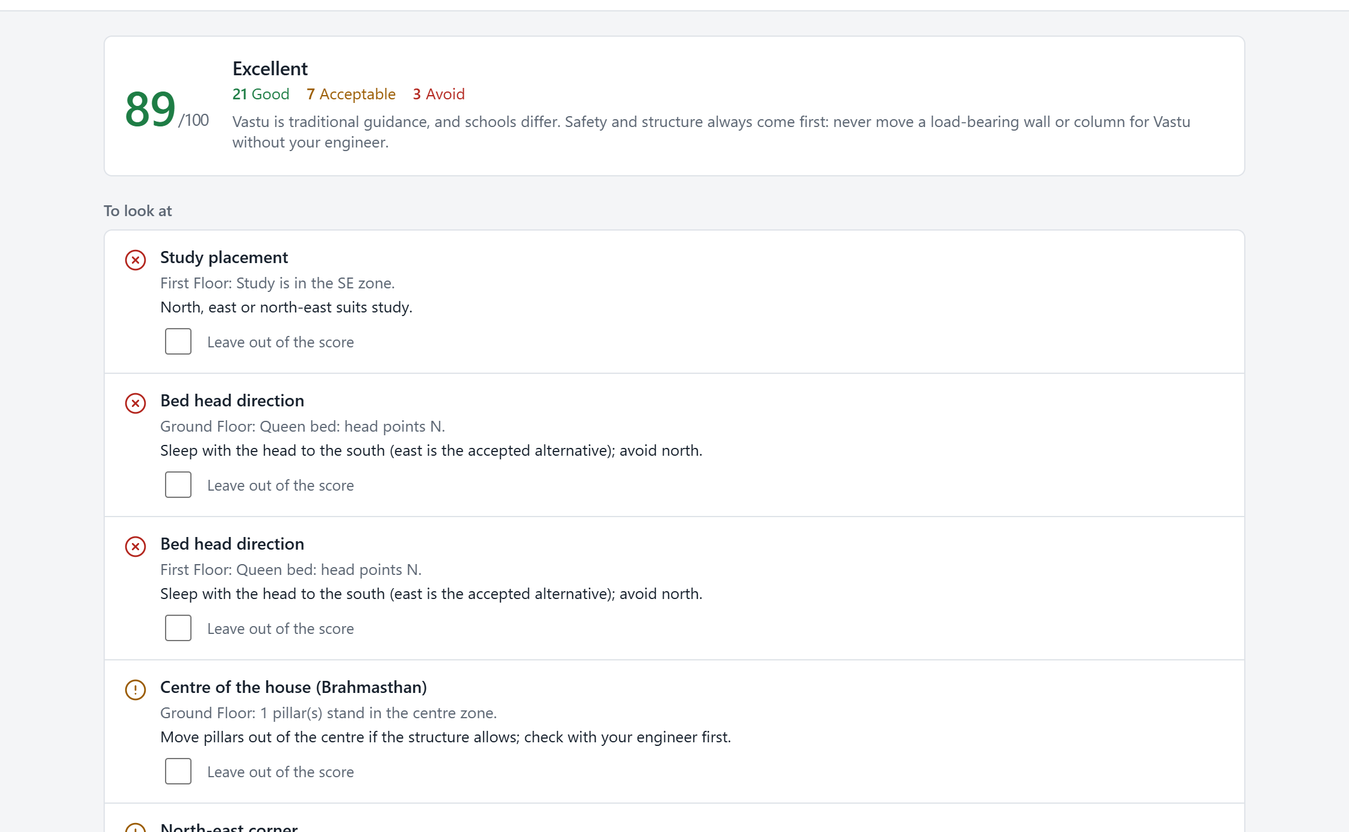
Vastu: a score, with reasons and suggestions
✓
Good
This follows the usual guidance.
~
Acceptable
An accepted alternative.
✕
Avoid
Comes with a suggestion for what to change.
For a fair score, first:
Set the north direction in Site and roof
Give each room its type
Mark the front door as the main entrance
The sample house scores 89 out of 100. Three items are marked Avoid: where the study sits, and the direction of two beds.
Notes:
Vastu traditions differ, so any rule can be left out of the score. Safety first: never move a load-bearing wall or column for Vastu without your engineer.

Slide 28
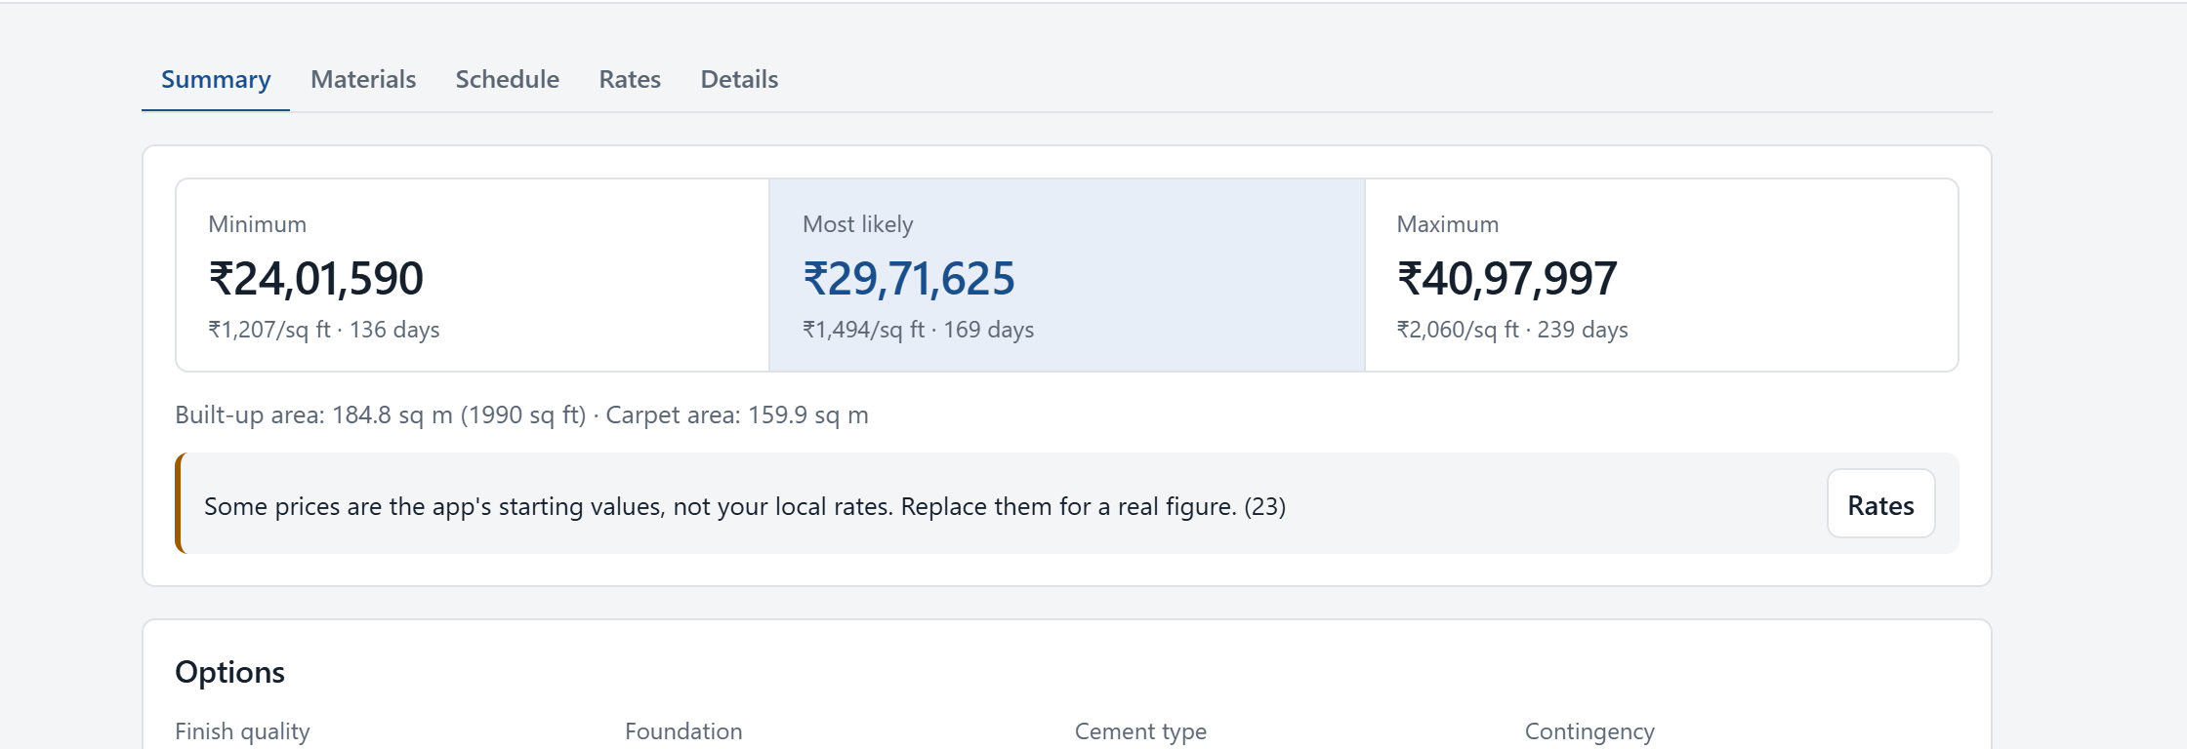
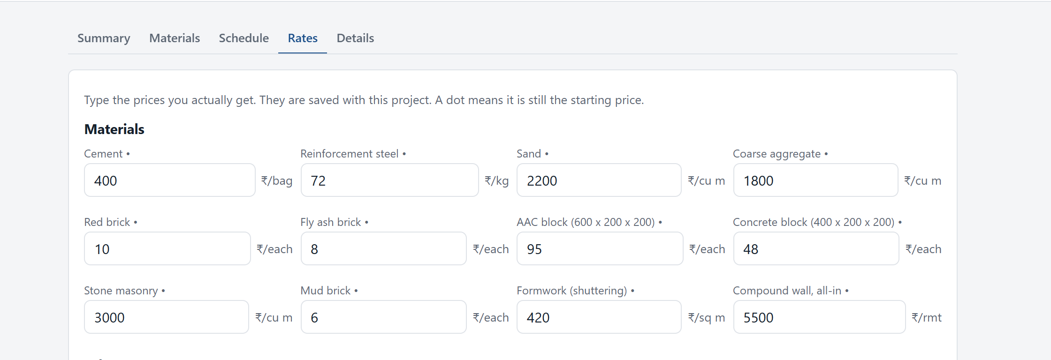
Estimates always show a range, never one number
₹24.0 lakh
₹29.7 lakh
₹41.0 lakh
Minimum
Most likely
Maximum
Sample house, about 1,990 sq ft built-up, using the app's starting prices. Quantities come from your drawn plan, so they update as you edit.
1
Open the Rates tab first
Starting prices are not your local prices. Type what you actually pay.
2
Choose your options
Finish quality, foundation, cement type, crew size, interiors, compound wall.
3
Read the assumptions
Each figure lists what it assumes, and what is left out.
Notes:
These are the sample house figures with the app's starting rates, which are placeholders. Type your local prices in the Rates tab for a figure you can use.

Slide 29

Know the materials, the days and the curing
Sample house | Minimum | Most likely | Maximum
Cement (bags) | 551 | 646 | 831
Steel (kg) | 4,300 | 5,755 | 8,591
Red bricks | 34,691 | 36,838 | 40,522
Sand (cu m) | 51.7 | 62.5 | 81.2
Aggregate (cu m) | 41.9 | 48.2 | 61.4
Time to build (days) | 136 | 169 | 239
Curing guide
Wet curing: at least 7 days with OPC cement, 10 days with PPC
Slab props, span up to 4.5 m: 7 days
Slab props, span over 4.5 m: 14 days
Beam props, span up to 6 m: 14 days
Beam props, span over 6 m: 21 days
Hot or windy weather needs more
Rule-of-thumb steel and concrete for planning. Your engineer's drawings decide the real figures.
Notes:
Curing and prop-removal periods follow IS 456:2000 minimums. The schedule adds tasks end to end, so a well-run site may overlap some of them.

Slide 30
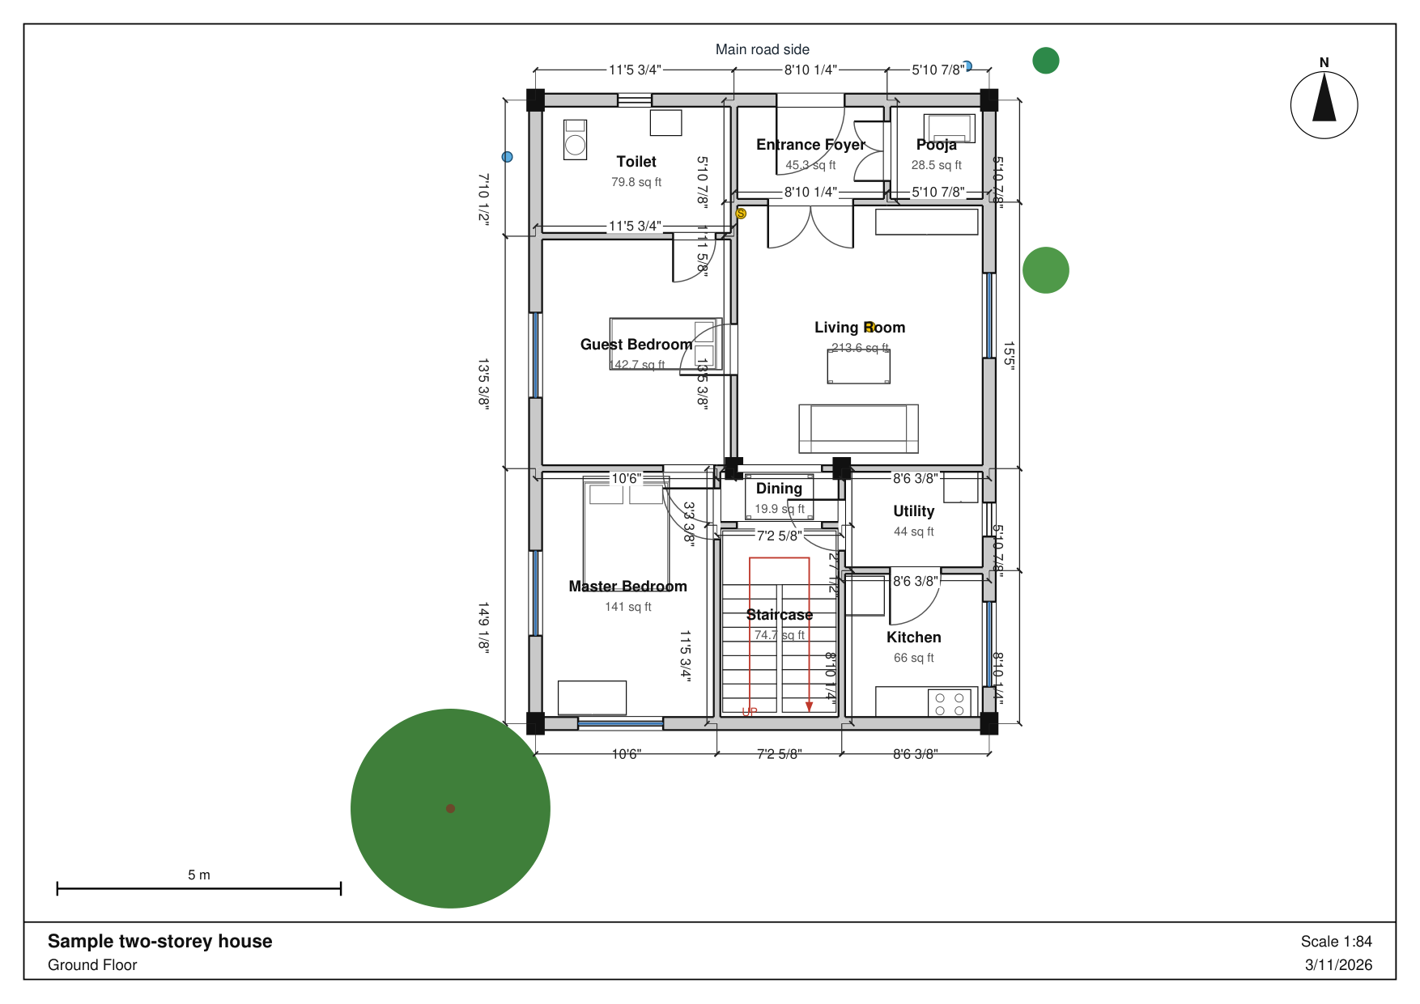
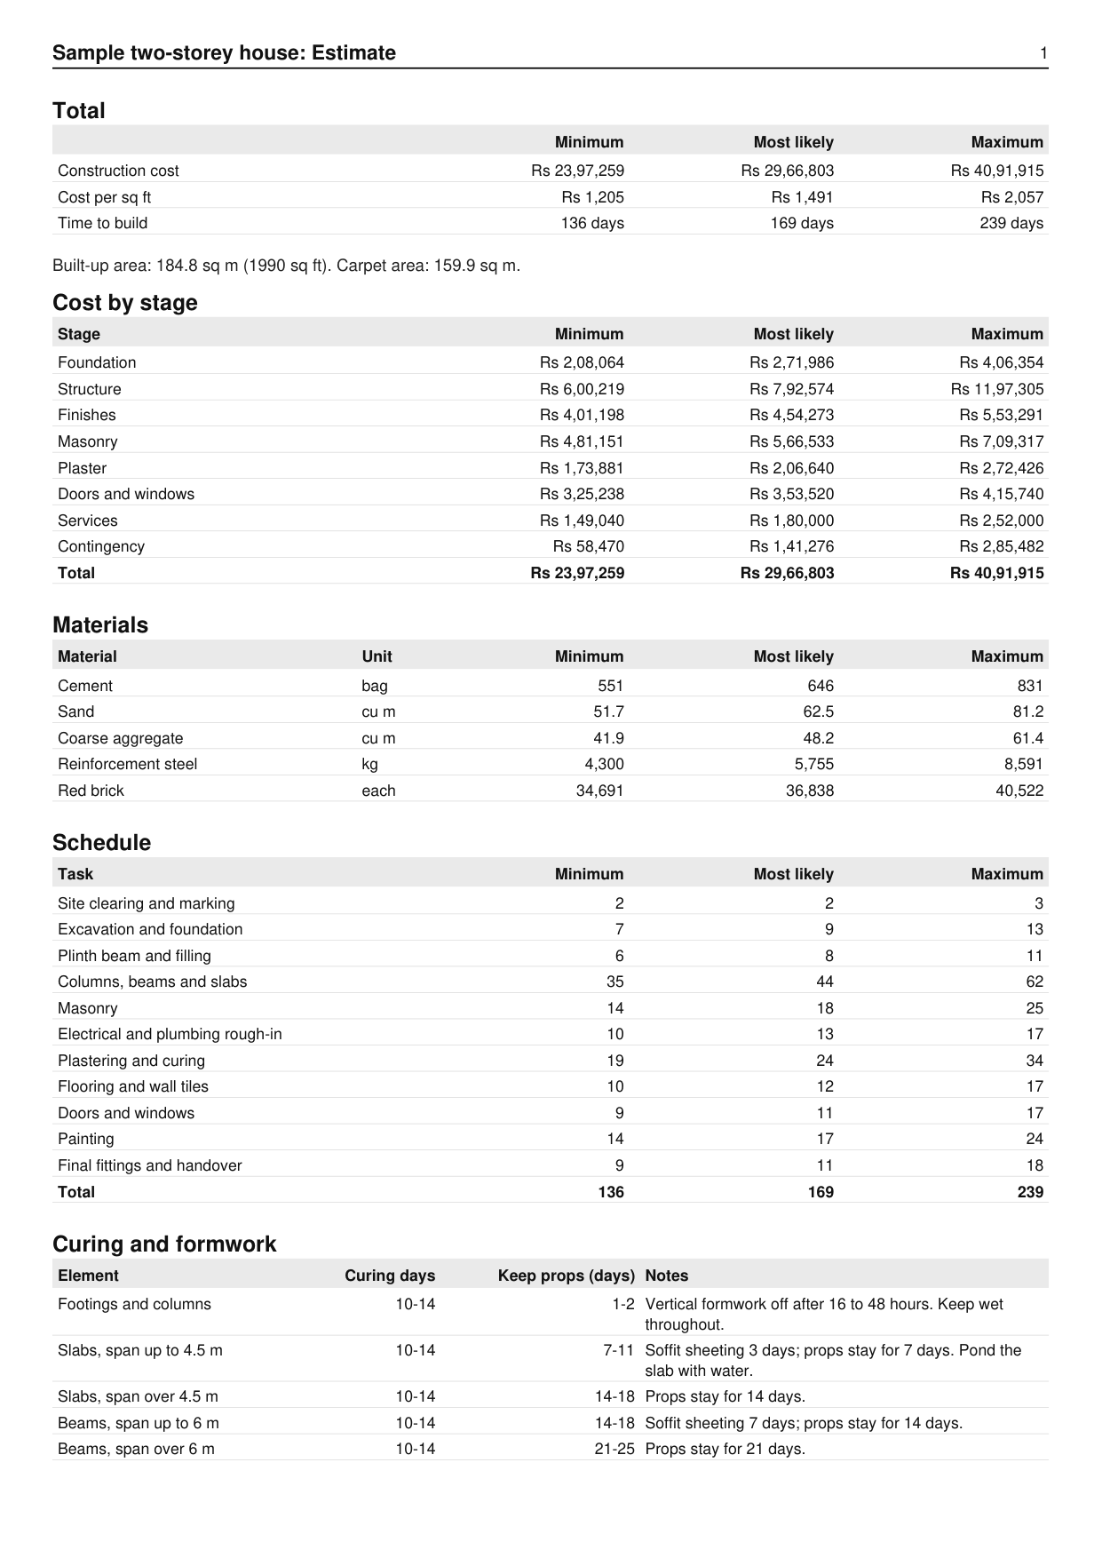
Print everything as one professional PDF
1
Pick
A4, A3 or A2.
2
Choose
Plans, rooms, Vastu, cost.
3
Make PDF
Print or share.
Floor plan with dimensions, north arrow and scale bar
Notes:
Plan lines are true vectors, so they stay sharp at any size. On Android, the PDF opens the phone's share sheet, from which you can print, save or send it.

Slide 31

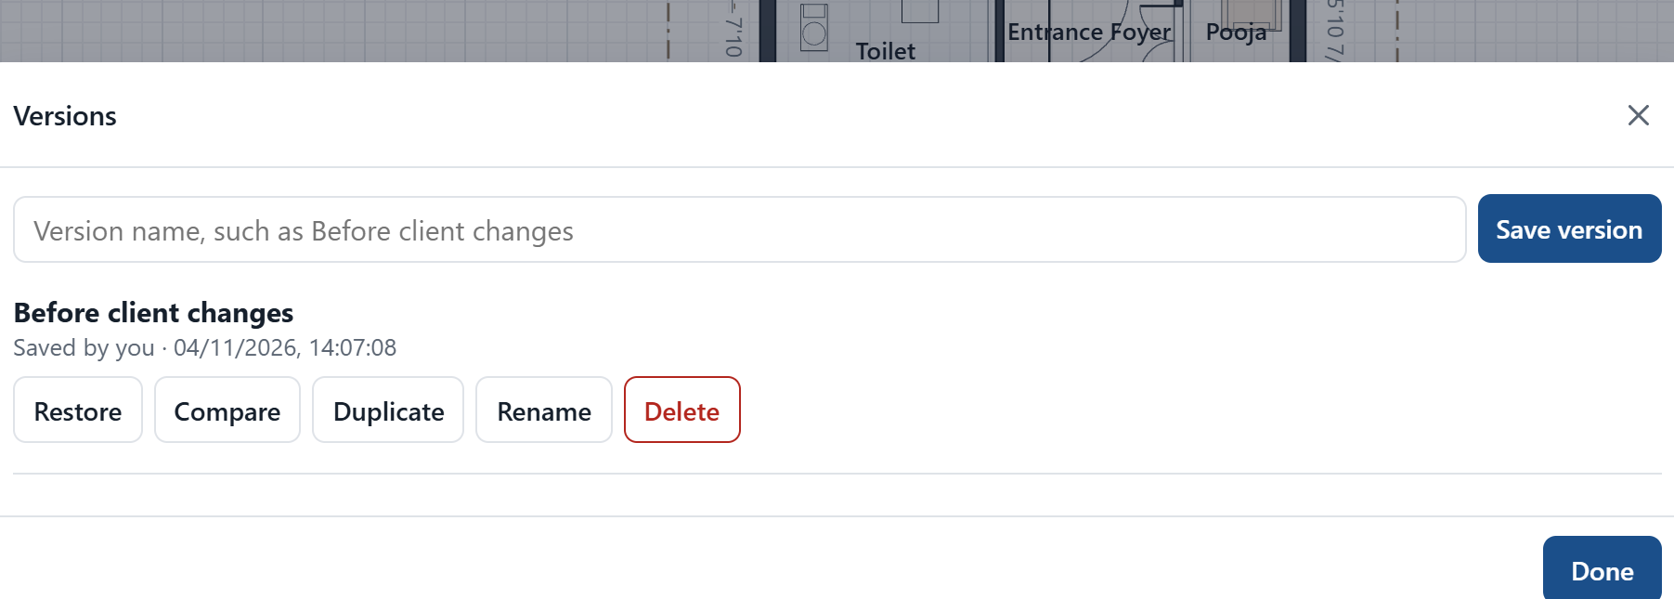


Your work is protected in three ways
Autosave
Every change saves itself within about a second. Watch for the Saved tick in the top bar.
Undo and history
Undo as far as you like. Your last 200 steps are still there after you reopen the app.
Versions
A restore point every 10 minutes, plus any you name. Compare or restore them at any time.
Notes:
Autosave was tested by force-stopping the app on Android and by killing the browser page: the work was still there. Clearing browser data on a laptop removes projects, so export anything important.

Slide 32
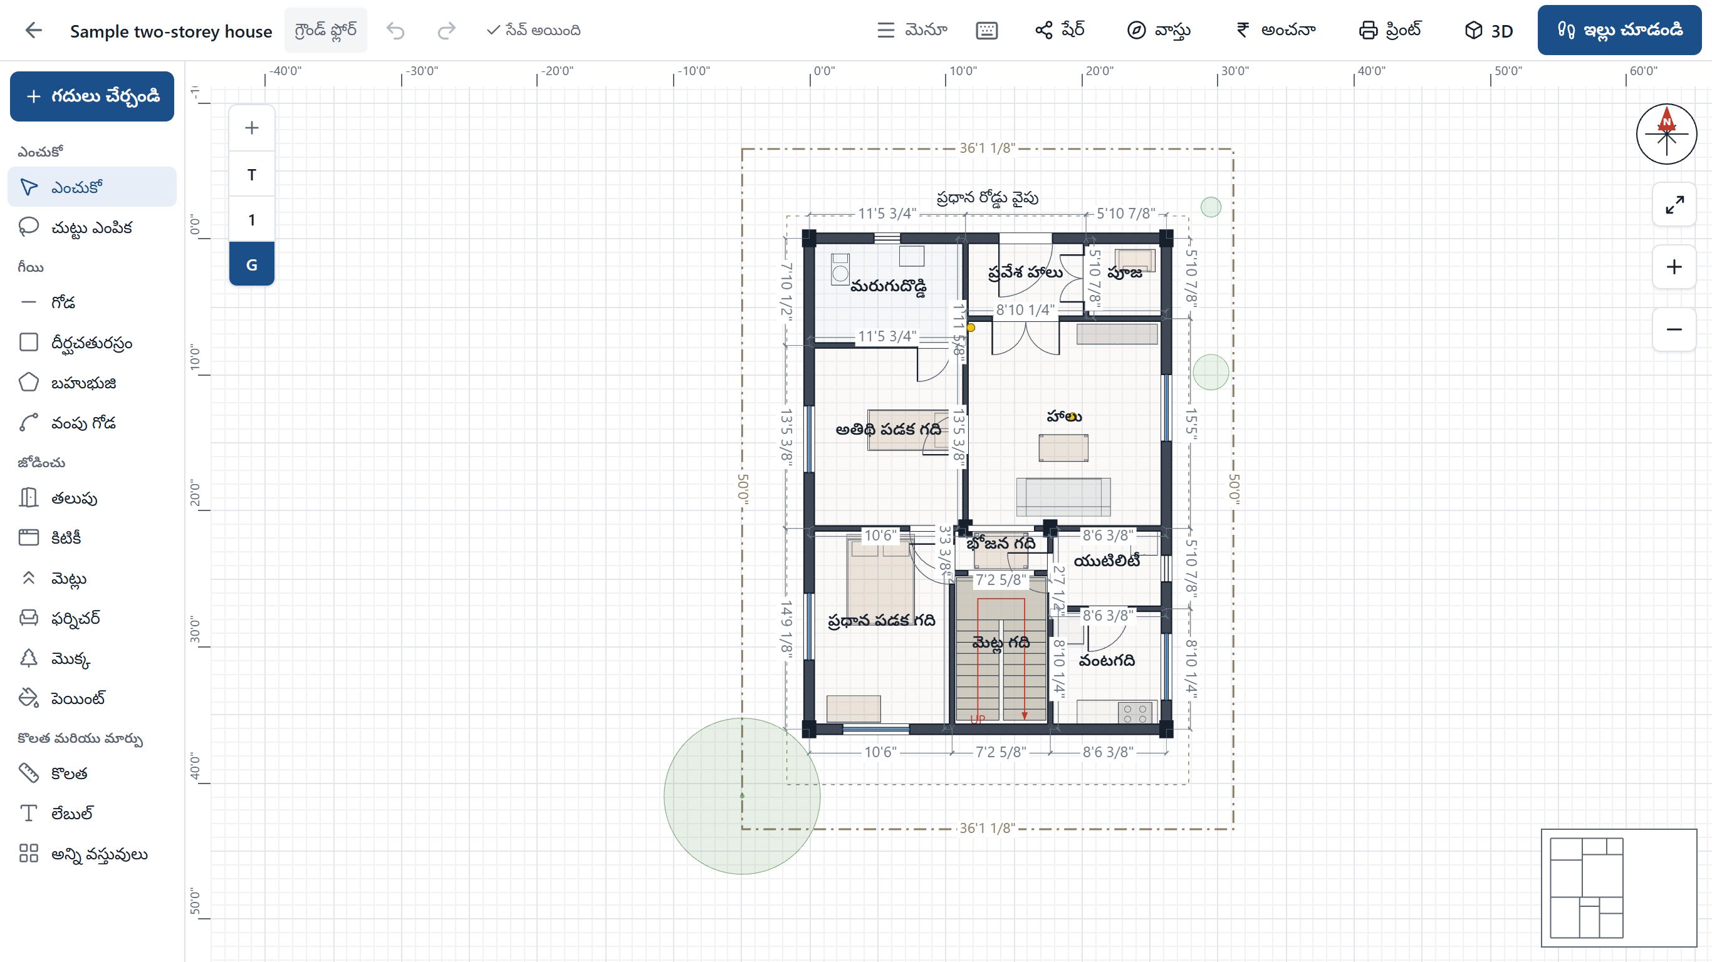
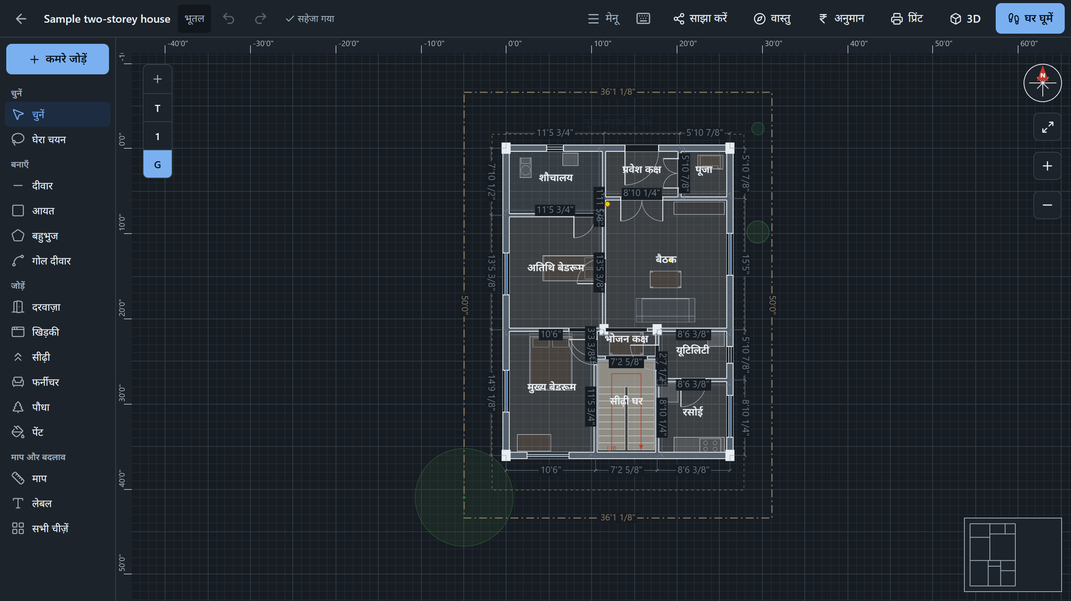
Work in your language and your light
Languages English, Hindi and Telugu, plus common words in Tamil, Kannada, Malayalam, Marathi, Gujarati and Bengali.
Themes Light, dark, and a high-contrast outdoor theme for reading a phone in bright sun on site.
Notes:
English, Hindi and Telugu cover the app's menus, labels and reports. Six more languages have the most common words and fall back to English for the rest.

Slide 33


What the app is, and what it is not
A great planning tool
Please remember
Try ideas quickly and see them in 3D
Explain a design to a family or a client
Get a realistic range for budget and time
Hand the mestri a measured printed plan
It is not a structural design. A licensed engineer must design footings, columns, beams and slabs.
Estimates are planning figures, not quotes. Use your own local rates.
Check local building rules, such as setbacks, with your authority.
iPhone and iPad use the Home Screen app. There is no App Store version yet.
Notes:
Being clear about limits keeps people safe. iPhone uses the Home Screen web app. An App Store version would need a Mac and an Apple developer account.

Slide 34
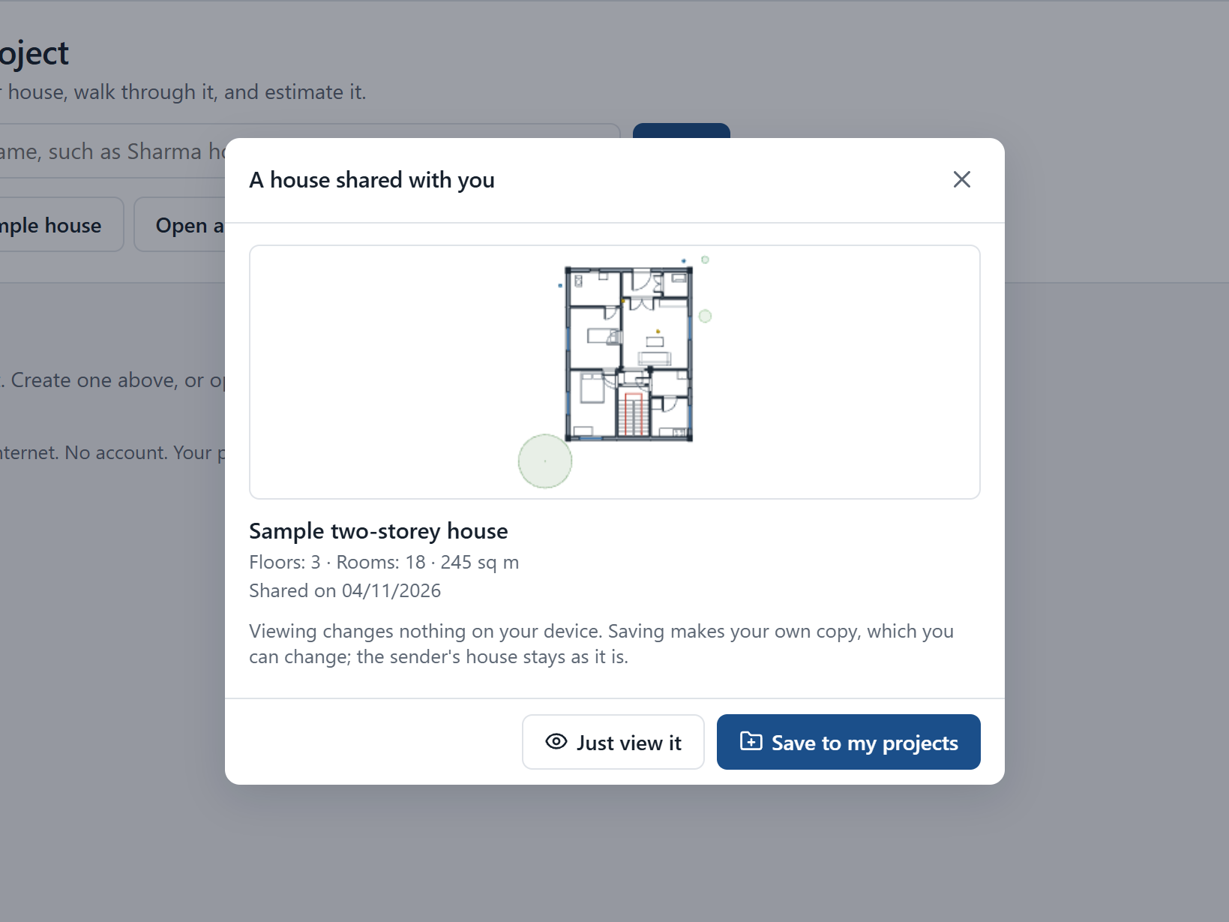
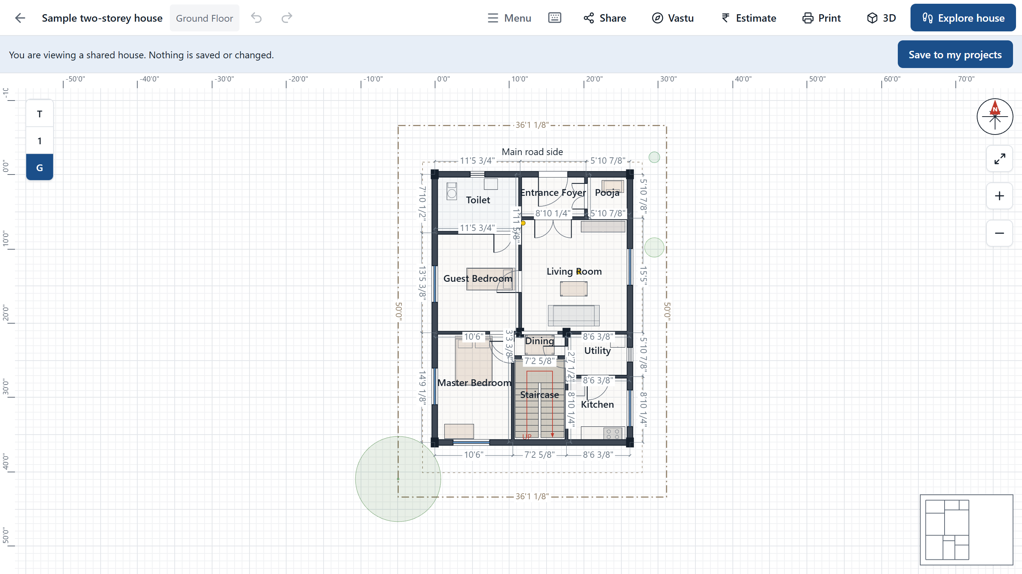
Send a house to a friend
1
Press Share
You get a .gharnirman file. Send it on WhatsApp, email or a pen drive.
2
Your friend opens it
Home, then Open a shared file. They can just view it, or save their own copy.
Notes:
The file holds the whole design, so send it only to people you would show the drawings to. No account or internet connection is needed in the app itself; send the file however you normally send files.

Slide 35
Your first ten minutes
1
Open the sample house
Press Explore house and walk up to it.
2
Create your own project
Press Add rooms, then add room after room.
3
Paint it and furnish it
Choose doors, furniture and plants by their pictures.
4
Set north and the road side
Then open Vastu to see your score.
5
Type your local rates
Then read your cost range in Estimate.
6
Make the PDF
Share it with your family, mestri or engineer.
Notes:
A simple path that touches every main feature. Enjoy building.

