Slide 1
Radar
A Monday worklist for CSMs, built for the Fello take-home
Nakshatra Nahar · Staff Engineer, Data Architecture & GTM AI Platform
October 2026 · all data synthetic
Notes:
Radar is what I built for the take-home. Every Monday it gives each CSM a short list of the accounts to call, the reason for each one, and a draft email. All the data is synthetic: three customer organisations, 5,000 accounts and about 230,000 records across five sources, messy and out of order on purpose.

Slide 2
The real problem is a Monday decision
The request
What I think the real problem is
“Every Monday they open a spreadsheet and basically guess who to call.”
“What I want is a dashboard with a health score per account, red / yellow / green. And then automate the outreach — if an account goes red, the system should email them.”
VP Customer Success
A capacity problem. A CSM owns about 110 accounts (measured) and has room for about ten proactive calls a week.
A ranking problem. CSMs need to know who to call this week and why, with evidence they can trust. Thirty red accounts is still a guess about who comes first.
A trust problem. An automatic email to a red account can reach a customer with an angry open ticket, or a champion who left last month.
So: a ranked weekly list sized to capacity, every risk with an owner and a due date, and drafts that a human sends.
Notes:
The VP asked for red, yellow and green per account, and an automatic email when an account goes red. I read the real problem as a choice each CSM makes every Monday: which ten of their accounts get a call this week. Colours don't rank a book, and an automatic email to a customer with an angry open ticket does damage, so I built a ranked list with evidence and drafts that a human approves.

Slide 3
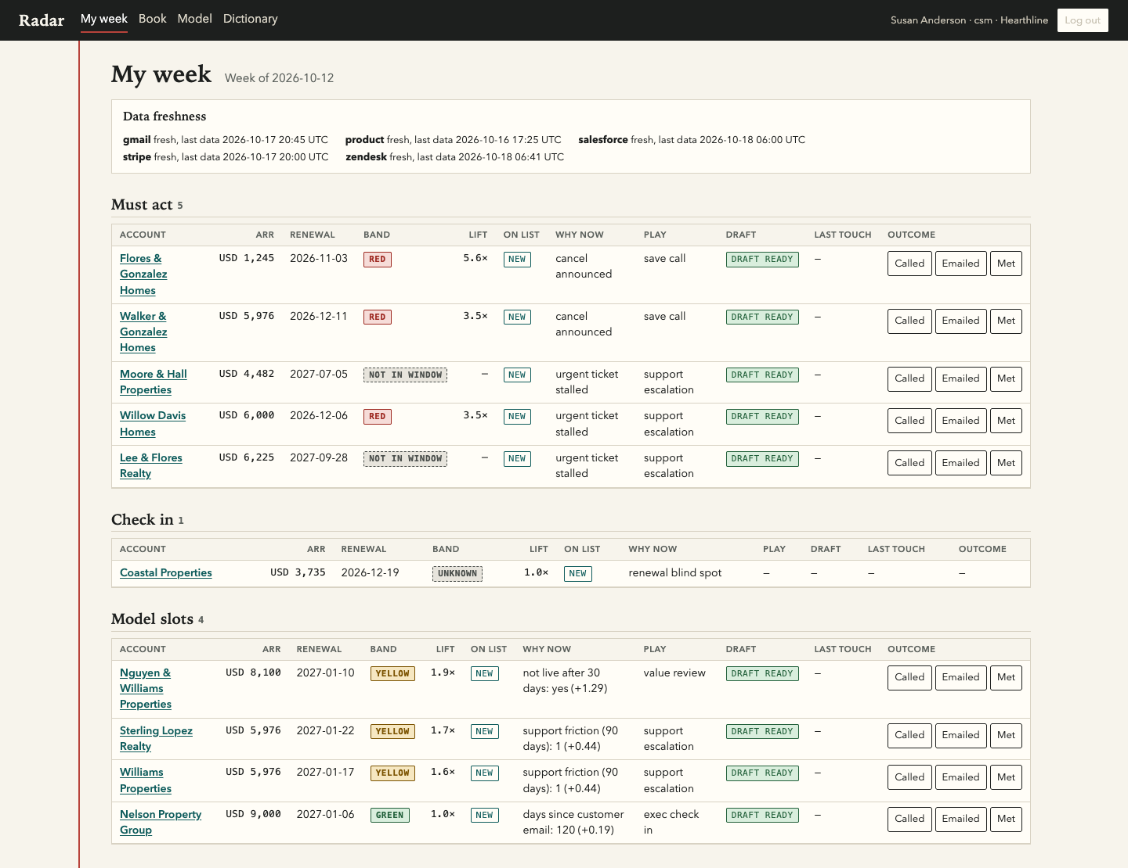
What a CSM sees on Monday
1 Must act. A hard fact (a cancellation, an urgent ticket stalled for three days) opens a case with a due date. It skips the model.
2 Model slots. The rest of the ten, ranked by expected ARR at risk. Each row shows its biggest behavioural reason, such as “support friction (90 days)”.
3 A draft, not an email. Every row has a play and a draft. Nothing goes to the customer until the CSM approves it, and the send is a dry run.
The list is frozen on Monday. New must-acts are added mid-week with a NEW mark; the list is never re-sorted.
1
3
2
Notes:
This is My week for one hearthline CSM, from the full-size database. Hard facts come first as must-act cases with a due date. A check-in covers an account we know too little about that renews soon. Then the model's slots fill the list to ten, each with its top behavioural reason and a draft that waits for the CSM.

Slide 4
How it decides: rules first, then the model
1 Must-act cases, all of them
Cancel announced, dunning exhausted, champion email bounced, urgent ticket stalled. Each has an SLA. More than K shows as overflow on the team page.
Why the floor sits on the ranking key
Capacity is a cap, not a quota: a healthy book gets a shorter list.
Each list is a prefix of its book's ranking. The floor can shorten a list but never reorders it or swaps in a smaller account.
The cost: it catches more churned ARR but flags fewer small churners early. In tallyworks (before the lead-time fix), 70 of 174 decisions were flagged ahead, against 90 under a floor on p.
Small high-risk accounts still reach the CSM through the must-act rules and the Book page.
2 Up to two check-ins
Accounts with Unknown coverage whose term ends within 90 days.
3 Model slots, up to K = 10
Ranked by expected ARR at risk (p × ARR). A slot needs at least the tenant's mean expected ARR at risk.
Notes:
Hard facts never wait for a model: they open a case with an owner and a due date. Then up to two check-ins for accounts we can't see that renew soon. The model fills what is left, ranked by p times ARR, and a slot needs at least the tenant's mean expected ARR at risk. Capacity is a cap, so a healthy book gets a shorter list, and the floor is on the ranking key, so it never reorders a list. The 90 under a floor on p is in docs/measurements.md, from the earlier eval at commit f517b6c.

Slide 5
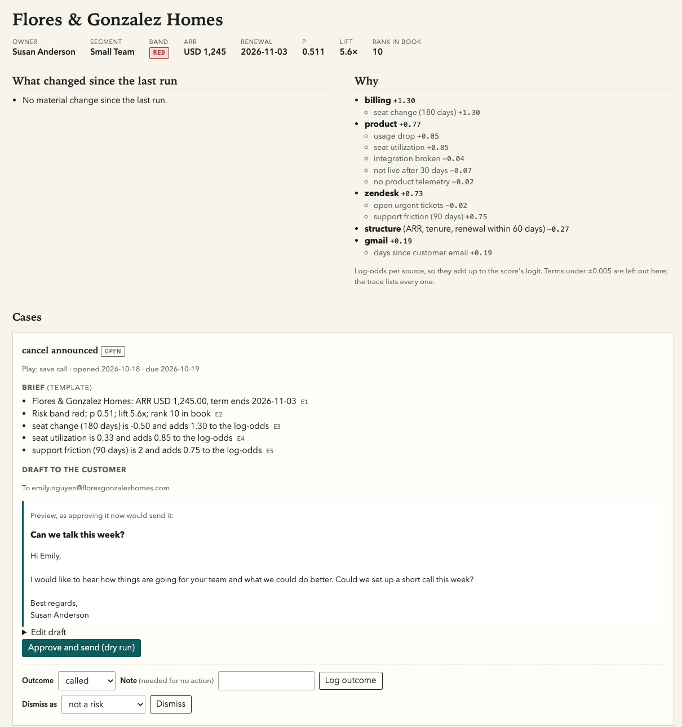
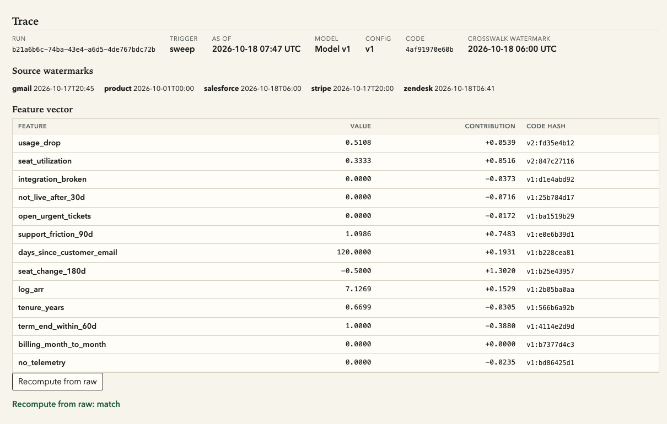
Every number traces back to the raw records
Why: contributions per feature in log-odds. They add up to the score's logit, checked on every stored score.
Trace: run, model version, as-of time, watermarks, a code hash per feature.
Recompute from raw: rebuilds features and p from stored events with the run's model. Result: match.
Notes:
On the left is the account page: the why is the model's contributions in log-odds, grouped by source, and the brief cites evidence items E1 to E5. On the right is the trace for the same score: the run, the model version, the as-of time, the source watermarks and the code hash of every feature. Recompute from raw rebuilds the features and p from stored events with that run's model, and here it matches.

Slide 6
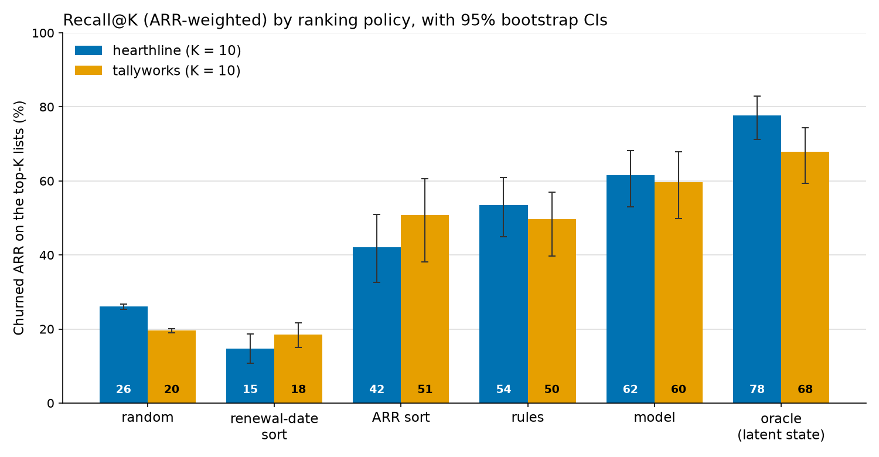
Does it work? More churned ARR on the lists
hearthline: model 61.6% (53.1 to 68.1), rules 53.5%, renewal sort 14.7%. Model minus rules +8.1 points (+3.2 to +13.1).
tallyworks: model 59.6% (49.8 to 67.9), rules 49.7%, renewal sort 18.4%. Model minus rules +9.8 points (+2.1 to +18.2).
Renewal sort does worse than random in hearthline and no better than random in tallyworks, because accounts close to renewal have mostly announced their decision already and left the list.
The VP's two lost renewals: on the model's list 12 and 11 weeks before the decision; renewal sort found them 2 weeks and 1 week before.
Recall@K: share of churned ARR that was on a CSM's top-10 list that week. Point-in-time backtest, rolling origins, paired cluster bootstrap over accounts (1,000 resamples). Kitewire, onboarded this year, has no model yet.
Notes:
Recall at K is the share of the ARR that went on to churn that was on a CSM's top ten that week, from a point-in-time backtest with rolling origins. The model beats the rules by about eight and ten points, and both intervals stay above zero. Renewal-date sort does worse than random in hearthline, where its interval sits below random's, and no better than random in tallyworks, where the intervals overlap: accounts close to renewal have mostly already announced their decision and left the list. The VP's two lost renewals were on the model's lists 12 and 11 weeks ahead; renewal sort found them 2 weeks and 1 week ahead.

Slide 7
Architecture: tenants kept apart by the database
Sources
Salesforce, Stripe, Zendesk, Gmail metadata, product
raw_records
immutable ledger, one row per source record
events
two clocks: occurred_at and available_at
identity
exact keys only; links are append-only
features
13, read as of T
model
logistic regression per tenant, JSON artifact
policy
must-acts, check-ins, model slots
worklist
frozen each Monday
As-of everywhere
A record is visible at T only if available_at ≤ T and occurred_at ≤ T. Training, scoring, evidence and the trace use the same rule.
Tenant isolation in Postgres
Every tenant table has FORCE row-level security on tenant_id. The app roles are NOBYPASSRLS and own nothing; the app refuses to start with an owner DSN.
A model per tenant
Each tenant's model is fitted on its own history. Kitewire, onboarded this year, starts cold on the rules alone.
Notes:
Records land unchanged in raw_records, then become events with two clocks: when something happened and when we could first have known it. Every feature is read as of a time T, so training never sees the future. Identity uses exact keys only. Isolation is Postgres row-level security, forced on every tenant table, and the app's roles cannot bypass it; each tenant gets its own model.

Slide 8
An unattended agent, and a human on every email
What runs unattended
Guardrails on the LLM
Event-driven rules. A payment failure, subscription change, ticket change or bounce queues a rule check in the same transaction. A must-act case opens at the next worker tick.
Daily sweep at 06:00 tenant time: score every account, recheck every rule.
Monday freeze: lock each list, open cases, write briefs and digests.
SLA escalation: an hourly check sends each overdue case to the manager, once.
Circuit breaker: a burst of new cases is held behind one incident, so a late batch can't become hundreds of alerts.
Words only. The LLM never scores, ranks, picks the recipient or picks the play. Code does.
A deterministic validator. Every number must appear in the cited evidence; no banned words (churn, risk, discount); no URLs or addresses in the email.
Template fallback. One retry with the errors, then a fixed template. No key or no budget means the template.
Drafts only. Every customer email waits in the outbox until a CSM approves it. The transport is a dry run and the deploy has no SMTP credentials.
Notes:
Nobody presses a button for any of this. A payment failure or a stalled ticket queues a rule check in the same transaction that stores it, a daily sweep rescores every account, Monday freezes the lists, and an hourly check escalates missed due dates once. The LLM only writes the wording: a deterministic validator checks it, a template replaces it if it fails twice, and nothing reaches a customer until a CSM approves the draft.

Slide 9
What breaks first at 10x
1 Neon Free storage, at about 1.7x
Limit: 584.4 MB at 1x against a 1 GB limit; about 5.7 GB at 10x (projected).
Fix: Prune on a schedule, drop the demo feed buffer, then a paid tier with raw_records and events partitioned by month.
2 Worker memory, at about 2.9x hearthline
Limit: Each job loads the tenant's whole history: 5.0 KB per event. Vercel Hobby's 2 GB is reached at about 400,000 events; 10x hearthline needs about 6,900 MiB.
Fix: Read events straight into columns, only rows visible at T, and scope each rule check to its one account.
3 The 60-second late-job window
Limit: A tick has a 240 s budget inside a 300 s function, so a job that starts late gets at most 60 s. An LLM brief must fit in that.
Fix: Pass the tick's deadline down and don't start a job whose recent p95 exceeds the time left. (The brief's evidence query already went from 3.75 s to 1 to 2 ms.)
The daily sweep does not break: about 30 s for hearthline at 10x, projected from 3.0 s at 1x.
Notes:
These come from docs/measurements.md: measured at 1x and on tiled 10x frames, with the database numbers projected. Storage breaks first, at about 1.7 times today's data on Neon's free tier. Then worker memory, because every job loads the whole tenant's history. Then the 60-second window a job gets when it starts late in a tick. The daily sweep itself does not break: about 30 seconds projected at 10x.

Slide 10
What I would build next, and what I left out
Next
A six-week pilot with three CSMs and a manager, measured on cases handled on time and surprise churn: lost ARR that never appeared on its owner's list.
The 10x fixes: monthly partitions, columnar loads, a deadline-aware tick.
Auto-send, one play at a time, once CSMs send its drafts unedited about 80% of the time for a month.
Which plays work: exposure and outcomes are already logged, so an uplift model becomes possible.
Scheduled retraining behind the existing promotion gates.
Left out on purpose
Real vendor integrations and real sending. A simulated feed uses the same ingestion entrypoint as the webhooks.
Reading Gmail bodies. Metadata only.
Fuzzy identity matching. A missing match is visible and fixable; a wrong one leaks one customer's data into another's email.
An LLM judge, a chat assistant, SSO, and more than one currency per tenant.
Notes:
Next is a real pilot, because the backtest can't tell us whether CSMs act on the list. After that, the 10x fixes and auto-send for one play at a time once CSMs send the drafts unedited most of the time. What I left out, I left out on purpose: fuzzy matching in particular, because a wrong match can put one customer's ticket into another customer's email.

