Slide 1
MACHINE LEARNING PROJECT
Feature Extraction &
Mobile Phone Price Prediction
A notebook-style walkthrough from raw Excel data to a trained regression model
Made by - Nakshatra Agrawal
Submitted to - NextHikes IT Solutions
Dataset: Processed_Flipdata.xlsx | Python • Jupyter Notebook • scikit-learn
01

Slide 2
Project at a glance
The task, input data and expected outcome
BUSINESS QUESTION
ML TASK
DELIVERABLE
Can a phone's specifications be used to estimate its selling price?
Supervised regression: learn the relationship between product features and price.
A reproducible notebook, model evaluation, feature ranking and business insights.
• Target column: Prize (the price field in the supplied workbook).
• Inputs: model, colour, memory, RAM, battery, cameras, AI lens, height and processor.
• Workflow: explore → clean → encode → split → train → evaluate → interpret.
02

Slide 3
End-to-end notebook workflow
Each numbered stage corresponds to a sequence of Jupyter cells
01
02
03
04
05
Load Excel
Explore data
Clean rows
Visualise
Prepare features
06
07
08
09
10
Split data
Train models
Evaluate
Explain features
Save model
03

Slide 4
01 | Understand the dataset
Notebook cells: load the workbook and inspect its structure
import pandas as pd
df = pd.read_excel("Processed_Flipdata.xlsx")
print(df.shape)
display(df.head())
df.info()
display(df.describe())
WHAT THE NOTEBOOK CHECKS
• Number of rows and columns
• First records and column names
• Data types (numeric vs categorical)
• Summary statistics and value ranges
Dataset after removing the exported index and duplicates: 531 rows × 11 useful columns. Target variable: Prize.
The workbook contains product specifications such as RAM, memory, camera, battery and processor.
04

Slide 5
02 | Data preprocessing
Notebook cells: remove export artefacts, duplicates and unusable target rows
df = df.drop(
columns=["Unnamed: 0"],
errors="ignore"
)
df = df.drop_duplicates()
df["Prize"] = pd.to_numeric(
df["Prize"], errors="coerce"
)
df = df.dropna(subset=["Prize"])
CLEANING OUTCOME
• Original records: 541
• Duplicate rows removed: 10
• Final records: 531
• Missing cells in supplied cleaned data: 0
• Unnecessary exported index removed
Why this matters: duplicate records can bias model learning; the target must be numeric for regression.
05

Slide 6
03 | Exploratory data analysis
Notebook cell: inspect the distribution of the target price
plt.figure(figsize=(8, 5))
sns.histplot(df["Prize"], kde=True)
plt.title("Distribution of Mobile Prices")
plt.xlabel("Price")
plt.ylabel("Frequency")
plt.show()
PRICE PROFILE
Minimum: ₹920
Median: ₹13,999
Average: ₹16,306
Maximum: ₹80,999
The range is wide, so model error should be interpreted in the context of the price scale.
EDA helps identify skew, unusual price bands and whether a small number of premium phones stretch the distribution.
06

Slide 7
03 | Explore feature–price relationships
Notebook cells: compare RAM and memory categories with price
sns.boxplot(x="RAM", y="Prize", data=df)
plt.title("RAM vs Mobile Price")
plt.xticks(rotation=45)
plt.show()
sns.boxplot(x="Memory", y="Prize", data=df)
plt.title("Memory vs Mobile Price")
plt.xticks(rotation=45)
plt.show()
HOW TO READ THE BOXPLOTS
• Each box represents the price spread for a RAM or memory category.
• The median line compares typical prices.
• Wider boxes/whiskers indicate greater price variation.
• These are exploratory relationships, not proof of causation.
This step motivates feature selection and helps explain the final model's feature-importance results.
07

Slide 8
04 | Define target and feature columns
Notebook cells: separate X and y, then identify categorical and numeric inputs
X = df.drop("Prize", axis=1)
y = df["Prize"]
categorical_cols = X.select_dtypes(
include=["object", "category"]
).columns.tolist()
numerical_cols = X.select_dtypes(
exclude=["object", "category"]
).columns.tolist()
MODELLING SETUP
X = phone specifications (predictors)
y = Prize (value to predict)
Categorical inputs need encoding. Numeric inputs can be imputed and scaled.
Keeping the target separate prevents the model from accidentally using the answer as an input.
08

Slide 9
05 | Encode and scale the features
Notebook cells: build a reusable preprocessing pipeline
numeric_transformer = Pipeline([
("imputer", SimpleImputer(strategy="median")),
("scaler", StandardScaler())
])
categorical_transformer = Pipeline([
("imputer", SimpleImputer(strategy="most_frequent")),
("encoder", OneHotEncoder(
handle_unknown="ignore"
))
])
preprocessor = ColumnTransformer([
("num", numeric_transformer, numerical_cols),
("cat", categorical_transformer, categorical_cols)
])
NUMERIC FEATURES
Median imputation fills missing values; StandardScaler standardises numeric scale.
CATEGORICAL FEATURES
Most-frequent imputation and one-hot encoding convert labels into model-ready columns.
09

Slide 10
06 | Split into training and testing data
Notebook cell: reserve unseen data for an honest evaluation
X_train, X_test, y_train, y_test = train_test_split(
X, y,
test_size=0.20,
random_state=42
)
80 / 20 SPLIT
80% of records train the algorithms.
20% are held back to test predictions on unseen phones.
random_state=42 makes the split reproducible.
Training
80%
Testing
20%
10

Slide 11
07 | Train four regression algorithms
Notebook cells: fit each algorithm inside the same preprocessing pipeline
Ridge Regression
Random Forest
Linear baseline with regularisation.
Ensemble of decision trees using bagging.
Extra Trees
Gradient Boosting
Randomised tree ensemble; captures non-linear patterns.
Sequential trees that correct earlier errors.
pipeline = Pipeline([("preprocessor", preprocessor), ("model", model)])
pipeline.fit(X_train, y_train)
11

Slide 12
08 | Evaluate model performance
Notebook cells: compare MAE, RMSE and R² on the held-out test set
MAE
RMSE
R² SCORE
Average absolute prediction error, in price units.
Penalises larger errors more strongly than MAE.
How much target variation is explained by the model.
Model comparison from the supplied dataset (sorted by MAE):
MODEL MAE RMSE R²
Extra Trees 1,617 4,040 0.845
Random Forest 1,887 4,178 0.834
Ridge Regression 2,101 5,109 0.752
Gradient Boosting 2,643 6,096 0.648
12

Slide 13
09 | Best-performing model
The best model is selected using the lowest test MAE
Extra Trees
R² SCORE
MAE
RMSE
0.845 (84.52%)
₹1,617
₹4,040
Interpretation: on this single 20% test split, the model's average absolute error is about ₹2,000. R² indicates a useful fit, but performance should be validated on new data before operational use.
13

Slide 14
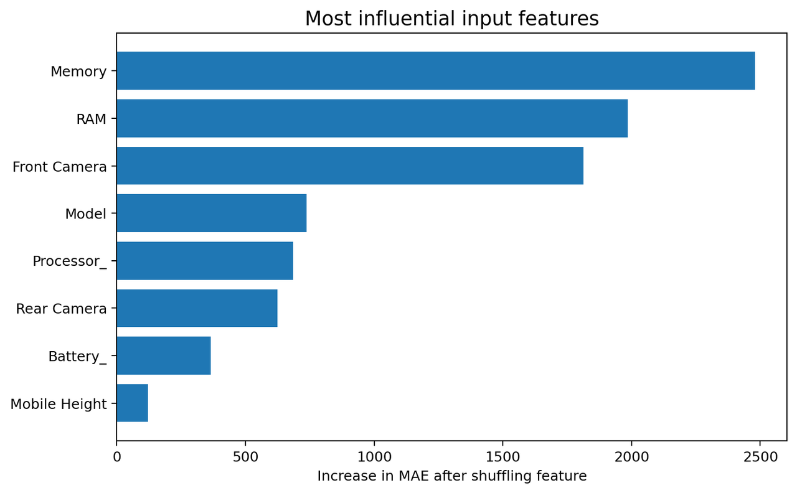
10 | Identify the most influential features
Permutation importance: shuffle one input and measure the increase in MAE
TOP SIGNALS
1. Memory
2. RAM
3. Front Camera
4. Model
5. Processor_
6. Rear Camera
Higher importance means shuffling that feature worsened model accuracy more.
Importance indicates predictive usefulness in this model; it does not prove that a feature causes a higher price.
14

Slide 15
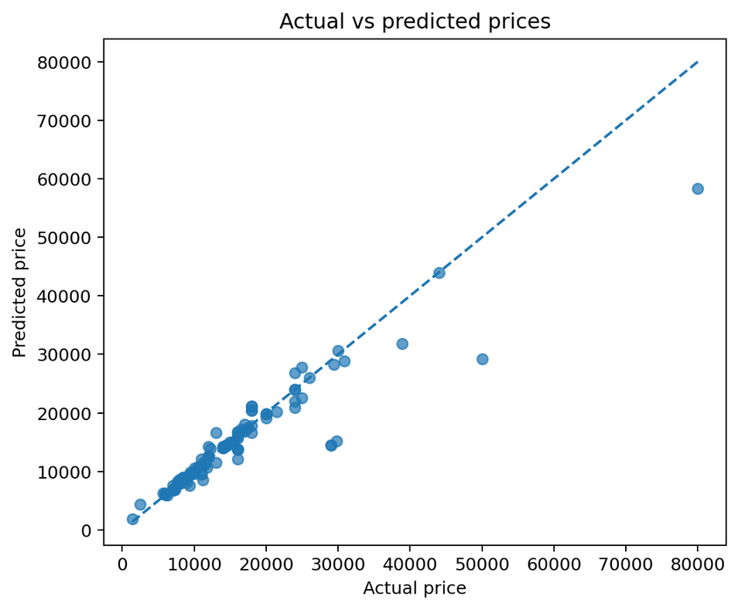
11 | Visual check: actual vs predicted prices
Each point is one phone in the test set; the dashed line is perfect prediction
HOW TO INTERPRET
• Points near the diagonal are more accurate predictions.
• Points far from the line have larger errors.
• Wider spread at higher prices may signal harder-to-predict premium models.
This plot complements numeric metrics by showing where predictions differ from actual prices.
15

Slide 16
12 | Save the trained model and reproduce the run
Notebook cells: persist the fitted pipeline for later predictions
WHAT IS SAVED?
The fitted preprocessing steps and selected estimator are saved together as one pipeline.
import joblib
joblib.dump(
best_model,
"mobile_price_prediction_model.pkl"
)
print("Model saved successfully!")
16

Slide 17
Conclusion & business recommendations
What the analysis suggests and what should happen next
• Extra Trees was the strongest model in this test run (R² = 84.52%).
• Memory, front camera and RAM were the top predictive features.
• Rear camera, battery and processor also contributed to prediction.
• Use feature insights to inform product positioning and price comparisons.
• Validate with newer market data before using predictions for live pricing.
PROJECT DELIVERABLES
✓ Data exploration and cleaning
✓ Feature encoding pipeline
✓ Four model comparison
✓ Evaluation metrics
✓ Feature-importance analysis
✓ Saved prediction model
Thank you
17

