Slide 1
RETAIL DATA EXPLORATORY ANALYSIS
From raw transactions to actionable business insights
Made by – Nakshatra Agrawal
Submitted to – Nexthikes IT Solutions Pvt Ltd.
100,000
retail transactions analyzed
Retail EDA Project | Nakshatra Agrawal
1

Slide 2
Executive Overview
01 | CONTEXT
100K
transactions
₹64,166
mean final price
0.731
price ↔ final price
15.05%
highest return rate
• The notebook analyzes customer, product, pricing, discount, delivery, shipping and return behavior.
• Transaction value is driven primarily by product price and quantity rather than customer age.
• Premium customers show the highest average transaction value, while category volumes remain broadly balanced.
• Discounting is associated with lower average final transaction value; high-value transactions create a meaningful right tail.
Management takeaway
Focus analysis and commercial decisions on basket economics, product pricing, customer segment value and return behavior—not age alone.
Retail EDA Project | Nakshatra Agrawal
2

Slide 3
Dataset & Analysis Objective
01 | CONTEXT
18–65
customer age range
₹500–₹60K
product price range
1–4
items / transaction
1–10 days
delivery range
• Dataset size: 100,000 retail transactions.
• Customer segments: New, Regular and Premium.
• Product categories include Health, Beauty, Electronics, Fashion, Grocery and Home & Kitchen.
• Core numerical fields analyzed: age, product_price, quantity, discount_percentage, final_price and delivery_days.
• Analysis objective: understand distributions, relationships, outliers and commercial patterns.
Analytical flow
Data understanding → distribution analysis → categorical analysis → outliers → bivariate relationships → correlation → multivariate analysis → business insights.
Retail EDA Project | Nakshatra Agrawal
3

Slide 4
Data Quality & Preparation
02 | DATA
Missing values
The notebook explicitly checks missing values before analysis.
Identifiers
Each transaction uses an order ID and a customer ID; the notebook checks their uniqueness.
Data types
Discount percentage is converted to numeric before creating discount bands.
• Descriptive statistics were used to establish ranges, means, medians and variability.
• Discount percentage was grouped into six bands: 0–5%, 6–10%, 11–15%, 16–20%, 21–25% and 26–30%.
• Outlier checks used both IQR and Z-score methods.
• Potential outliers were retained because unusual values may represent genuine high-value retail purchases.
Retail EDA Project | Nakshatra Agrawal
4

Slide 5
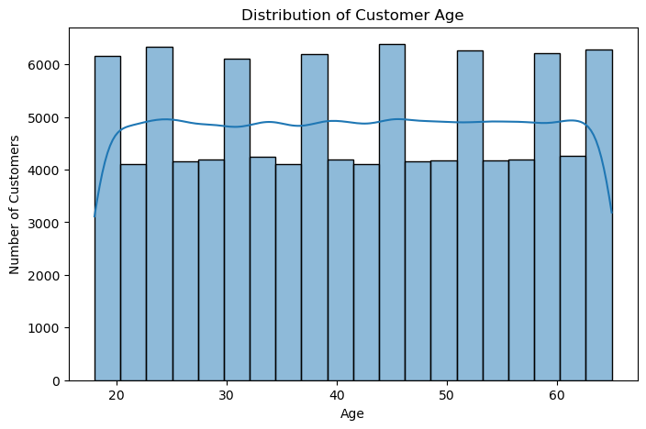
Customer Age Distribution
03 | UNIVARIATE
Insight
Customer ages range from 18 to 65, with an average of approximately 42 years. The distribution is approximately symmetric.
What it means
The dataset represents a broad adult customer base; age alone should not be treated as a strong spending predictor.
Retail EDA Project | Nakshatra Agrawal
5

Slide 6
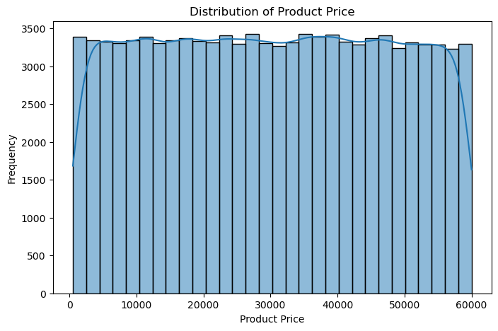
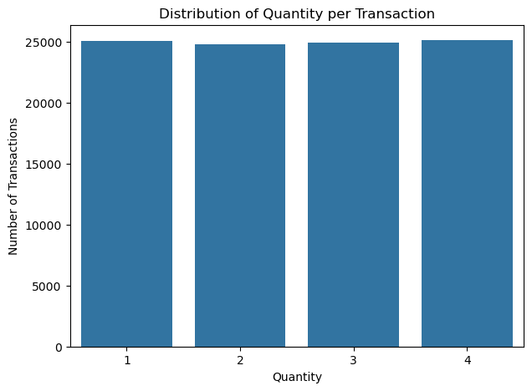
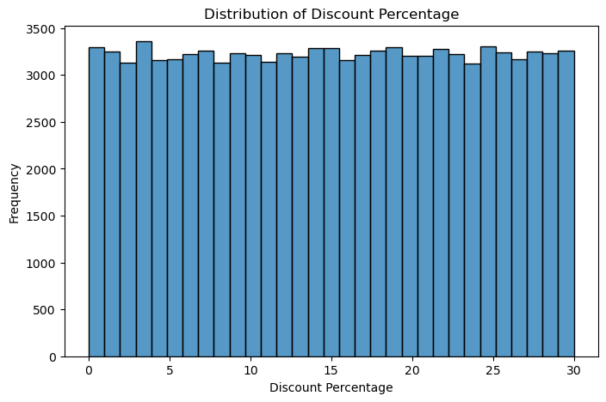
Product Price, Quantity & Discount
03 | UNIVARIATE
₹30,165
average product price
2.5
average quantity
15%
average discount
Insight
Prices are broadly balanced around their center; transactions contain 1–4 items; discounts span 0–30%.
Retail EDA Project | Nakshatra Agrawal
6

Slide 7
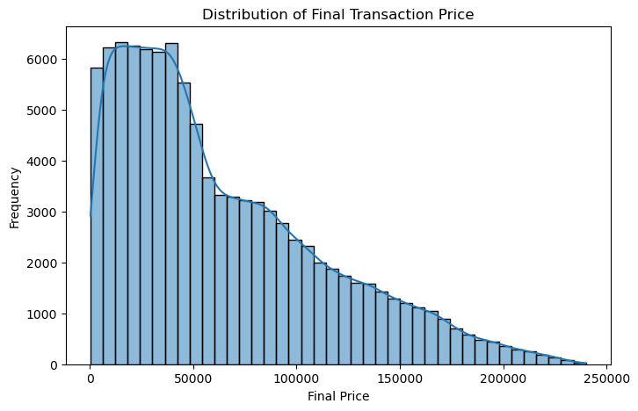
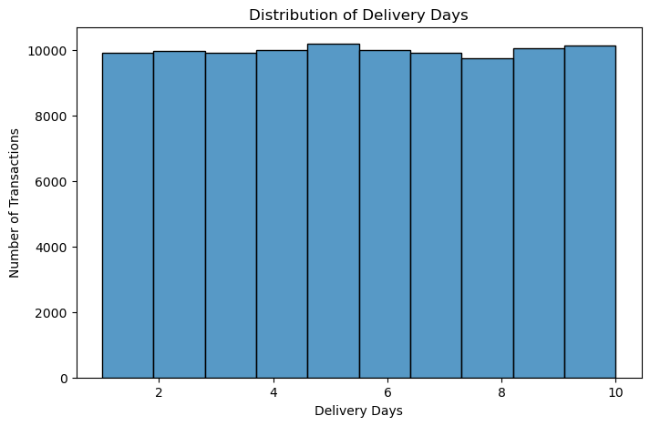
Final Transaction Value & Delivery
03 | UNIVARIATE
Final price insight
Mean ≈ ₹64,166 vs median ≈ ₹49,752. The higher mean indicates a right-skewed distribution with relatively high-value transactions.
Delivery insight
Delivery ranges from 1–10 days, averaging approximately 5.5 days.
Retail EDA Project | Nakshatra Agrawal
7

Slide 8
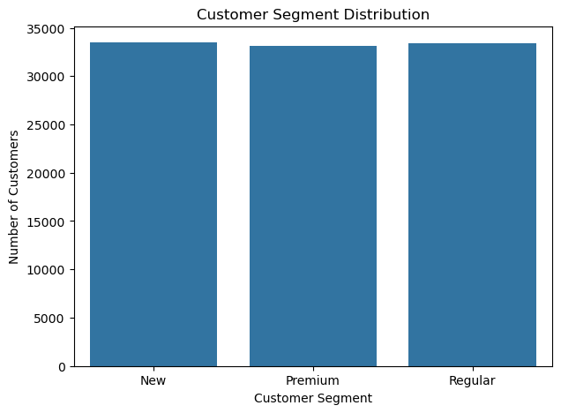
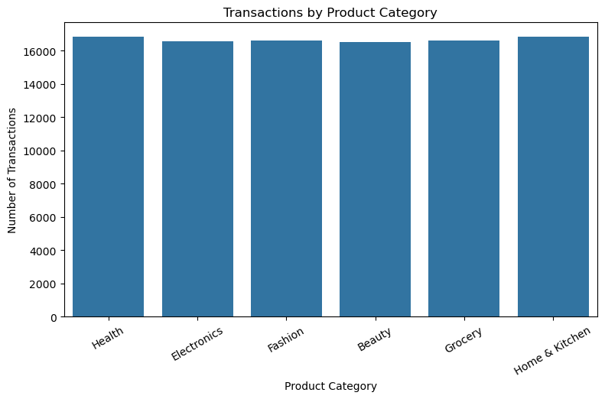
Customer Segment & Product Category
04 | CATEGORICAL
Segment insight
New, Regular and Premium transactions are relatively balanced in volume.
Category insight
Health has the highest transaction count (16,858); Beauty is lowest (16,513). The gap is small, so category volumes are broadly balanced.
Retail EDA Project | Nakshatra Agrawal
8

Slide 9
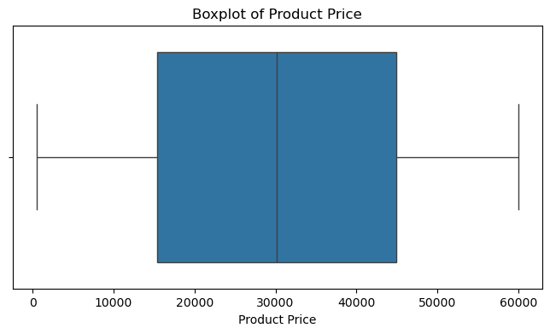
Outlier Analysis
05 | DATA QUALITY
IQR method
Q1 = ₹24,705
Q3 = ₹94,046
Upper bound = ₹198,058
Potential outliers = 1,335
Z-score method
Transactions with |Z| > 3: 503.
The notebook retains these observations because they may be legitimate high-value purchases.
Business implication
Do not automatically remove high-value transactions. Validate them before treating them as errors.
Retail EDA Project | Nakshatra Agrawal
9

Slide 10
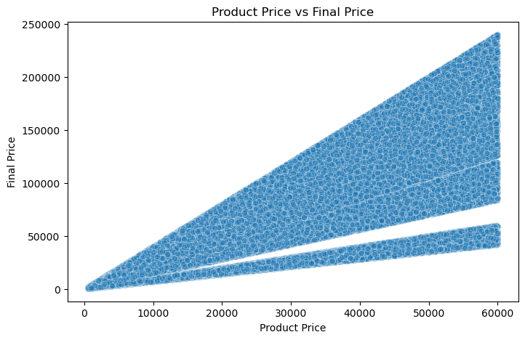
What Drives Transaction Value?
06 | BIVARIATE
Key relationship
Product price and final transaction value have a strong positive relationship. Correlation ≈ 0.731.
Interpretation
Higher-priced products generally generate higher final transaction values.
Retail EDA Project | Nakshatra Agrawal
10

Slide 11
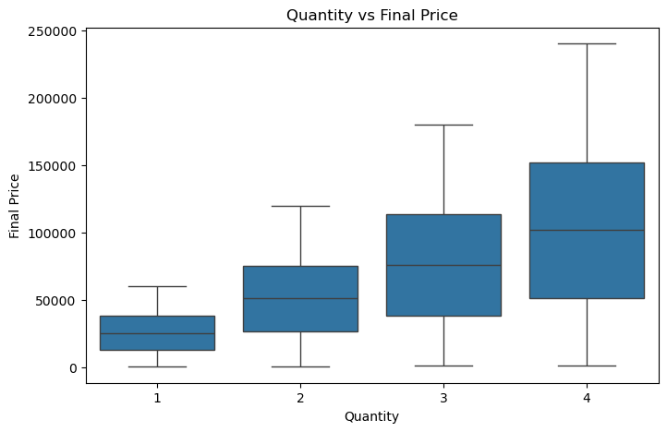
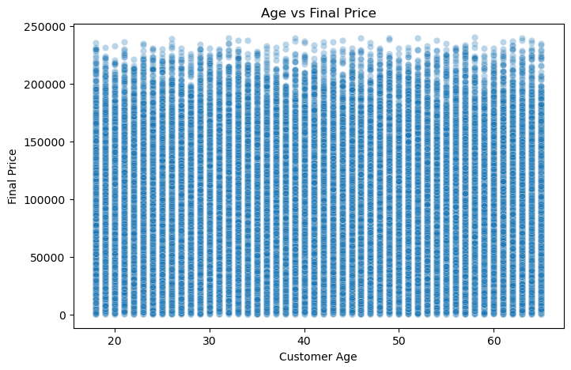
Quantity Matters More Than Age
06 | BIVARIATE
Quantity insight
Final transaction value generally rises as quantity increases; correlation with final price ≈ 0.575.
Age insight
Age has almost no linear relationship with final transaction value; correlation ≈ -0.001.
Retail EDA Project | Nakshatra Agrawal
11

Slide 12
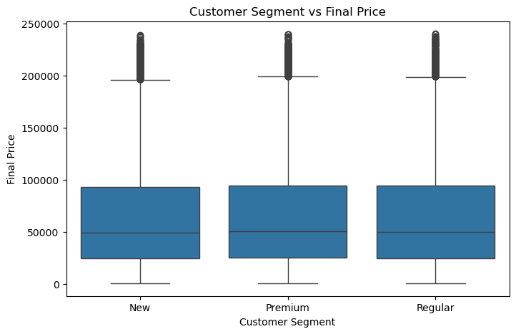
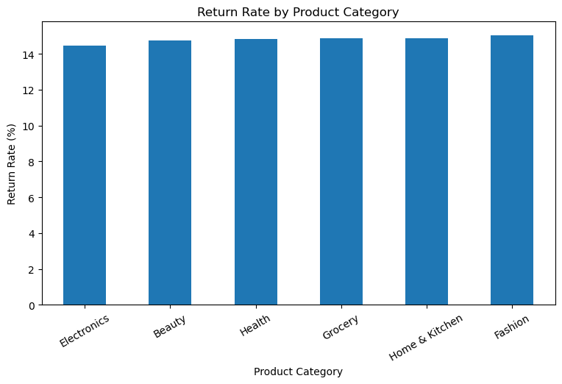
Customer Value & Return Behavior
06 | BIVARIATE
Segment insight
Premium customers show the highest average transaction value, followed closely by Regular customers; New customers are slightly lower.
Return insight
Fashion has the highest return rate at ≈15.05%; Electronics is lowest at ≈14.47%. Differences are relatively small.
12

Slide 13
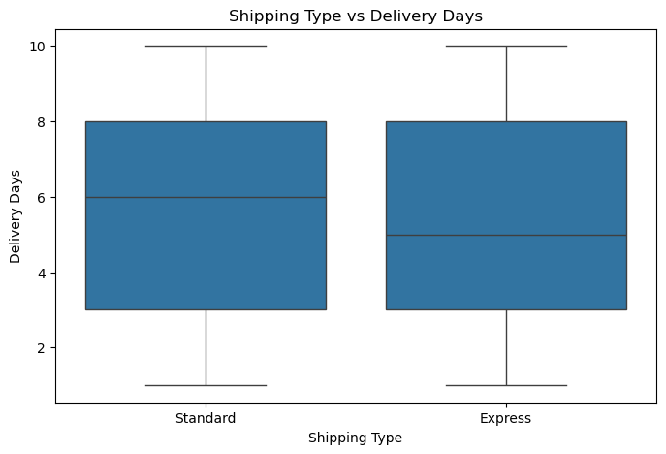
Shipping Type, Delivery & Returns
06 | BIVARIATE
Insight
Express shipping has slightly lower average delivery time than Standard shipping, but the difference is small.
Return connection
Delivery duration is broadly similar for returned and non-returned orders, suggesting delivery time alone has limited relationship with returns.
Retail EDA Project | Nakshatra Agrawal
13

Slide 14
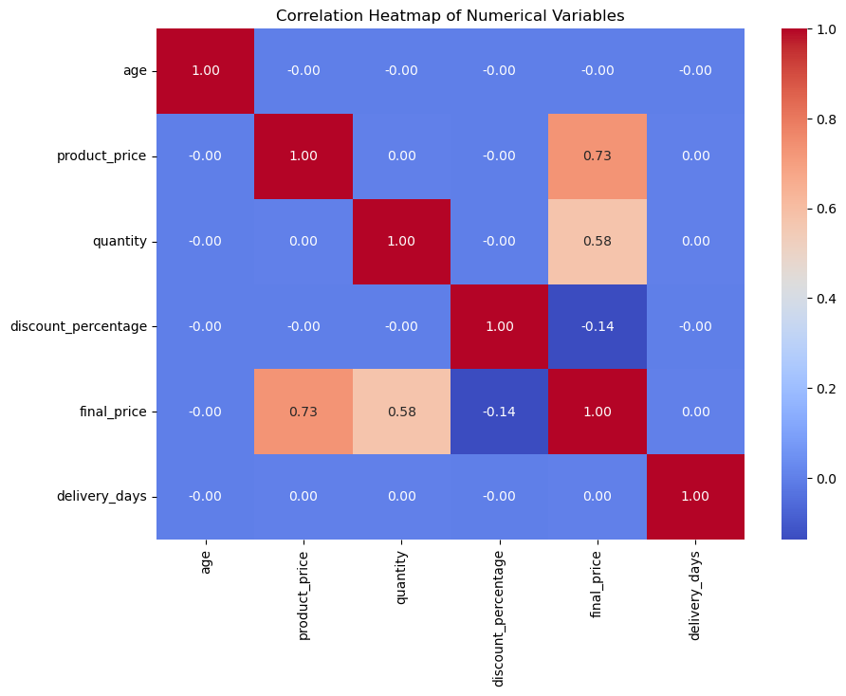
Correlation Analysis
07 | RELATIONSHIPS
Strongest positive links
Product price → final price: 0.731
Quantity → final price: 0.575
Negative link
Discount percentage → final price: -0.137. This is a weak negative linear relationship.
Minimal links
Age and delivery days show almost no linear relationship with final price.
Retail EDA Project | Nakshatra Agrawal
14

Slide 15
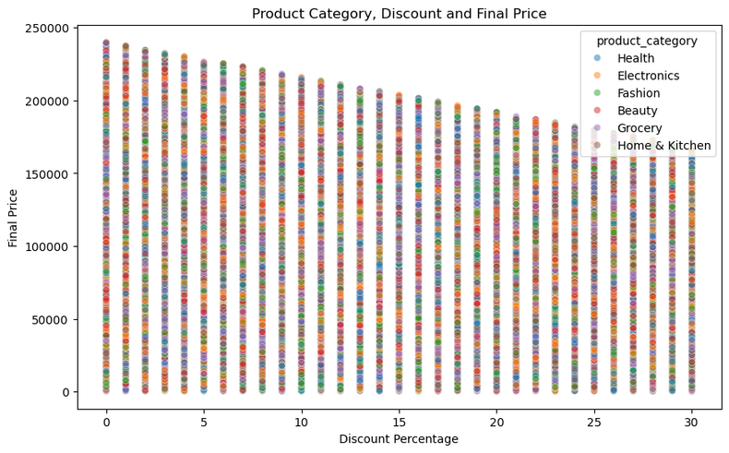
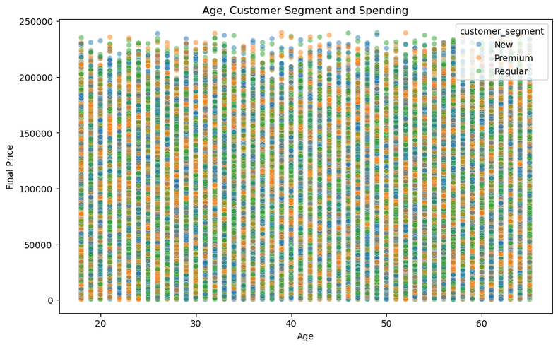
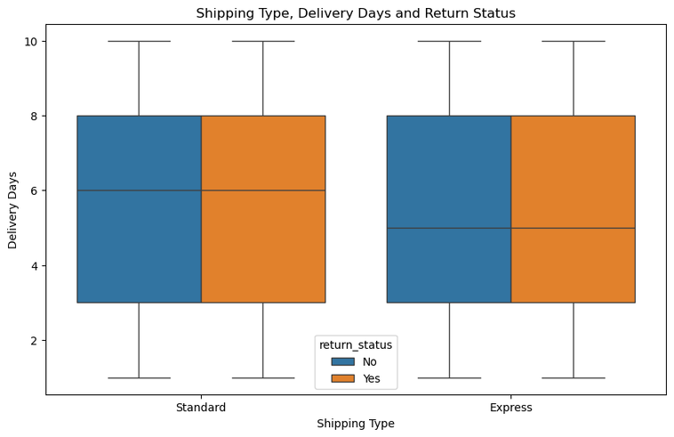
Multivariate Analysis
08 | DEEPER INSIGHTS
Discount × value
Higher discount percentages are associated with lower final transaction values.
Age × segment
Premium customers in the 30–45 age group show the highest average transaction value among analyzed age-segment groups.
Shipping × returns
Delivery duration is broadly similar across shipping and return groups.
Retail EDA Project | Nakshatra Agrawal
15

Slide 16
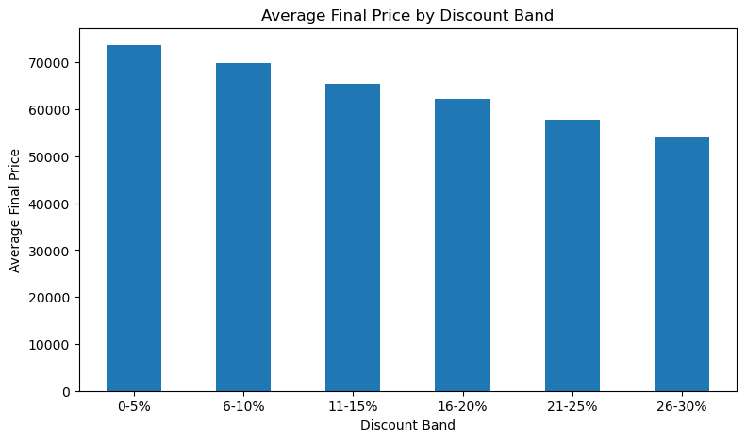
Discount Analysis: A Clear Commercial Pattern
09 | PRICING
Average final price falls as discount rises
0–5%: ₹73,663
6–10%: ₹69,797
11–15%: ₹65,423
16–20%: ₹62,282
21–25%: ₹57,823
26–30%: ₹54,142
Interpret carefully
This is an observed association in the dataset—not proof that discounts alone cause lower transaction values.
Retail EDA Project | Nakshatra Agrawal
16

Slide 17
Key Takeaways & Business Recommendations
10 | CONCLUSION
• Prioritize product mix and basket-size analysis: product price and quantity are the strongest observed drivers of final value.
• Use customer segment for differentiated commercial strategies; Premium customers show higher average transaction value.
• Treat discounting as a pricing lever to be optimized, since higher discount bands coincide with lower average final value.
• Monitor Fashion returns, while recognizing that category-level return-rate differences are relatively small.
• Investigate high-value outliers before removal; they may represent legitimate revenue opportunities.
• Do not rely on customer age or delivery time alone to explain transaction value.
Final message
The EDA converts 100,000 raw transactions into a clear picture of pricing, basket size, customer value, discount behavior, returns and delivery.
Next analytical step
A natural extension would be predictive modeling or dashboarding to estimate transaction value, return risk or customer value.
Retail EDA Project | Nakshatra Agrawal
17

Slide 18
Thank you

