Slide 1
M
ModelLedger
Prove the story of an AI picture
Companies stamp. Anyone checks.
Trusted · Self-asserted · Unverifiable
Notebook on BNB Smart Chain testnet
BroCode · Maharashtra · Blockchain problem 3
ModelLedger · BroCode · BNB · 1/12

Slide 2
The problem
Anyone can claim “we made this.”
1
2
3
AI images are everywhere
Claims are cheap
No public check
Models spit out pictures every second.
Download + caption = fake provenance.
Users can’t verify company + model + history.
ModelLedger · BroCode · BNB · 2/12

Slide 3
Our solution
A stamp notebook for pictures
Allowed companies stamp a picture when they create, edit, or post it — with the AI model and time.
Later, anyone uploads the file and gets one clear answer.
Trusted
Self-asserted
Unverifiable
Real stamp. File still matches.
Someone claimed a name. No stamp.
Story missing, broken, or unclear.
ModelLedger · BroCode · BNB · 3/12

Slide 4
How it works
Two doors · one notebook
1
2
3
→
→
Register
Stamp
Check
Company + models
+ API key
Create → Edit → Publish
(website or API)
Anyone uploads
→ one answer
ModelLedger · BroCode · BNB · 4/12

Slide 5
Real product = company API
Website is the demo remote
AI company
registers
Their app
generates image
Call Stamp API
with key
Client gets
stamped file
Maker + models
+ API key
Their model,
their pipeline
We stamp file
+ notebook line
Anyone can
Check later
ModelLedger · BroCode · BNB · 5/12

Slide 6
Three company jobs
One company = one job = one stamp = one API key
Maker
Creates the picture.
First line. Needs approved AI model.
Editor
Changes the picture.
Must point at an earlier stamp.
Publisher
Posts the picture.
Must point at an earlier stamp.
ModelLedger · BroCode · BNB · 6/12

Slide 7
Simple analogy
Like a car number plate + RTO register
Car world
ModelLedger
Number plate on the car
Hidden id inside the PNG
RTO public register
BNB notebook line
Registered plate issuer
Allowed company stamp
VIN / engine check
File fingerprints
ModelLedger · BroCode · BNB · 7/12

Slide 8
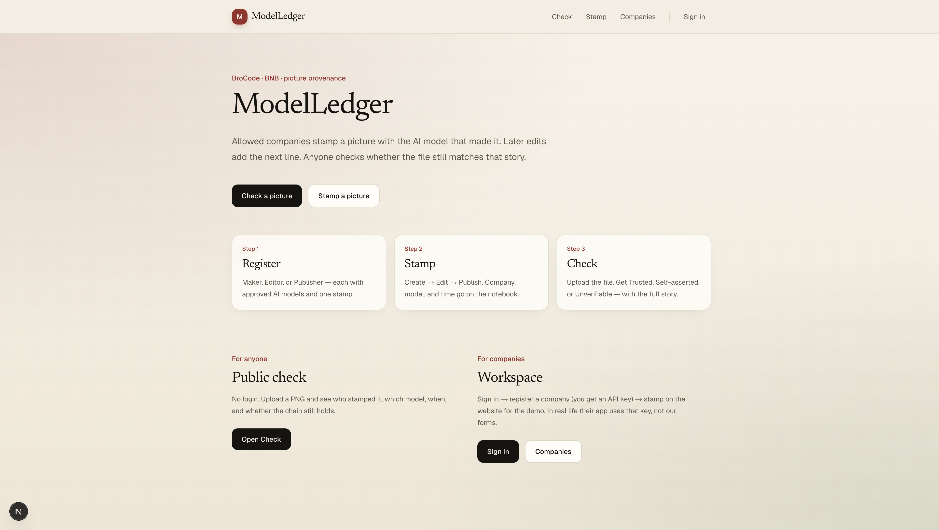
Product · Home
Clear path: Register → Stamp → Check
ModelLedger · BroCode · BNB · 8/12

Slide 9
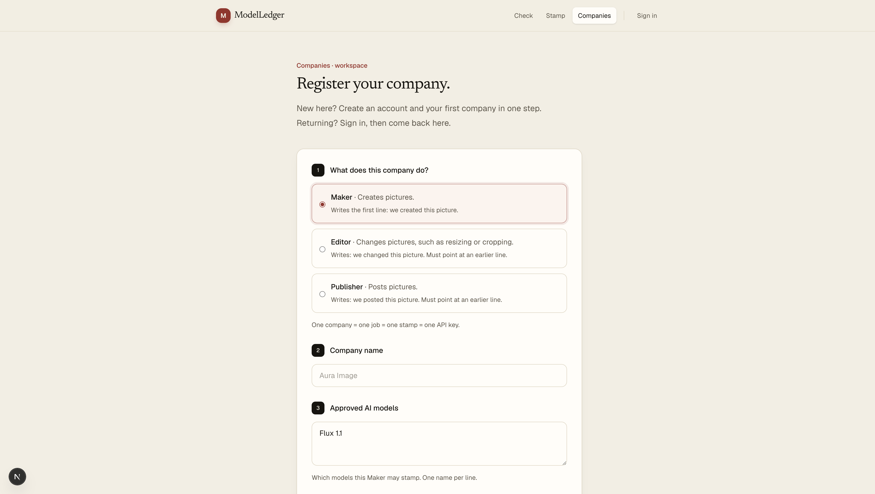
Product · Companies
Register job + models · API key comes with the company
ModelLedger · BroCode · BNB · 9/12

Slide 10
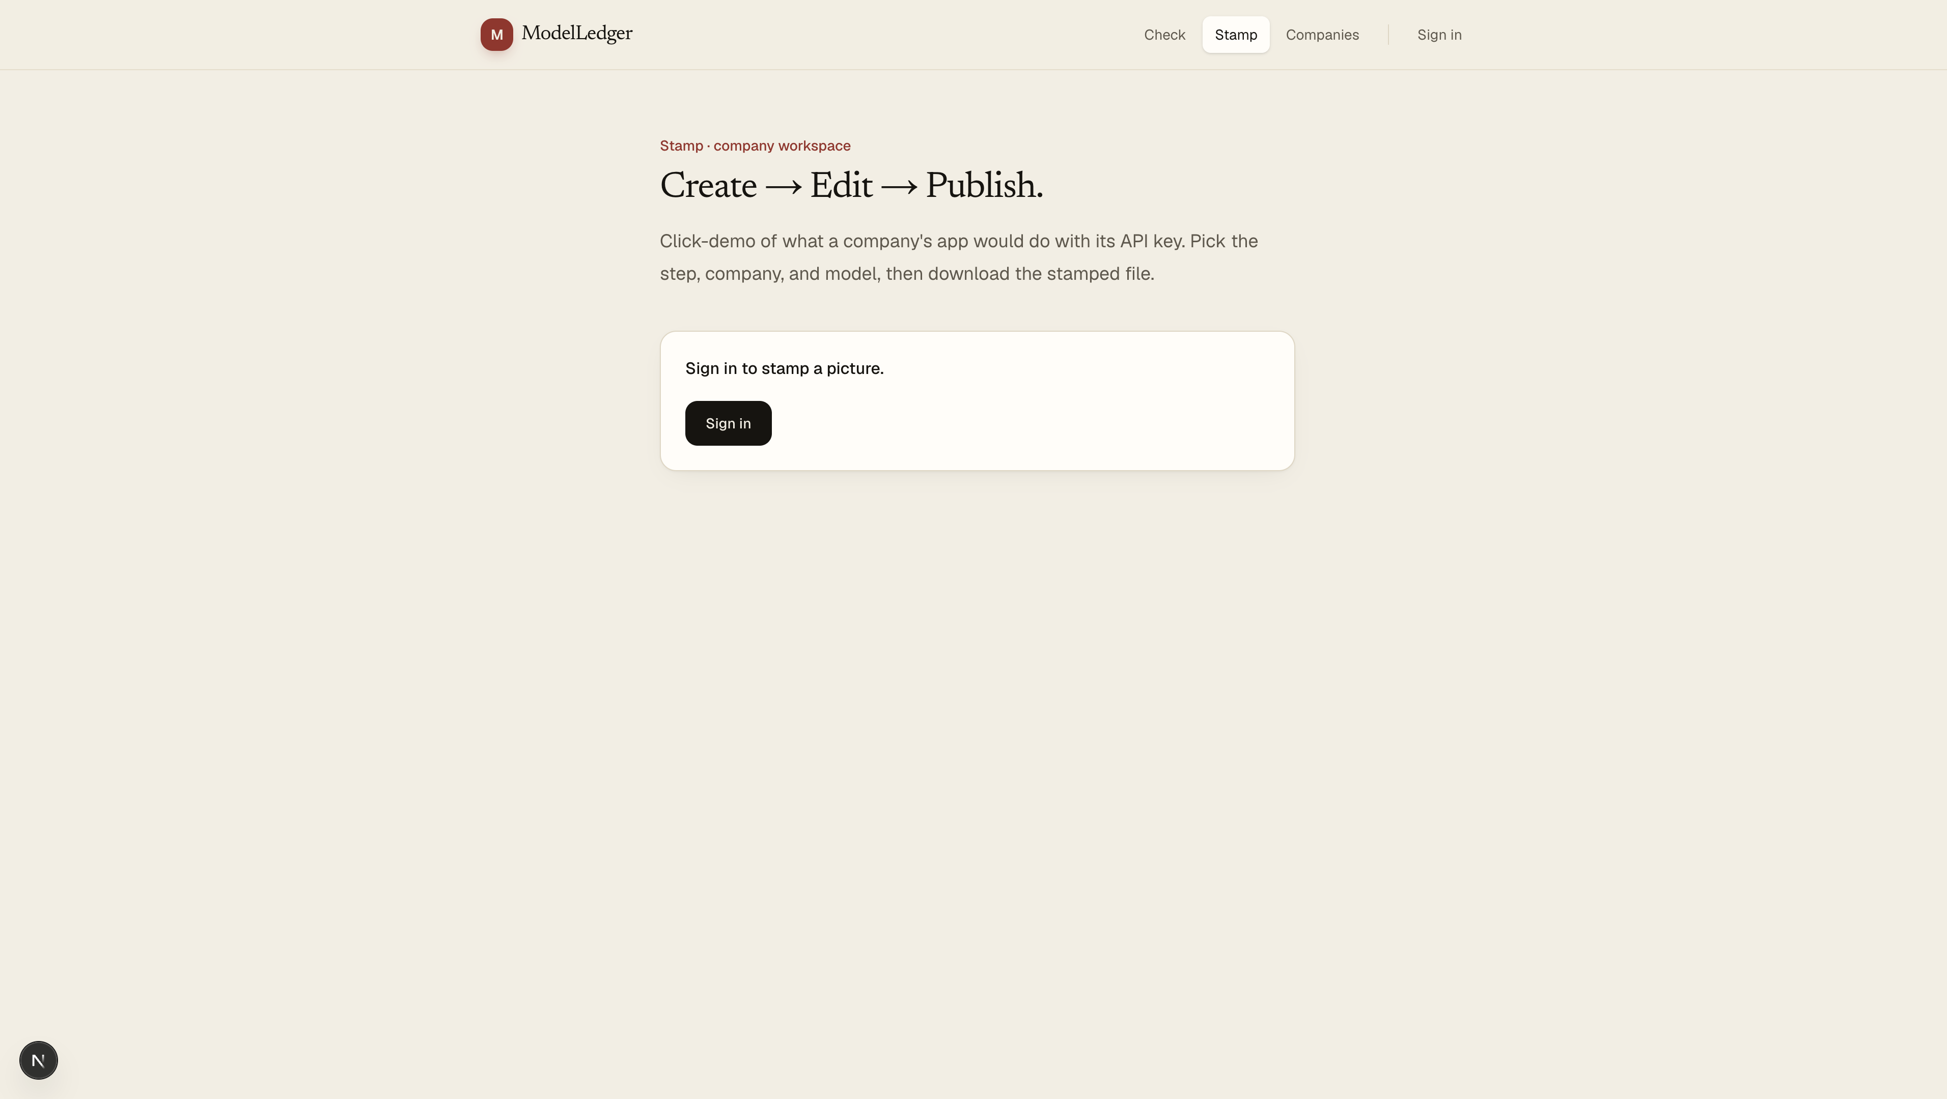
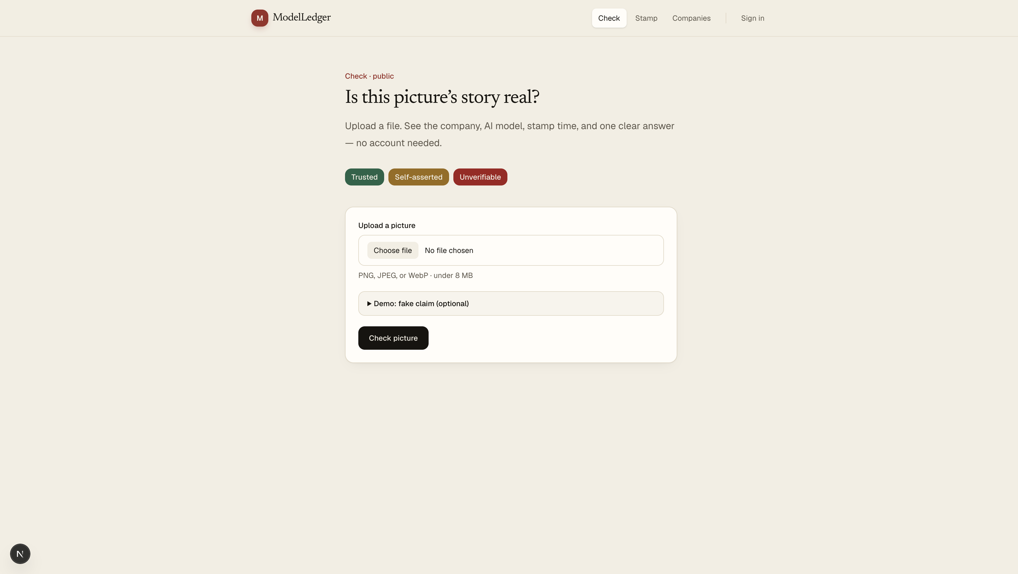
Product · Stamp & Check
Click demo for companies · public check for everyone
ModelLedger · BroCode · BNB · 10/12

Slide 11
Live demo next
What we will click (2–3 minutes)
1
Open Check — show Trusted / Self-asserted / Unverifiable
2
Companies — register Maker + model (API key appears once)
3
Stamp → Create — company + model → download stamped PNG
4
Check — upload download → Trusted (company, model, time)
5
Say: in production their eng calls Stamp API with that key
ModelLedger · BroCode · BNB · 11/12

Slide 12
They generate. We stamp. Anyone checks.
Website = demo remote
Product = company Stamp API + public Check
Notebook on BNB testnet
Thank you · Questions?
ModelLedger · BroCode · BNB · 12/12

