Slide 1
Student Management System
Chief Programmer
Bright Wadja
Programmer/Designer
Syed Asif Zaidi
Sebastian Sanchez
Data/Database Administrator
Fatin Ahmed

Slide 2
Introduction
Definition:
A Student Management System (SMS) is a system that manages the records of students regarding registration and grading.
SMS Involves
Course registration
Adding/Viewing grades
Adding/managing students

Slide 3
Objectives
Create a database of students similar to an SMS
e.g. Blackboard
To manage students’ information

Slide 4
Applications
To gather students’ information
Software Requirements
CPU: single Core 2.4 GHz
RAM: 512 MB
Hard Drive: 5 Gb
SSMS: SQL Server or MySQL

Slide 5
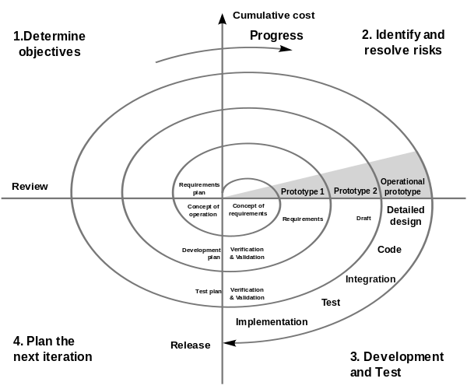
Spiral Life Cycle

Slide 6
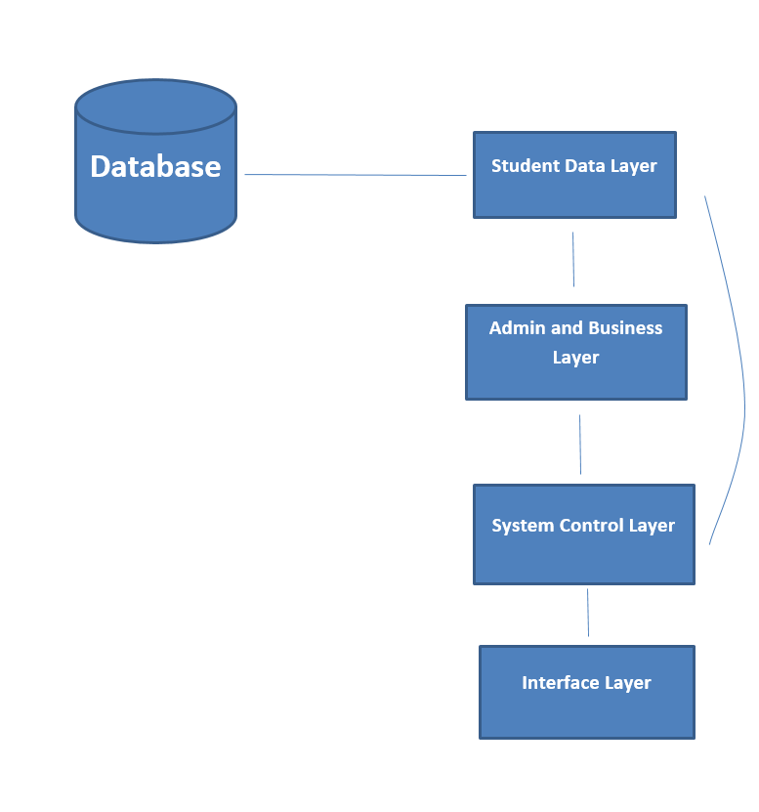
Architecture Diagram

Slide 7
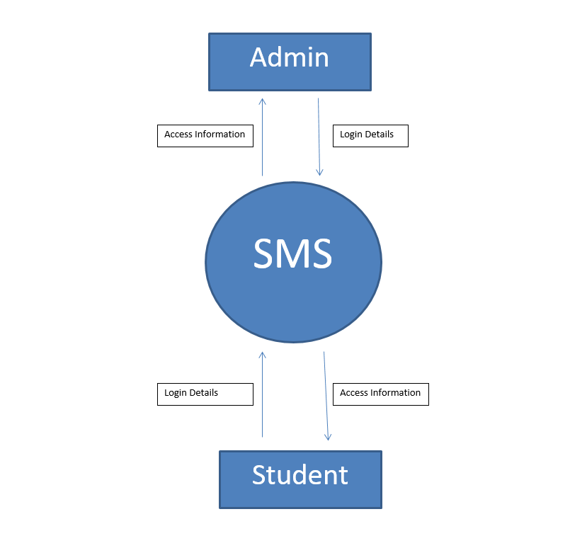
Login Diagram

Slide 8
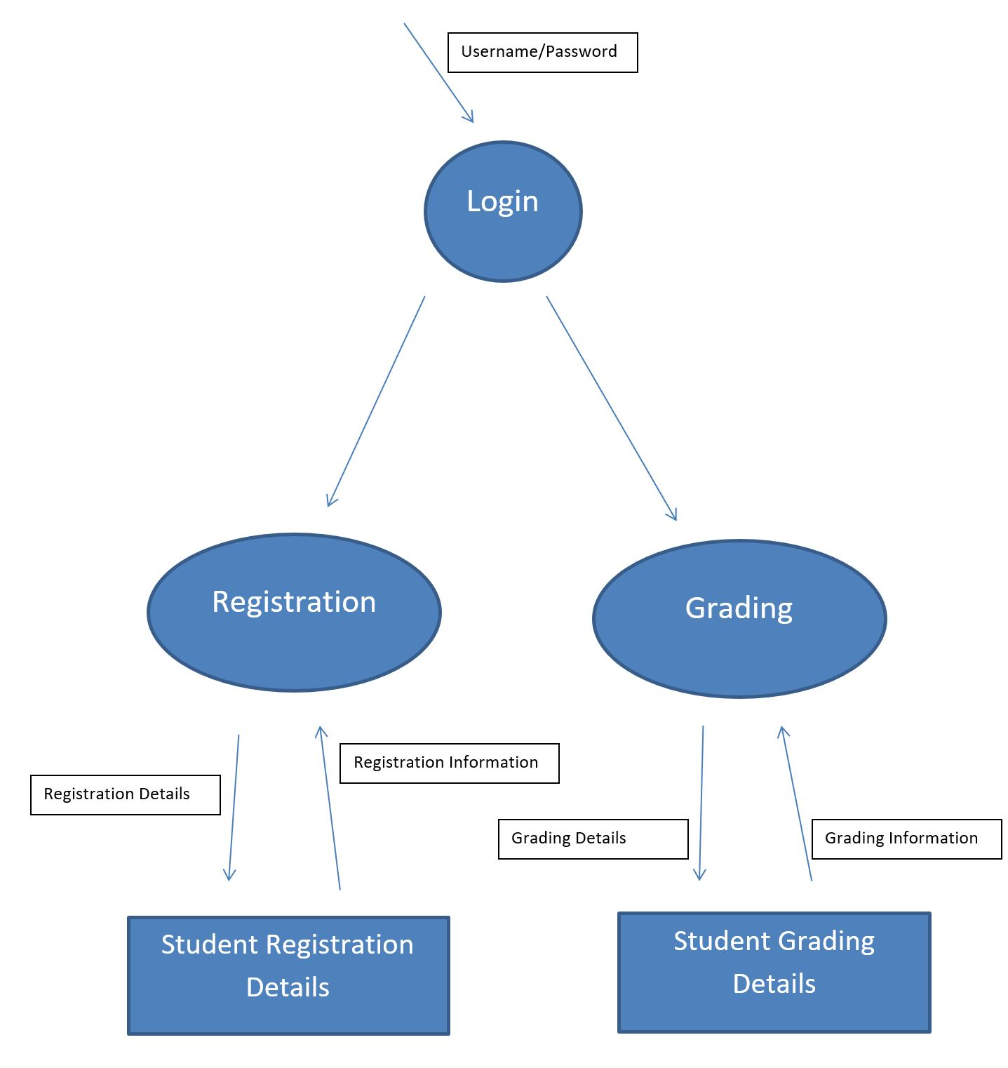
Data Flow Diagram

Slide 9
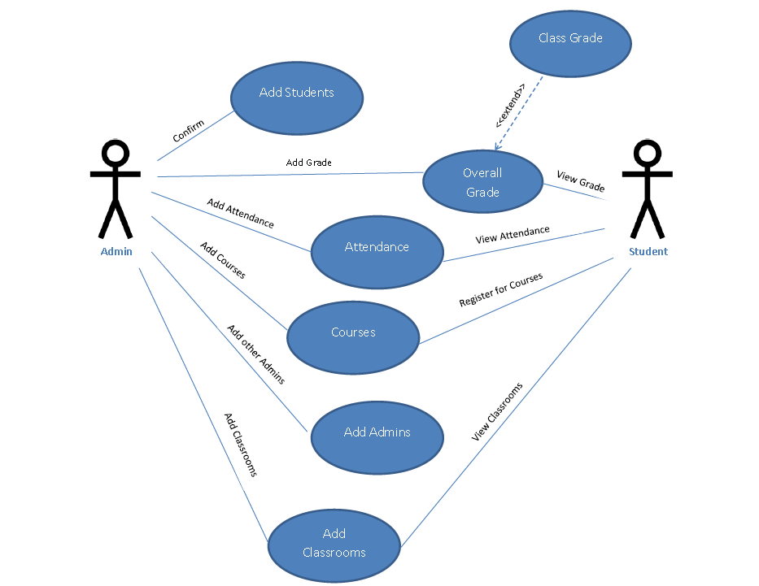
Use Case Models

Slide 10
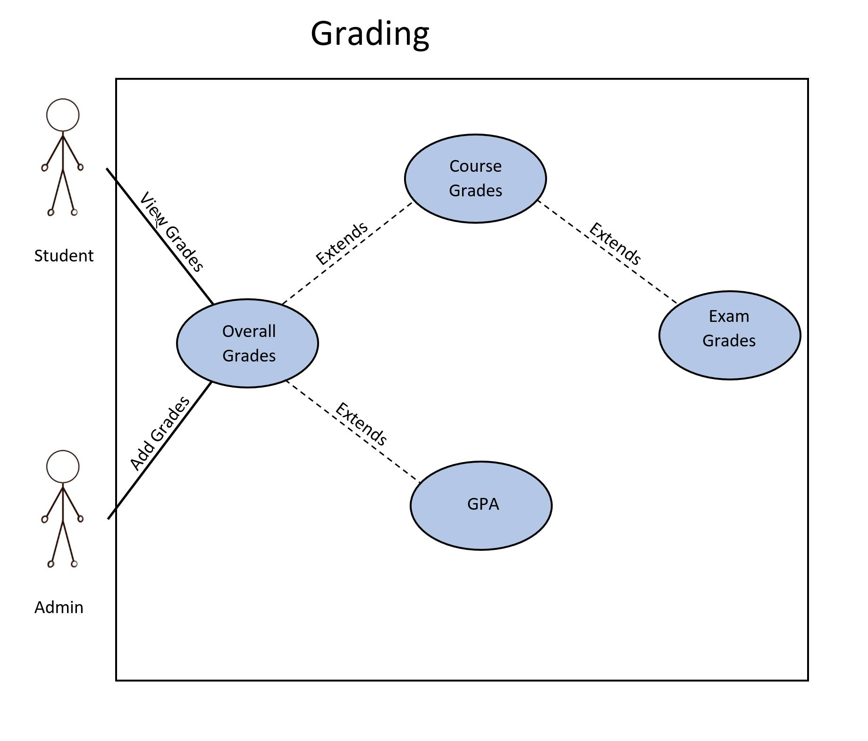

Slide 11
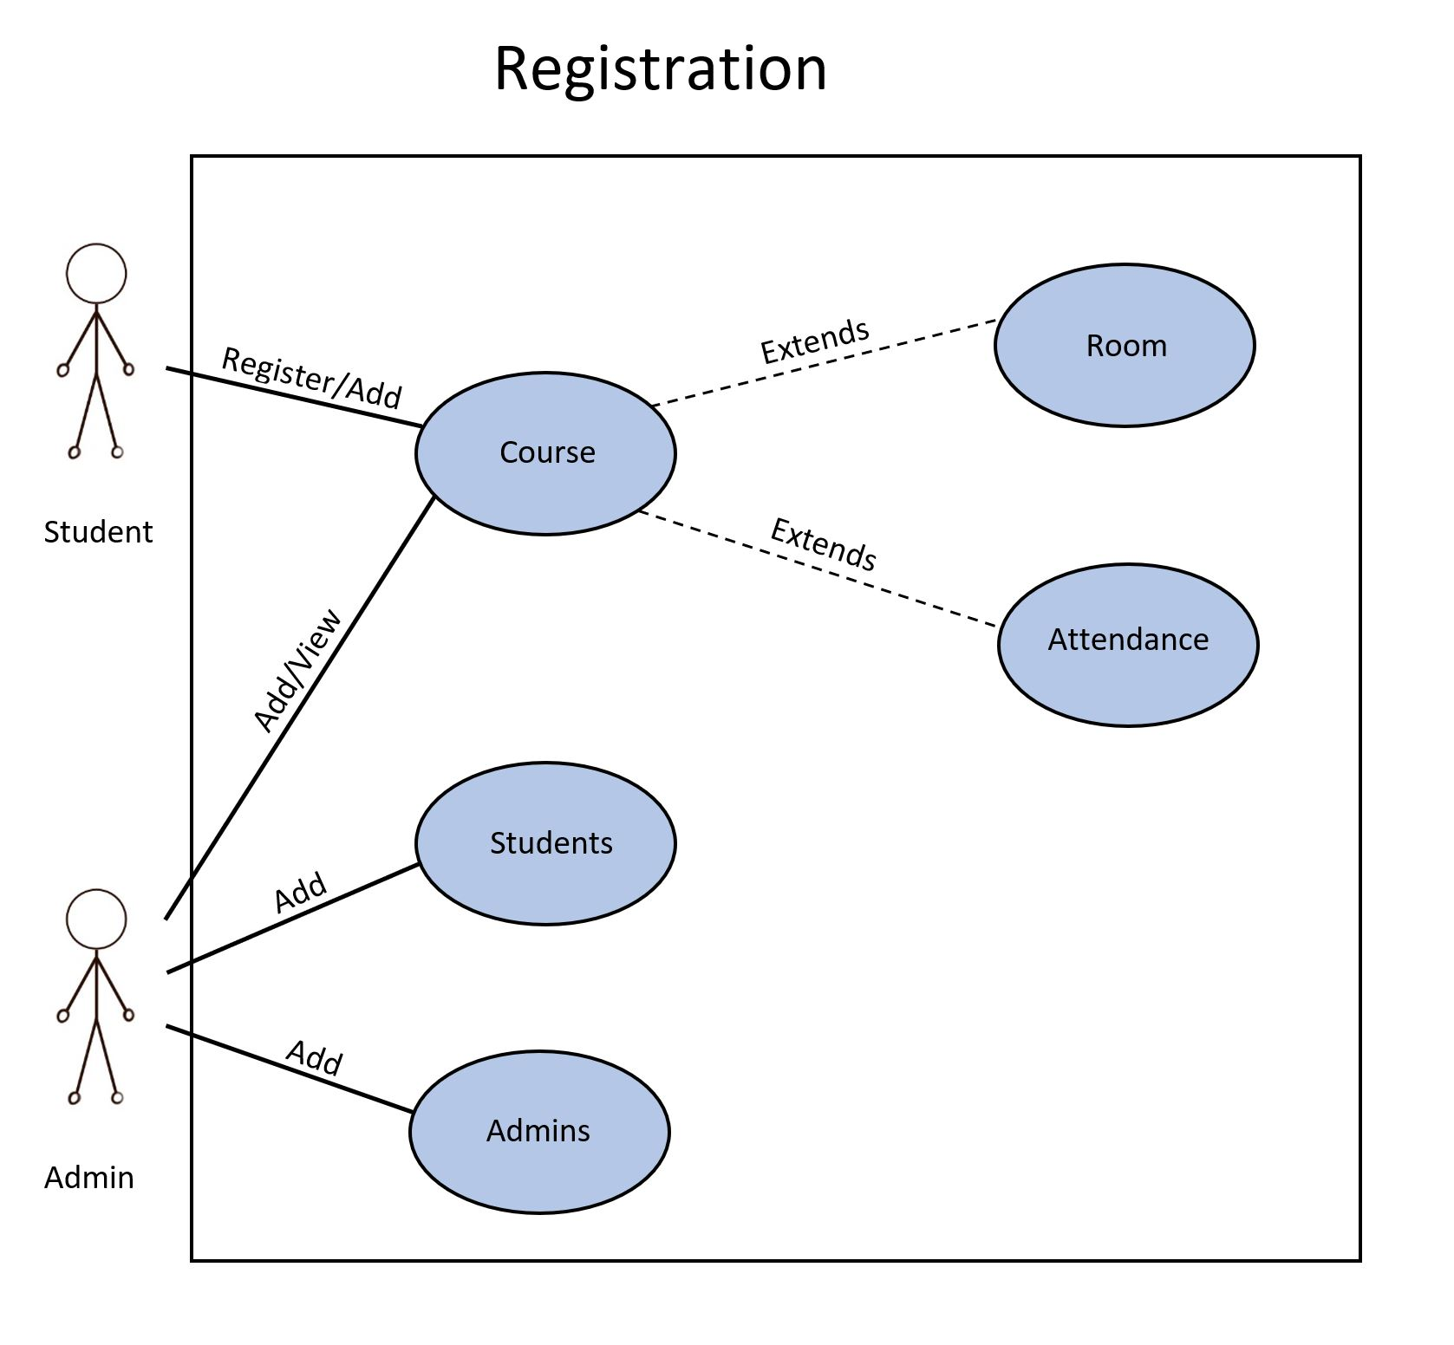

Slide 12
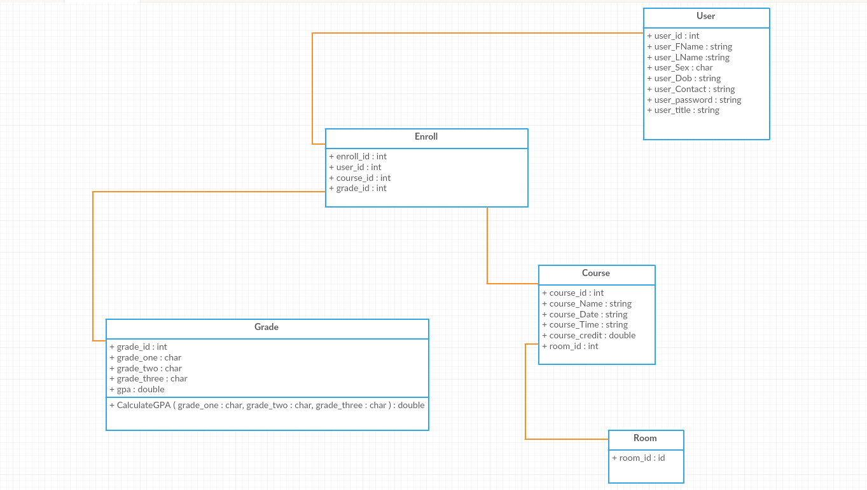
Class Diagram

Slide 13
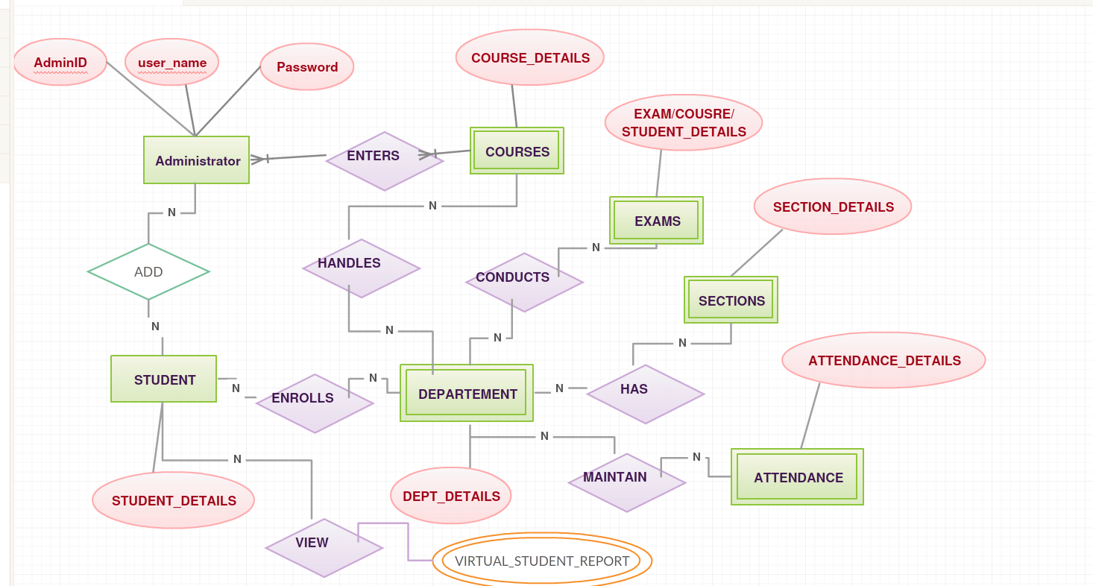
E/R Diagram

Slide 14
