Slide 1
FLIGHT CONTROL TEAM PROGRESS REPORT (week 14)
Arnold Odhiambo
Robert Mukono

Slide 2
AGENDA
Malindi Trip Report
Progress towards test launch
Tasks for the Week

Slide 3
TRIP REPORT
Visited Braglio Space Center, Malindi, 12-14 April, 2022
Purpose:
  Get acquainted with Kenyan Space Activities
  Learn ASI activities in Space Center and outside
  Inquire on JKUAT partnership with Braglio Space Center

Slide 4
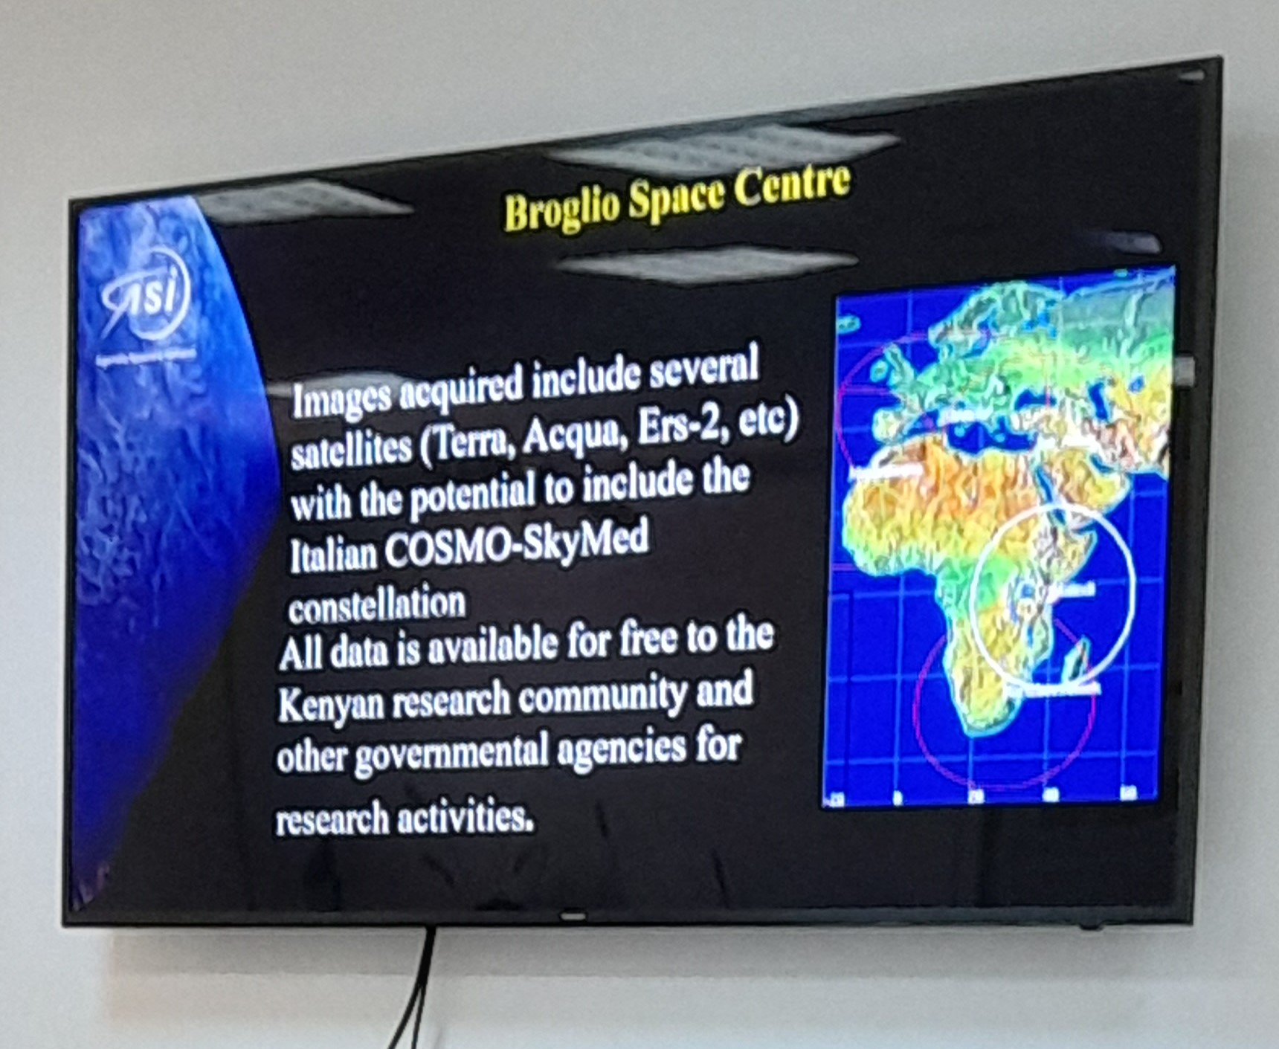
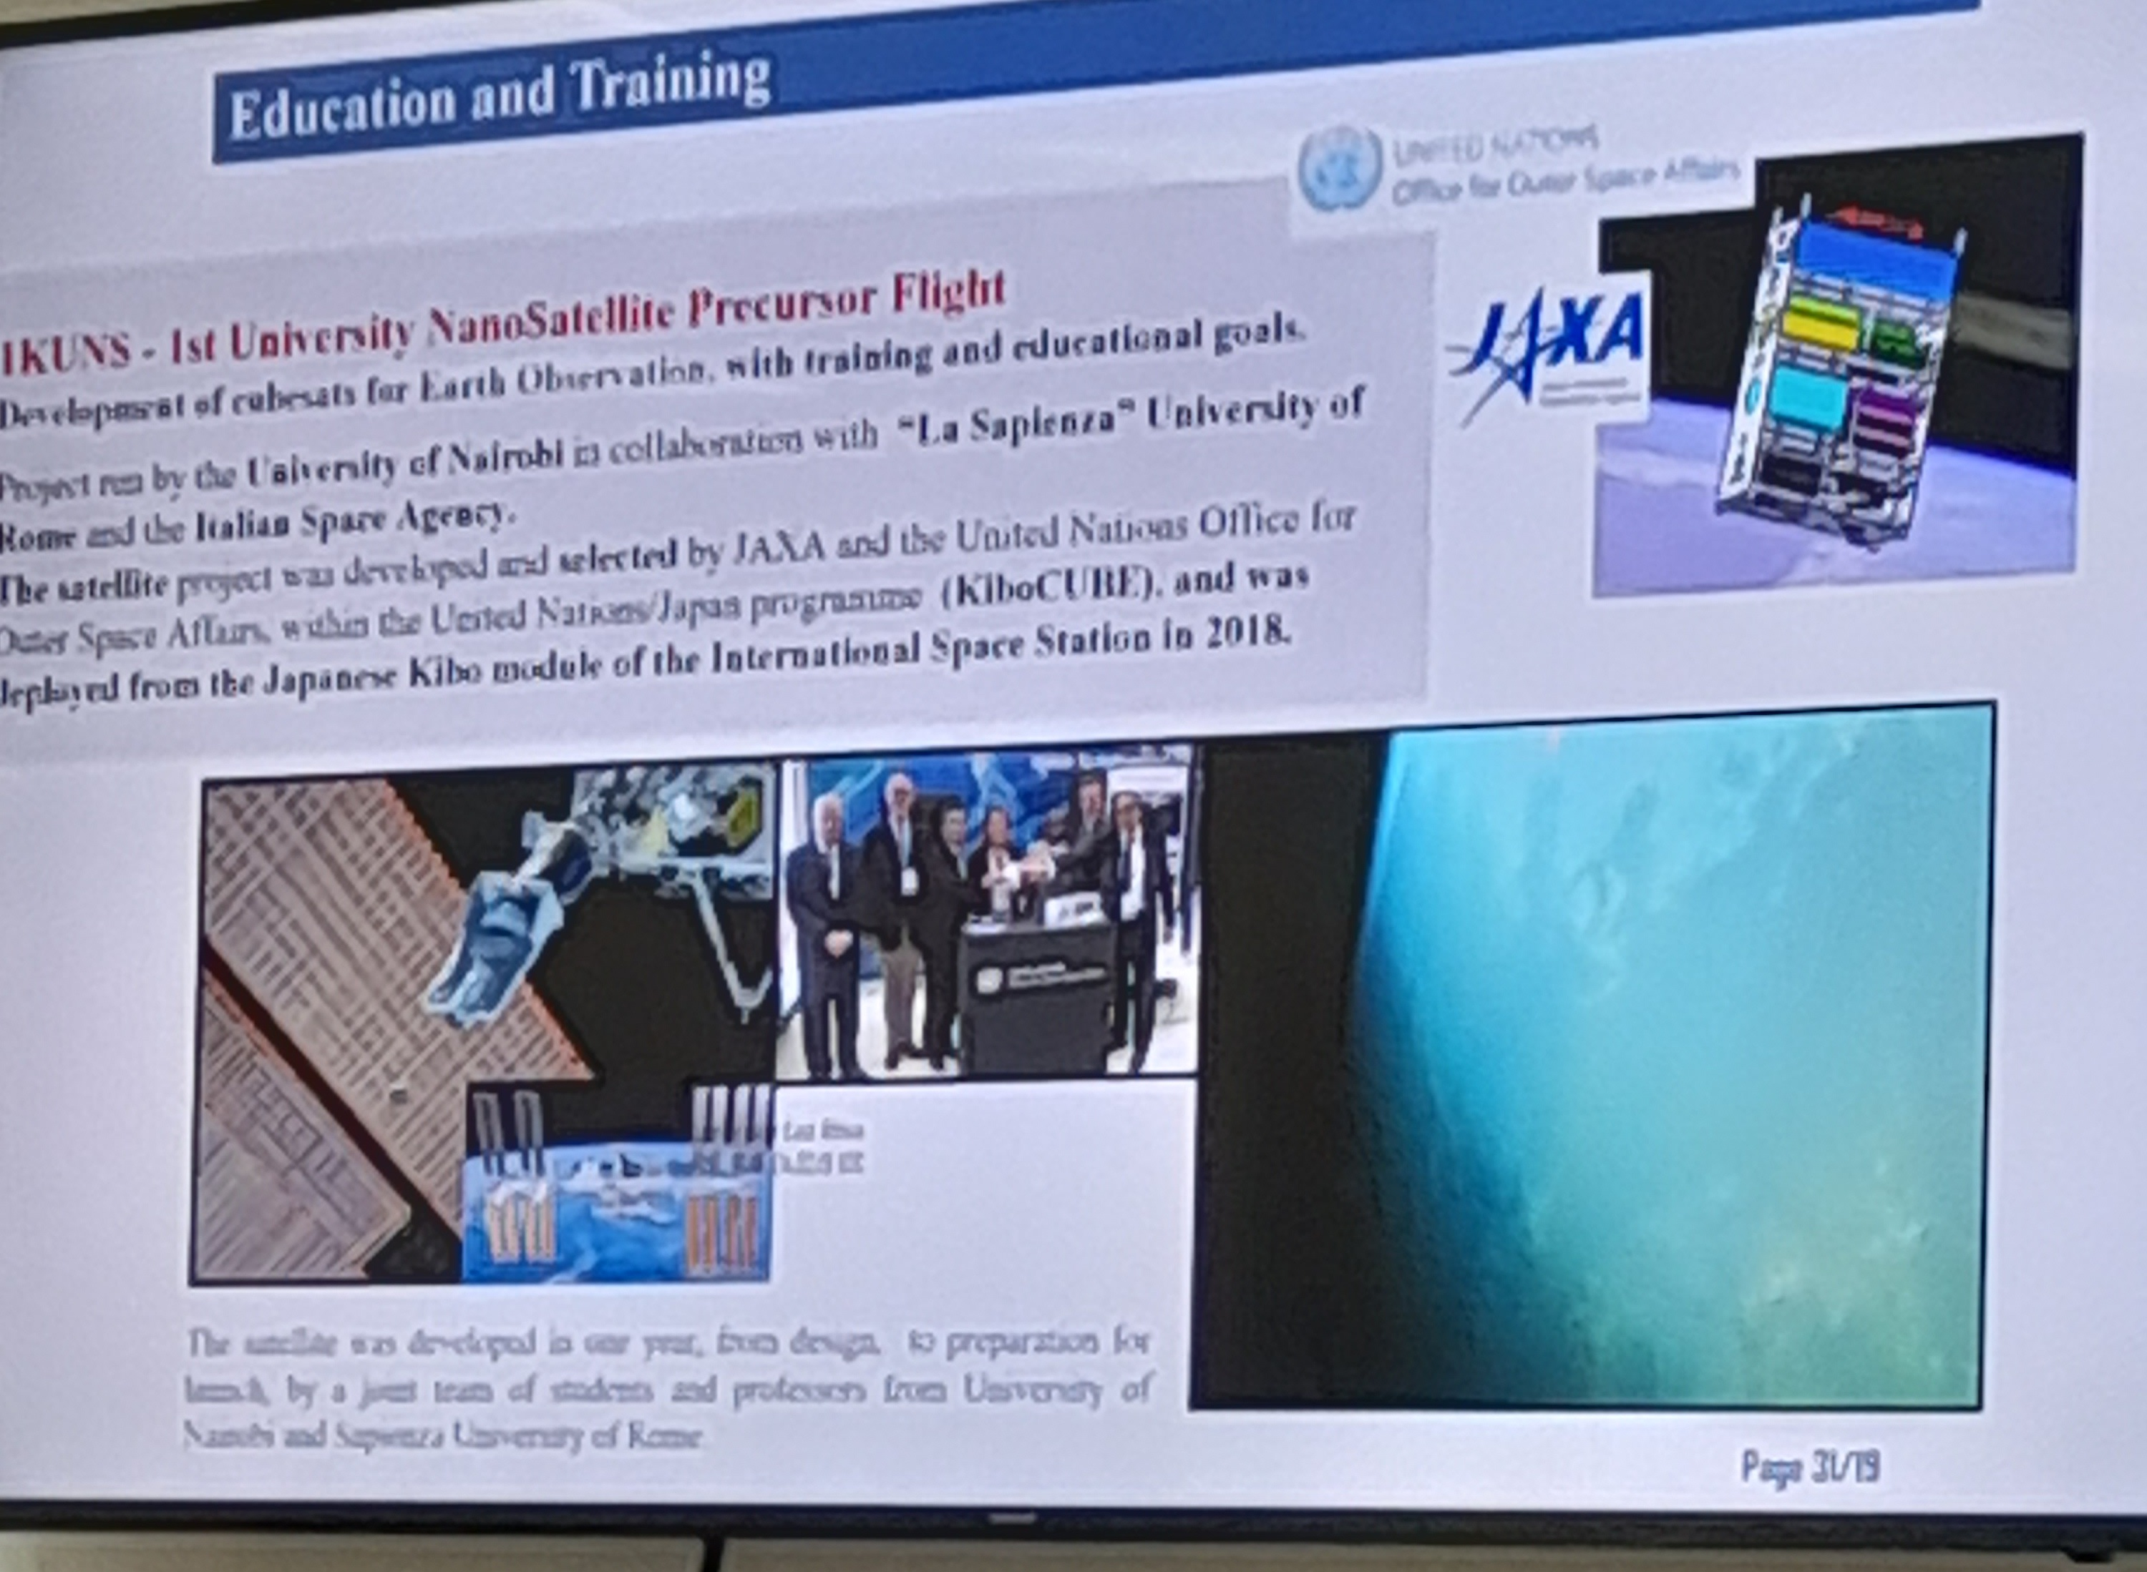
KENyan space activities
Satellite tracking and telemetry
Cubesats for earth observation
Data available for Kenyan research communities and government agencies
Partnership btn UoN, UoR, and ASI
Satellite deployed by Japanese Kibo module in 2018

Slide 5
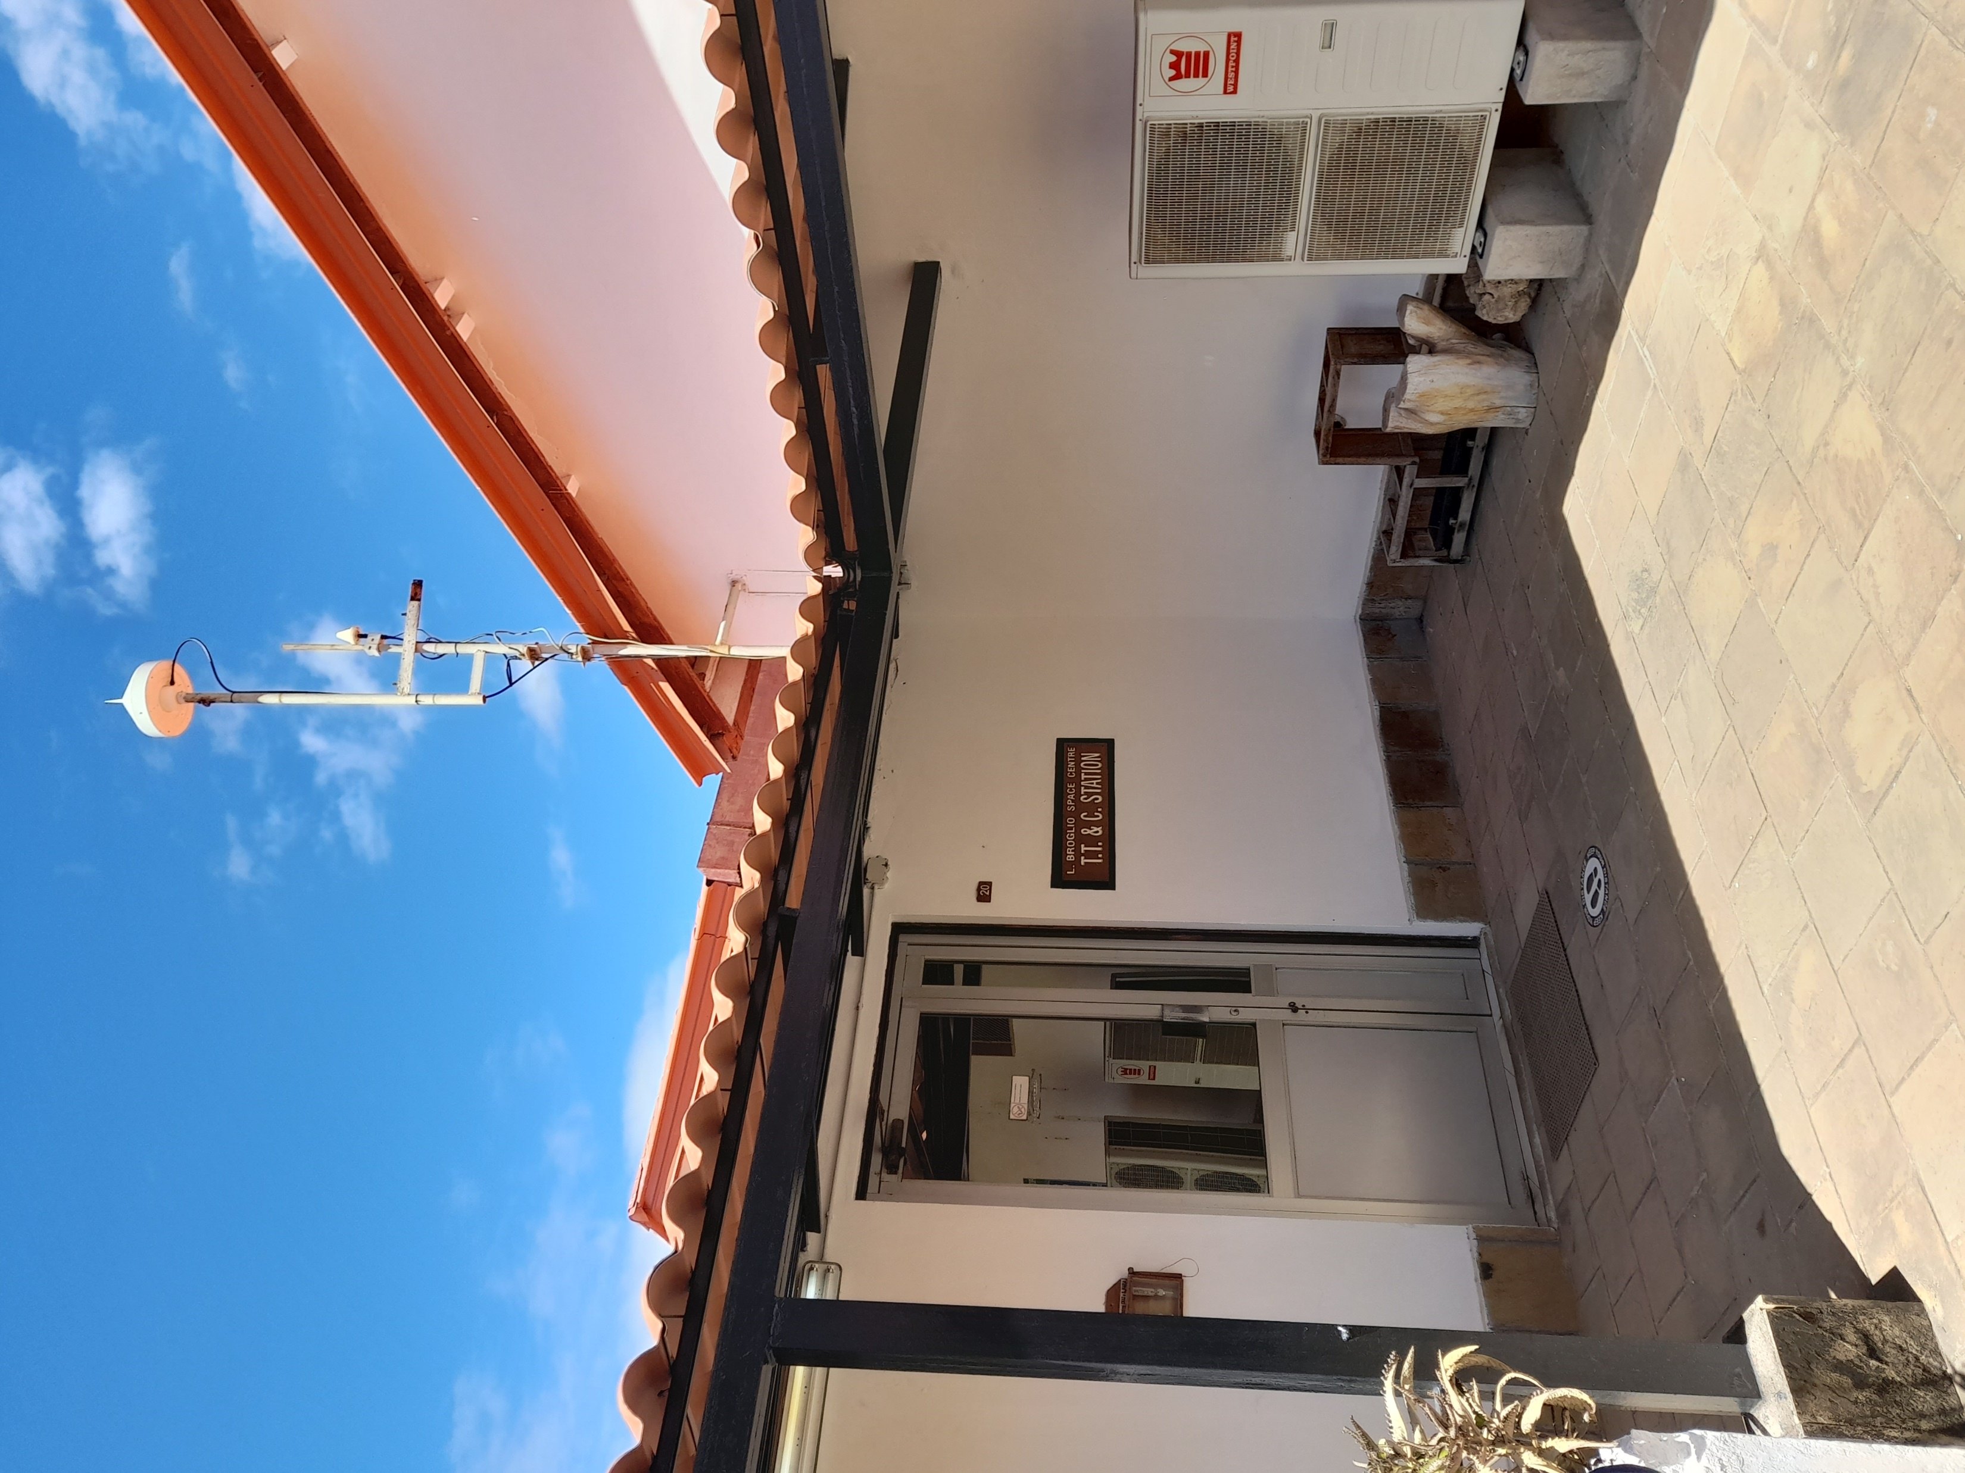
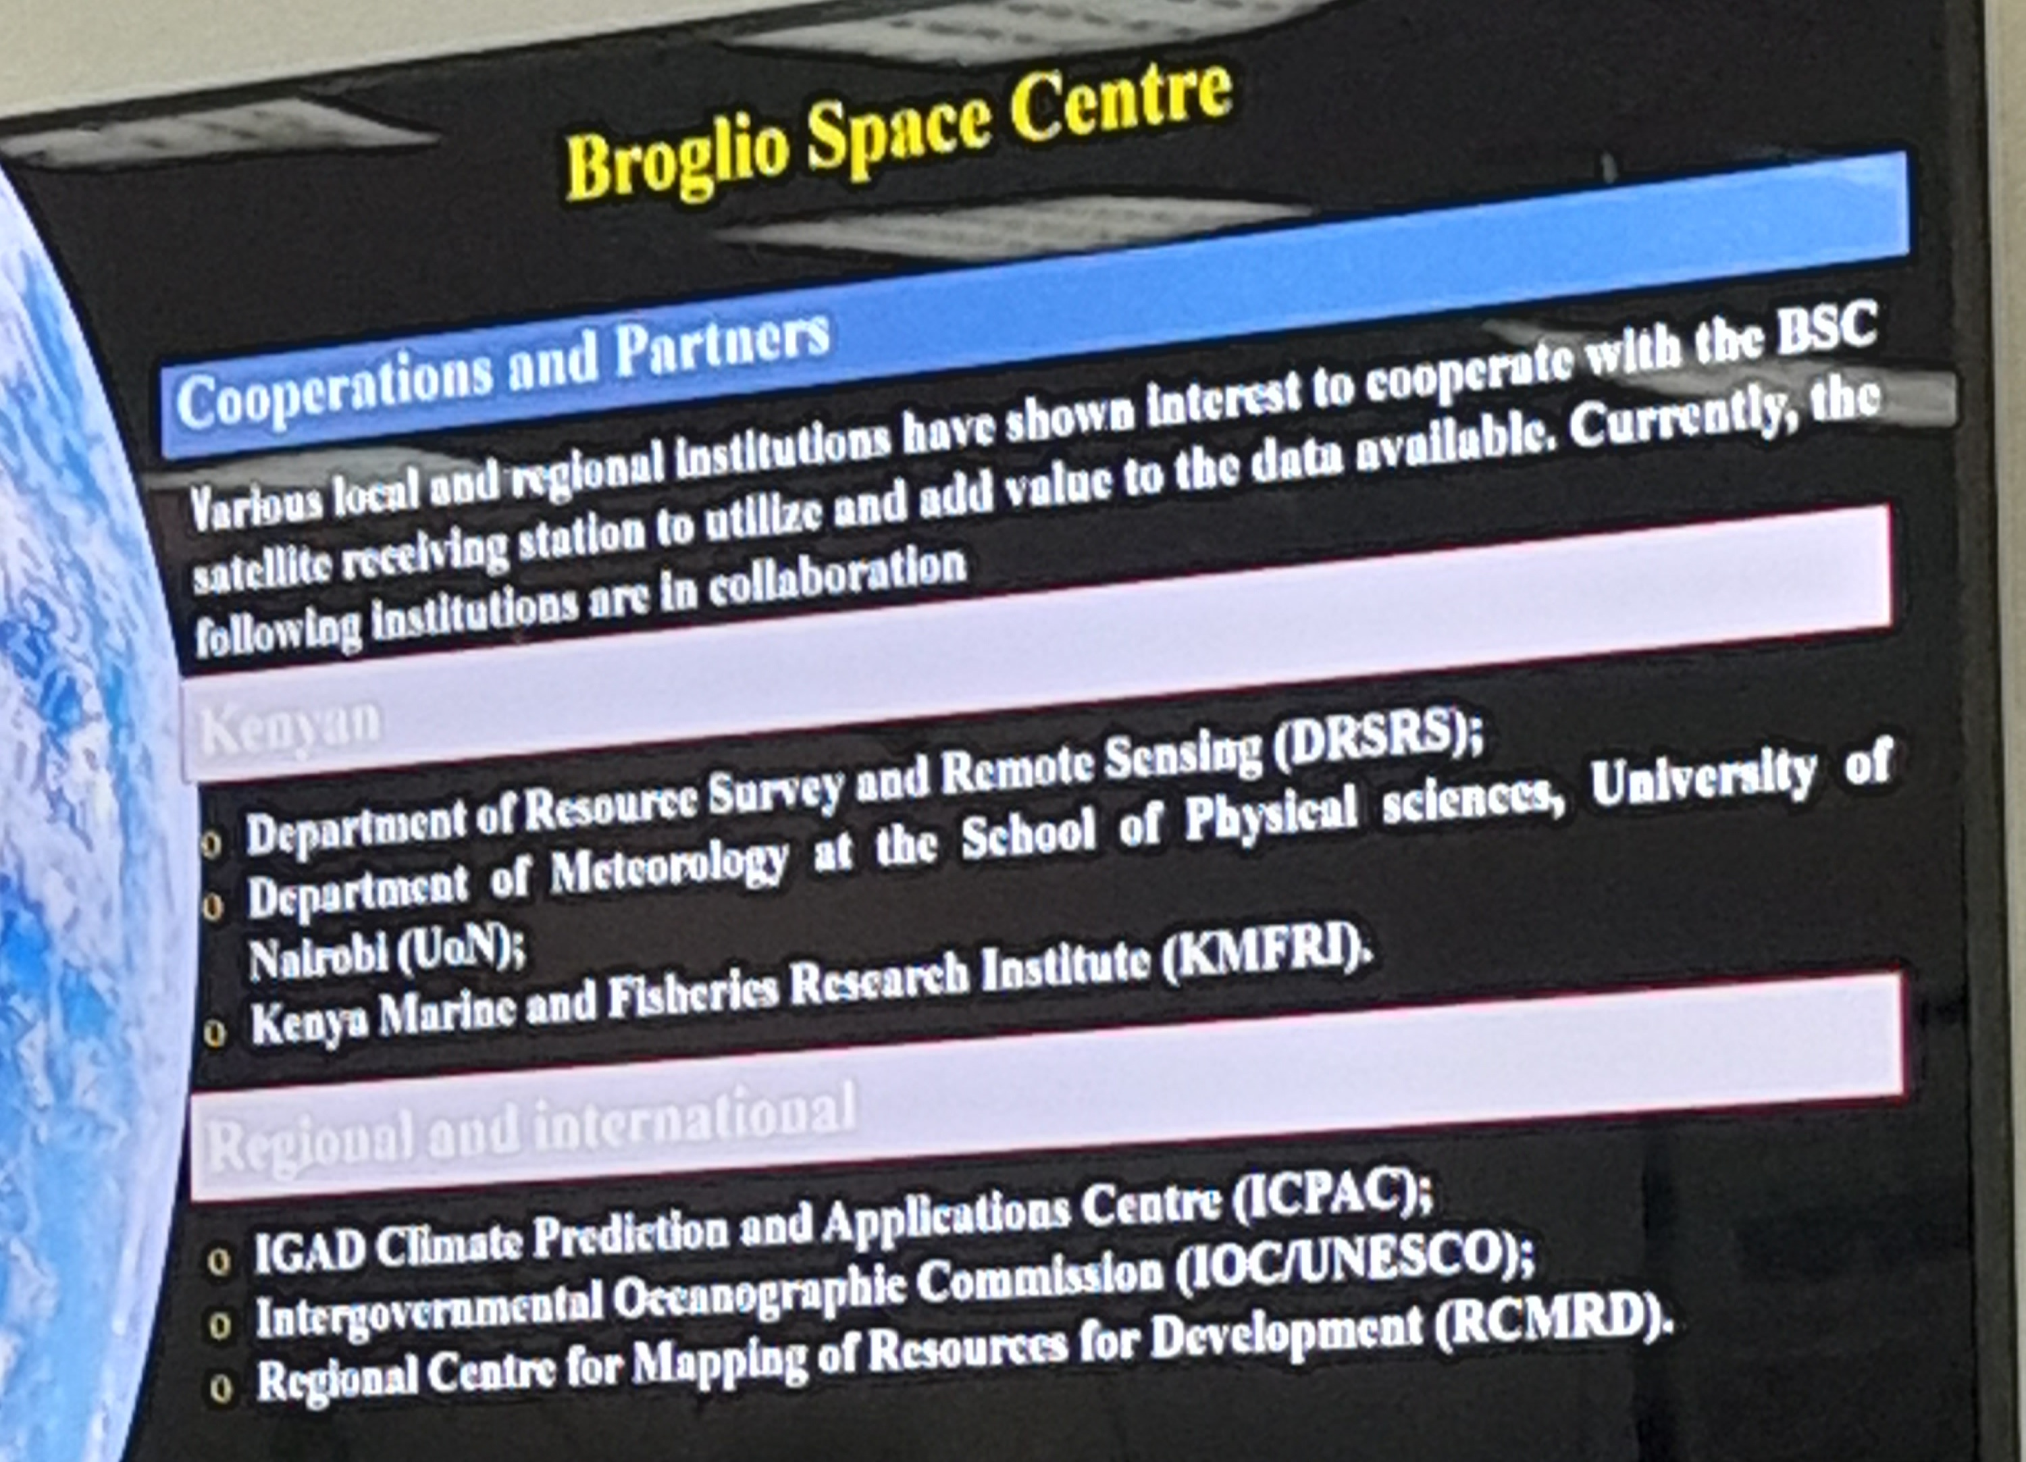
ASI Activities
Telemetry, Tracking, and Commanding (TT & C) Ground Stations
Partnerships
PoC btn Satellite & Mission Control Centers
System parameter measurements from satellite instrumentation systems
Department of Resource Survey and Remote Sensing
Department of Meteorology (UoN)
Kenyan Marine and Fisheries Research

Slide 6
JKUAT PARTNERSHIP
Person in charge highly pessimistic about use of launch pad
However, history of partnerships with various Kenyan agencies suggest viable partnership with JKUAT
Overall, successful trip

Slide 7
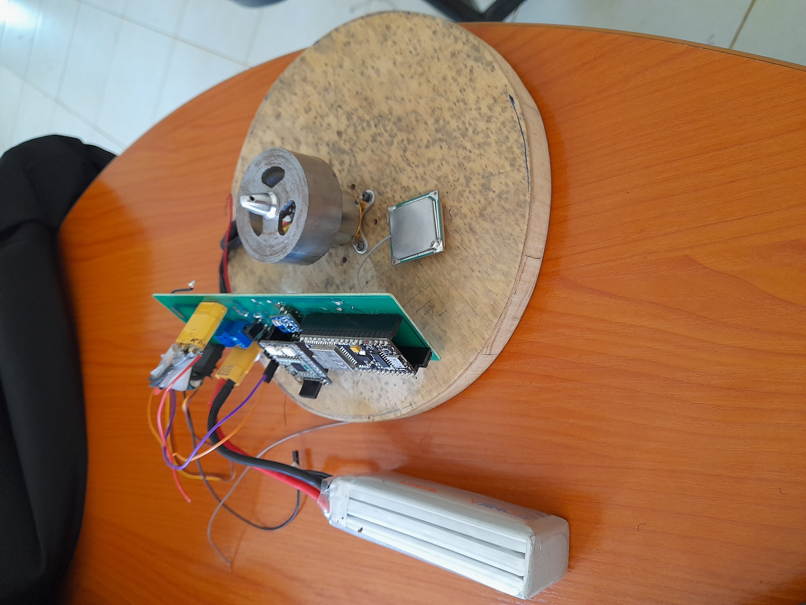
Progress towards test launch
Complete fabrication of Avionics/Flight Control onboard MCU
Carried out continuity tests to ensure motor receives power
To be done:
  Integrate flight control code with avionics code in onboard MCU
  Test reaction wheel for successful roll control
  Test launch

Slide 8
TASKS for the week
  Integrate flight control code with avionics code in onboard MCU
  Test reaction wheel for successful roll control
  Test launch

Slide 9


