Slide 1
WEEK 2
Motor configuration, nozzle and casing

Slide 3
MOTOR
The grain structure that brought desired results was the bates configuration.
The dimensions are as follows:
1. Length – 102mm x 4 cartridges
2. Diameter – 60mm
3. Core diameter – 20mm

Slide 4
Simulation results
Average pressure – 6.57Mpa
Peak pressure – 7.52Mpa
ISP – 115.77seconds
Burn time – 1.83seconds
Motor Designation – K1095
6.

Slide 5
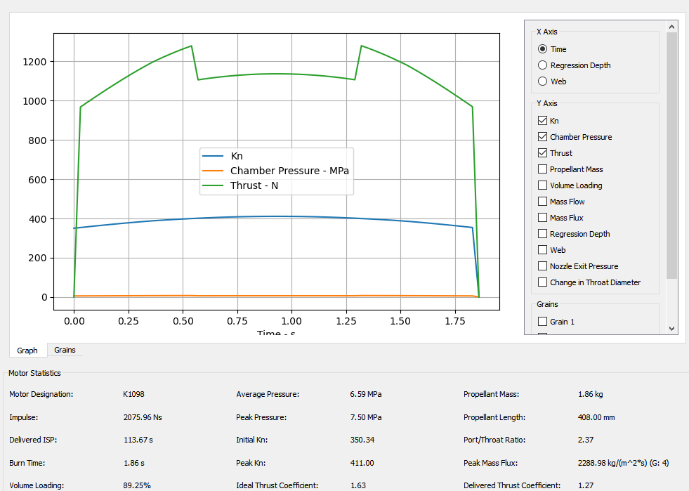
Properties from simulation

Slide 6
NOZZLE
the nozzle configurations are as follows
Throat diameter - 13.000000 mm
Exit diameter – 40.00000mm
Divergence half angle – 12 degrees
Convergence half angle – 25 degrees
Throat length – 3mm

Slide 7
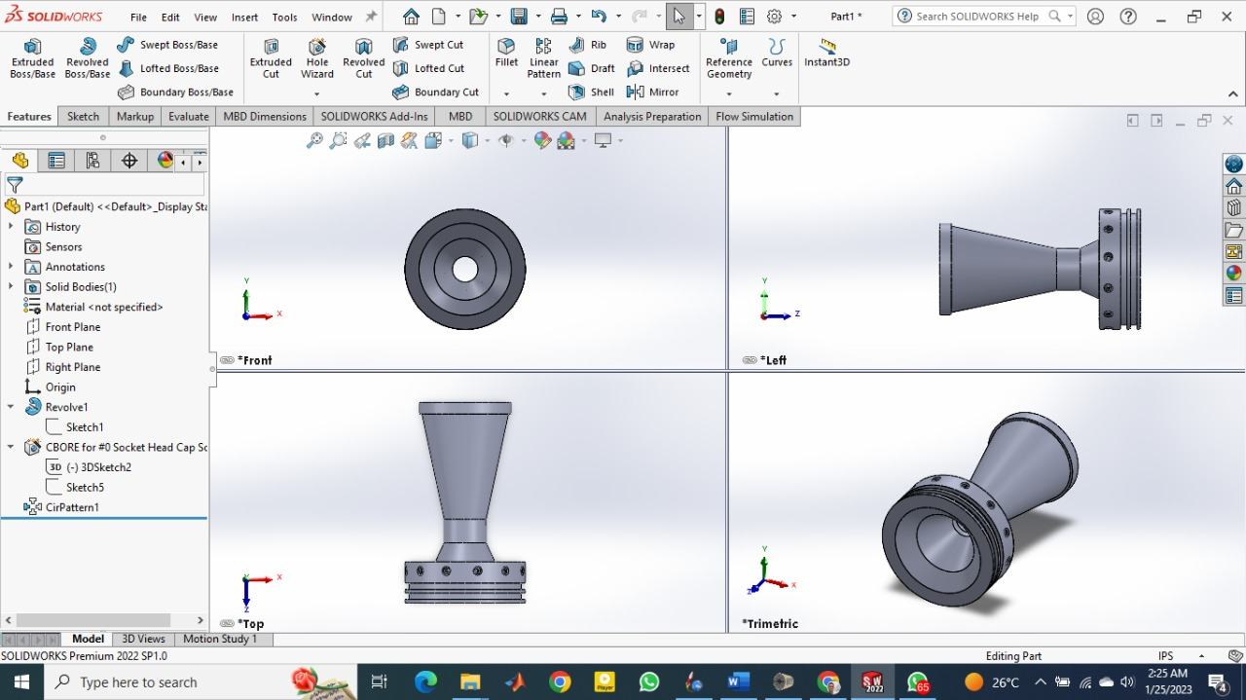
Nozzle diagrams

Slide 8
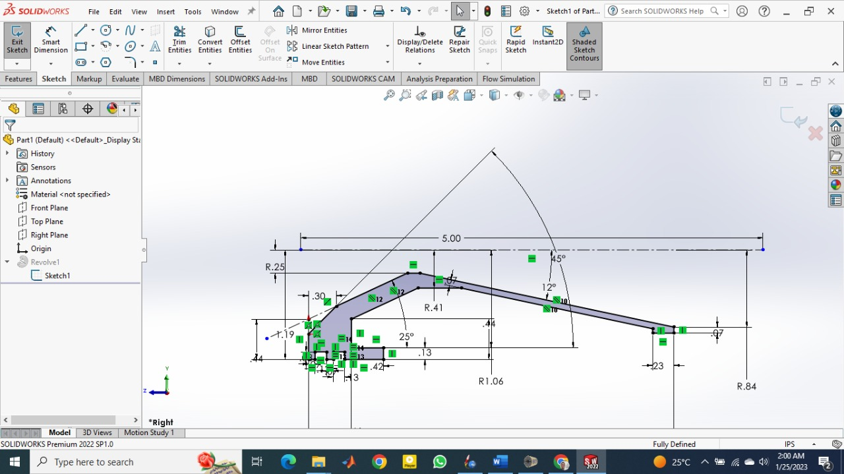
Section view

Slide 9
Casing
The casing of choice was Aluminum 6063 of density 2690kg/mm3 and yield strength 214Mpa
Casing external diameter – 70mm
Casing thickness taking a safety factor of 2 – 2.5mm
BURST PRESSURE – 23.75Mpa

