Slide 1
WEEK 7 REPORT

Slide 2
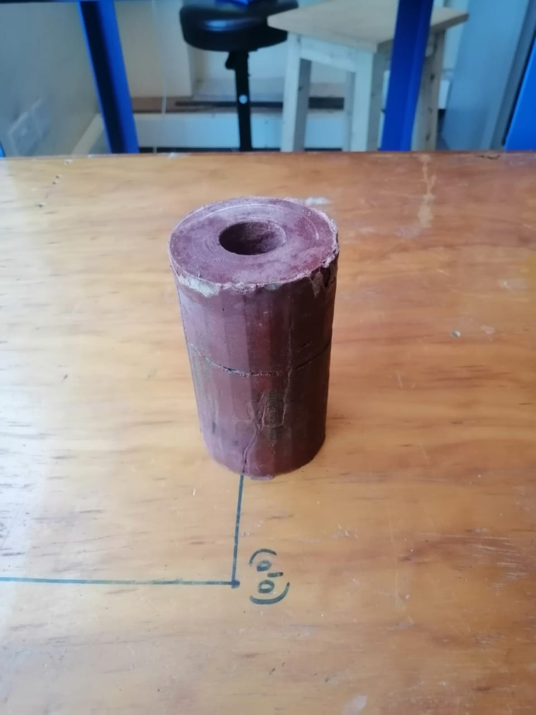
CArTRIDGE
Cartridge weight 486grams
Expected weight 555grams
Sources of inconsistency
-Inefficient packing and compression method
-Liner used deformed during packing thus reducing the volume

Slide 3
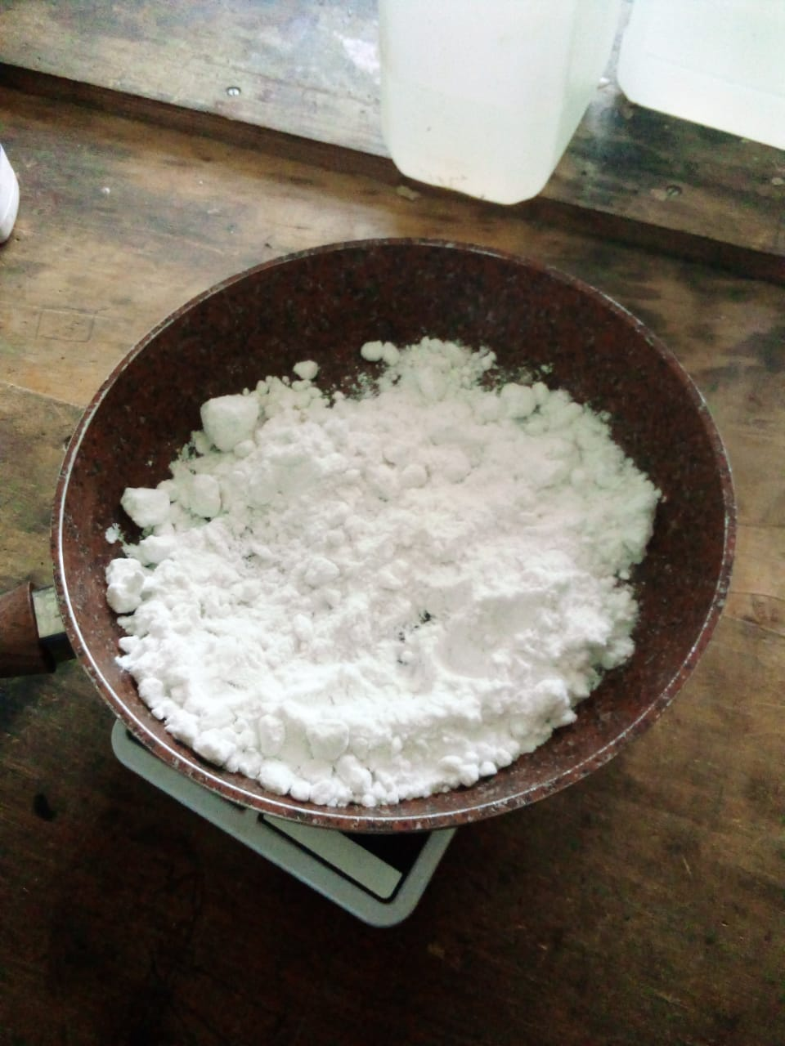
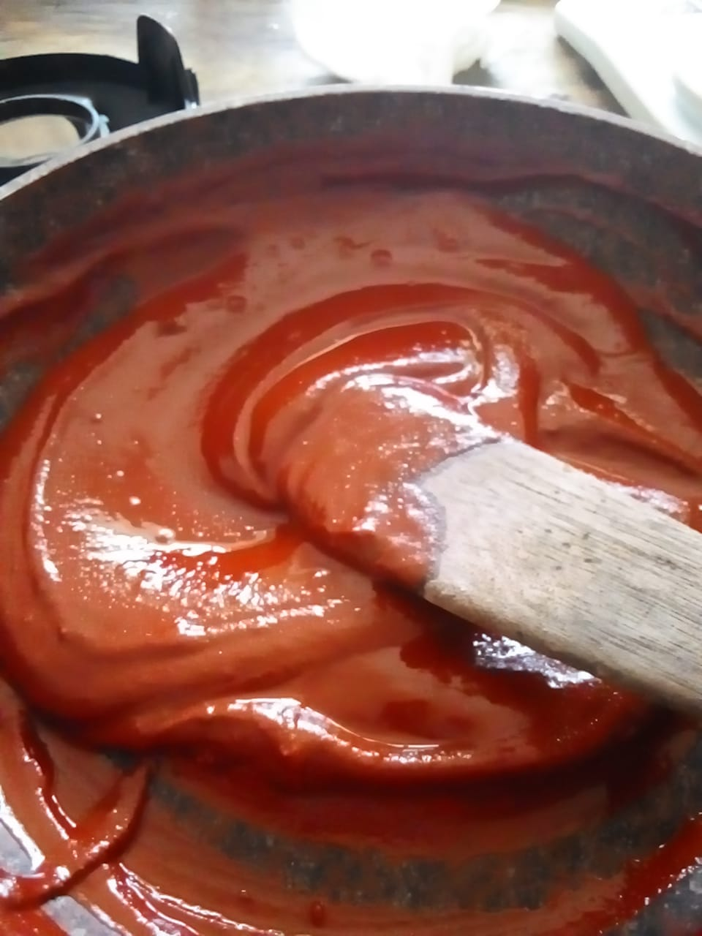
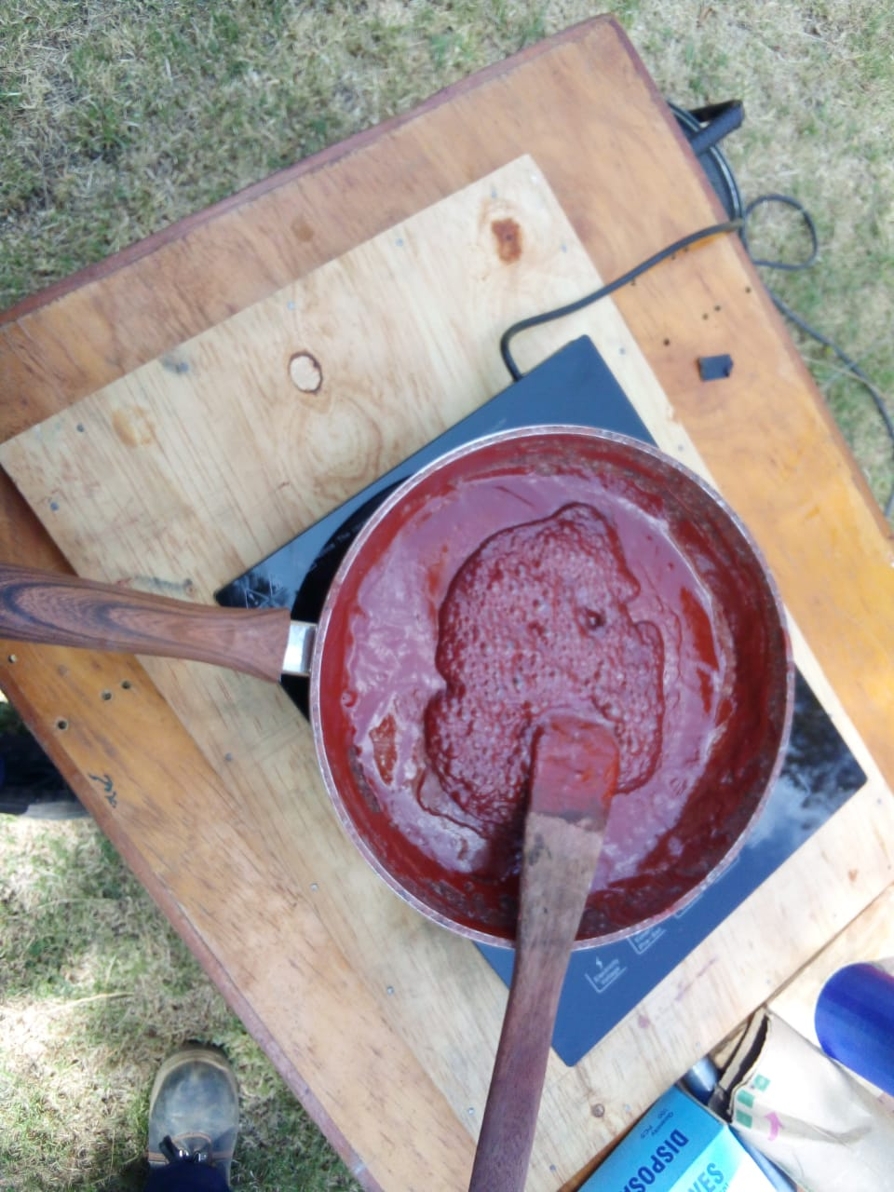
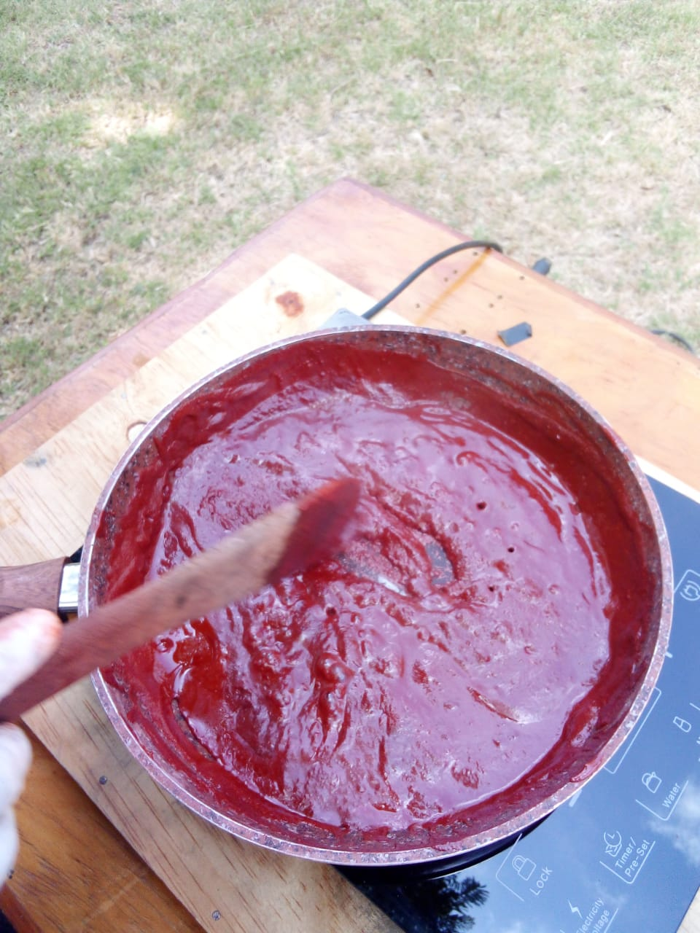
SOLID PROPELLANT MIXING PROCEDURE
-Following the changes made in the procedure the results are what was to be expected
-The viscosity improved and the mixture did not immediately solidify when heat source was removed thus yielding allowing for easy packing into the mould

Slide 4
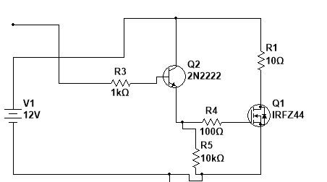
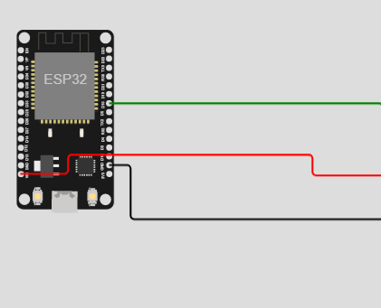
Igniter design(REVISED)
Remote igniter
In this system the igniter is connected to an esp32 and a battery. The esp32 hosts a webpage that can be used to switch the igniter and ensure the igniter is switched at the right time.
The igniter can be lit in range of 10 to 300m with little delay time and since the esp32 listens to connection waiting for the right connection.

Slide 5
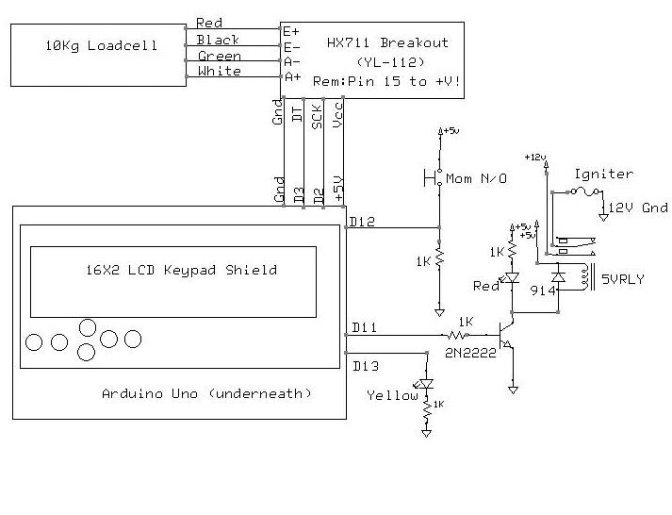
STATIC TEST STAND SYSTEM
The design for the system uses an Arduino board
To collect the data from the burning of the motor.
The data we will be collecting are ISP, Thrust
And Burn time. The data we will collect from the
Serial monitor will be used to plot a graph so
That we can monitor the characteristics visually.
and an esp32 for remote launch.

Slide 6
THE END

