Slide 1

Static Test Stand
Week 3

Slide 2
Research on static test stands Used to determine the motor performance -thrust, -chamber pressure, -specific impulse, -verify structural and thermal capability of motor, -anomalies in behavior Design concepts:-horizontal -vertical (nozzle facing up or down)
1

Slide 3
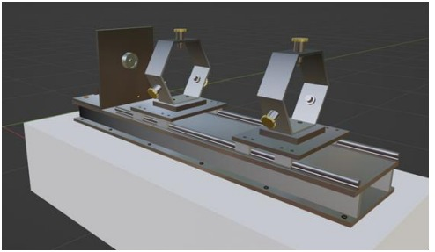
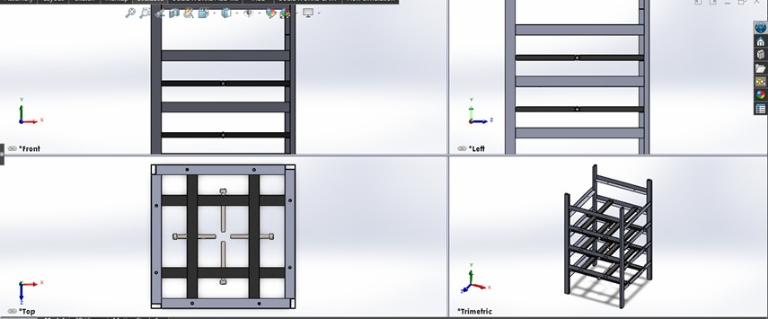
-Horizontal test stand Vertical test stand (nozzle up) Courtesy of Akash et.al
3

Slide 4
-
Vertical with nozzle facing downward:
Advantages:
No need to account for gravity and motor weight
Residue build up is accurate
Flight path can be approximated more accurately
Disadvantages:
Need to eliminate all upward movement of the test stand which is hard
Needs a firm support
Need method to hold motor without influencing its pressure just before ignition
3

Slide 5
Probable solutions: Using electromagnets that switches off on ignition to hold motor Use cement supports Divert the thrust sideways Vertical with nozzle facing up: Advantages: -Simple in design -Relatively safe -Easy data collection
4

Slide 6
Design choice considerations: -Safety -Complexity of design -Availability of the materials -Portability
5

Slide 7
Tasks for week 4: - 3D modelling of test stand -Avionics design -Fabrication
6

Slide 8
End

