Slide 1

Week 4 report

Slide 2
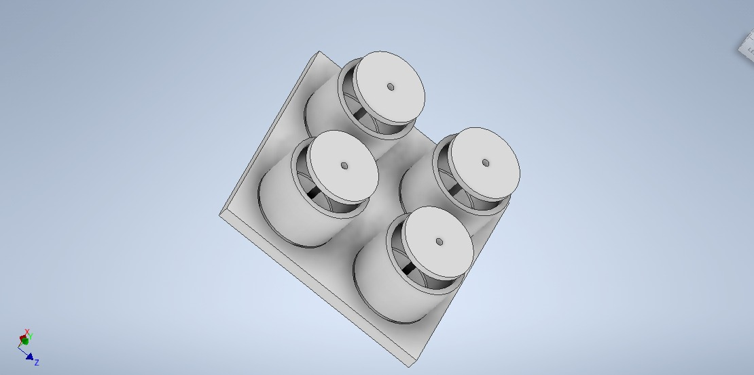
Propellant mold
Dimensions 800mm × 800 mm
300mm(outer circle radius)
_ 260 mm(inner circle radius
Pressing plate-260mm
Rod 150mm length
Threadsize M30×3.5

Slide 3
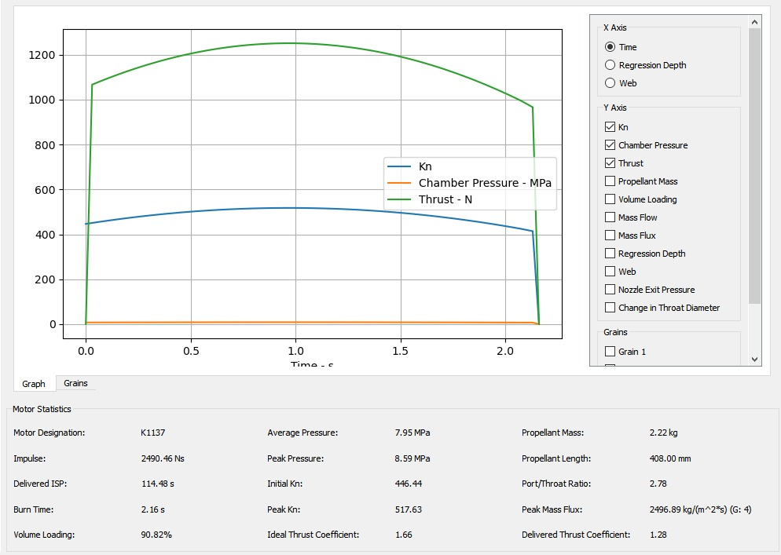
propellant
Propellant type KNSB
BATES grain
Propellant diameter, 66mm,
Core diameter 25mm
Grain length 102mm
4 grains

Slide 4
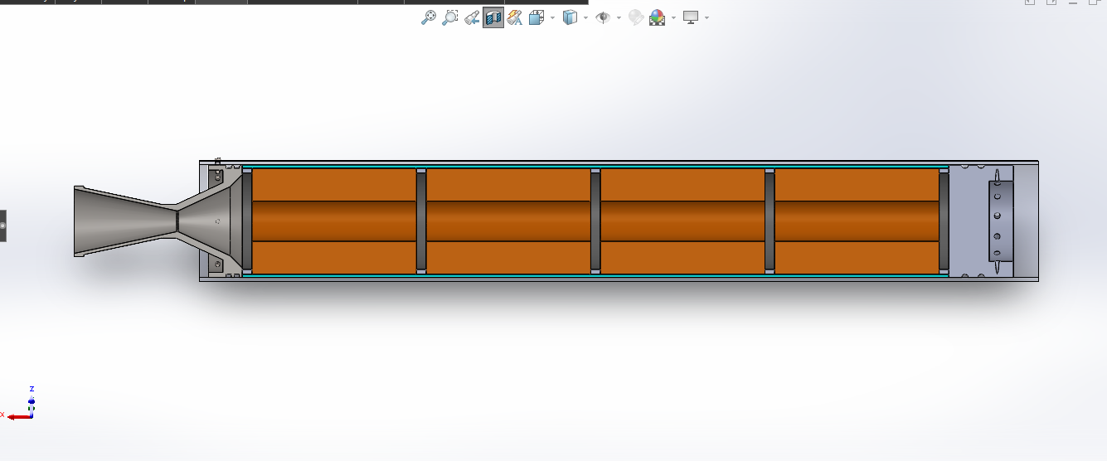
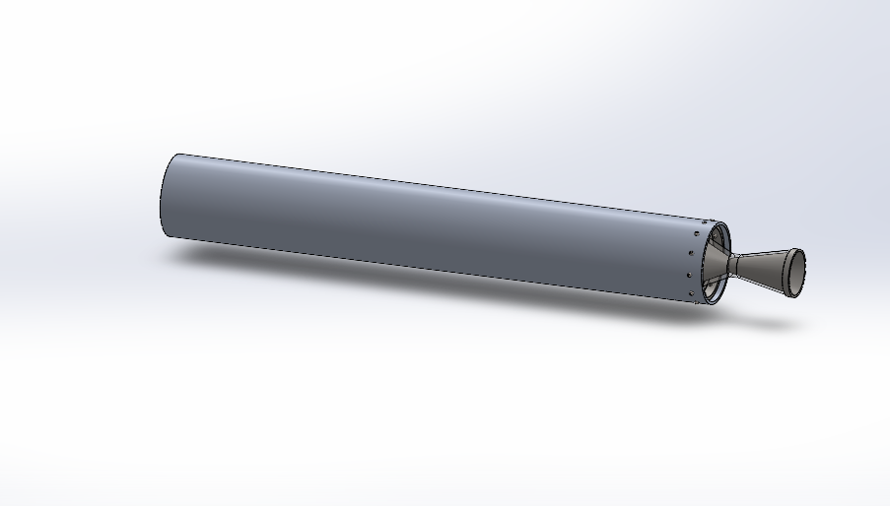
motor
Casing outer diameter 75mm
Thickness, 2.5 mm
Casing material aluminum 7075 T-6
Nozzle material stainless steel
Nozzle throat length 3mm
Nozzle throat diameter 13mm
Nozzle exit diameter 40mm
Bulkhead material Aluminum 7075-T6
Fasteners socket cap head screws
Spacer rings thickness 6mm

Slide 5
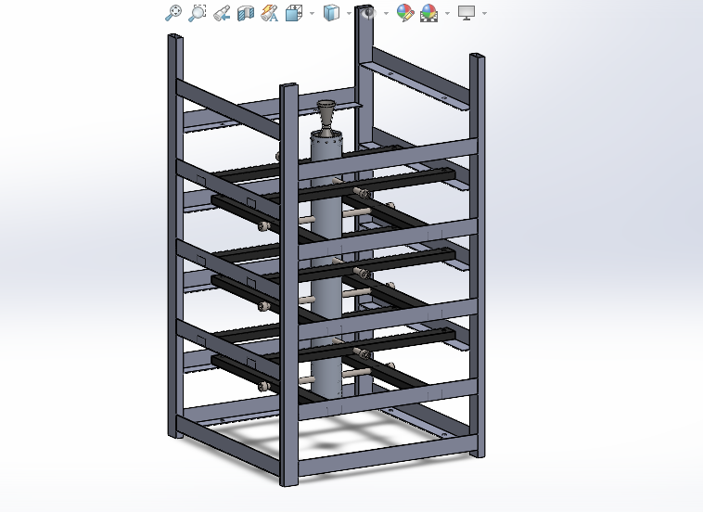
Test stand
Length 500mm
Width 500mm
Height 1000mm
Materials angle line, steel tubes, bolts and nuts

