Slide 1

Week 6 report

Slide 2
Propellant Preparation
Test grain
Mass – 200g
Potassium Nitrate – 129g
Iron(III)Oxide – 1.5g
Sorbitol – 69.5g
Procedure
Add the iron(III)oxide to the potassium nitrate and stir to mix
Add sorbitol to the mixture above while stirring
Preheat the pan using an induction heater to about 180 degrees
Place the mixture above in the pan and stir until its able to drip of the spoon
Place the mixture in the mold blocks and compress to the appropriate size and wait for it to solidify

Slide 3
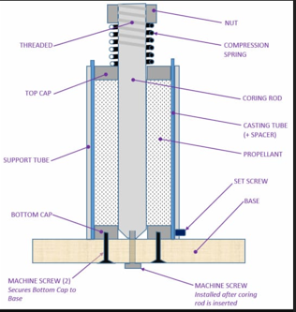
Propellant Preparation
Grain for motor
Mass – 555g
Iron(III)oxide-3g
Potassium Nitrate -364g
Sorbitol-188g
The total number of grains to be made is 4

Slide 4
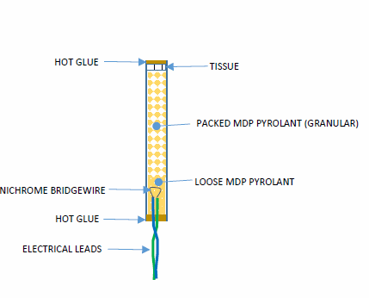
IGNITOR
The igniter developed is a MDP type.
It uses black powder or match stick head
The igniter is powered by 11.1 v battery
A nichrome wire is used to heat the powder for ignition

Slide 5
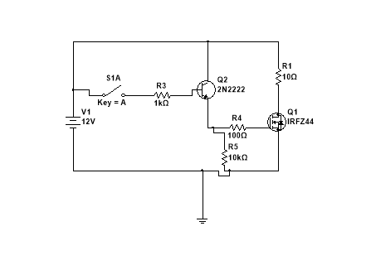
Circuit for igniter
The circuit is fabricated on perf board

