Slide 1

WEEK 10 SOLID PROPULSION REPORT
BATCH 2

Slide 2
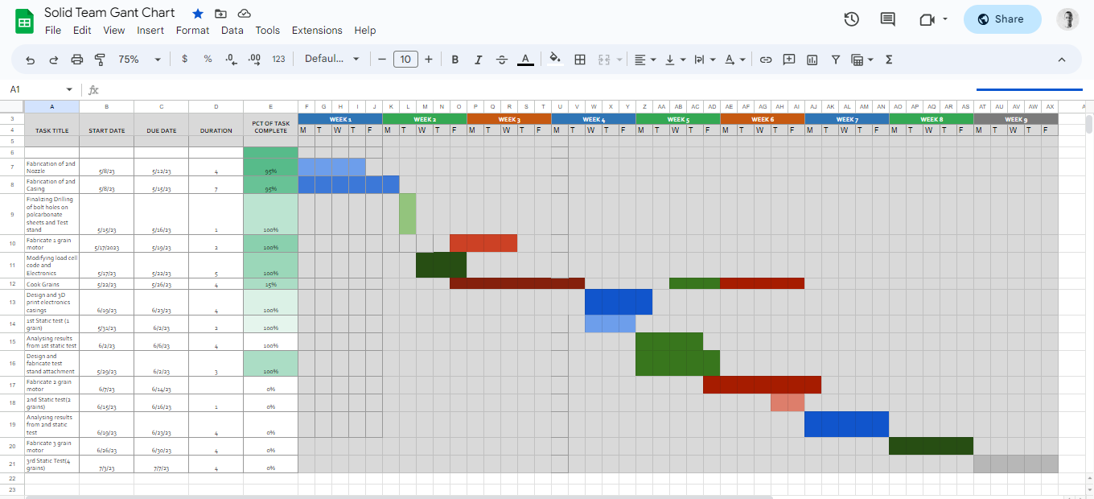
https://docs.google.com/spreadsheets/d/1hBBPNcnpQUVeR51bRd35yVVWFX5lDWHhBGYU0TpIXSk/edit#gid=0
Gantt chart

Slide 3
WEEKLY OBJECTIVES
COOK
COOK3FULL GRAINS.
TWO GRAIN MOTOR.
PREPARE TWO GRAIN MOTOR FOR SECOND TEST.
REDESIGN.
CASING FOR ELECTRONICS.
MOTOR HOLDER.

Slide 4
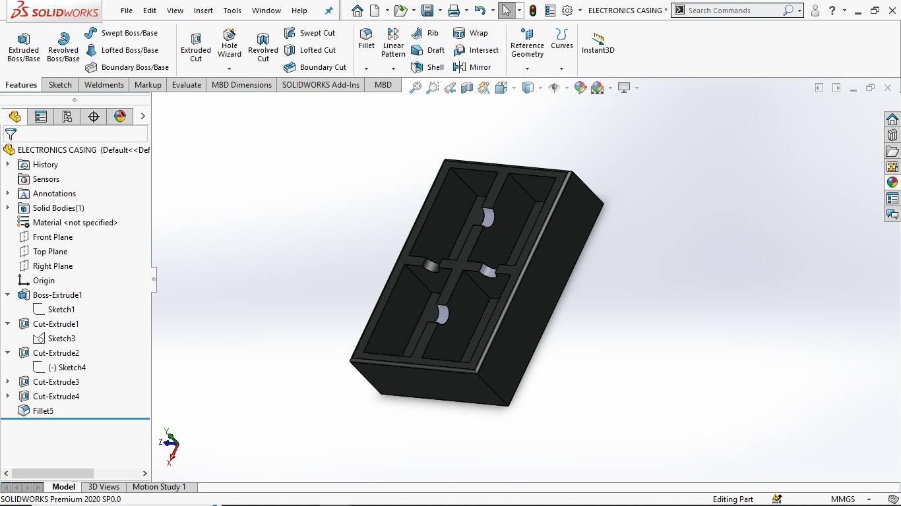
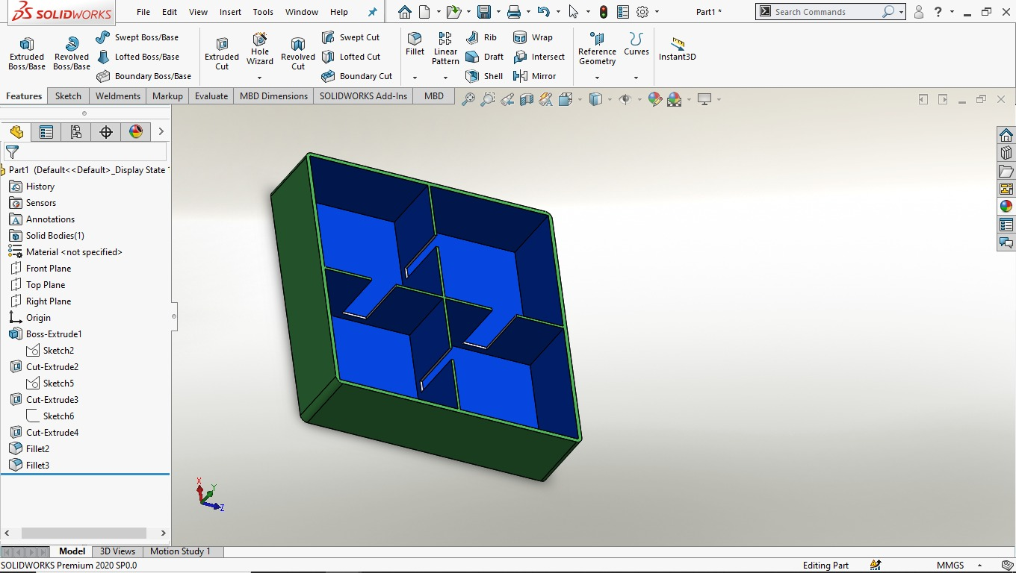
REDESIGN.
CASING FOR ELECTRONICS.

Slide 5
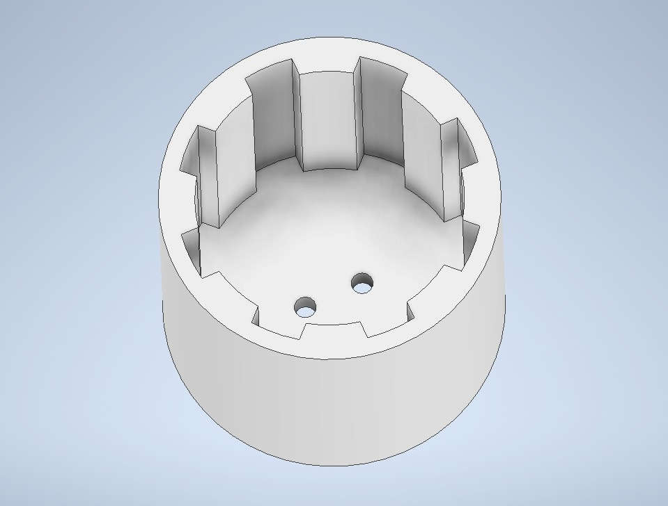
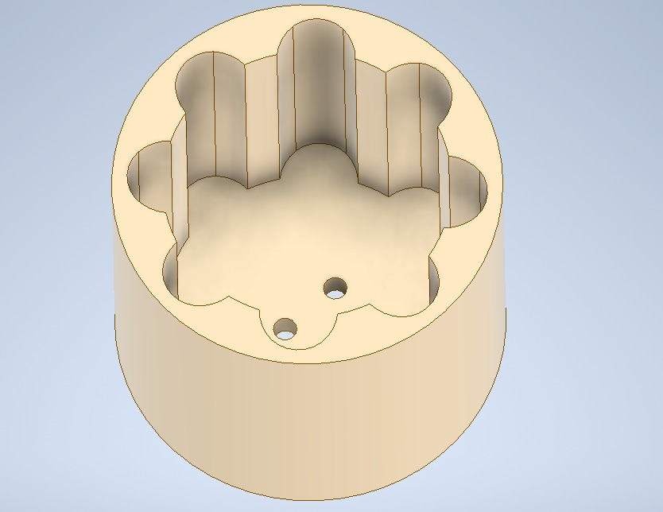
COOKING TWO GRINS
REDESIGN.
MOTOR HOLDER.

Slide 6
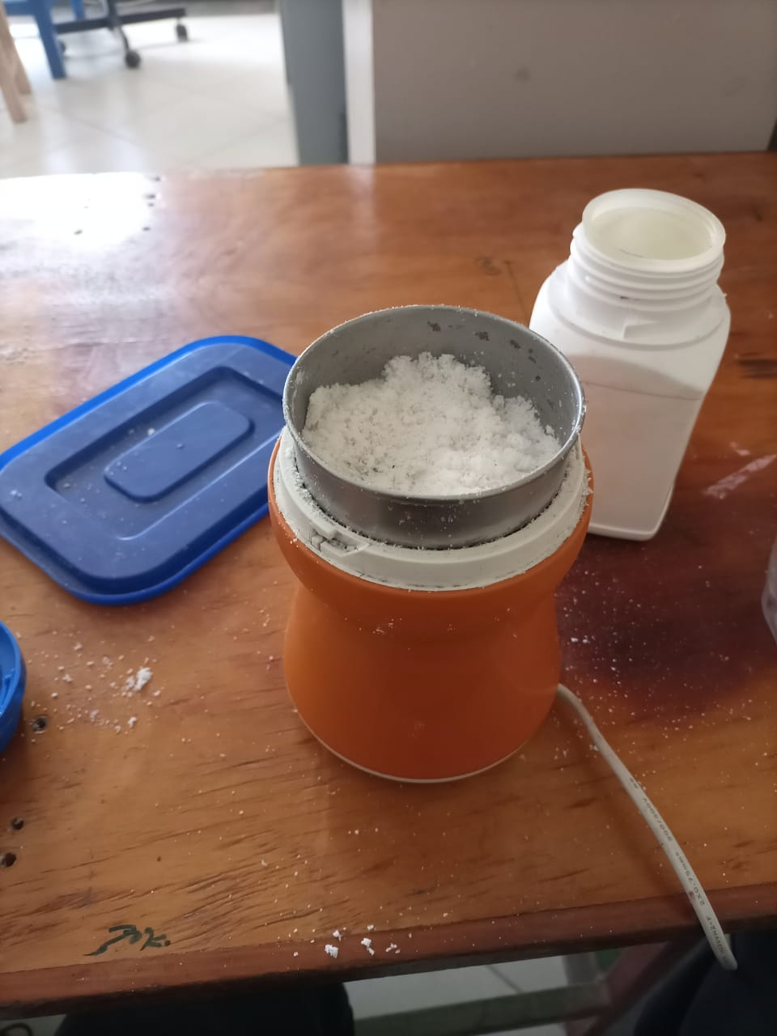
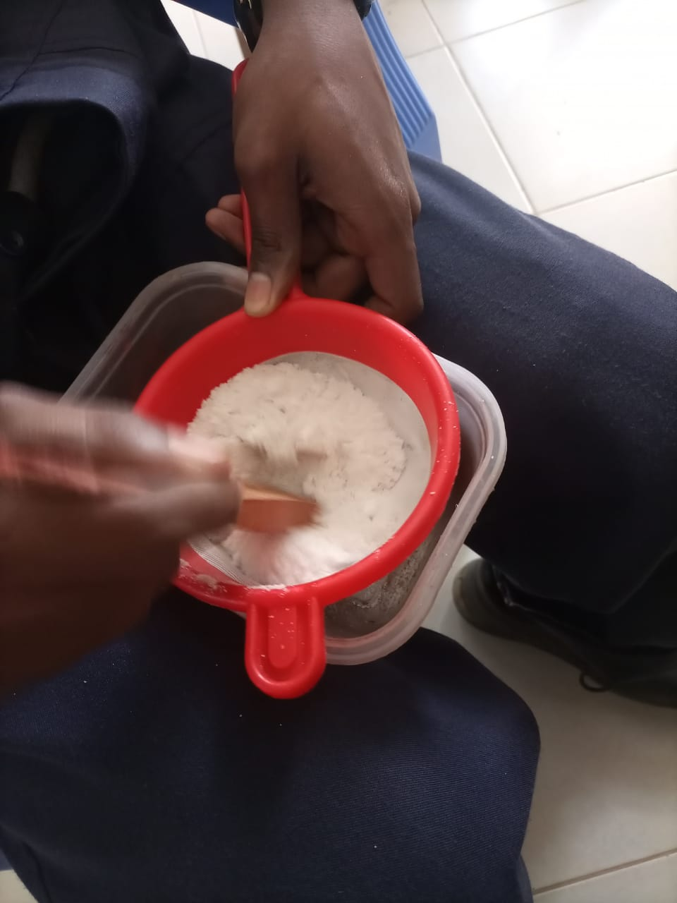
FINAL PRODUCT
COOK.
COOK 3 FULL GRAINS.

Slide 7
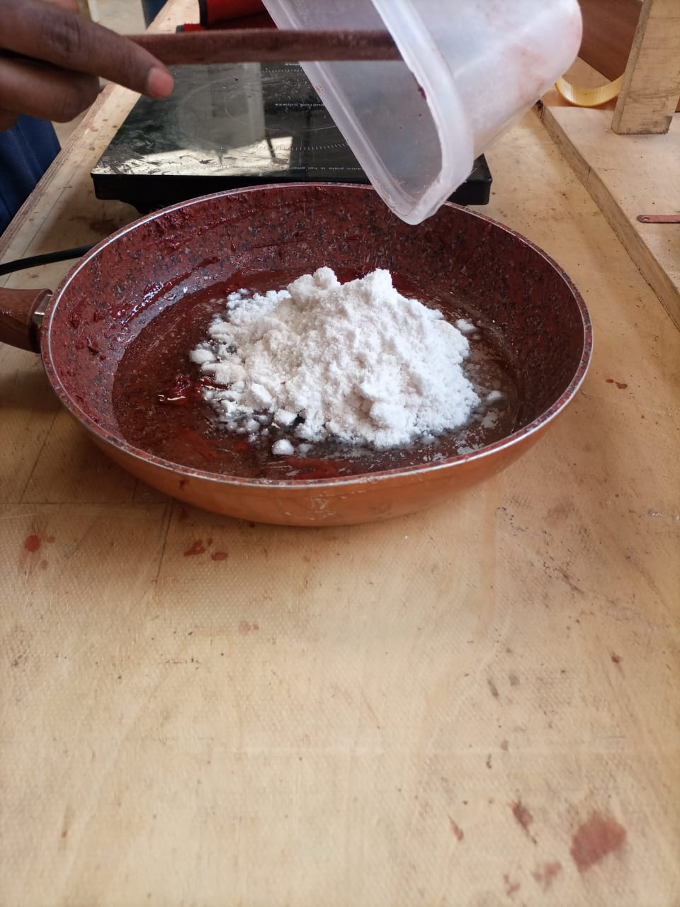
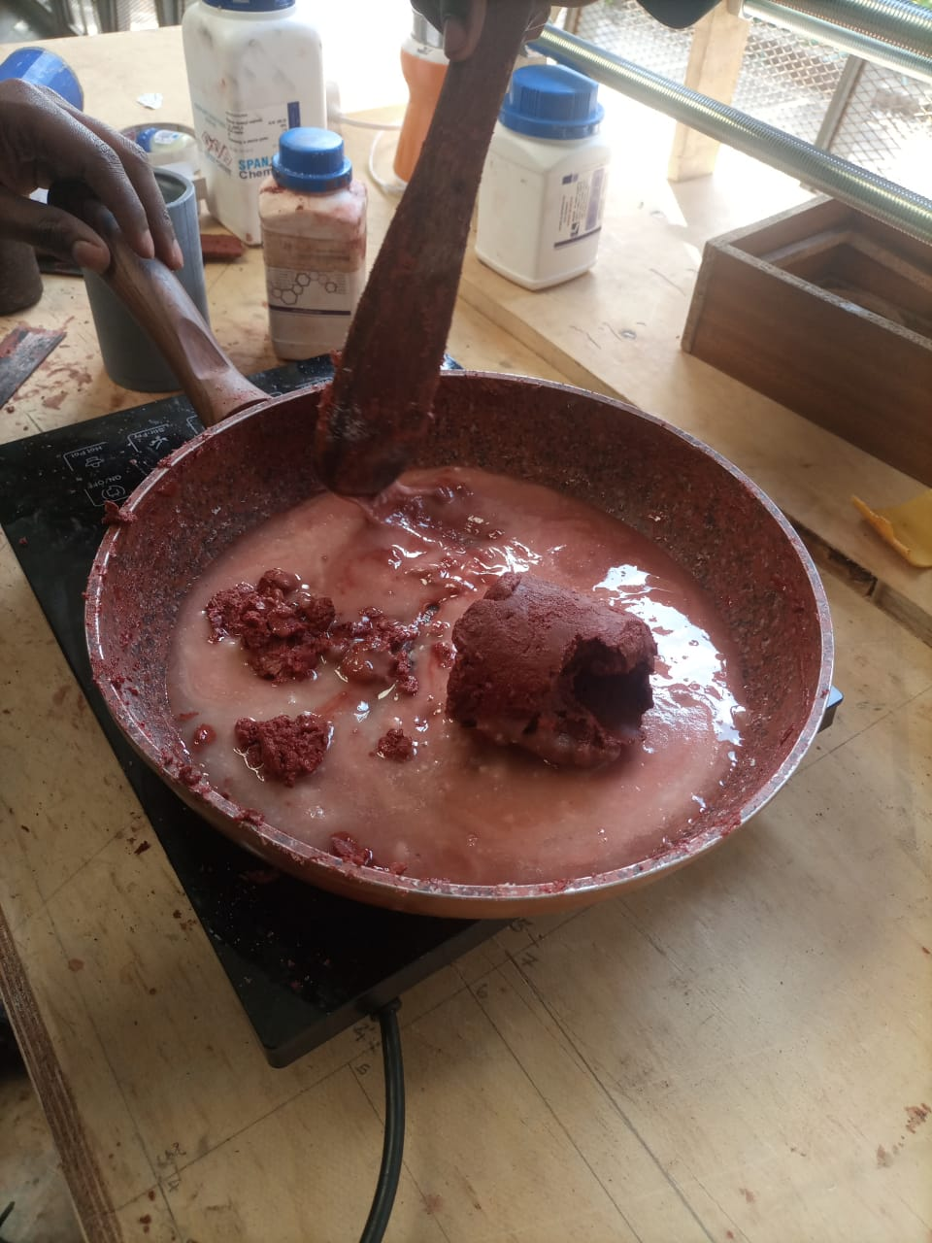
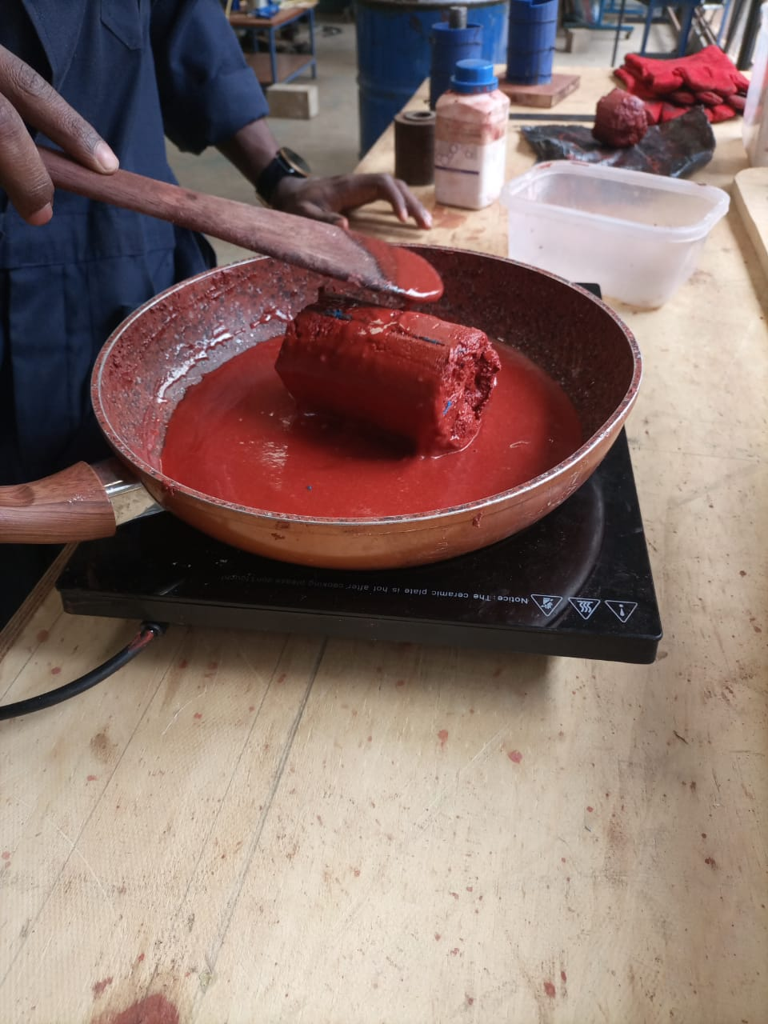
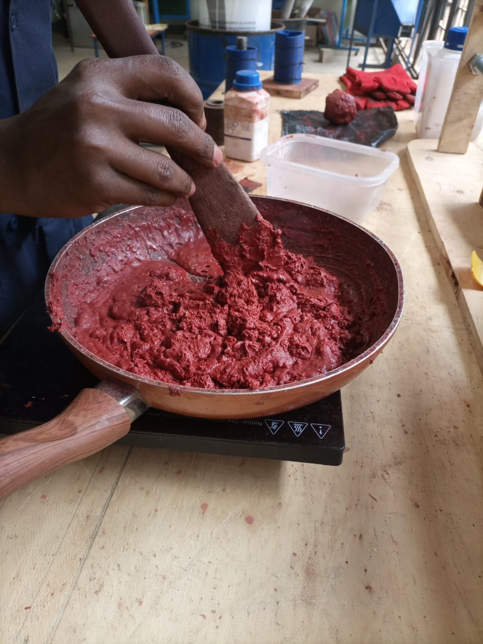
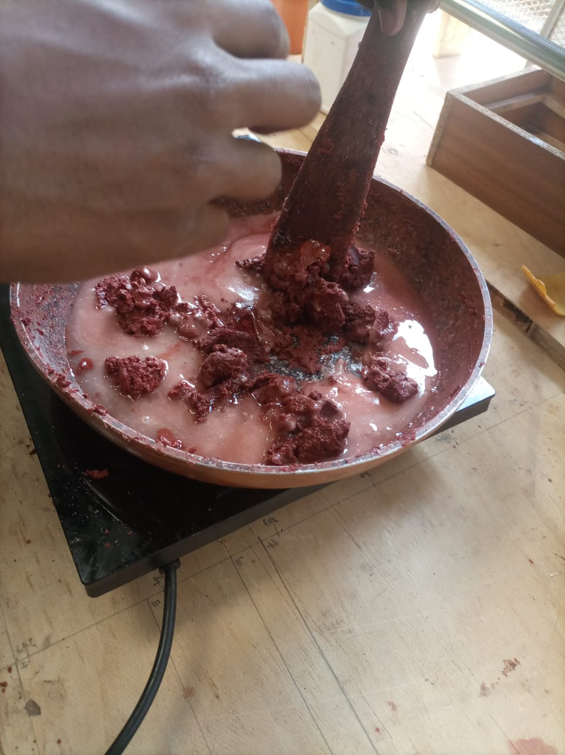
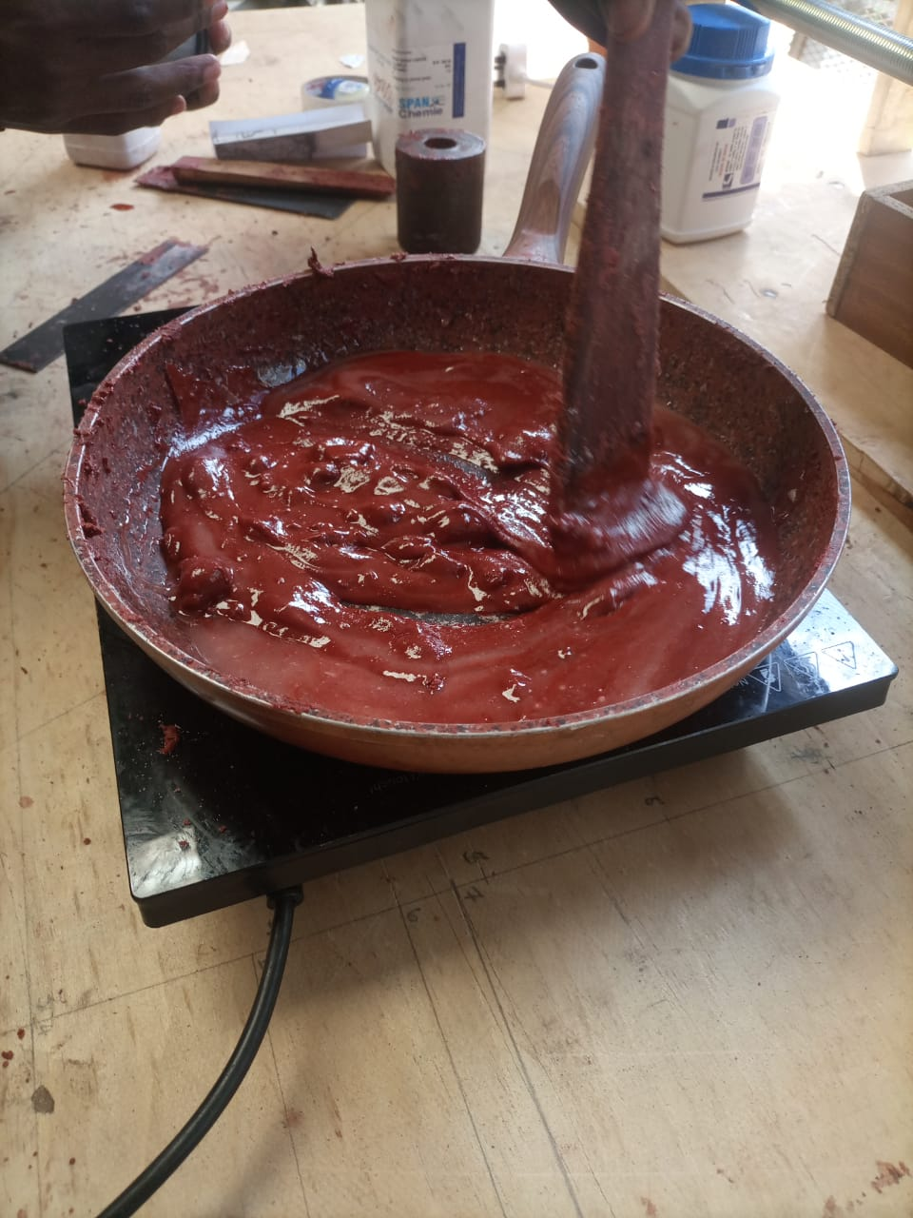
DRILLING OF BULKHEAD AND CASING
COOK.

Slide 8
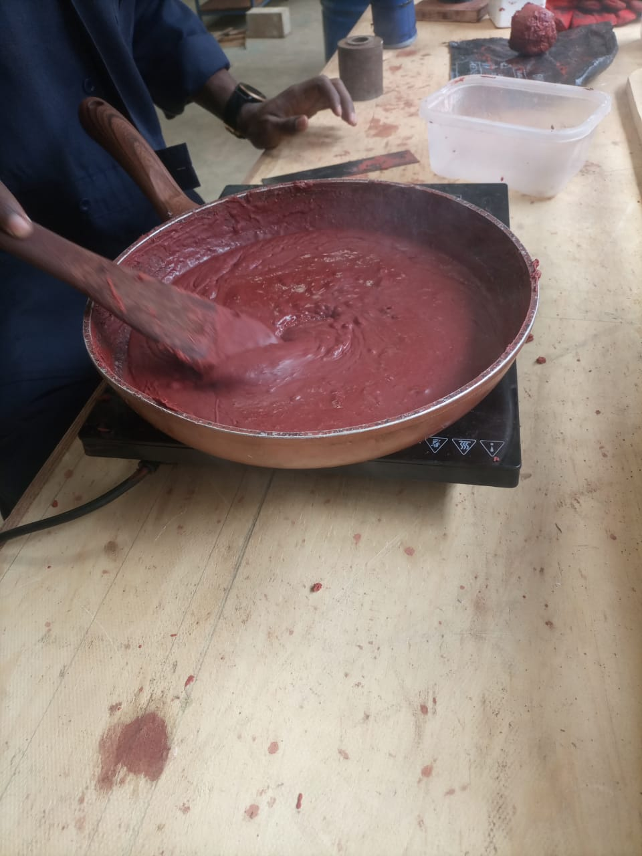
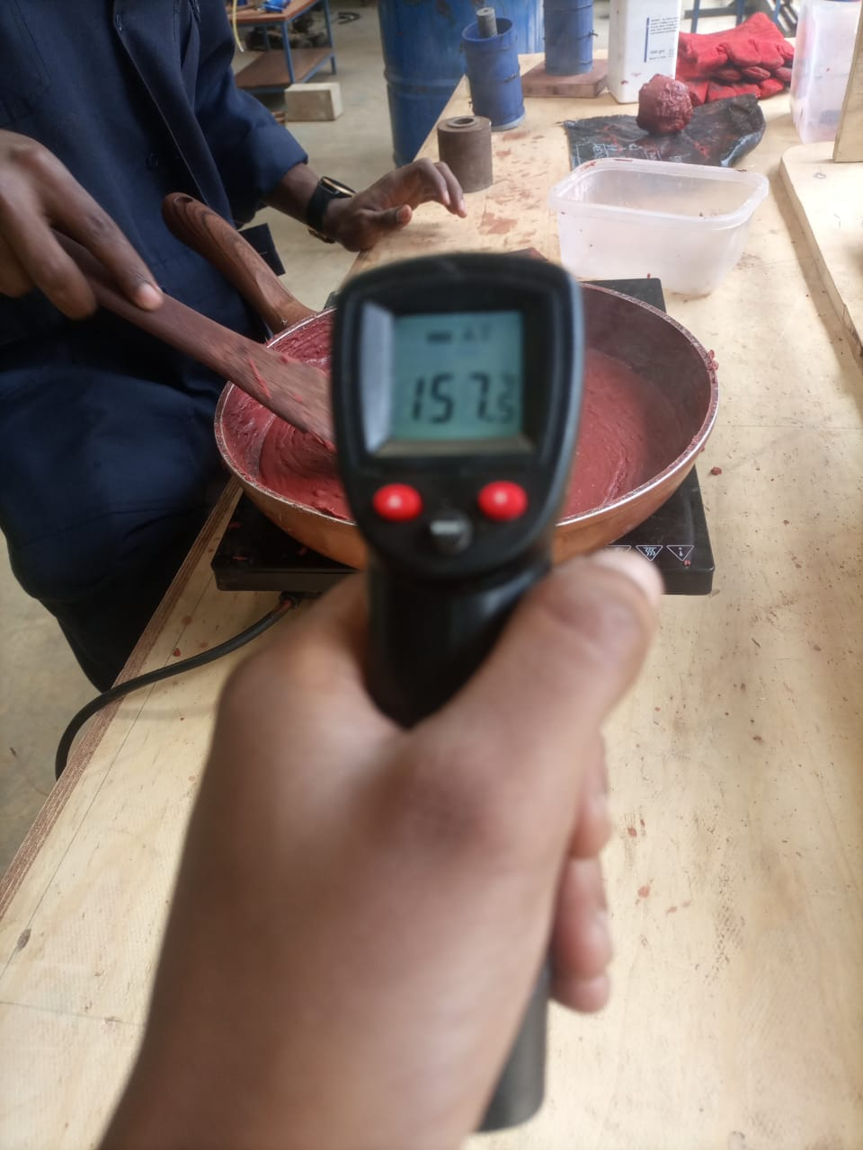
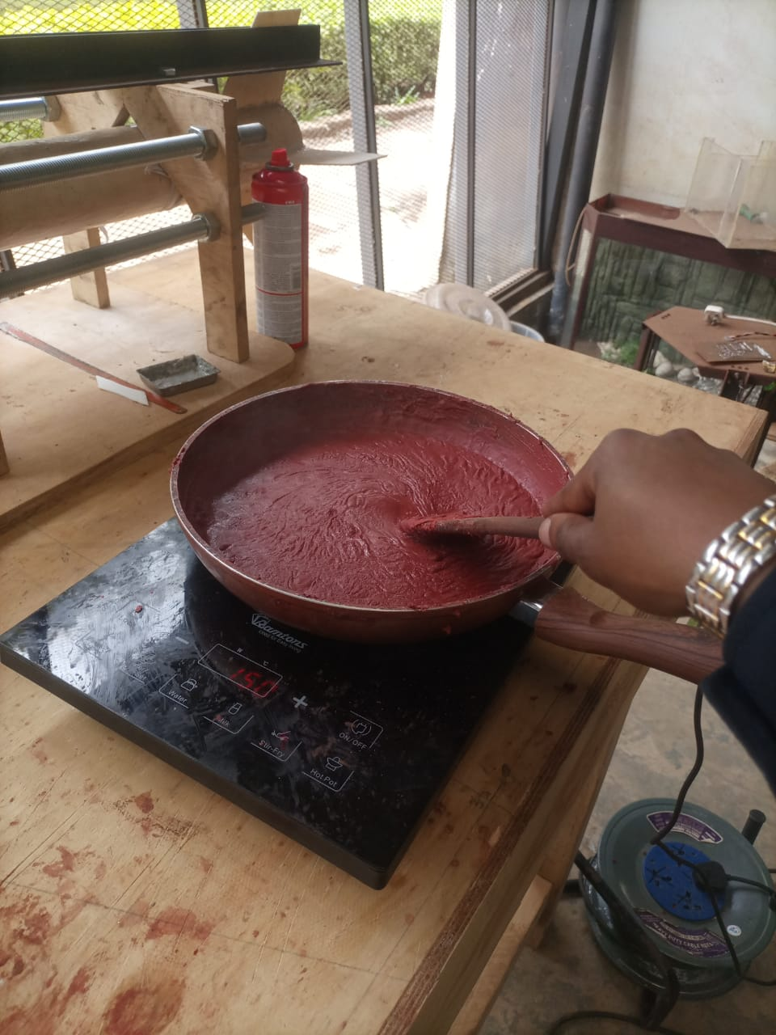
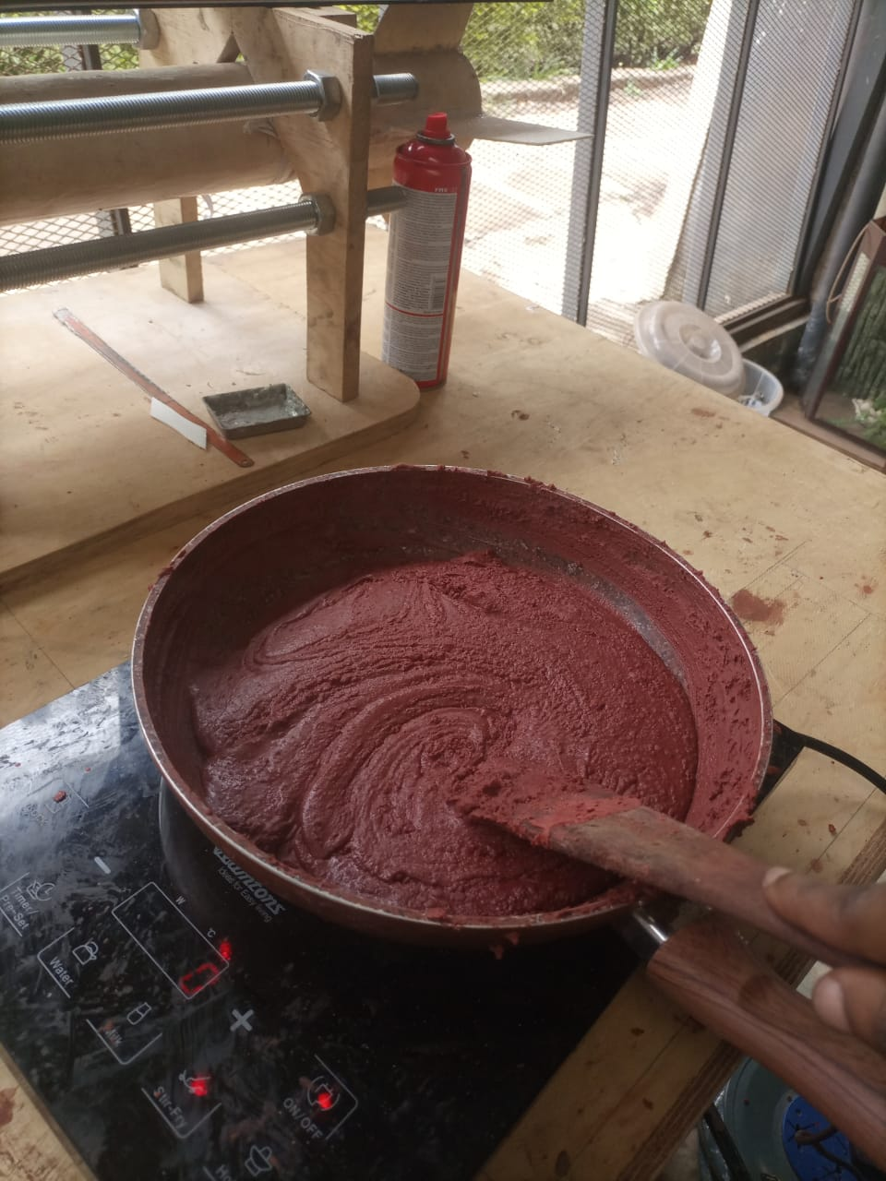
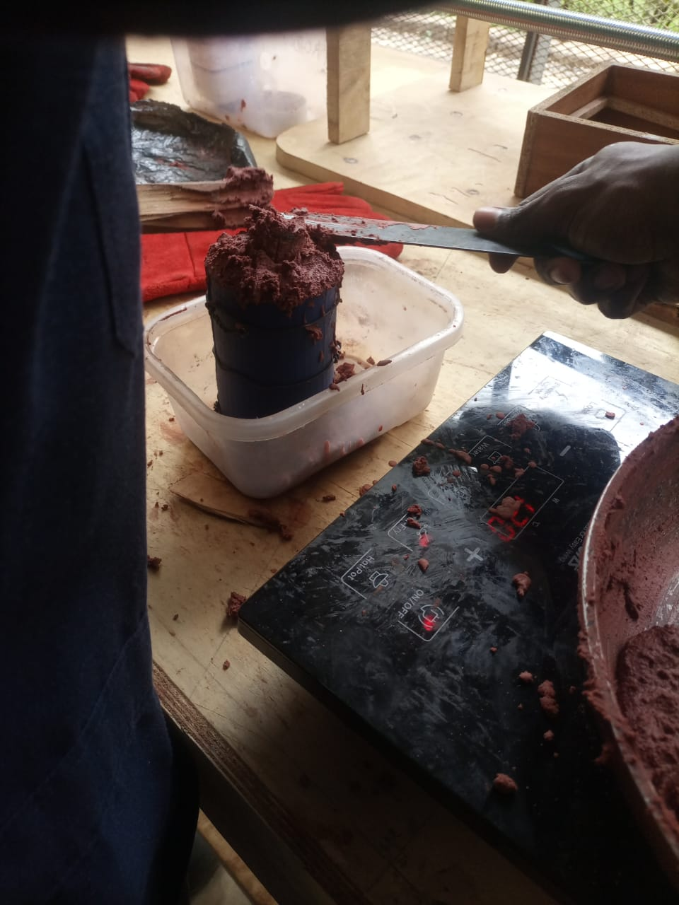
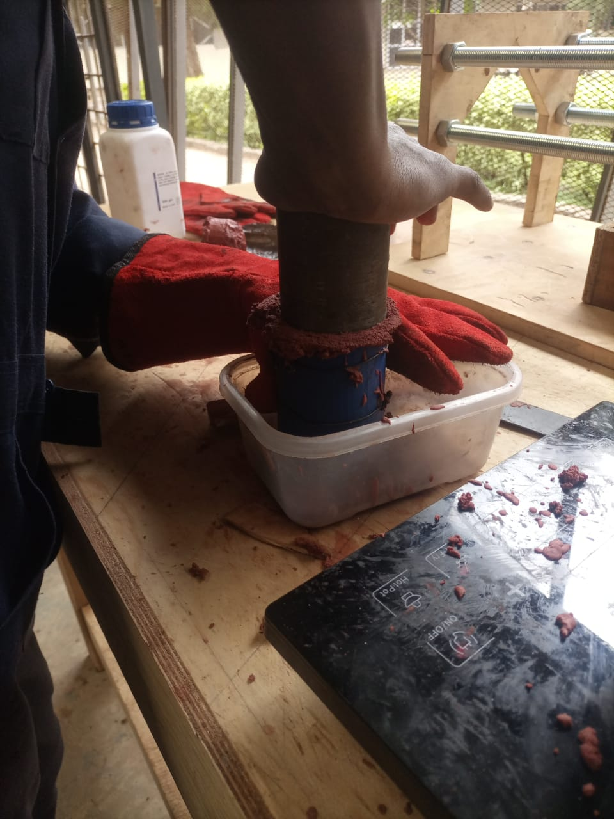

Slide 9
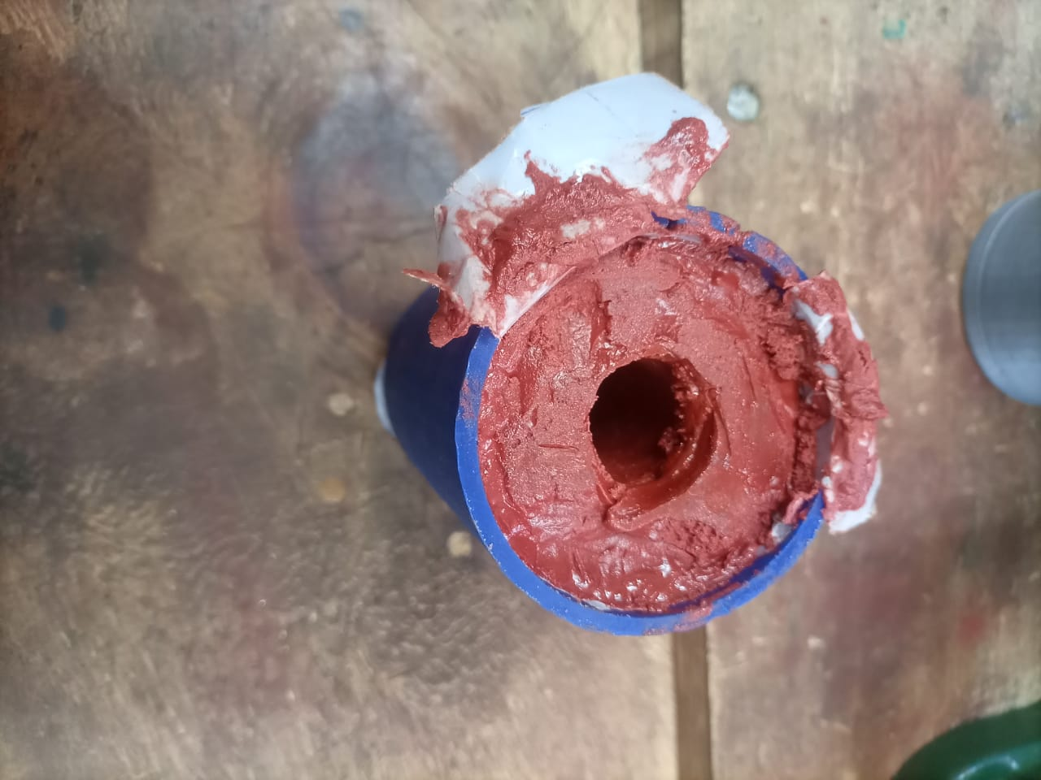
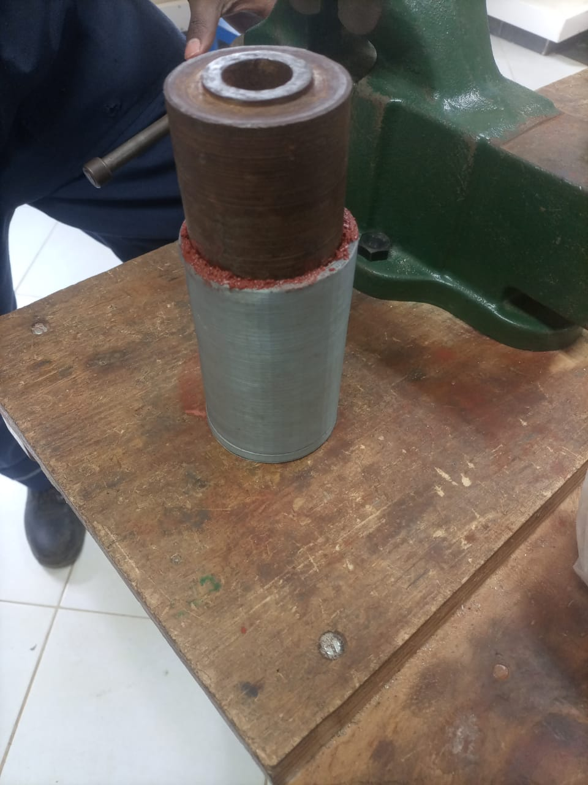
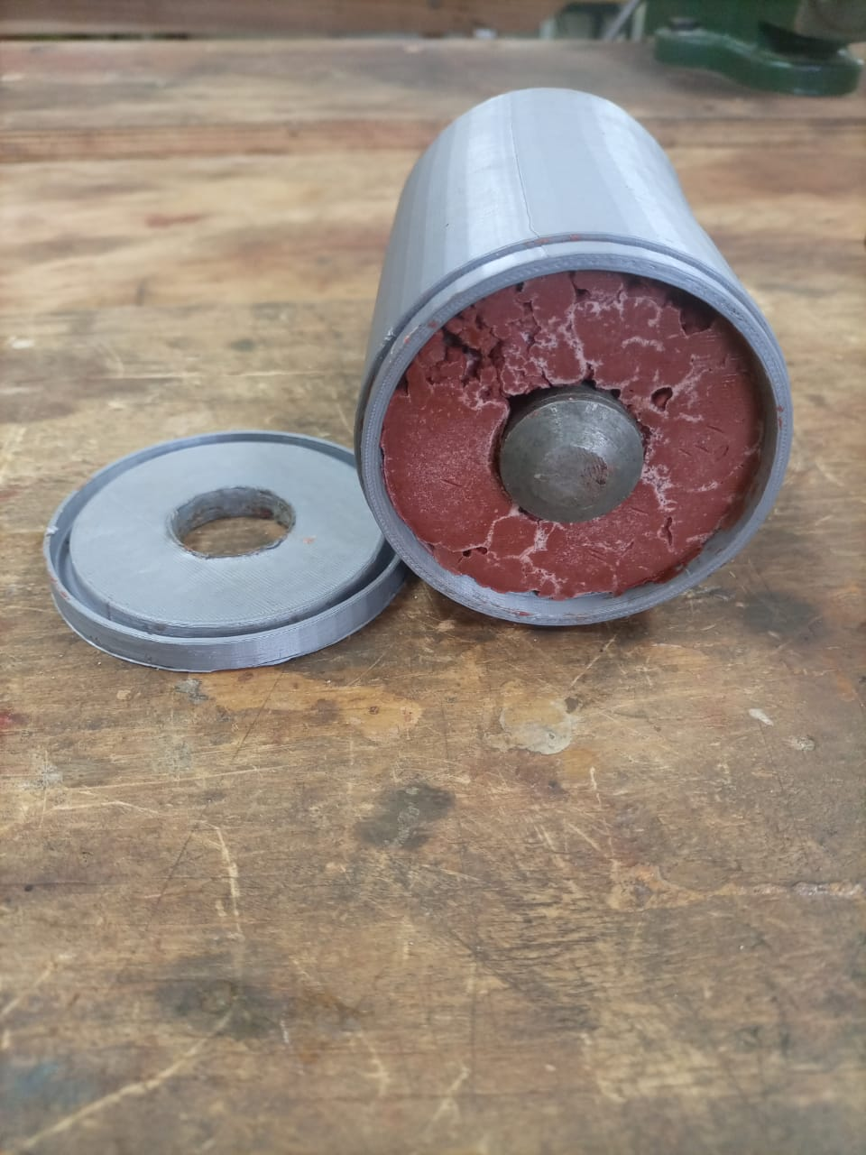
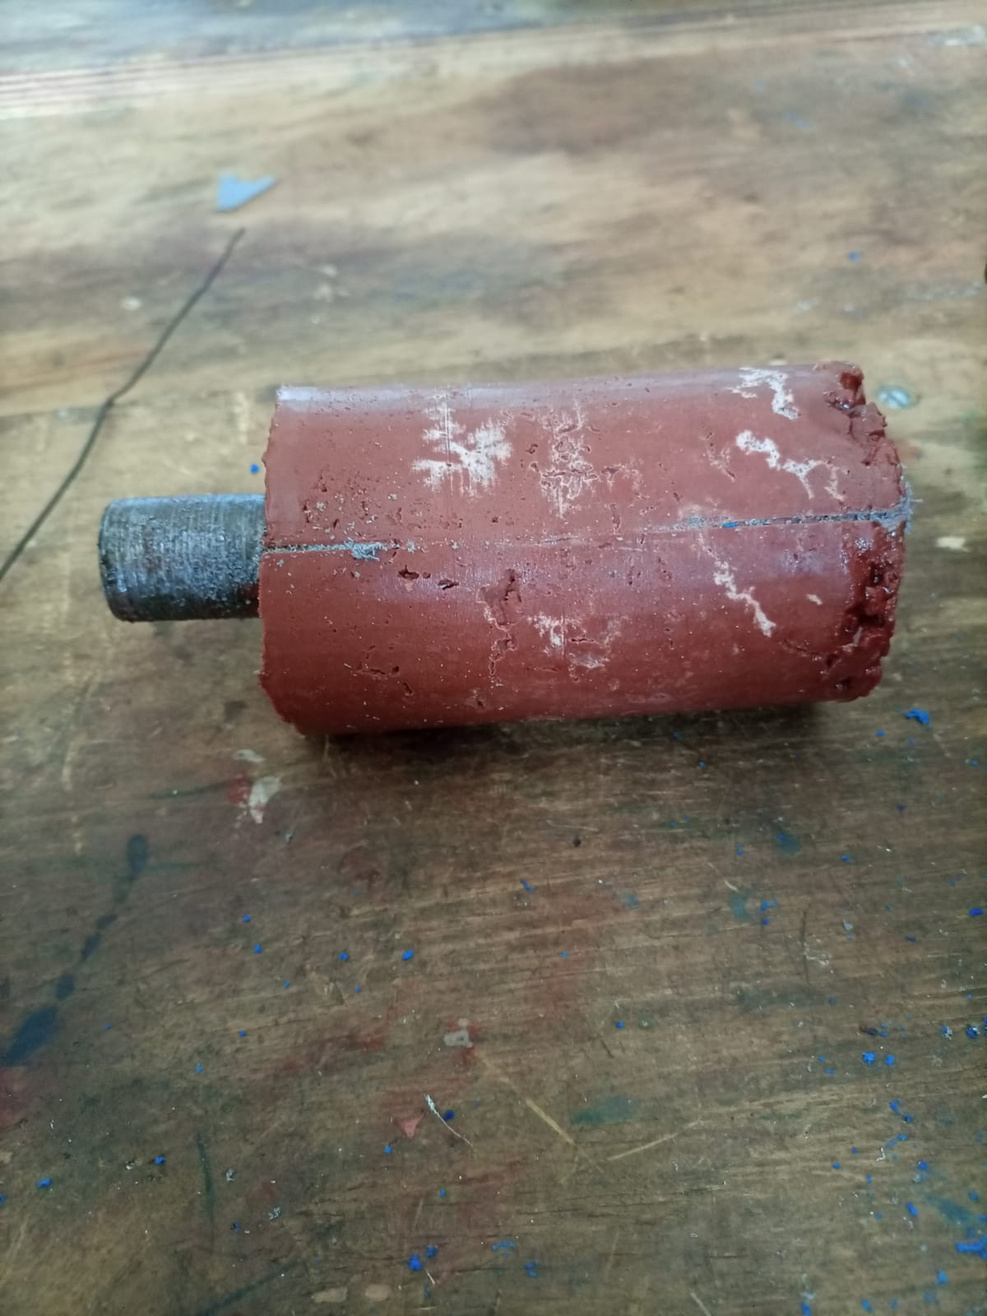
FINAL PRODUCT.

Slide 10
CHALLENGES
Lathe machine faulty.

Slide 11
NEXT WEEK’S OBJECTIVES
TWO GRAIN MOTOR SECOND STATIC TEST.
COOK 2 GRAINS FROM SCRATCH.
START AND FINISH WORKING ON THE 3 GRAIN MOTOR.
MODIFY THE DESIGN OF CASTING TOOLS.
.

Slide 12

THANK YOU

