Slide 1
Recovery Team
Week 8

Slide 2
Last Week’s Objectives
Drone Test Preparation
Piston Cage Test Design
Flight Computer
Dashboard Completion

Slide 3
Drone Test Preparation
The Flight Computer Board is done. We are testing it to ensure there are no faults before tomorrow’s test.
The software is also ready awaiting uploading to the flight computer to be used for testing
The drone test sheet is also prepared and it’s on discord

Slide 4
Piston cage test design
Due to safety considerations, we are designing a piston test cage that will be housing the piston during ejection charge tests.
The cage will be welded at the welding shop and covered with a mesh to ensure there is no debris that flies in case of structural failure.
We also include a mechanism for testing the amount of force produced by each charge used in the piston. We will measure this force by fixing a loadcell plate on one end of the cage such that when the piston rod is ejected, it hits the load cell and we can record the maximum force.

Slide 5
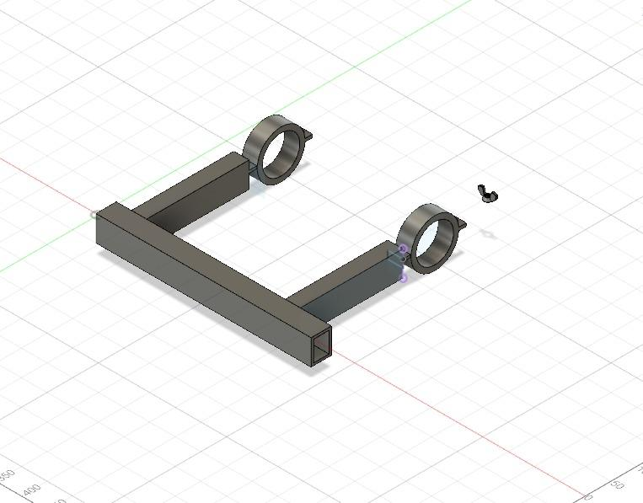
Piston Test Cage Design

Slide 6
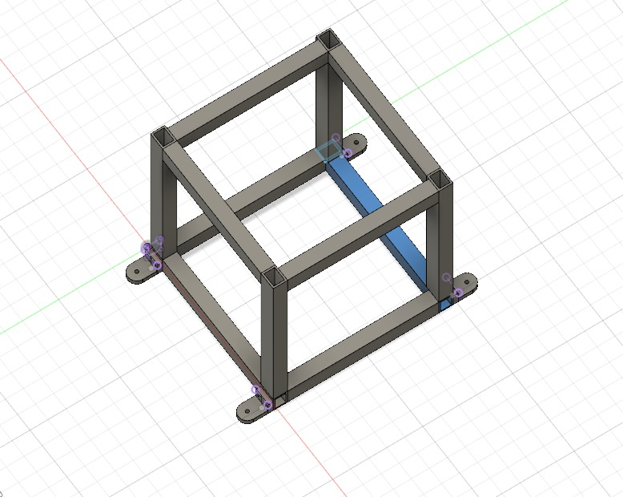
Piston Test Cage Design

Slide 7
Dashboard Completion
The initial dashboard functionality included data flow from the rocket to the InfluxDB via the antenna, router, and mosquito.
The new consideration includes a change in the framework, this was in quest to reduce the storage space, and improve speed. (the docker image for instance reduced from 564mb to 210mb).
However, the speed is relatively similar while space has reduced.

Slide 8
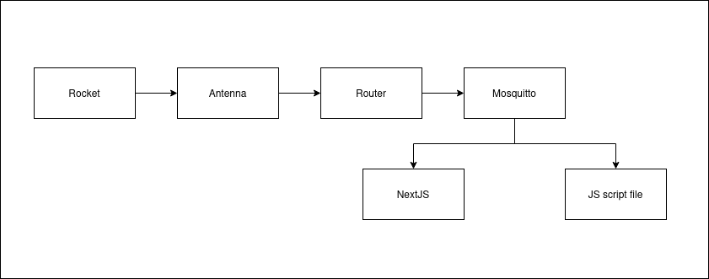
Current Data Flow

Slide 9
Incorporation of a GPS Tracking System
A Mapbox has been incorporated
It’s however online, the offline version can only work on android platforms

Slide 10
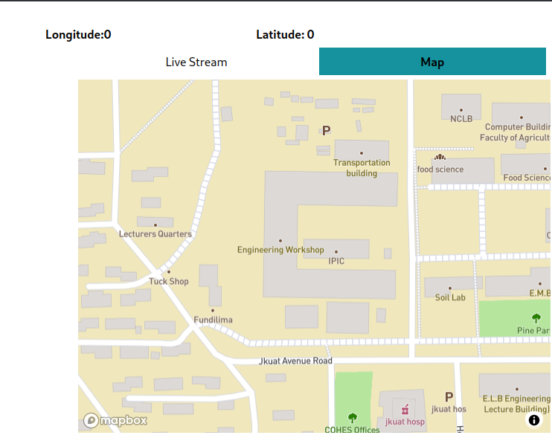
Dashboard

Slide 11
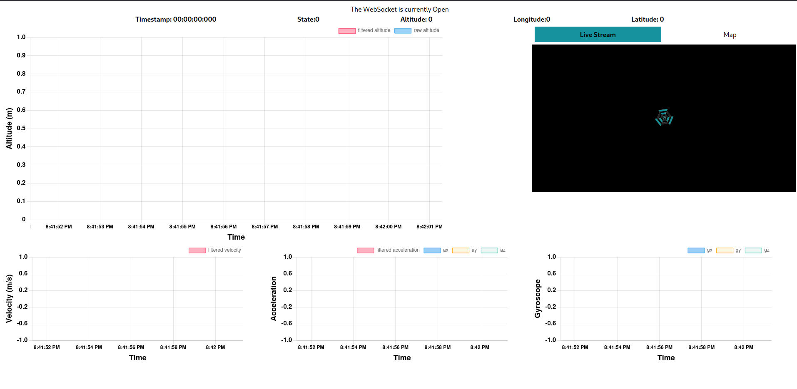
Dashboard

Slide 12
3D Rocket Model
We have also incorporated a 3D model to show the real time rocket orientation
The screenshot is indicated below

Slide 13
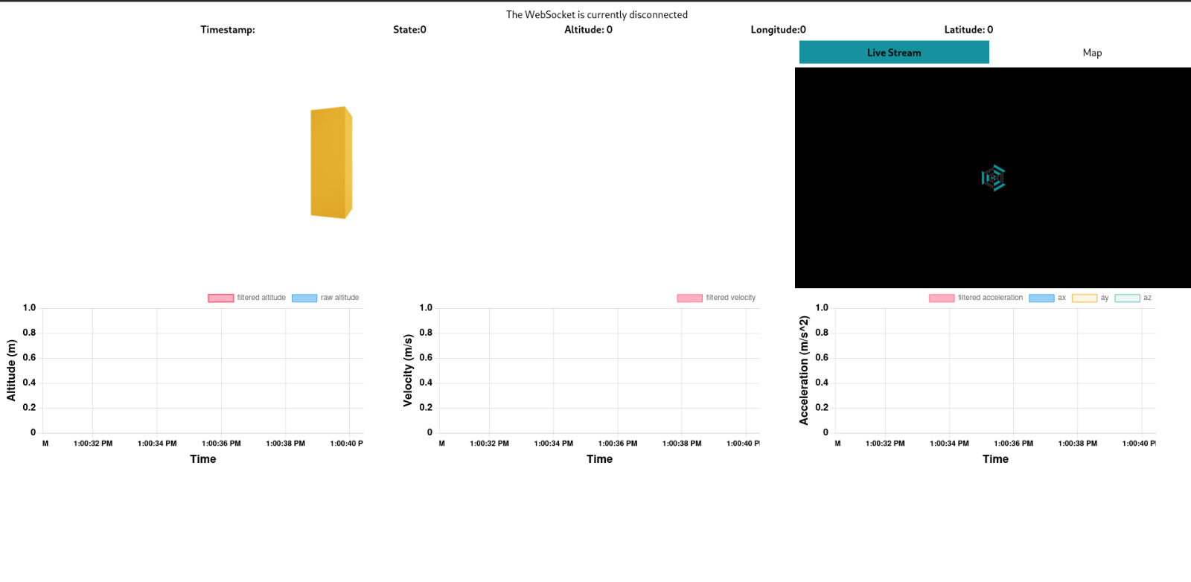
3D Rocket Model

