Slide 1
LIQUID PROPULSION
Week 10 Report

Slide 2
Tasks assigned for week 10
#137 -> Calibration of :
Pressure sensor
Temperature Sensor
#138 -> Addition of rails into test stand
#139 -> Remote operation

Slide 3
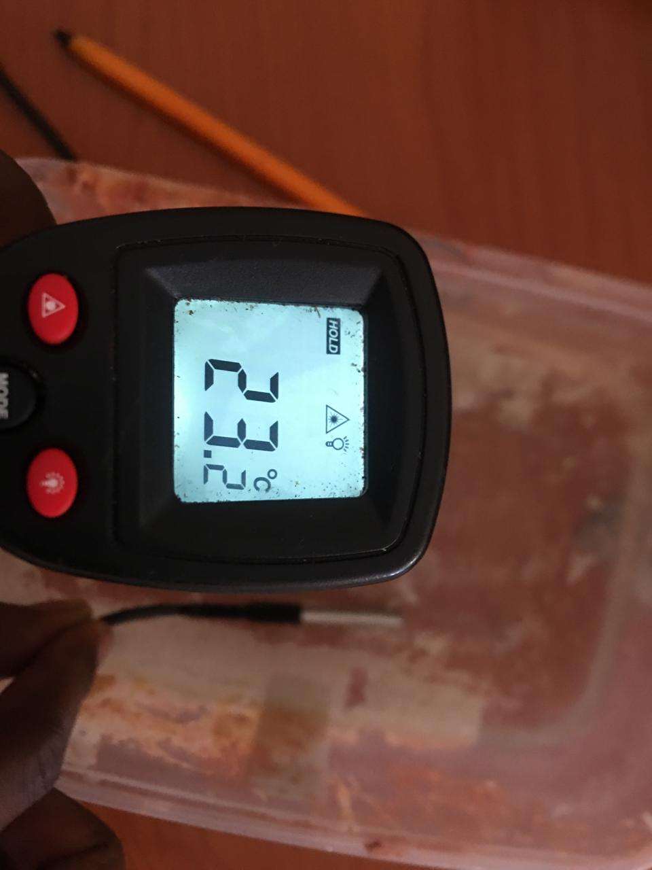
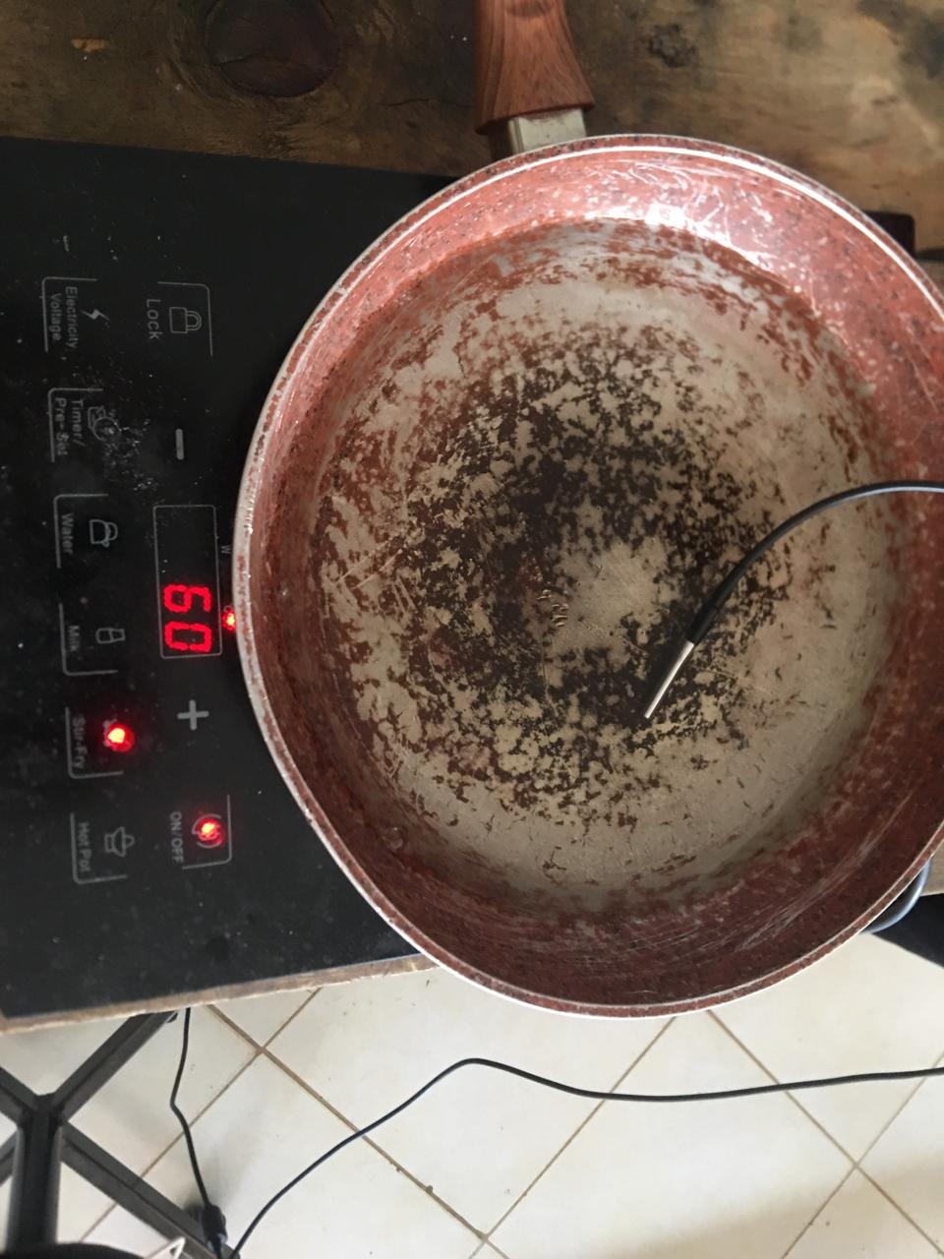
Calibration of Temperature Sensor
Test device : Infrared Temperature Sensor
Used standard temperature(Measured temperature ):
Water at room temperature(23.2 degrees celcius)
Boiling water at 100 degrees celcius.
Repeated the same for different temperatures -> 55, 60, 90 …..

Slide 4
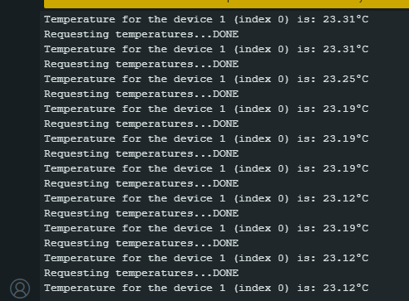
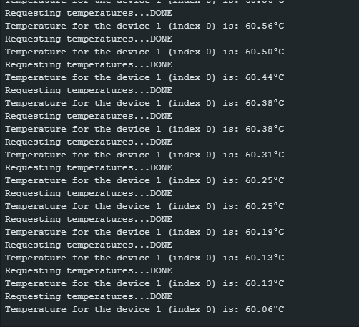
Readings during calibration
Reading at 23.2 degree celcius
Reading at 60
degree celcius

Slide 5

Calibration of Pressure Sensor
To calibrate we used the following parameters:
Voltage range that the sensor can output(From the datasheet) = (0.5 – 4.5 )V
Microcontroller maps these within a range of 4096 values.
Minimum Pressure (Pmin) gets mapped onto -> (0.5 * 4096)/ 5 = 409.6
Max Pressure (Pmax) gets mapped onto -> (4.5 * 4096)/5 = 3686.4
Pressure range(Prange) the pressure sensor can read is 1.2MPa
Actual Pressure Read = $\left(\frac{Preading −Pmin}{Pmax −Pmin}\right)$ * Prange

Slide 6
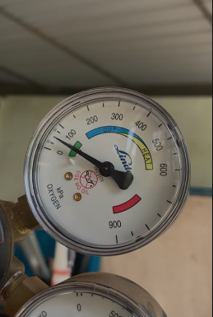
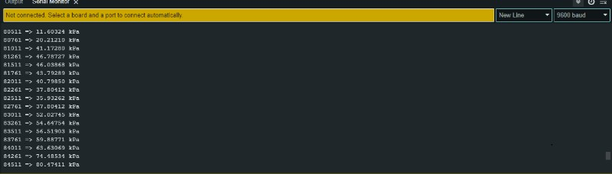
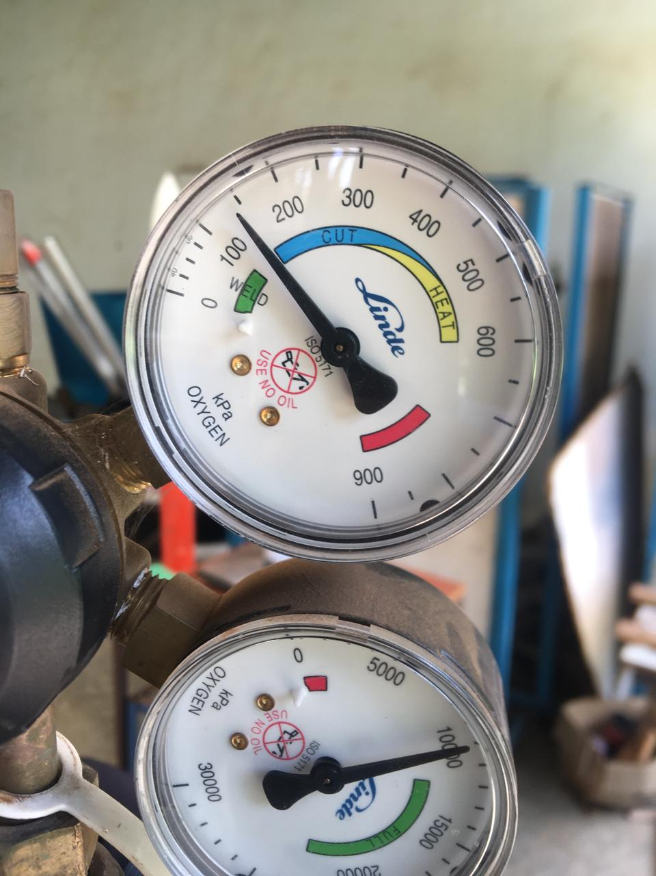
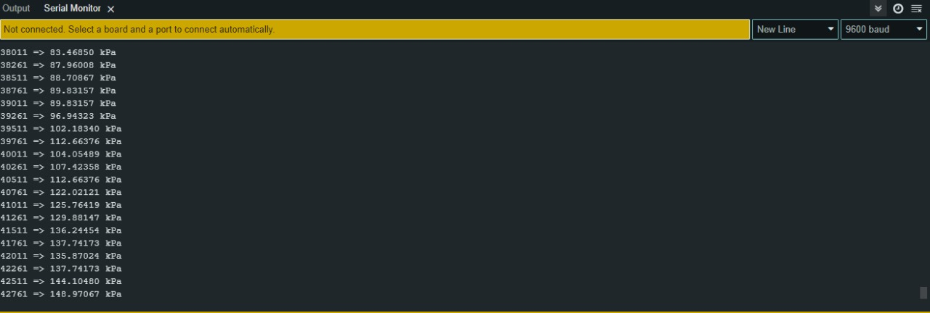
Pressure read from pressure dial vs Pressure Sensor Reading

Slide 7
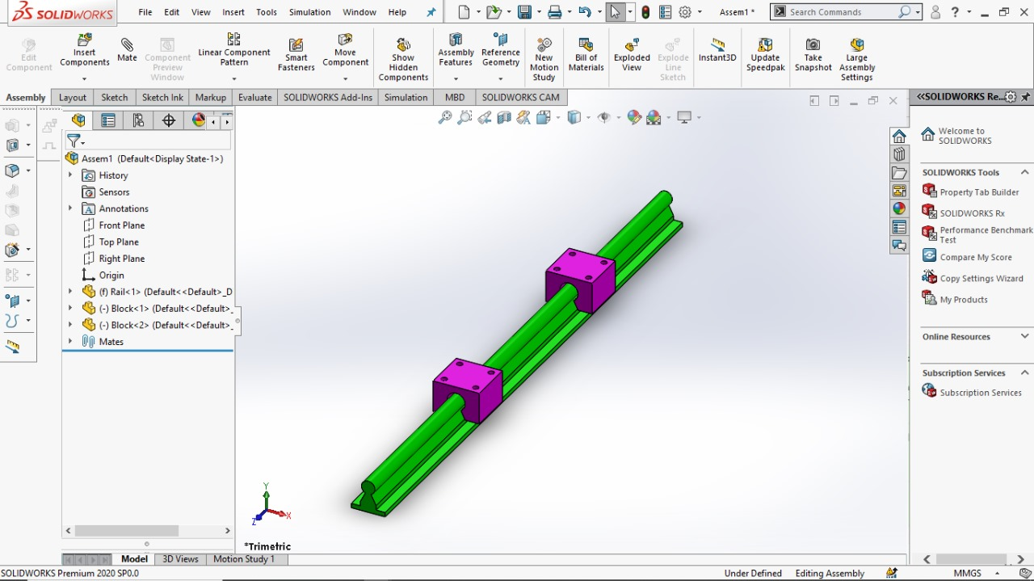
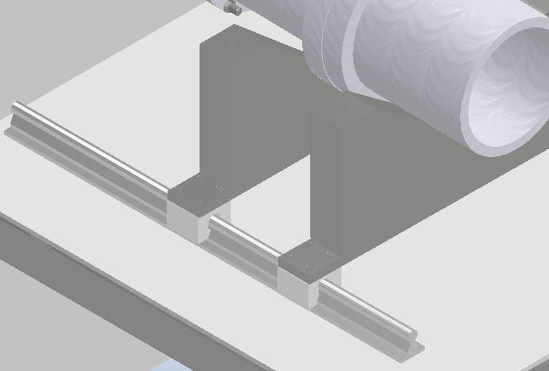
Addition of rails into test stand
We chose a linear rail of specifiactions:
1kN to support a load of 2kN of thrust
This linear load rating is for the static load . And can handle the dynamic load of 2kn.

Slide 8
Next Weeks Tasks
1. Development of the Remote operation Feature.
2. Going through the PID diagram to integrate the available sensors to our circuitry.
3. Overall integration of Safety features to our circuitry.

Slide 9
THANK YOU

