Slide 1
Network Traffic Analyser
Finding botnet-infected hosts in Wireshark captures with HDFS, Pig, Hive and Spark MLlib
CSE412 Big Data & Large-Scale Computing · Applied Project · October 2026

Slide 2
1. Introduction
A network capture (what Wireshark records) logs every packet: time, source, destination, protocol, size, TCP flags
It is the most detailed log a network keeps, and it is large: one 16-hour capture in our data has 50.8 million packets
We built an end-to-end analyser that turns captures into a list of hosts that behave like botnet-infected machines
Course track E (ETL + warehouse + ML): HDFS → Apache Pig → Apache Hive → Spark MLlib, with real data flowing between them
A web dashboard lets anyone upload their own capture and watch it go through the pipeline step by step

Slide 3
2. Literature Survey
Work | What it does | Why it matters here
BotHunter — Gu et al., USENIX Security 2007 | Follows an infection's life cycle (scan → exploit → C&C) in IDS alerts | Bots leave a recognisable pattern of network behaviour
BotMiner — Gu et al., USENIX Security 2008 | Clusters hosts by similar communication and malicious activity | Judge hosts by what they do, not by signatures
CTU-13 — Garcia et al., Computers & Security 2014 | Real botnet traffic on a university network, labelled hosts | Our dataset and ground truth
Sommer & Paxson, IEEE S&P 2010 | Why ML intrusion detection struggles outside its training data | Explains our weak result on unseen malware
Lee & Lee, ACM CCR 2013 | Packet and NetFlow analysis at terabyte scale on Hadoop and Hive | Hadoop-family tools fit packet-scale data
Pig Latin (SIGMOD 2008), Hive (VLDB 2009), Spark (CACM 2016) | The three engines we use | Dataflow ETL, SQL warehouse, distributed ML

Slide 4
3. Problem Statement
Given only packet headers from a network capture, find the hosts infected with botnet malware — and test whether this still works when the malware changes.
Why one tool is not enough:
Volume: 74.9 million packets to parse, de-duplicate and group into flows — a batch ETL job (Pig)
Query access: checking the cleaning, joining labels and reports over 7.4 million flows, plus a self-join of every flow with its reply — SQL (Hive)
Learning: telling infected from normal hosts needs a trained, honestly evaluated classifier (Spark MLlib)

Slide 5
4. Proposed Solution — Architecture
Capture
Wireshark-style log
HDFS
Apache Pig
Apache Hive
Spark MLlib
Dashboard
.pcap / .pcapng
No., Time, Source, Destination, Protocol, Length, Info
raw logs 10.8 GB
parse, clean, de-duplicate → 1-min flows
labels, reply-flow join, host features, reports
train + score botnet model
upload + results
Every stage reads the previous stage's output from HDFS; blue boxes are the three course tools
Spark's predictions go back into Hive, so results can be queried with SQL

Slide 6
4. Proposed Solution — Why each tool
Tool | What it does in the pipeline | Why this tool
HDFS 3.4.1 | Stores the 10.8 GB of packet logs and every stage's output | One shared store all engines read and write
Apache Pig 0.18 (on Tez) | Reads Wireshark's free-text Info column (ports, flags, sizes), drops non-IP rows and duplicates, builds 7.4M one-minute flows | Messy line-by-line text cleaning is a dataflow job, not SQL
Apache Hive 4.2 (on Tez) | Joins host labels, matches each flow with its reply, summarises each host minute by minute, validates Pig's output | Large joins and reports are natural in SQL
Spark MLlib 4.0 | Trains Logistic Regression and Random Forest, evaluates them, scores new captures | Distributed ML over 2.3M host-minutes
Streamlit | Upload page and result dashboards | Simple Python web UI

Slide 7
4. Proposed Solution — Dataset
Capture | Malware | Behaviour | Length | Packets | Infected hosts
CTU-13 scenario 5 | Virut | spam, port scan, HTTP | 30 min | 4.5M | 1
CTU-13 scenario 11 | Rbot | IRC control, ICMP flood | 16 min | 6.3M | 3
CTU-13 scenario 12 | NSIS.ay | peer-to-peer | 1 h 13 min | 13.2M | 3
CTU-13 scenario 13 | Virut | spam, port scan, HTTP | 16 h 22 min | 50.8M | 1
Real traffic from a university router in Prague (Stratosphere Lab), with lab PCs deliberately infected
Labels: infected hosts and 3 verified normal workstations per capture; all other hosts are unlabelled background
Packet headers only (no payloads) — published that way for privacy

Slide 8
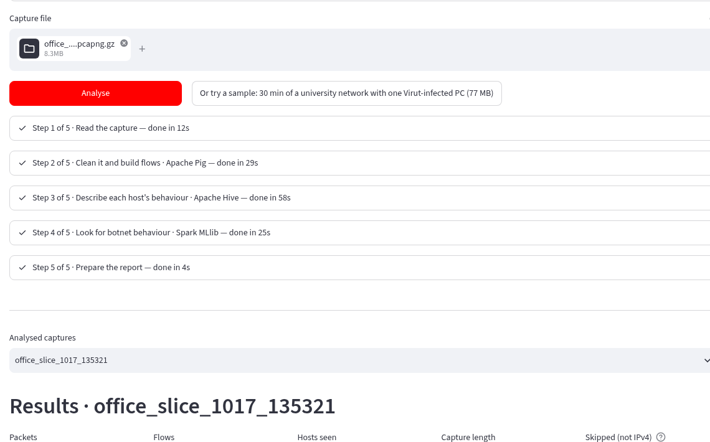
4. Proposed Solution — Web app
Upload a capture file (.pcap / .pcapng)
It runs through 5 steps: read → Pig → Hive → Spark → report
Each step shows live progress and its time
Result: a verdict, hosts ranked by botnet score, traffic charts, packet view
A 30 MB capture (353k packets) takes about 2 minutes

Slide 9
5. Results — Pipeline at full scale
Stage | Output | Time
Read captures → HDFS | 74,863,851 packet rows (10.8 GB) | 5.6 min
Pig: clean + build flows | 74,863,787 IPv4 packets, 64 rejected, 0 duplicates → 7,394,677 flows | 5.1 min
Hive: features + reports | 2,274,264 host-minutes, validation counts, dashboard tables | 10.8 min
Spark MLlib: train + evaluate | 2 models × 2 evaluation methods, saved model | 1.8 min
Total |  | 24 min
Single-node Hadoop cluster (24 cores, 16 GB RAM). Every packet is accounted for: parsed, rejected (ARP / IPv6 / malformed) or de-duplicated.

Slide 10
5. Results — How infected hosts behave
Per host, per minute (average) | Infected | Normal
Connection attempts never answered | 26.1 | 0.002
Flows with no reply at all | 8.8 | 0.07
Mail (SMTP) flows — spam | 6.6 | 0
IRC flows — botnet control channel | 1.0 | 0
Different hosts contacted | 17.0 | 9.3
Bots try many connections that nobody answers — the clearest signal
Spam and IRC traffic only ever come from infected hosts
The model's top features agree: unanswered SYNs, SYN flows, HTTPS flows, flow count

Slide 11
5. Results — Detecting a known infection
Random Forest: F1 0.988 — catches 97.8% of infected minutes with 99.7% precision
0 false alarms on the verified normal PCs
A simple "talks to 20+ hosts" rule scores F1 0.07: servers do that all the time

Slide 12
5. Results — Detecting unseen malware
Train on 3 captures, test on the 4th
Virut is still caught (AUC-PR 0.97–1.0): the other Virut capture was in training
Rbot and NSIS behave differently and are missed
Behaviour models do not transfer to new malware families — as Sommer & Paxson predict

Slide 13
6. Conclusion
What worked
  A working HDFS → Pig → Hive → Spark MLlib pipeline over 74.9M real packets, end to end in 24 minutes
  Infected hosts found with F1 0.988 and no false alarms on normal PCs, when the malware is known
  A web app where anyone can upload a Wireshark capture and get results in minutes
Limits
  Malware families not seen in training are missed; only 3–4 infected and 3 normal hosts per capture are labelled
  Headers only, IPv4 only, single-node cluster
Future work
  Train on more botnet families (other CTU-13 scenarios), add IPv6 and DNS features, add live capture with Kafka + Spark Streaming

