Slide 1
PYTHON TKINTER DESKTOP APPLICATION
Prompt Pilot
Intelligent Multi-LLM Intent Recommendation & Prompt Engineering System
PROJECT TEAM MEMBERS
Nakulvasudev T
Reg No: RA2511031010028
Lead Software Architect & GUI Engineering
SriMithru
Reg No: RA2511031010040
Data Engineering & Domain Knowledge Curation
Mukesh
Reg No: RA2511031010038
Model Intelligence Research, QA & Documentation

Slide 2
PROJECT BACKGROUND
Introduction & Project Motivation
The Modern AI Challenge
• The Multi-LLM Landscape:
Users now navigate ChatGPT, Claude, Gemini, DeepSeek, Perplexity, and Copilot—each with divergent architectures and specialized strengths.
• The 'Model Fatigue' Dilemma:
Selecting the wrong model leads to subpar outputs (e.g., using a general chatbot for live web research or deep algorithmic debugging).
• The Prompt Engineering Barrier:
Most users write vague queries without domain-specific constraints (e.g., missing 'time complexity' for code or 'cite sources' for research).
• Lack of Model Tier Awareness:
Providers offer complex tier structures (Opus vs Sonnet, Pro vs Flash, Thinking vs Instant) without clear speed vs capability clarity.
The Prompt Pilot Solution
✔ Automated Intent Recognition:
Parses natural language task descriptions using a heuristic NLP engine matching 300+ trigger keywords across 10 specialized domains.
✔ Deterministic Priority Ranking:
Ranks top LLMs in strict priority order for the detected task domain, complete with contextual rationale ('Good for...').
✔ Granular Model Tier Breakdown:
Exposes concrete sub-model hierarchies (e.g. Claude Opus > Sonnet > Haiku) tagged by capability: fastest, balanced, or deep reasoning.
✔ Curated Prompt Keywords:
Generates instant copy-ready prompt engineering keywords to enforce structural constraints, formatting, and edge-case handling.
✔ Zero Overhead Desktop App:
Built in pure Python with Tkinter—launches instantly with zero accounts, no subscription keys, and 100% offline recommendation logic.

Slide 3
SYSTEM COMPARISON
Comparative Analysis: Proposed vs. Existing System
Evaluation Metric | Traditional / Existing Workflow | Proposed System: Prompt Pilot
Task & Model Discovery | Manual guesswork. Users cycle through multiple browser tabs (ChatGPT, Claude, Gemini) trial-and-erroring queries without knowing model specialties. | Instant Automated Recommendation. User enters 1 sentence; Prompt Pilot identifies task category and returns prioritized LLMs in 0 milliseconds.
Model Tier Transparency | Opaque and confusing naming schemes (e.g. Sonnet, Haiku, Flash, Thinking, Sonar) with no guidance on latency vs intelligence trade-offs. | Granular Model Hierarchy. Lists exact models ranked by tier with explicit capability tags: fastest, balanced, deep reasoning, or most capable.
Prompt Formulation Quality | Unstructured prompts resulting in hallucinations, missing details, verbose fluff, and lack of technical constraints. | Contextual Keyword Suggestions. Supplies curated domain-specific keywords (e.g. 'edge cases', 'cite sources with links', 'ELI5', 'table format').
Operational Overhead | High context-switching penalty. Requires multiple active logins, heavy web pages, API rate-limits, and subscription fragmentation. | Lightweight Local Desktop Tool. Zero logins, zero API tokens, runs on pure Python standard library, instant response with clean visual feedback.

Slide 4
TEAM ASSIGNMENTS & RESPONSIBILITIES
Individual Technical Contributions & Architecture
★ Evaluation Criterion: Rigorous technical work breakdown. Individual modules, algorithmic development, and verified deliverables.
Nakulvasudev T
Reg No: RA2511031010028
Lead Software Architect & GUI Engineering
▶ Desktop GUI Architecture
Architected and implemented the Tkinter desktop GUI, structuring the two-column master-detail layout, layout geometry, responsive packing, and PhotoImage logo caching.
▶ NLP Tokenizer & String Cleaning
Engineered the text sanitization pipeline (`lower()`, punctuation stripping `.,?!;:()'"`, and tokenization) to extract clean search tokens from user inputs.
▶ Matching & Greedy Scoring Logic
Implemented `find_llms()` and `is_match()` algorithms: evaluates trigger occurrences across 10 categories, handles greedy tie-breaking, and triggers fallback picks.
▶ Dynamic Tier & Detail Resolver
Constructed `show_details()` and `models_text()` to dynamically bind model hierarchies, format bullet lists, and manage selection states with error handling.
SriMithru
Reg No: RA2511031010040
Data Engineering & Knowledge Base Curation
▶ Domain Vocabulary Dataset
Researched and curated 300+ categorized trigger words spanning Coding, Research, Writing, Study, Data, Math, Translation, Brainstorming, Design, and General.
▶ Empirical Model Benchmarking
Conducted comparative performance benchmarks across LLMs to establish deterministic priority ranking orders (`order` dictionary) for each domain.
▶ Contextual Rationale Synthesis
Formulated detailed domain capability explanations (`good_for` dictionary) articulating why specific models outperform competitors for each task.
▶ Prompt Engineering Keywords
Researched and compiled specialized prompt constraint keywords (`keywords` dictionary) optimized for output quality, precision, and edge-case prevention.
Mukesh
Reg No: RA2511031010038
Model Intelligence Research & Quality Assurance
▶ LLM Tier Hierarchy Mapping
Investigated contemporary model families across providers to build the granular sub-model catalog (`models` dictionary) covering Opus/Sonnet, Pro/Flash, and Sonar.
▶ Performance Tagging System
Designed and mapped the capability tagging ontology (`tags` dictionary) categorizing model tiers into 'fastest', 'balanced', 'deep reasoning', and 'most capable'.
▶ Test Suite & Edge-Case QA
Authored comprehensive test suites: verified zero-match general fallbacks, empty inputs, non-selection validation, punctuation stripping, and prefix matches.
▶ Technical Documentation Deliverables
Created architectural data-flow diagrams, system specifications, and coordinated evaluation deliverables for academic defense.

Slide 5
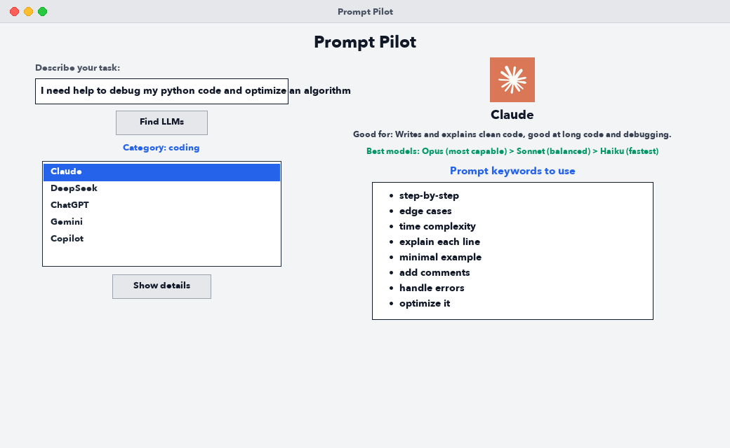
APPLICATION WALKTHROUGH — USE CASE 1
Software Demonstration: Coding & Algorithm Optimization
Workflow Breakdown
• Input Prompt:
"I need help to debug my python code and optimize an algorithm"
• Intent Classification:
The tokenizer strips punctuation and matches trigger words 'debug', 'python', 'code', 'algorithm'. Categorized as 'coding'.
• Ranked LLM Recommendation:
Claude is identified as the #1 coding model, followed by DeepSeek, ChatGPT, Gemini, and Copilot in deterministic priority order.
• Model Tier Guidance:
Prescribes Claude 3.5/3.7 tier hierarchy: Opus (most capable), Sonnet (balanced), Haiku (fastest).
• Actionable Prompt Keywords:
Recommends essential coding prompt constraints: 'step-by-step', 'edge cases', 'time complexity', 'explain each line'.

Slide 6
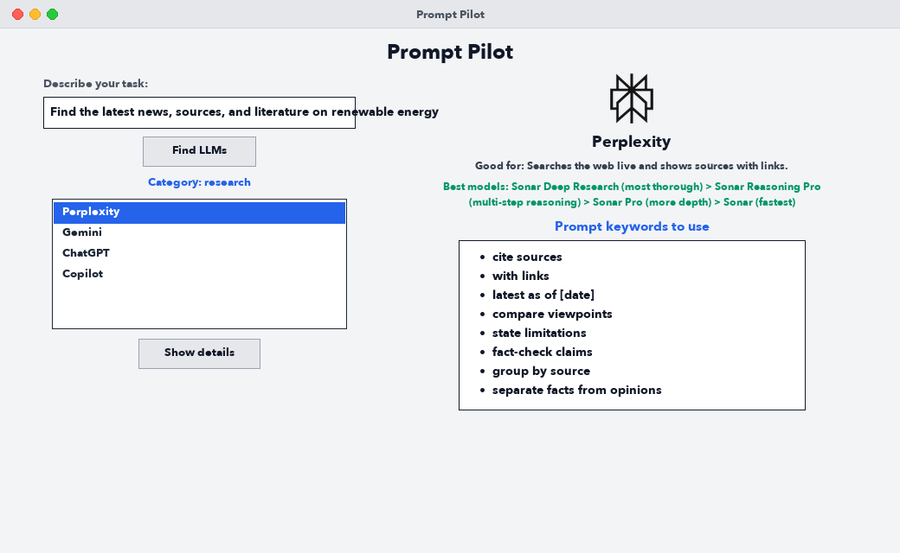
APPLICATION WALKTHROUGH — USE CASE 2
Software Demonstration: Academic & Web Research
Research Intelligence
• Input Prompt:
"Find the latest news, sources, and literature on renewable energy"
• Intent Classification:
Matches trigger words 'latest', 'news', 'sources', 'literature'. Classified cleanly into 'research' category.
• Ranked LLM Recommendation:
Perplexity is recommended as #1 pick due to real-time search indexing and source attribution, followed by Gemini and ChatGPT.
• Sub-Model Specialization:
Details Perplexity Sonar options: Sonar Deep Research (thorough synthesis) down to Sonar (rapid lookup).
• Prompt Engineering Anchors:
Guides the user to attach key phrases: 'cite sources', 'with links', 'latest as of [date]', 'separate facts from opinions'.

Slide 7
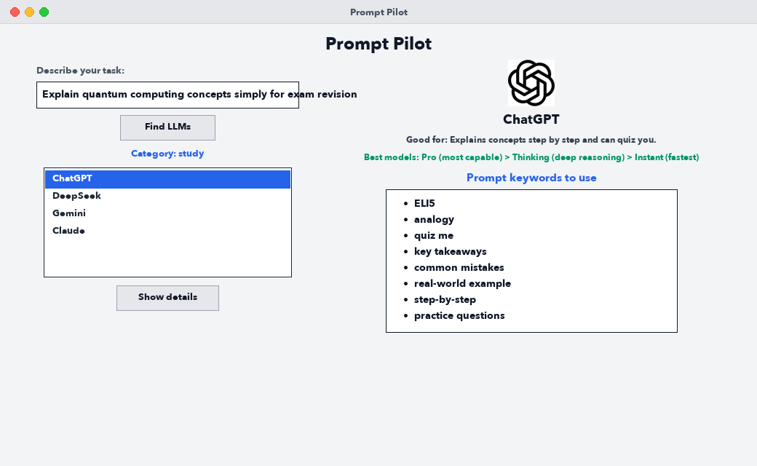
APPLICATION WALKTHROUGH — USE CASE 3
Software Demonstration: Conceptual Study & Exam Revision
Educational Workflow
• Input Prompt:
"Explain quantum computing concepts simply for exam revision"
• Intent Classification:
Matches 'explain', 'concept', 'exam', 'revision' — successfully routes to the 'study' learning domain.
• Ranked LLM Recommendation:
ChatGPT is prioritized as #1 for pedagogical step-by-step breakdowns, followed by DeepSeek, Gemini, and Claude.
• Tier Adaptation:
Shows ChatGPT reasoning paths: Pro (most capable), Thinking (deep mathematical reasoning), Instant (quick answers).
• Pedagogical Keywords:
Injects proven study prompt anchors: 'ELI5' (Explain Like I'm 5), 'analogy', 'quiz me', 'common mistakes', 'practice questions'.

Slide 8
TECHNICAL SUMMARY & ROADMAP
System Architecture, Testing & Conclusion
1. Technical Pipeline
▶ Input Stage
TaskEntry widget captures user input via Tkinter `.get()` method.
▶ Sanitization
Punctuation stripping (`.,?!;:()"'`), lowercasing, and word tokenization.
▶ Heuristic Scoring
Iterates through 10-domain trigger sets; counts frequency matches per domain.
▶ Priority Resolution
Determines top category; fetches model priority list from `order` dictionary.
▶ Dynamic GUI Rendering
Loads PNG logo, formats tier hierarchy via `models_text()`, and renders bulleted prompt keywords.
2. Verification & Testing
✔ Standard Inputs
Tested 10+ standard prompts (coding, research, translation, data, math) verifying exact category outputs.
✔ Edge Case Fallback
Tested unrecognized prompts ('hello'); successfully triggers fallback to 'general' model ranking.
✔ Selection Validation
Clicking 'Show details' without an item selected alerts user in red without crashing.
✔ Prefix Matching
Implemented `is_match()` to match words of 5+ letters (e.g. 'summarizing' matches 'summarize').
✔ Cross-Platform Layout
Verified zero-crop responsive window sizing across macOS screen bounds.
3. Conclusion & Roadmap
★ Educational Outcome
Successfully developed an end-to-end Python desktop application showcasing algorithmic text analysis and Tkinter GUI design.
★ 1-Click Prompt Copy
Roadmap: Add a 'Copy Formatted Prompt' button to instantly copy the prompt with keywords to system clipboard.
★ Local LLM Support
Roadmap: Integration with local open-weights engines (Ollama, Llama 3) for private offline inference.
★ Theme Customization
Roadmap: System dark-mode switch and custom user trigger keyword addition.
★ Project Status
Fully functioning, documented, and ready for academic presentation & viva.

