Slide 1
Audio Source Separation
using
Multi-Channel U-Net
Presenters: Nakula Neeraje, Videh Aggarwal

Slide 2
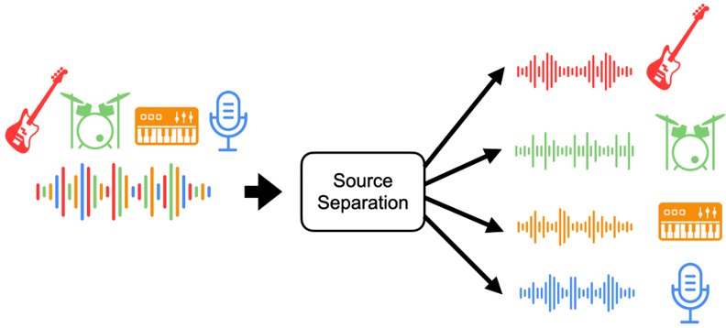
Introduction
Music source separation involves identifying and estimating the various sources present in the original audio mixture.
We are working with 4 sources - Vocals, Bass, Drums and Rest, to leverage the advantage our model has with multiple sources.

Slide 3
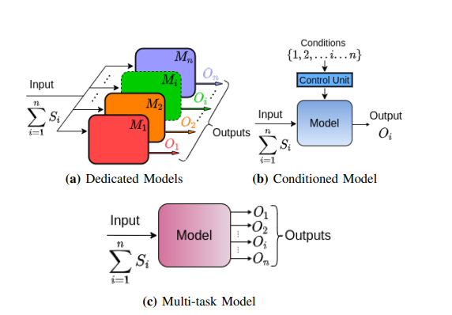
Related Work
Dedicated Models: Independent models for each output.
Conditioned Model: Control parameters dependent on input influence a single model and predict the masks.
Multi-Task Model: Multiple channels corresponding to each output.
R. Caruana, “Multitask learning,” Machine learning, vol. 28, no. 1, pp. 41–75, 1997.

Slide 4
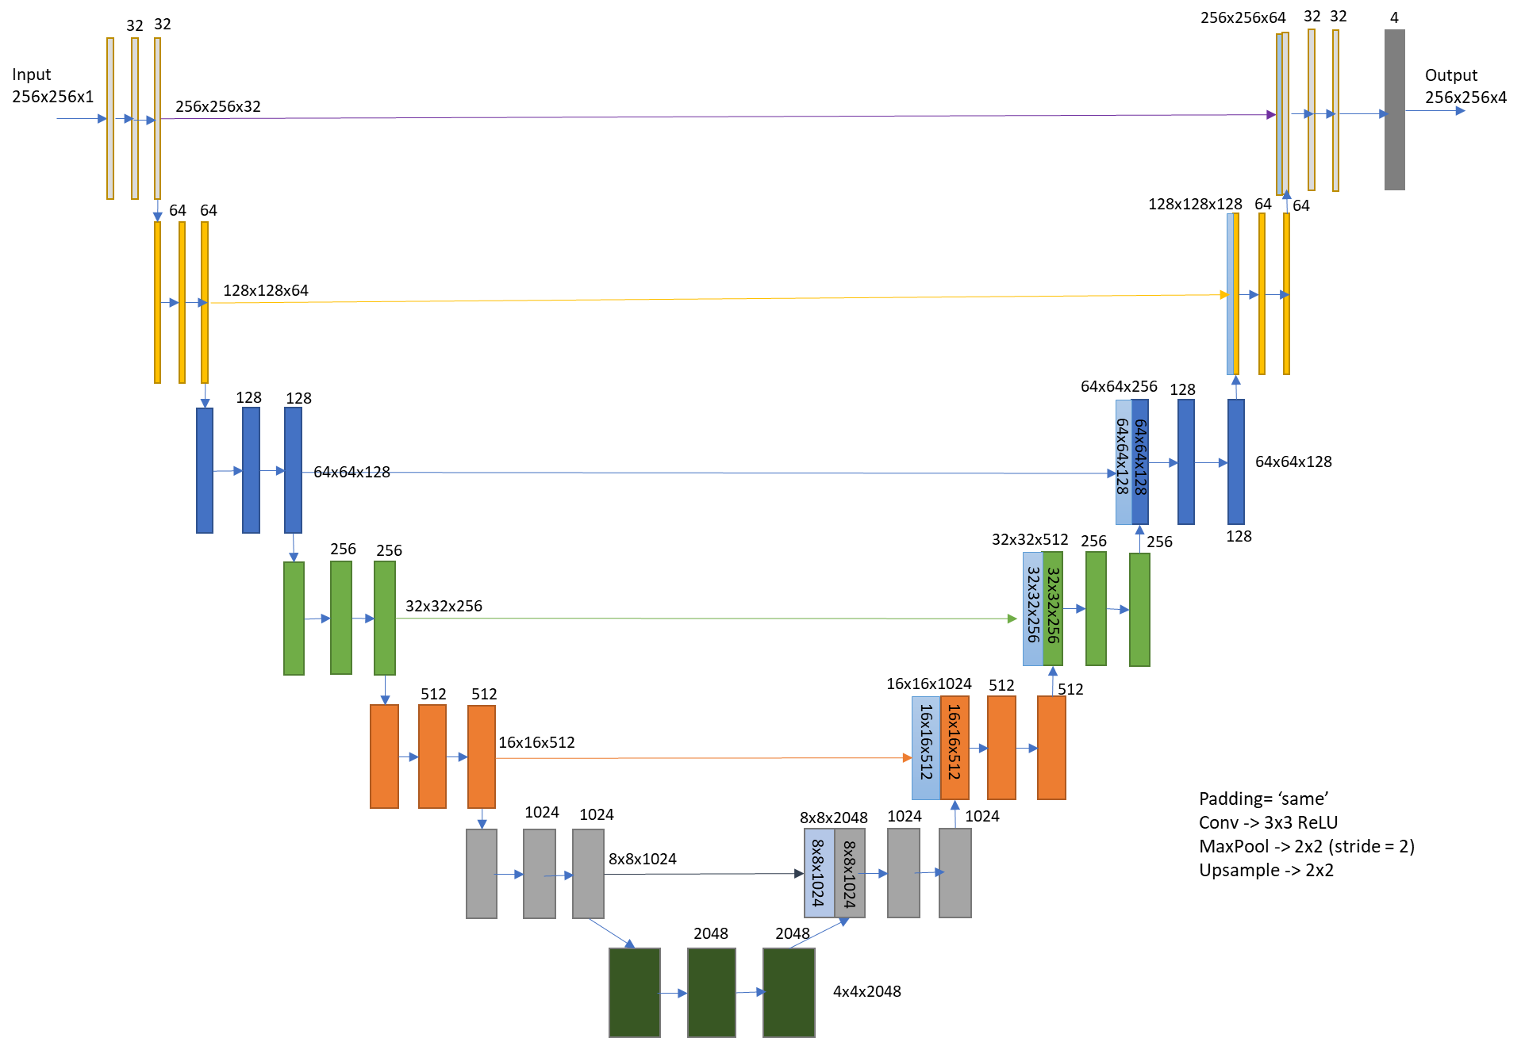
Model Architecture - Multi Channel UNet :
Encoder
Decoder

Slide 5
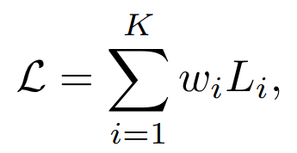
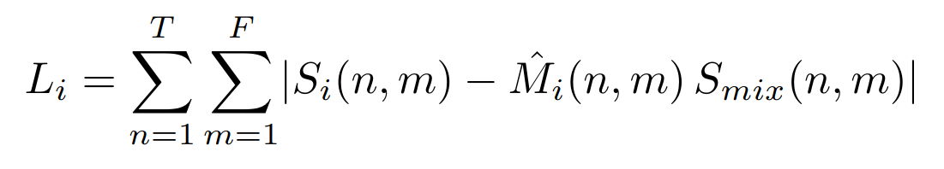
Loss Function
Multi-task learning loss function

Slide 6

Loss Weighting Strategies
Dynamic Weight Average:
Loss decreasing rapidly is assigned a lower weight in comparison to the Loss decreasing slowly.
‘t’ is the iteration index and ‘T’ is the temperature that defines the softness of weights.
A very high ‘T’ equalizes the weights. It is a hyperparameter we can tune.

Slide 7
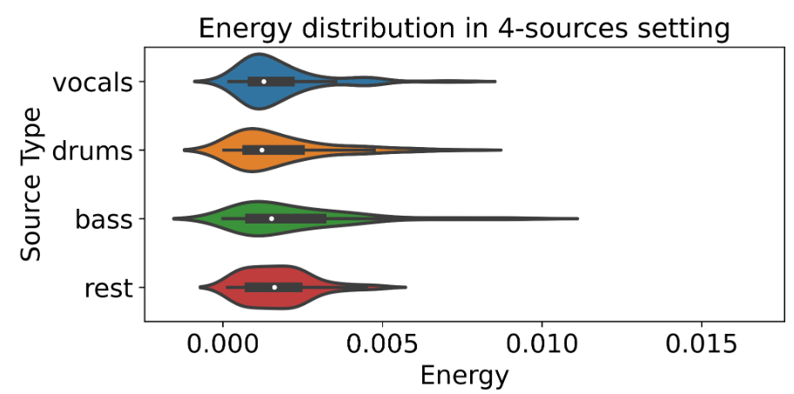
Energy Based Weighting:
Different sources have different average energies.
The model tends to prioritize the sources with greater average energy.
Hence, weights have been assigned as:

Slide 8



Energy Based Weighting:
Average Energy of i^{th} source:
Average Energy of i^{th} source in the t^{th} batch:
Squared Energy of i^{th} source:

Slide 9

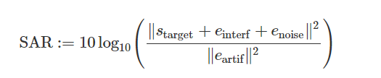
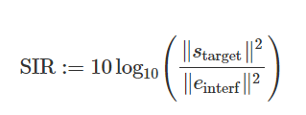
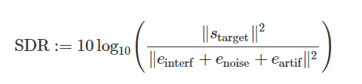
Evaluation Metrics:

Slide 10
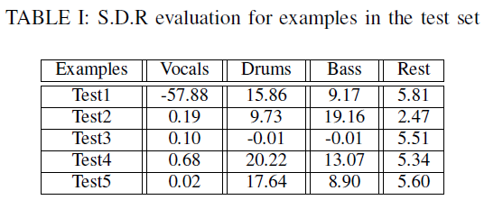
Results:

