Slide 1


Modelling and Solving Human – Robot collaborative tasks using POMDPs
Nakul Gopalan Stefanie Tellex
H2R lab, Brown University
July 16, 2015

Slide 2

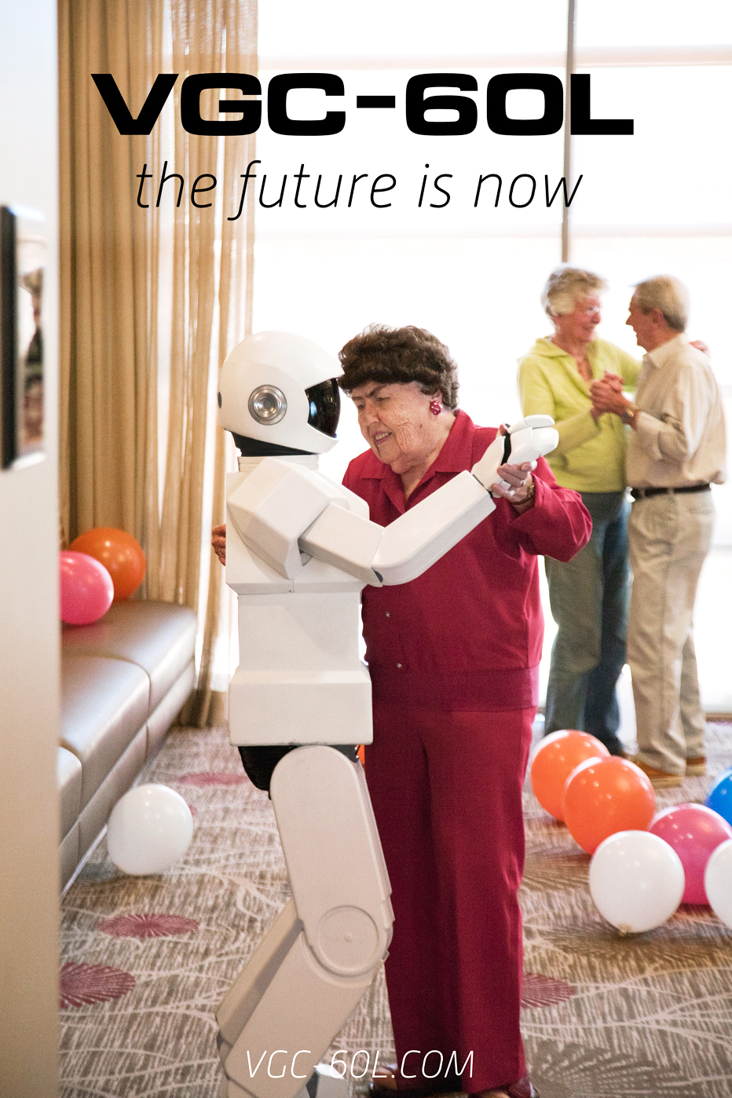
Motivation
Need collaborative tasks between humans and robots.
Involves solving tasks without complete state information in real time.
Need to deal with large observation spaces from speech and gestures.
Notes:
We need robots to perform collaborative tasks with humans as coworkers.
We need to model these collaborative tasks as joint tasks between robots and humans.
However the robot has only partial state information whether physical or human partner's requirements.
We also need to deal in real time with a large observation set.

Slide 3
POMDP refresher
World state s not known to the agent when solving the problem.
Partially Observable Markov Decision Process - <S, A, T , R, O, Ω> Kaelbling et al. [1998]
O observation function, T transition dynamics, Ω set of observations
MDP over belief space where belief state b updates as:
Notes:
Mostly this slide should not be read at all.

Slide 4
Related work
Elderly care Montemerlo et al. [2002], museum robot Burgard et al. [1999], caregiver wheelchair Doshi and Roy [2008]
Most of these works done with relatively simple observation space and state space.
They lack a joint action and state space for both partners.
POMDP based dialogue models, Young et al. [2013] have a joint state and action space.
Lack physical state information which is important.
Notes:
Don't read through the related work, key point: they deal with small state and observation spaces with joint action space and physical space. Dialogue models have joint action space but for robot we need knowledge of the physical world.
Elderly care Montemerlo et al. [2002], museum robot Burgard et al. [1999], caregiver wheelchair Doshi and Roy [2008]
Most of these works done with relatively simple observation space and state space.
They lack a joint action and state space for both partners.
POMDP based dialogue models, Young et al. [2013] have a joint state and action space.
Lack physical state information which is important.

Slide 5
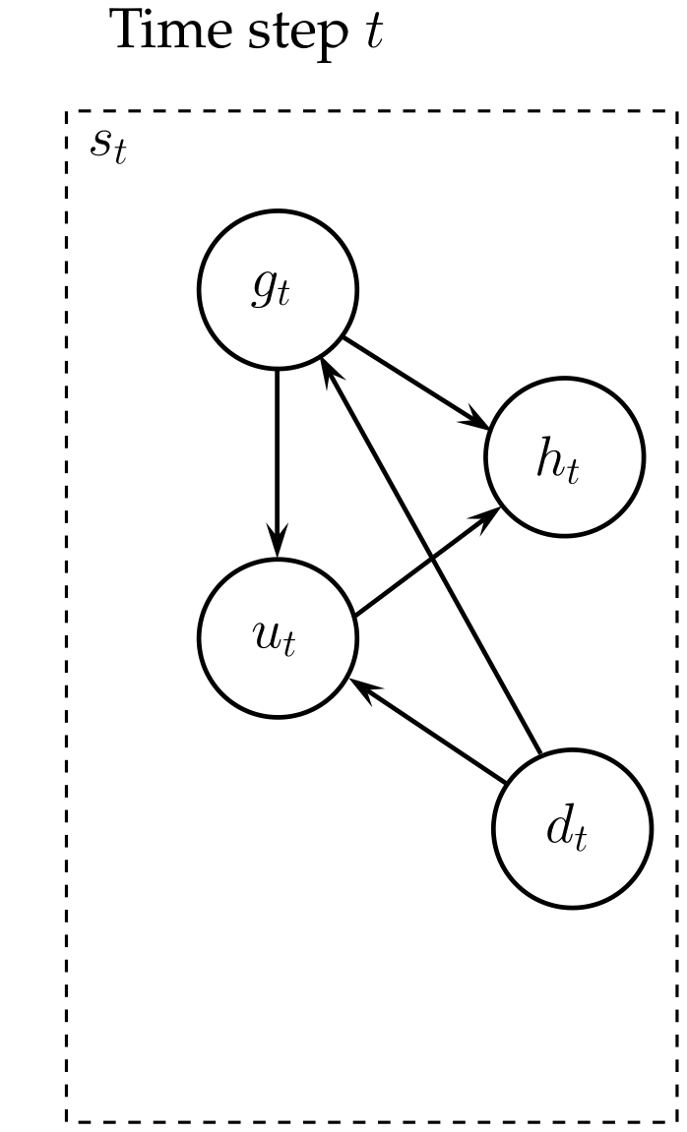
Human Task Representation
Where, st state of the world, gt human goal, ut human action, ht task history at time t.
Notes:
Single step human state

Slide 6
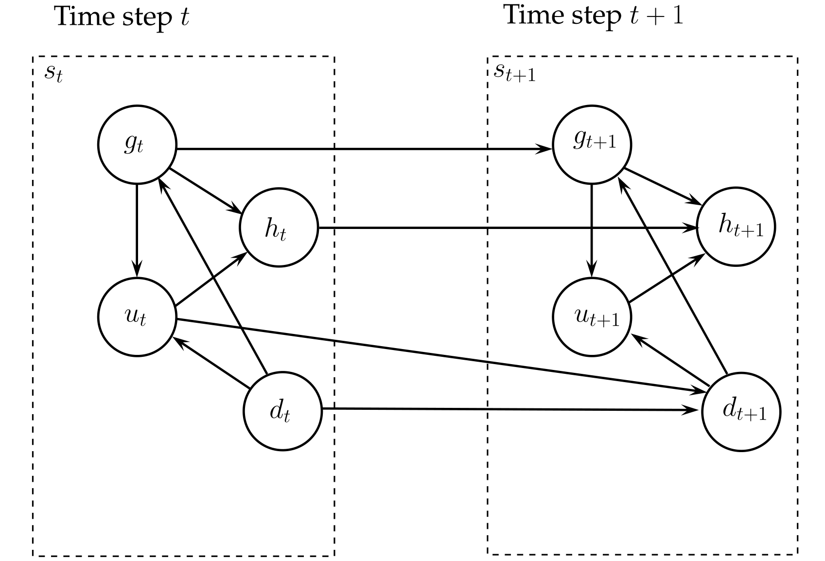
Human Task Representation
Where, st state of the world, gt human goal, ut human action, ht task history at time t.
Notes:
When human takes an action.

Slide 7
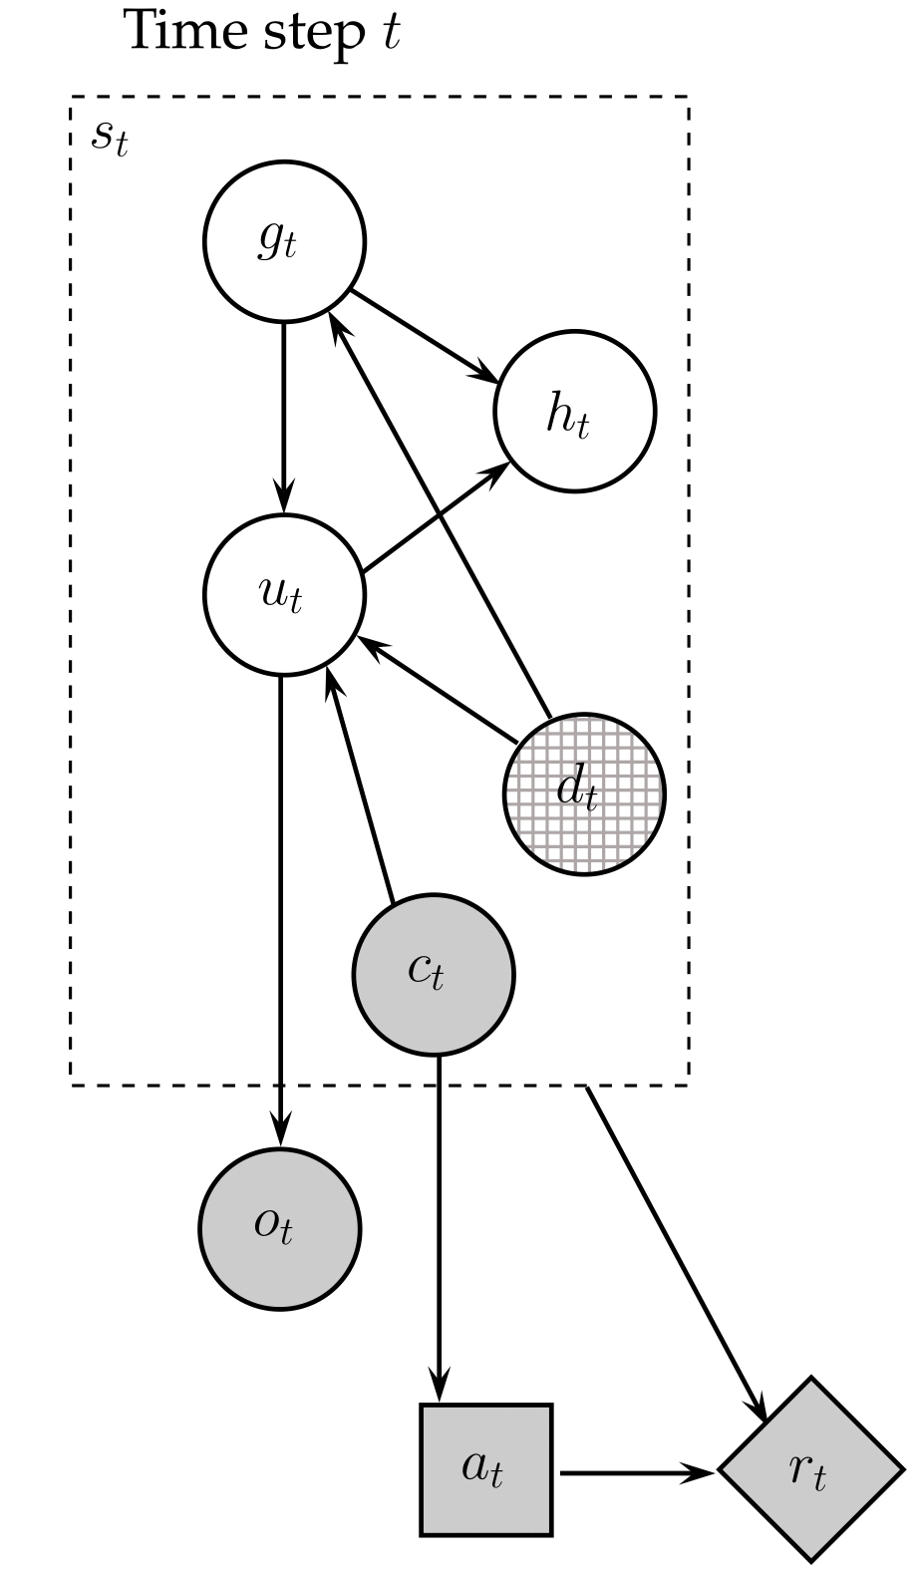
Human-Robot Task POMDP influence diagram
Where, st state of the world, gt human goal, ut human action, ht task history, dt physical state, ct action counter, ot observation, at robot action, rt reward, at time t.
Notes:
When human takes an action.

Slide 8
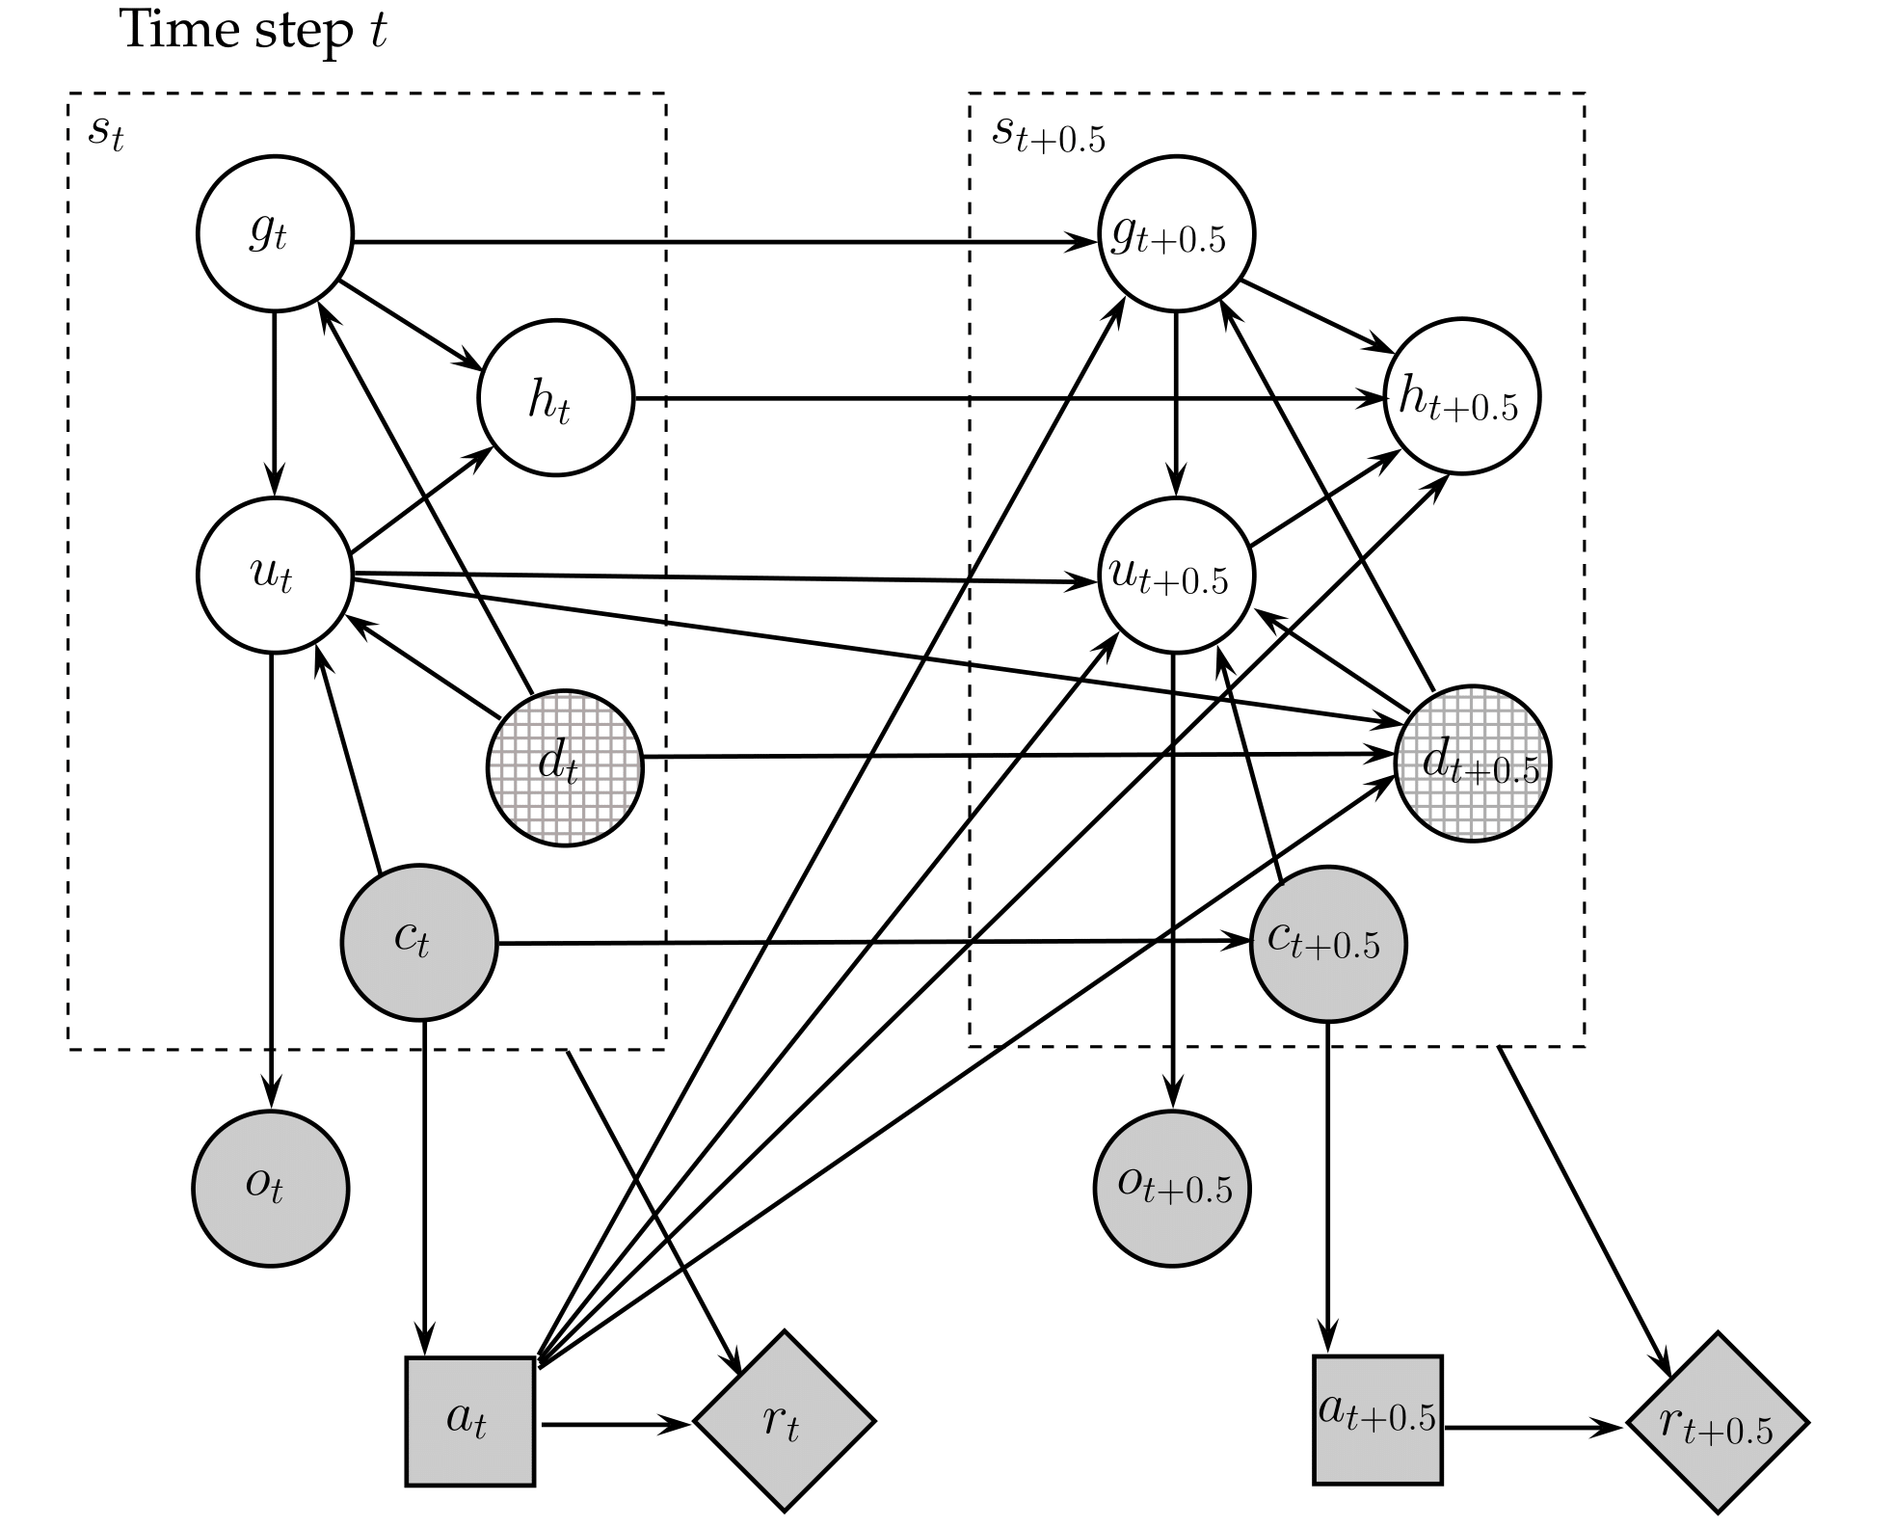
Human-Robot Task POMDP influence diagram
Where, st state of the world, gt human goal, ut human action, ht task history, dt physical state, ct action counter, ot observation, at robot action, rt reward, at time t.
Notes:
When human takes an action.

Slide 9
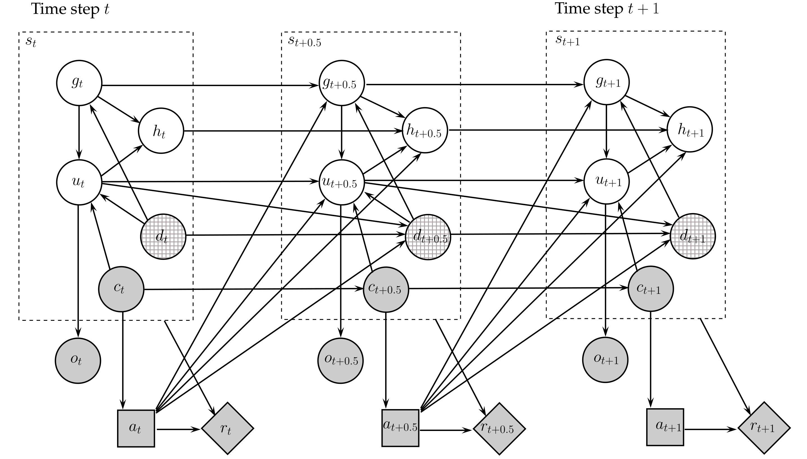
Human-Robot Task POMDP influence diagram
Where, st state of the world, gt human goal, ut human action, ht task history, dt physical state, ct action counter, ot observation, at robot action, rt reward, at time t.
Notes:
When human takes an action.

Slide 10
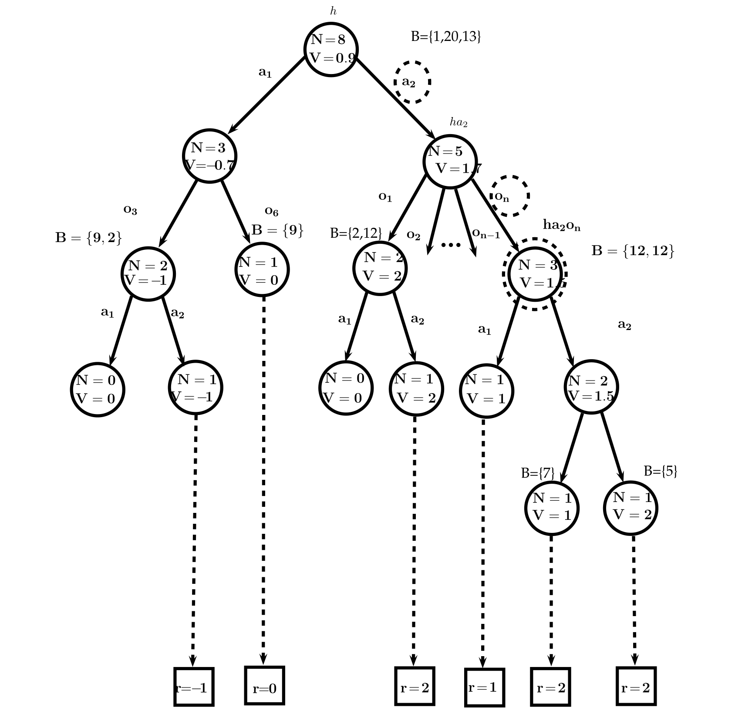
POMCP solver
Notes:
When human takes an action.

Slide 11
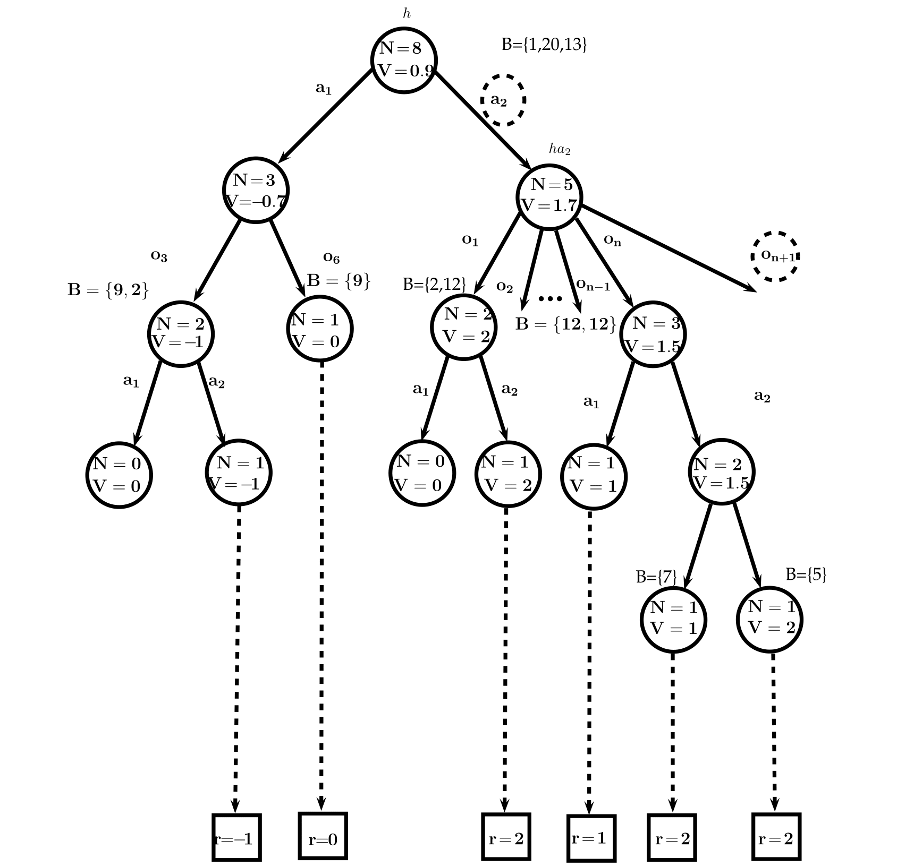
POMCP solver
Notes:
When human takes an action.

Slide 12
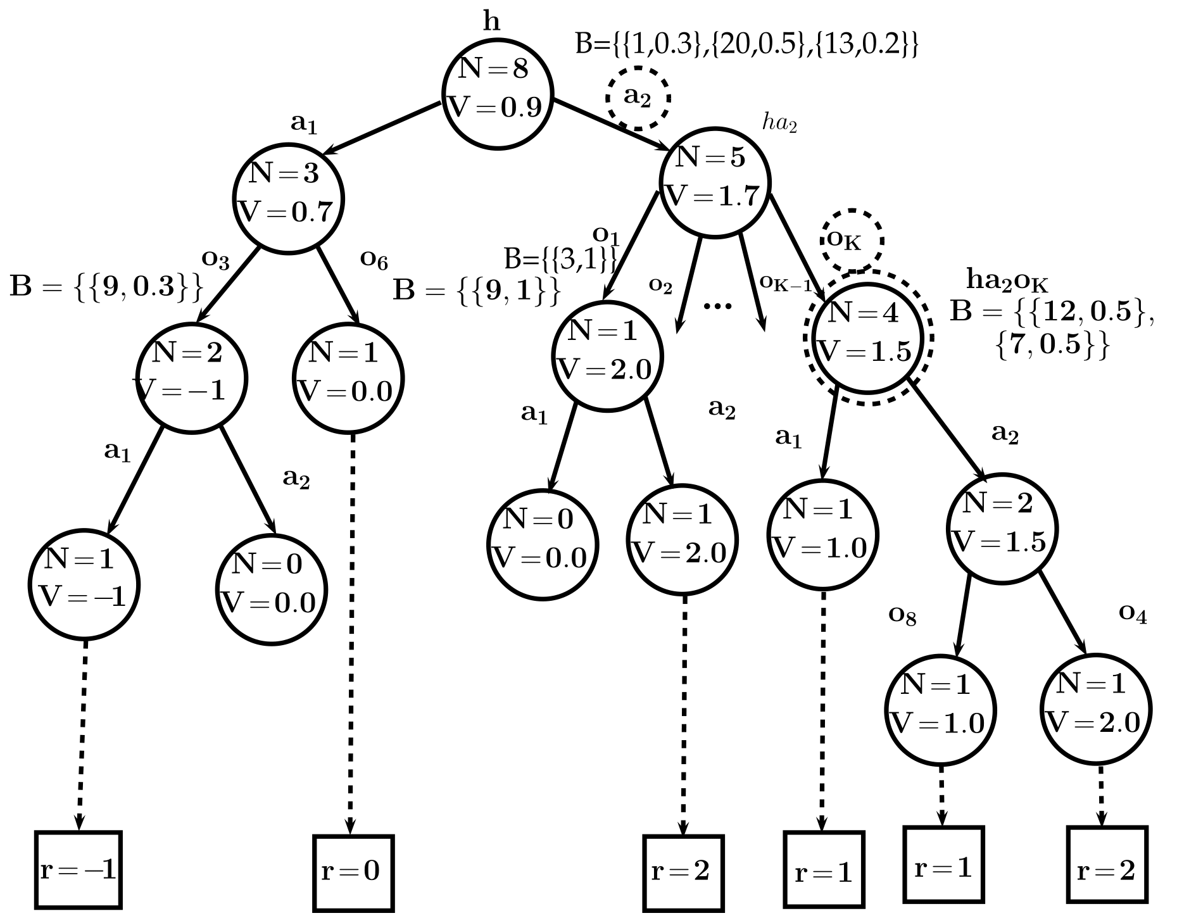
LBLWPOMCP solver
Notes:
When human takes an action.

Slide 13
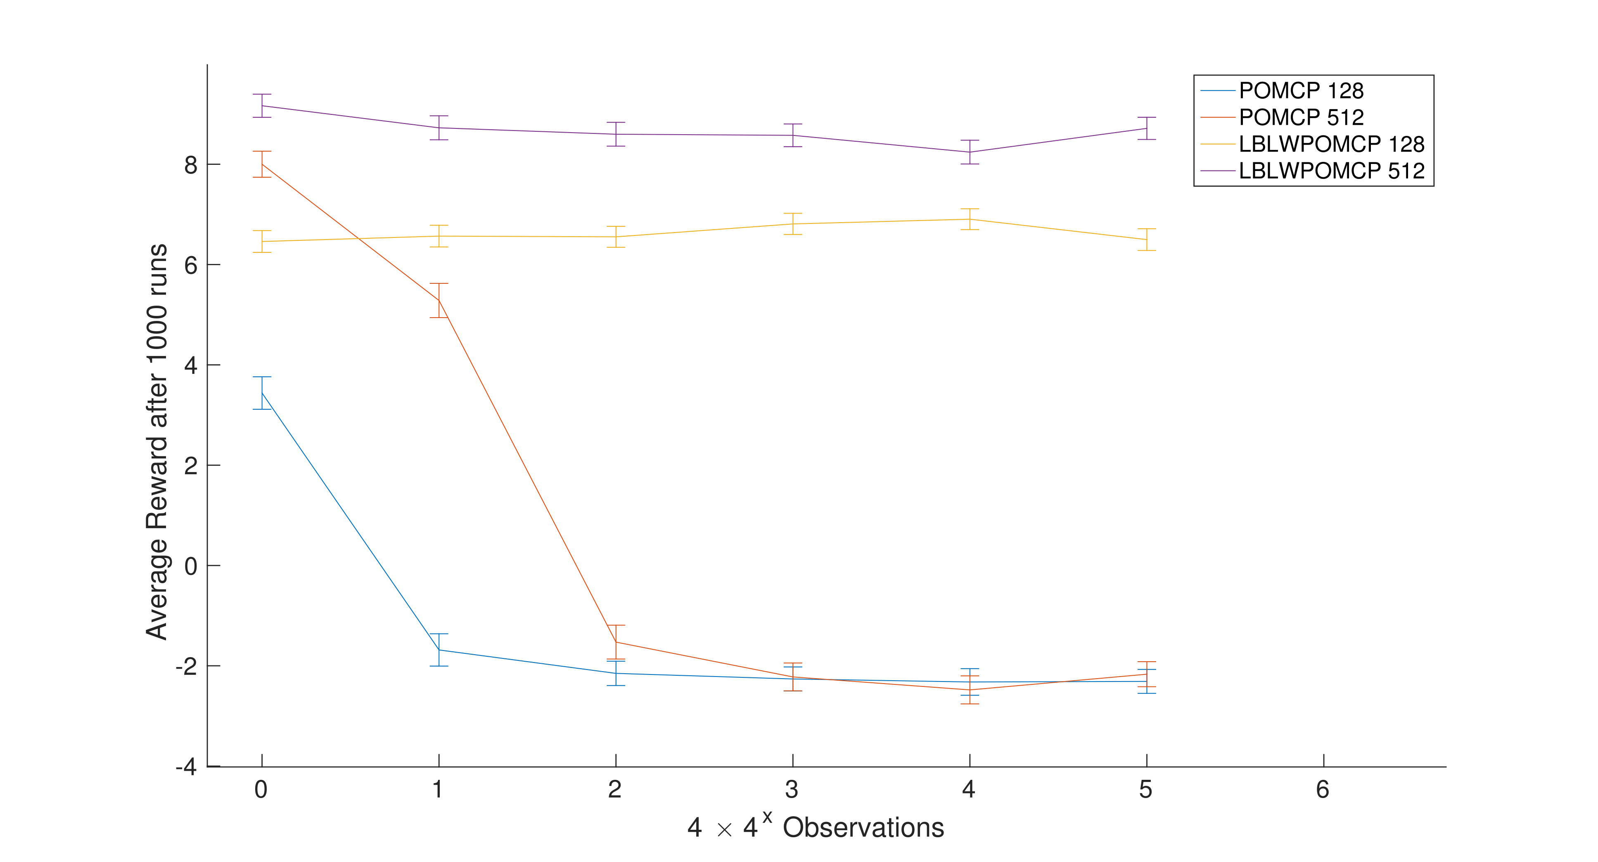
Rocksample domain
247,808 states, 15 actions, average reward with increased observations,+10/-10 reward for mining good/bad rock
Notes:
When human takes an action.

Slide 14
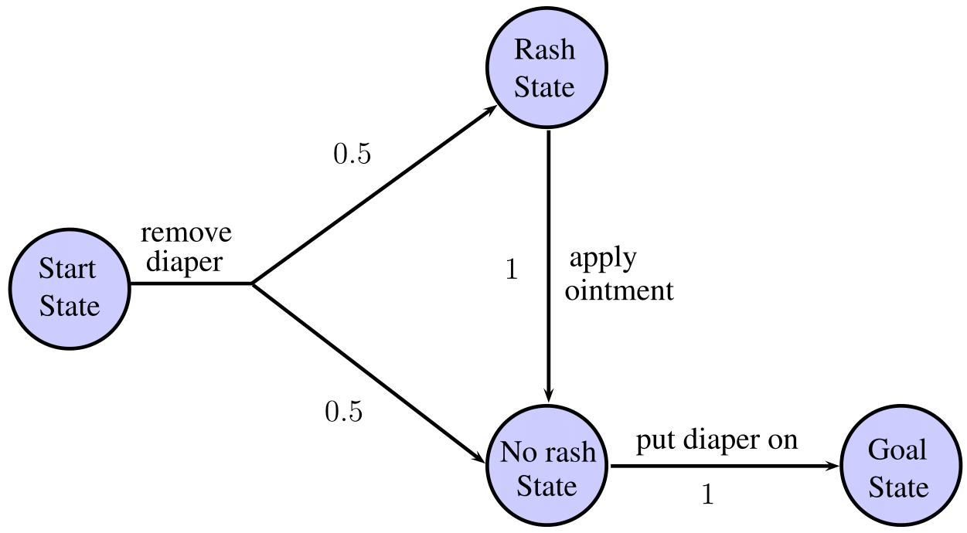
Childcare domain
A simplistic human policy to change diapers.
Notes:
When human takes an action.

Slide 15
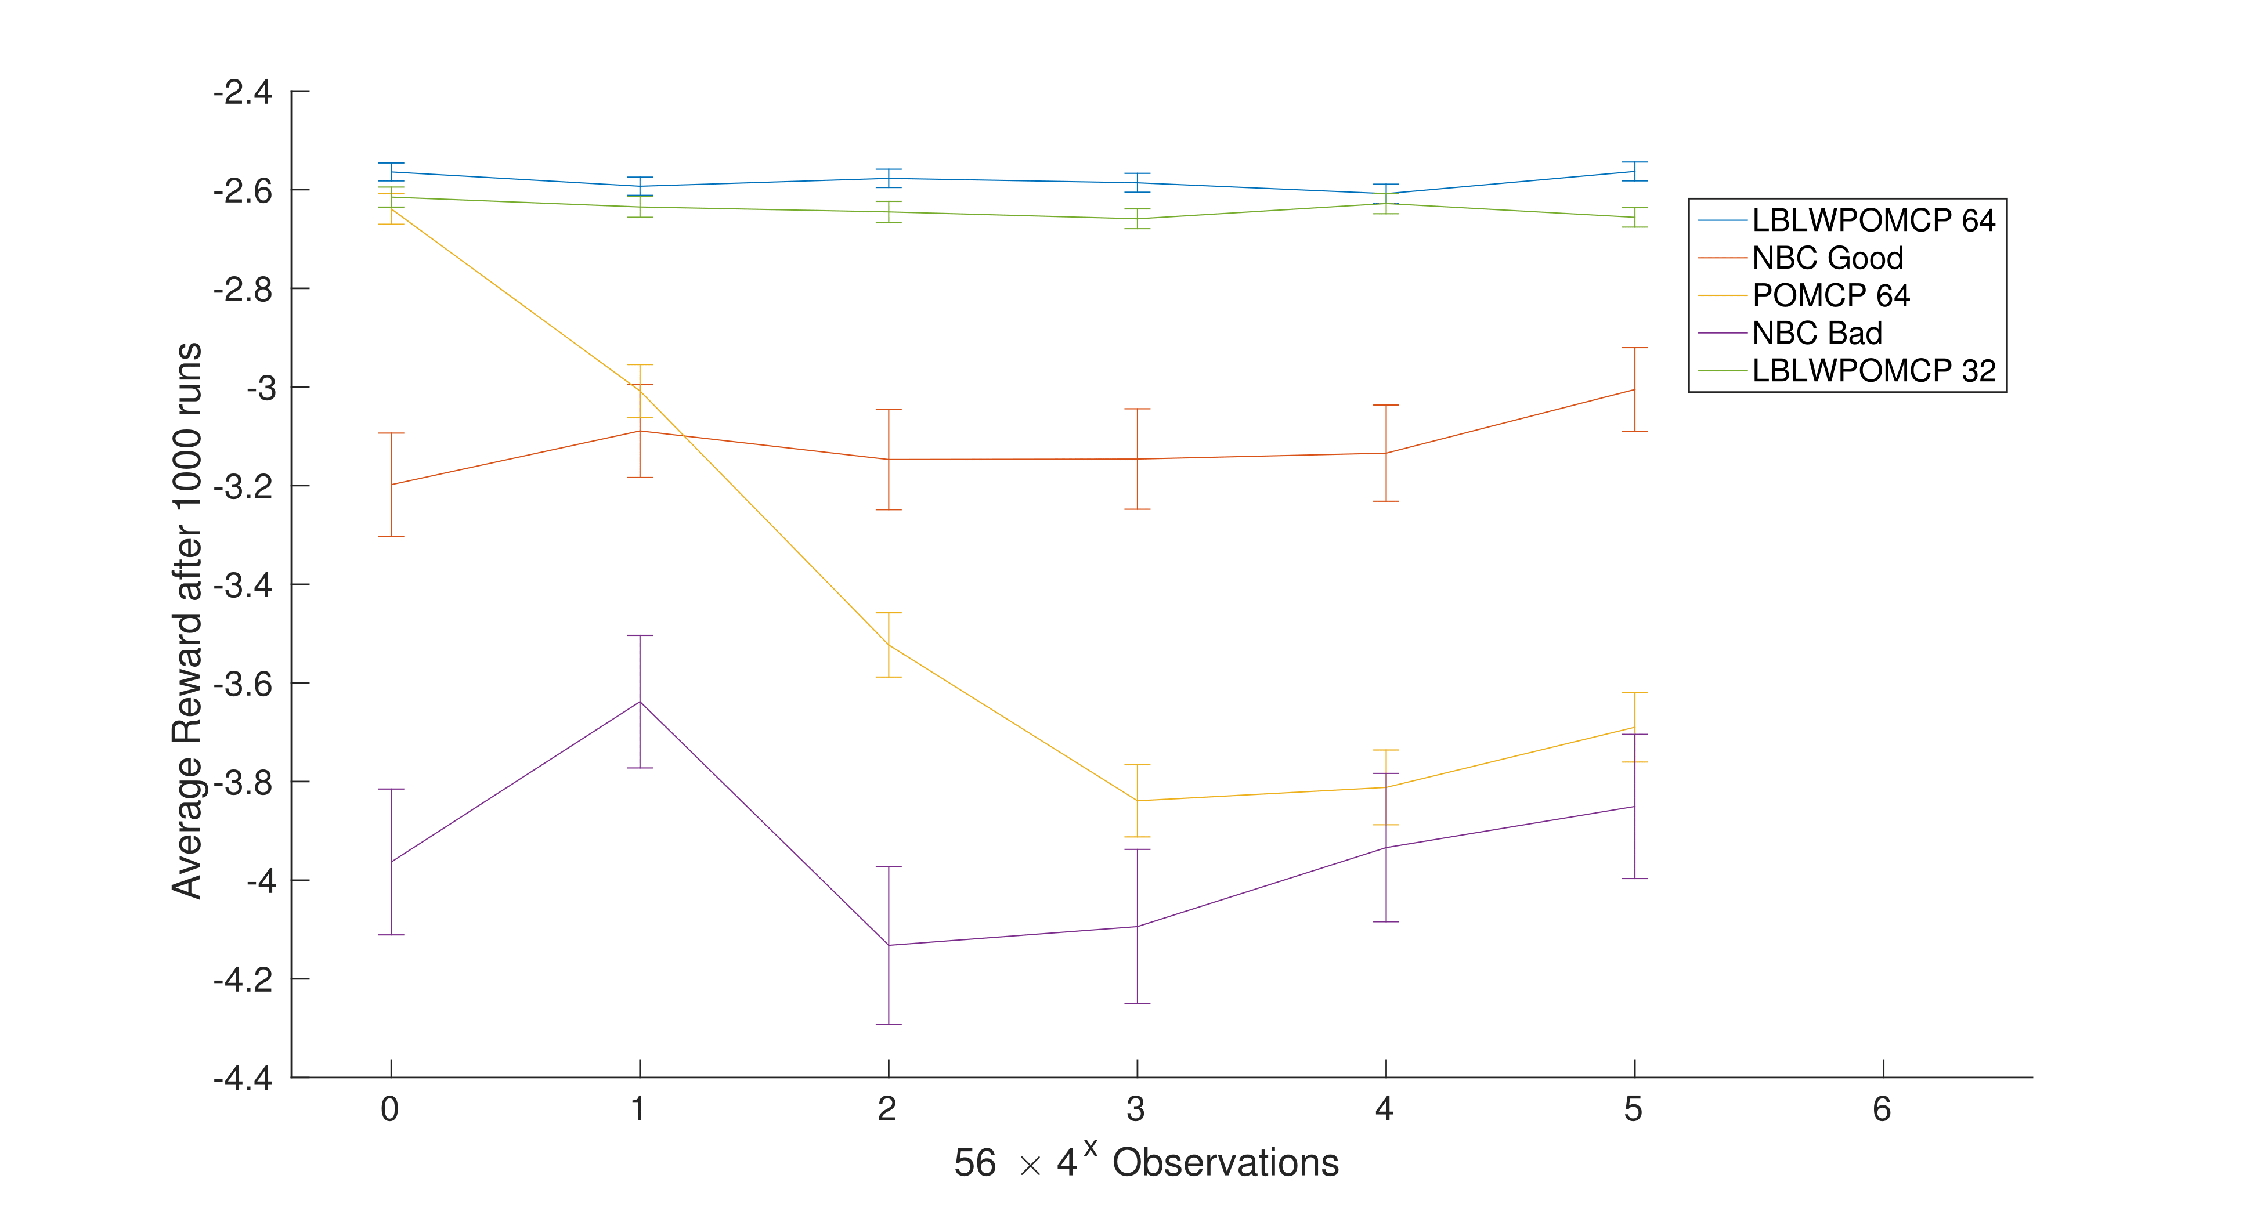
Childcare domain
14 state, 3 actions, average reward with increased observations, -1 reward for all actions
Notes:
When human takes an action.

Slide 16
Childcare domain video
Notes:
When human takes an action.

Slide 17
Conclusion
We have a principled method to model a collaborative human robot scenario.
LBLWPOMCP solver was found to produce better results with almost no overheard of feature engineering, hyper parameter selections, and was considerably fast when solving the domains.
We used the solver to solve a human robot collaborative task POMDP.

