Slide 1
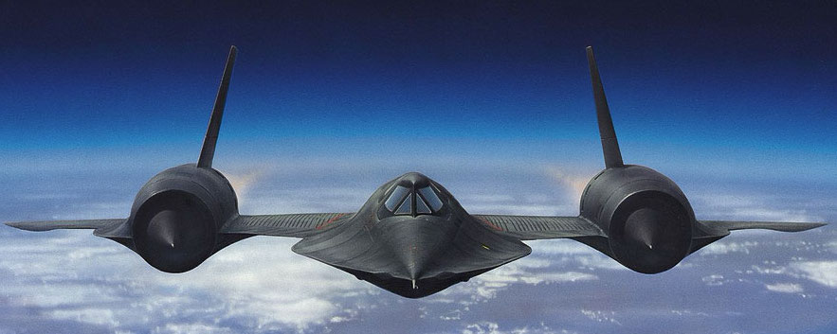
The Lockheed SR-71 “Blackbird”
History, characteristics, and features

Slide 2
Description
Three variants built: A/B/C
Length: 32.7 m
Wingspan: 16.9 m
Top speed: Mach 3.3
Altitude ceiling: 24,000 m

Slide 3

Operational history
1957: First Pratt and Whitney J58 tests
1960: U2 downing incident
1962: Skunk Works at Lockheed signs contract for six SR-71 craft
1964: Public announcement and first flight
1989: Termination of SR-71 program
1994: Congress orders reactivation of three SR-71s
1995: Lockheed restores Blackbirds
1999: Last flights

Slide 4
Engines
Twin Pratt & Whitney J58-P4 delivering a total force of 300 kilonewtons
Turbojet inside a ramjet

Slide 5
Subsonic Mode

Slide 6
Supersonic mode

Slide 7
HULL
All-titanium body
Rulite ore sourced from the USSR
Custom-built titanium tooling
Loose on takeoff

