Slide 1
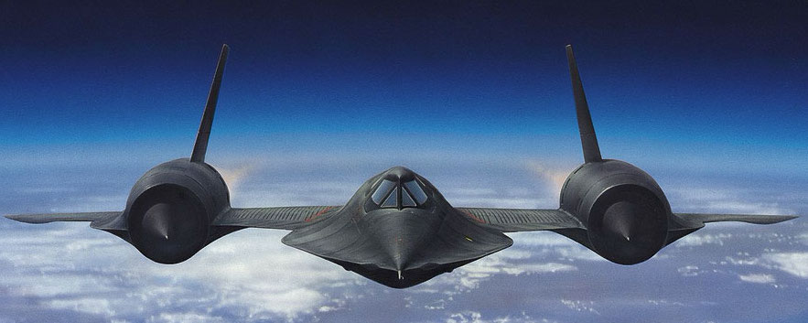
The Lockheed SR-71 “Blackbird”
History, characteristics, and features

Slide 2
Overview
Three variants built: A/B/C
Length: 32.7 m
Wingspan: 16.9 m
Top speed: Mach 3.3
Altitude ceiling: 24,000 m
Notes:
Far ahead of its time
Built before the pocket calculator
Designed by hand, with slide rule, on graph paper

Slide 3

Operational history
1957: First Pratt and Whitney J58 tests
1960: U2 downing incident
1962: Skunk Works at Lockheed signs contract for six SR-71 craft
1964: Public announcement and first flight
1989: Termination of SR-71 program
1994: Congress orders reactivation of three SR-71s
1995: Lockheed restores Blackbirds
1999: Last flights
Notes:
Skunk works, undercover
Legendary engineer Kelly Johnson
Already made U2

Slide 4
Engines
Twin Pratt & Whitney J58-P4 powerplants
Total force of 300 kilonewtons
Conventional turbojets cannot withstand the temperatures needed for high speeds
Problem solved by putting a turbojet inside a ramjet
Notes:
Could power a small cruise ship

Slide 5
Subsonic Mode

Slide 6
Supersonic mode

Slide 7
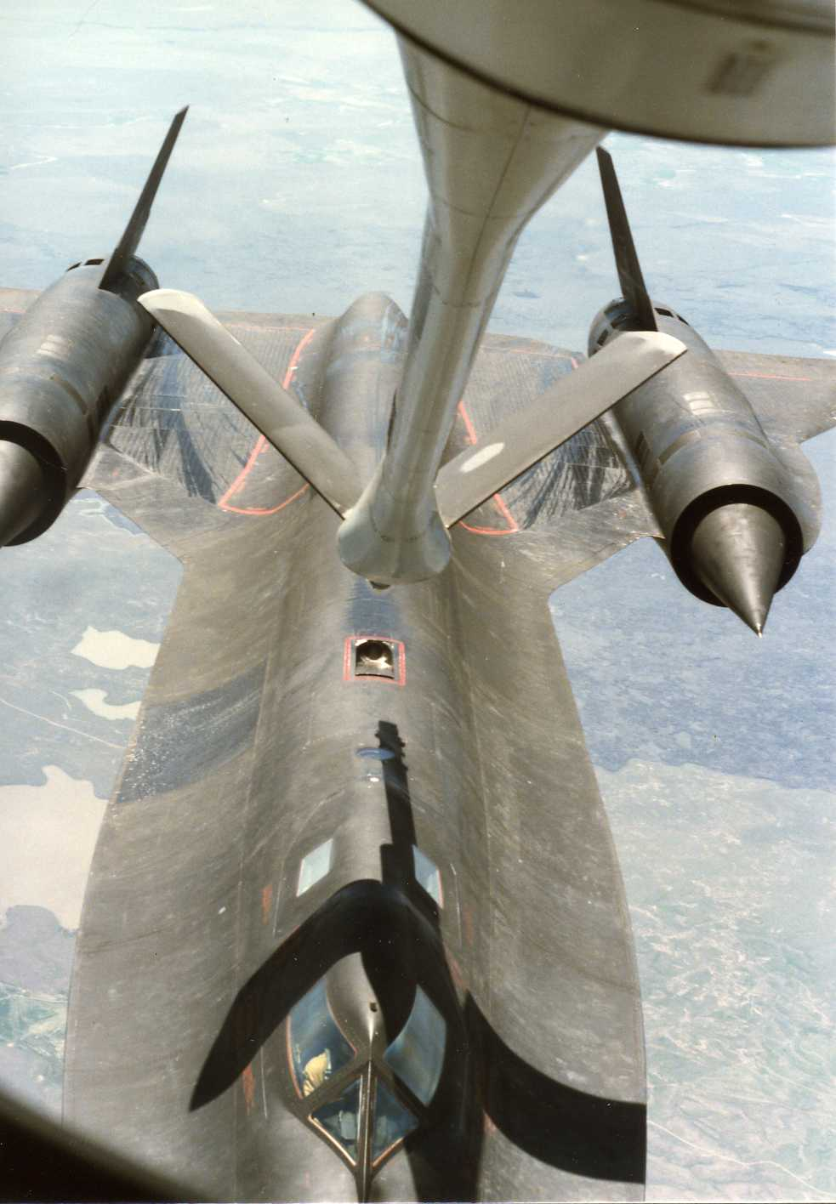
HULL
All-titanium body
Rutile ore sourced from the USSR
Custom-built titanium tooling
Loose on takeoff
Leaked fuel on the runway and had to refuel in-flight
Notes:
CIA/third world country shadow companies

Slide 8
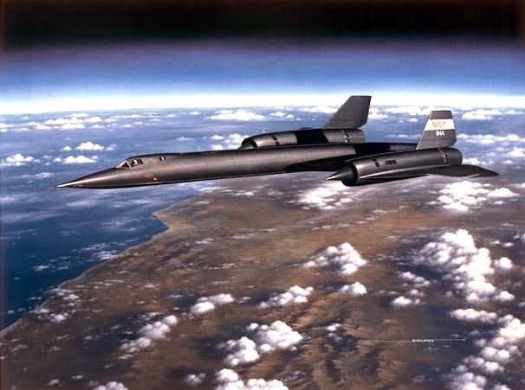
Stealth
Shape optimized for low radar cross-section
High altitude flight
High speed allowed easy escape from interceptors

Slide 9
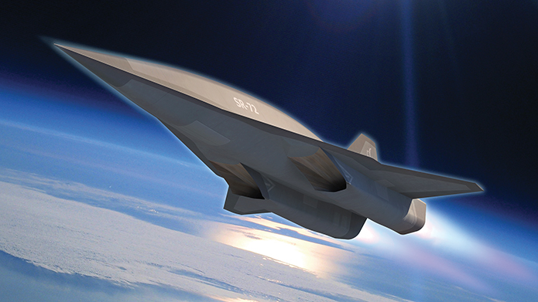
Legacy
Highly successful program with zero losses to the enemy
Many technologies developed for the Blackbird are in use on aircraft today
Recently announced development on the SR-72 “Aurora”

Slide 10
Questions?

