Slide 1
TDMA Schedule Planner
and Optimizer
Centralized Python scheduler using Distance-2 graph coloring
Wireless Protocol Development Internship Assignment
Vaan Megam Networks
Nakul Joshi
Part 1 — Network Brain

Slide 2
1. Problem Statement
TDMA lets radios share a frequency by transmitting in different time slots.
Direct interference
Two-hop interference
Spatial reuse
If two nearby radios communicate at the same time, they can interfere.
1-hop neighbors must use different slots.
Nodes that share a common neighbor can create a receiver collision.
2-hop nodes must also use different slots.
Nodes separated by more than two hops can reuse the same TDMA slot.
Assignment requirement: generate a conflict-free Slot × Node Boolean matrix and Node-to-Slot mapping.
VMN • TDMA Schedule Planner & Optimizer
2

Slide 3
2. Solution Architecture
JSON
Graph
Conflict
Optimize
Validate
Export
16 node coordinates
500 m connectivity
Distance-2 graph
103 colorings
No conflicts
JSON + CSV
→
→
→
→
→
The scheduling logic is separated from CLI input/output and visualization.
VMN • TDMA Schedule Planner & Optimizer
3

Slide 4
3. Wireless Network Graph
Graph model
Current topology
• Radio → graph node
• Wireless link → graph edge
• Communication range → 500 m
• Distance uses Euclidean geometry
For every node pair:
d = √((x₂−x₁)² + (y₂−y₁)²)
If d ≤ 500 m, an edge is created.
16 nodes
27 wireless links
The graph is undirected and each edge stores the physical distance.
This graph becomes the foundation for the Distance-2 conflict model.
VMN • TDMA Schedule Planner & Optimizer
4

Slide 5
4. Distance-2 Conflict Graph
The wireless graph is transformed into a scheduling conflict graph.
1 hop
2 hops
> 2 hops
Directly connected radios
→ MUST use different slots
Radios connected through a common neighbor
→ MUST use different slots
No Distance-2 conflict
→ Slot reuse is permitted
Current topology: 53 conflict links
VMN • TDMA Schedule Planner & Optimizer
5

Slide 6
5. Optimization Strategy
Graph coloring maps directly to TDMA scheduling:
Node
Edge
Color
Wireless radio
Scheduling conflict
TDMA time slot
Candidate strategies
Selection rule
• Largest-first greedy
• Smallest-last greedy
• DSATUR / saturation-largest-first
• 100 deterministic randomized greedy runs
Choose the valid candidate using the fewest slots.
The 7-slot result is a heuristic result, not a proof of the global minimum.
VMN • TDMA Schedule Planner & Optimizer
6

Slide 7
6. Actual Result
16
27
53
103
7
Nodes
Wireless links
Conflict links
Coloring candidates
Slots selected
Schedule validation
✓ VALID — No conflicting nodes share the same TDMA slot.
Selected heuristic: largest_first
Current slot assignment:
S0: 01, 03, 11 S1: 02, 05, 07 S2: 06, 08
S3: 04, 10, 16 S4: 09, 12 S5: 14 S6: 13, 15
VMN • TDMA Schedule Planner & Optimizer
7

Slide 8
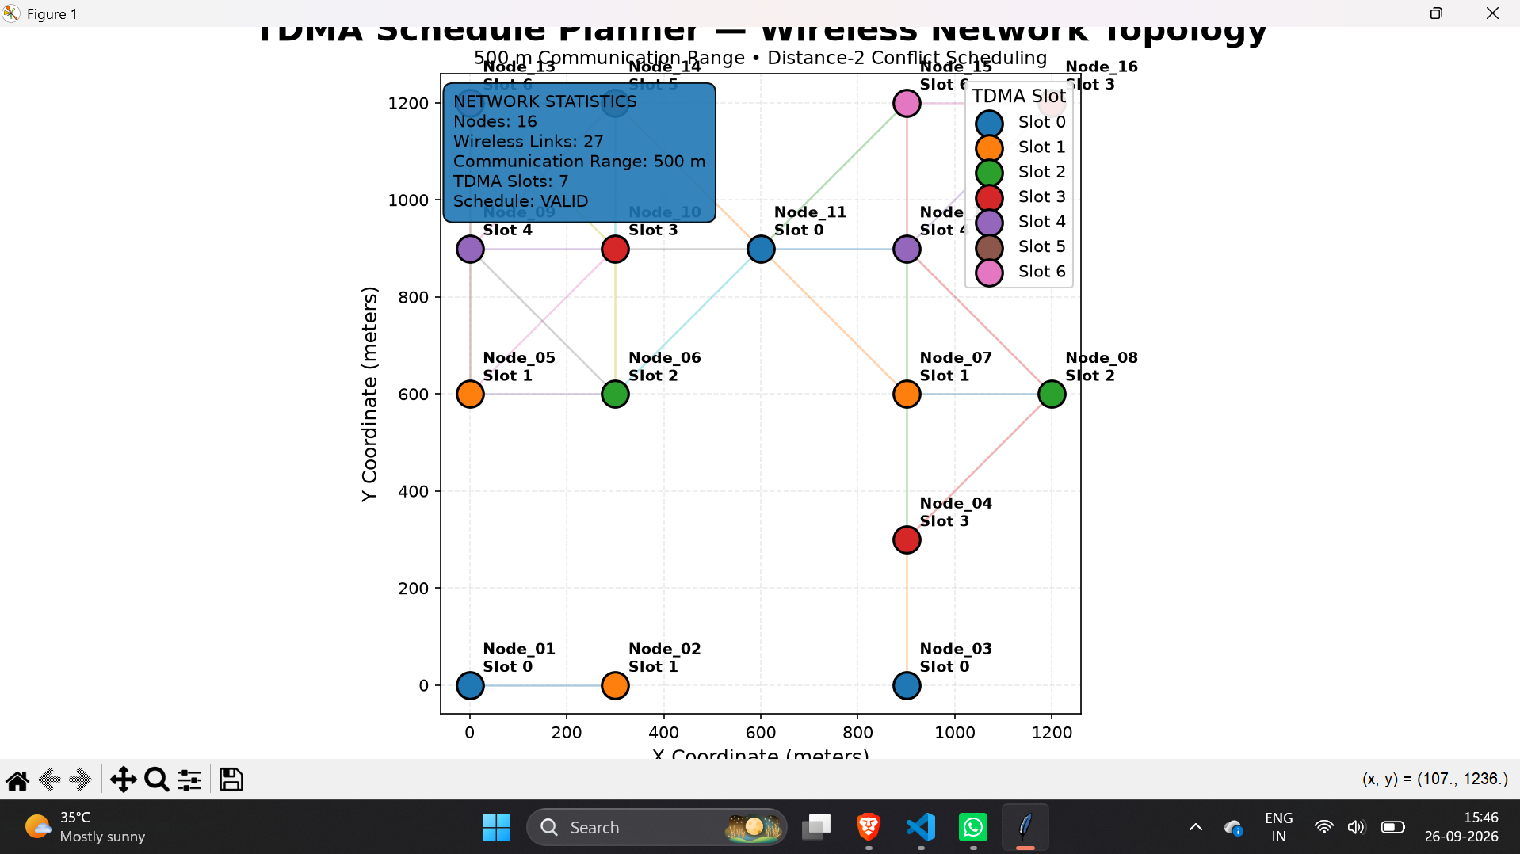
7. Topology Visualization
VMN • TDMA Schedule Planner & Optimizer
8

Slide 9
8. CLI, Outputs and Testing
CLI
Testing
python src/main.py --input examples/nodes.json
Input validation:
• Exactly 16 nodes
• Two coordinates per node
• Numeric coordinates
Outputs:
• schedule.json
• schedule.csv
Pytest regression suite
9 / 9 tests passed
Coverage includes:
• Graph construction
• Conflict generation
• Schedule validation
• Matrix generation
• Slot assignment
• Invalid node count
• Invalid coordinates
• Non-numeric coordinates
VMN • TDMA Schedule Planner & Optimizer
9

Slide 10
9. EMANE Integration — Part 2 Approach
Part 2 is an integration approach, not claimed as completed functionality.
Python
Optimizer
Schedule
Matrix
XML / ProtoBuf
Bridge
EMANE TDMA
Radio Model
Virtual Radios
+ Packets
→
→
→
→
• Configure EMANE's native TDMA Radio Model.
• Map slot/frame/frequency concepts to the generated schedule.
• Convert the matrix into the expected schedule event format.
• Verify packet behavior in the virtual network.
VMN • TDMA Schedule Planner & Optimizer
10

Slide 11
10. Engineering Decisions & Limitations
Why this design?
Current limitations
• Multiple heuristics instead of one greedy ordering
• Fixed seeds for reproducibility
• Explicit conflict validation
• Separate modules for graph, scheduling, CLI and visualization
• JSON/CSV outputs for downstream use
• Centralized topology knowledge
• Fixed 500 m communication model
• No RF/SINR/fading model in Part 1
• Seven slots is not claimed to be globally optimal
• EMANE bridge is not yet implemented
VMN • TDMA Schedule Planner & Optimizer
11

Slide 12
11. Conclusion & Next Steps
Implemented
Next
• Centralized Python TDMA optimizer
• 500 m connectivity graph
• Distance-2 conflict graph
• Multi-heuristic slot optimization
• Conflict-free 7-slot test result
• CLI + JSON/CSV output
• Automated 9/9 tests
• Finalize documentation
• Demonstrate CLI and schedule
• Explain algorithm and complexity
• Develop EMANE integration bridge
• Validate packet behavior in simulation
Thank you
VMN • TDMA Schedule Planner & Optimizer
12

