Slide 1
LITMUS
News Sources
Nakul Patel
Uy Nguyen

Slide 2
Outline
Motivation
System Introduction
Results
Demo
Future Work
Notes:
Nakul

Slide 3
Motivation
LITMUS
Social media data
Accuracy of data content analysis
Lack of geolocation information
Physical Sensor Data
Not feasible
USGS - Recent Landslides Events
Lack of accuracy
Not real-time
Notes:
Our motivation and goal of this project is to help improve the result of LITMUS which is a Multi Service Composition System for Landslide Detection.
Currently LITMUS system validates its social media findings with physical sensors and landslide reports from USGS.
The challenges with that is, due to privacy concerns most tweets lack geo-location information and there is lots of noise. How do we differentiate Landslide disaster vs Landslide victory.
It is not feasible to put physical sensors everywhere and USGS does not report in real-time and lacks accuracy.
With our project we wish to integrate real-time authoritative news source into LITMUS system as an additional source for validation.

Slide 4
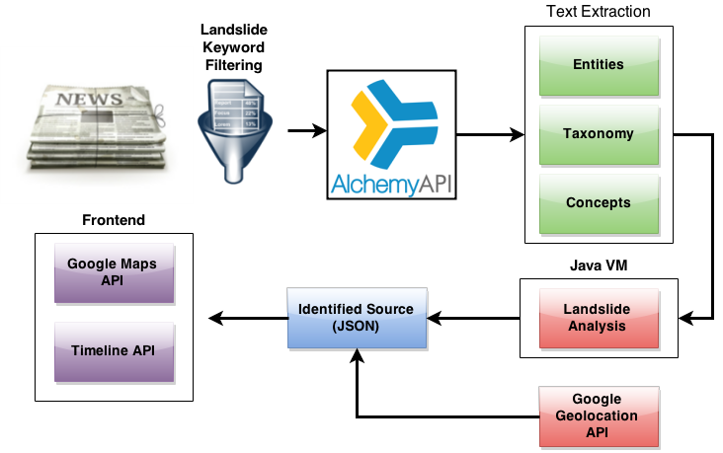
System Overview
Notes:
Nakul

Slide 5

News Sources
Alexa - web traffic data with focus on top 50 news sites globally
Top news site based upon monthly web traffic
News APIs vs RSS Feeds
Notes:
Uy

Slide 6
Other News Sources?
Capturing sources outside global sources list
Google Alerts
Google News Search
Bing News Search
Notes:
Uy

Slide 7

Alchemy API
Machine Learning API
natural language processing
deep learning
text analysis
Notes:
Uy

Slide 8

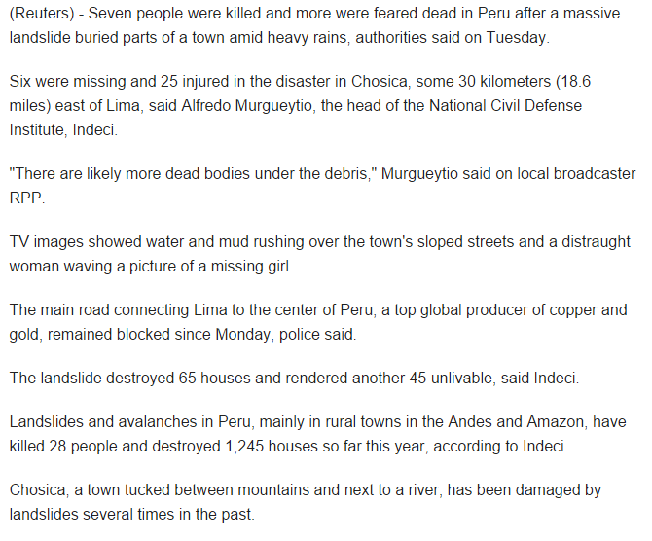
AlchemyAPI
Notes:
Uy

Slide 9
Alchemy API
Entities, concepts, keywords, and taxonomy with relevance and sentiment analysis
Utilizing taxonomy and entities
Example Taxonomy breakdown
Article: Ubinas Volcano Causes Massive Landslides in Peru
Taxonomy Categories: /science/geology/seismology/earthquakes
/science/weather/meteorological disaster
/travel/tourist destinations/canada
Notes:
Uy
Taxonomy - AlchemyAPI automatically categorizes your text, HTML or web-based content into a hierarchical taxonomy. Using complex statistics and natural language processing technology, the taxonomy API can classify your content into its most likely topic category up to five levels deep.
Entities - Named entities specify things such as persons, places and organizations. AlchemyAPI's named entity extraction is capable of identifying people, companies, organizations, cities, geographic features and other typed entities from your HTML, text or web-based content.

Slide 10
Geolocation
Obtained from Alchemy API
If no geolocation coordinates provided, location name reverse lookup via Google Geolocation API
Notes:
Uy

Slide 11
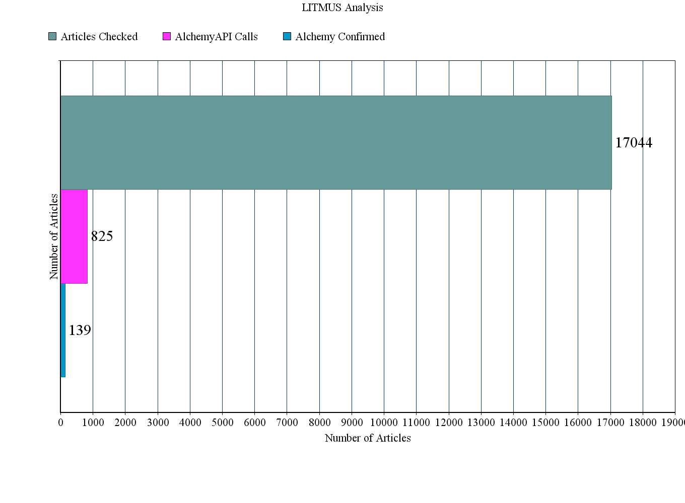
Results - 10 Day Period
Notes:
Nakul

Slide 12
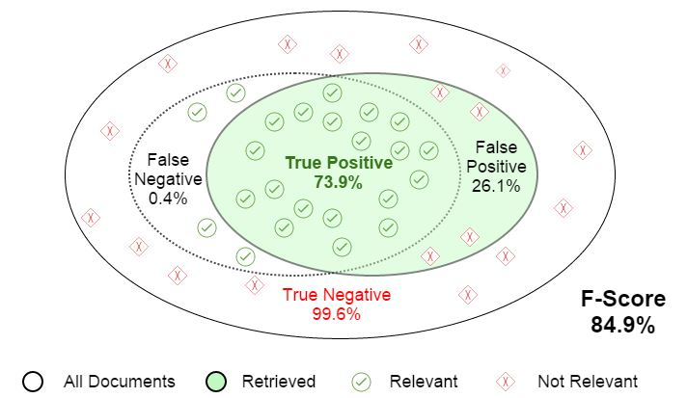
Analysis
Notes:
Nakul
False Positive Examples:
Rain in this area has very high chance or landslide
Related news article about landslide, on a page that doesn't talk about landslide
Articles examining risk of a landslide in city
Area opened first time after landslide in January, but all it talks about landslide

Slide 13
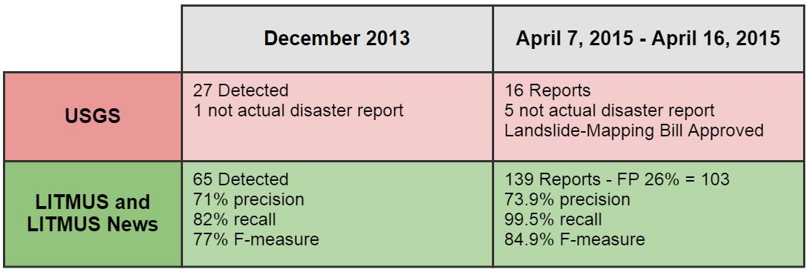
LITMUS News vs. USGS
[1] Aibek Musaev, De Wang, Calton Pu “LITMUS: a Multi-Service Composition System for Landslide Detection”. IEEE Transactions on Services Computing 2014
Notes:
Nakul

Slide 14
Demo

Slide 15
Future Work
Detect other natural disasters
Track occurrences such as ebola outbreaks over time in a geographic format
Multi-threaded processing

Slide 16
Questions?

