Slide 1
Using unsupervised machine learning techniques to understand the user engagement and performance of public health care posts on social media.
Name: Nakul Sarwate
Roll No.: 3144
Class: TE 1
Batch: M1
Seminar Guide: Prof. D. D. Kadam

Slide 2
Table of contents
Domain
Keywords
Motivation
Data collection
Clustering

Slide 3
Domain: Data Analysis and Machine Learning
Social Media, a growing platform for opportunities to spread awareness about public health care information.
Various health care organizations using social media to interact with the public need to understand the user engagement.
Analyzing big social media data extremely important to understand the characteristics of post performance .
Using data mining techniques and statistics to increase the popularity of health care pages on Facebook.

Slide 4
Keywords:
Social media analysis
Unsupervised learning
K-means clustering
Statistics
Business Intelligence

Slide 5
Motivation
Public health is a major concern in today’s times. Individuals and organizations are realizing the benefits of social media in communicating health care information.
Knowledge on how organizations spread and how users interact with health information through social media has become increasingly important.
How necessary it is to analyze huge amounts of data generated on social network and use machine learning and statistics to spread awareness to a larger audience is the main reason that motivated me to choose this topic.

Slide 6
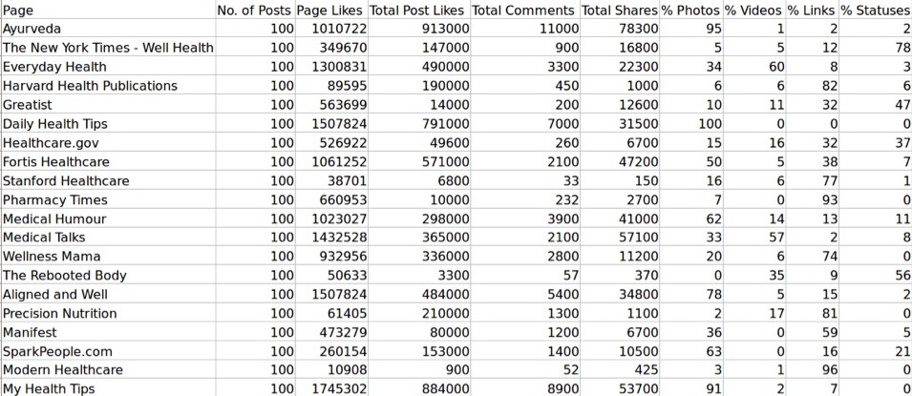
Data Collection

Slide 7
Unsupervised Machine Learning: K- Means Clustering
Clustering is an unsupervised data mining technique to identify groups of similar data items, primarily to discover patterns and interesting correlations that exist in large datasets.
Various clustering algorithms are used to achieve partitioning of data into a predeﬁned number of clusters with the help of an objective function to compute membership values of each data item.
K-Means is the most popular clustering algorithm and is used extensively in many scientific and industrial applications.
It uses a objective function that partitions the dataset in such a way that the sum of the squared errors between centroid (or empirical mean) of a cluster partition to its data points is minimized.

Slide 8
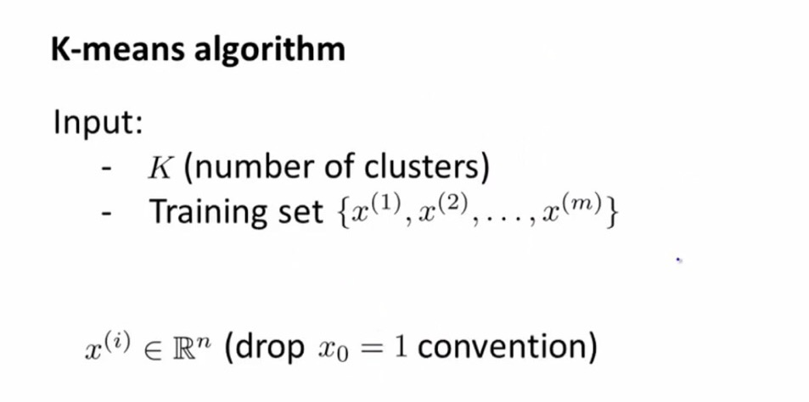
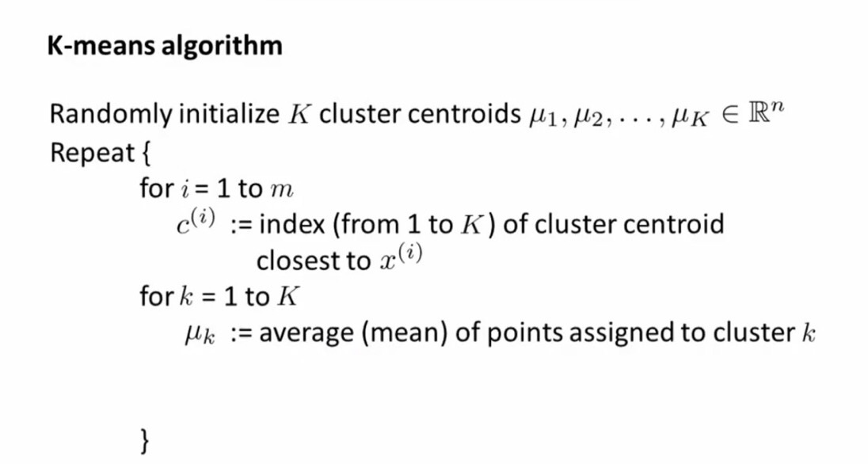

Slide 9
Why K-Means? : A comparative study

Slide 10
Results

Slide 11
Analysis and Statistics

Slide 12
Conclusion and Future Scope

Slide 13
References
Nadiya Straton, Kjeld Hansen, Raghava Rao Mukkamala, Abid Hussain, Tor-Morten Grønli, Henning Langberg and Ravi Vatrapu, “Big Social Data Analytics for Public Health: Facebook Engagement and Performance”, 2016 IEEE 18th International Conference on e-Health Networking, Applications and Services (Healthcom).
M. P. Hamm, A. Chisholm, J. Shulhan, A. Milne, S. D. Scott, T. P. Klassen, and L. Hartling, “Social media use by health care professionals and trainees: a scoping review”, Academic Medicine, vol. 88, no. 9, pp. 1376–1383, 2013.
P.Berkhin,“A survey of clustering data mining techniques”, in Grouping multidimensional data. Springer, 2006, pp. 25–71.
J. A. Hartigan and M. A. Wong, “Algorithm as 136: A k-means clustering algorithm”, Journal of the Royal Statistical Society. Series C (Applied Statistics), vol. 28, no. 1, pp. 100–108, 1979.

