Slide 1
Digital Transformation Strategy
Accelerating Growth Through Technology
Team Members
John Doe | Jane Smith | Mike Johnson | Sarah Williams
September 2025

Slide 2
Executive Summary
Problem Statement
Company facing 20% YoY decline in market share due to digital disruption
Proposed Solution
Implement comprehensive digital transformation across all channels
Expected Impact
Expected 35% revenue growth and 25% cost reduction within 18 months
Timeline
Phase 1: Q1-Q2 | Phase 2: Q3-Q4 | Full Implementation: Year 2

Slide 3
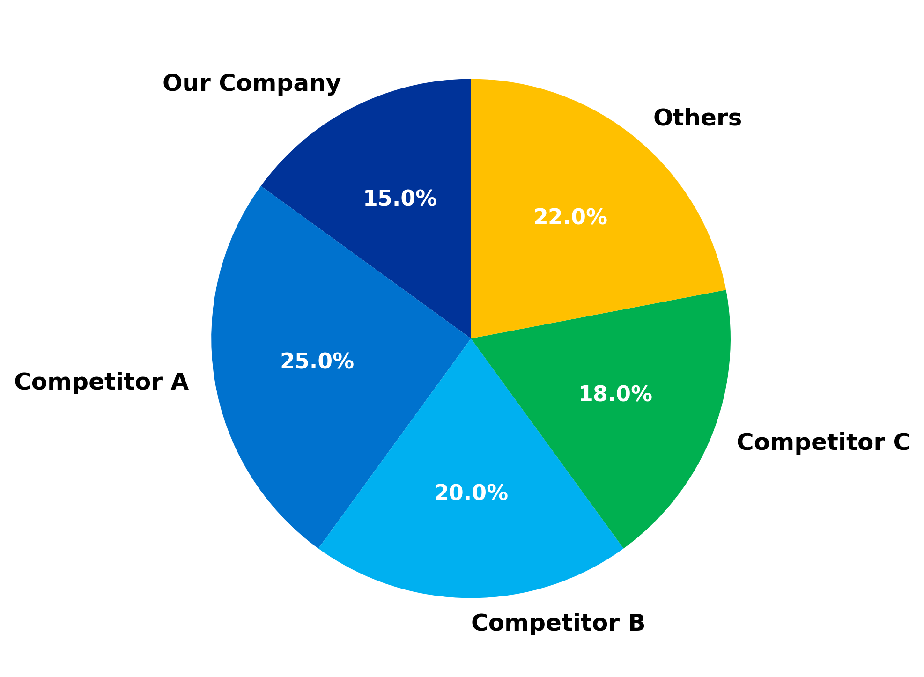
Current Market Share Distribution

Slide 4
Revenue Projection ($M)

Slide 5
Implementation Timeline
Q1 2024
Q2 2024
Q3 2024
Q4 2024
Q1 2025
Platform Selection
Pilot Launch
Scale to 50%
Full Rollout
Optimization

Slide 6
Financial Projections
Metric | Current | Year 1 | Year 2 | Year 3
Revenue ($M) | 45 | 52 | 68 | 85
Operating Margin (%) | 12% | 15% | 20% | 25%
EBITDA ($M) | 5.4 | 7.8 | 13.6 | 21.3
ROI (%) | - | 125% | 180% | 250%

Slide 7
SWOT Analysis
Strengths
• Strong brand recognition
• Experienced team
• Financial stability
Weaknesses
• Legacy systems
• Limited digital expertise
• Resistance to change
Opportunities
• Growing digital market
• Customer demand for online
• Cost reduction potential
Threats
• Aggressive competitors
• Technology risks
• Implementation complexity

Slide 8
Next Steps & Implementation
Immediate Actions (Week 1)
30-Day Milestones
Long-term Goals
□ Form transformation team
□ Conduct technology audit
□ Define success metrics
□ Complete vendor selection
□ Launch pilot program
□ Train core team
□ Achieve 50% digital revenue
□ Reduce costs by 25%
□ Market leader position

