Slide 1
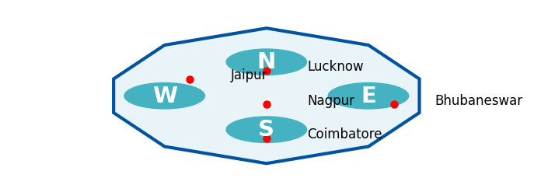
Why Tier-2 & Tier-3 India is Ripe for Disruption
MACRO TRENDS DRIVING DISRUPTION
Tier-2/3 India: Focus Markets
GDP Growth: Tier-2/3 → ~45% of India's GDP by 2025
Population: ~650M population base
Smartphone: ~60% penetration (vs 78% urban)
UPI Adoption: >12B transactions/month
Data Cost: Among lowest globally (~$0.17/GB)
UNDERSERVED SECTORS
Healthcare
600M underserved
Avg travel 50+ km
Education
Teacher ratio 1:60
vs 1:30 ideal
Finance
190M unbanked
<5% insurance
Agriculture
Post-harvest loss
₹90,000 Cr/yr
Digital readiness + structural gaps = fertile ground for tech-enabled disruption in Bharat.
1
Notes:
Tier-2 and Tier-3 India are digitally enabled — UPI, smartphones, cheap data — but structurally underserved across healthcare, education, finance and agriculture. This duality creates massive disruption potential.

Slide 2
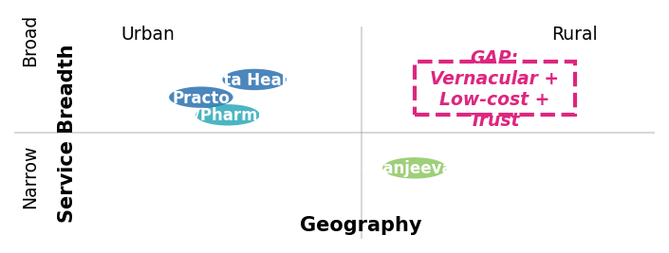
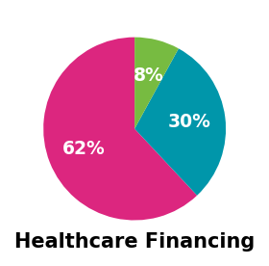
Healthcare in Tier-2/3 India: Urgent Problem, Large Market
ACCESSIBILITY
AFFORDABILITY
AWARENESS & TRUST
• 75% doctors in urban
• 600M underserved
• Travel >50 km
• 62% out-of-pocket
• 60M → poverty/year
• Catastrophic costs
• Preventive care stigma
• Unlicensed reliance
• Low health literacy
MARKET POTENTIAL
Healthcare Market
USD 372B by 2025 | CAGR 22%
Telemedicine
USD 5.4B by 2025
Diagnostics
CAGR ~20%
eSanjeevani Proof
160M+ teleconsults
Competitive Landscape
Healthcare = burning platform: unmet need, adoption signals, and policy tailwinds make it the top disruption sector.
2
Notes:
Healthcare in Tier-2/3 has the sharpest pain points: doctor shortages, catastrophic OOP costs, and proven adoption of telemedicine. This sector is where tech disruption has the highest impact and fastest scalability.

Slide 3
MediChain — Tech-enabled Primary Care & Diagnostics
AI Symptom Triage
Vernacular chatbot Cost <₹20
IoT Diagnostic Kiosks
BP, sugar, ECG Cost ~₹1L
Blockchain Records
NDHM-aligned Portable
Pharmacy Linkages
Last-mile meds Local tie-ups
KEY DIFFERENTIATORS
• Vernacular-first UX for Tier-2/3 adoption
• Micro-pricing: <₹100 consults, ₹499 family
• Trust: Pharmacy kiosks + NGO/govt tie-ups
Pilot Conversion Funnel
IMPACT & SCALE
Economic Impact
• Affordable care
• Lower OOP burden
• Scalable model
Social Impact
• 100M underserved
• Preventive adoption
• SDG-3 aligned
Addressable pop.
650,000
Digital + kiosk reach
75,000
Active users (6mo)
50,000
Teleconsults
20,000
Paying subscribers
5,000
Y1: Pilot | 100 kiosks, 50K users
Y3: Scale | 25 cities, 1M users
Y5: National | Pan-India, 100M lives
MediChain = A vernacular, trust-first, low-cost healthcare pathway for Bharat's Tier-2/3 markets.
3
Notes:
MediChain combines vernacular AI triage, kiosk-based diagnostics, secure records and pharmacy tie-ups. It pilots small (100 kiosks, 50K users) but scales to 100M lives by year five — balancing profitability and social impact.

