Slide 1
DIGITAL BANKING TRANSFORMATION
Capturing $2.5B opportunity through customer-centric innovation
SIMSREE Team Alpha | Mumbai
September 2025

Slide 2
AGENDA
1
Executive Summary
Problem statement and proposed solution
2
Market Analysis
Industry trends and competitive landscape
3
Strategic Framework
Our approach to digital transformation
4
Implementation Roadmap
Phased approach with quick wins
5
Financial Impact
2
ROI analysis and value creation
6
Recommendations
Next steps and success factors

Slide 3
EXECUTIVE SUMMARY
Traditional banks must transform digitally or lose 40% market share to fintech competitors by 2026
Customer expectations have fundamentally shifted - 78% prefer digital-first banking
Fintech disruption accelerating with $150B invested globally in 2023
Early movers capturing 3x revenue growth vs. traditional peers
Implementation window closing - first-mover advantage critical
3

Slide 4
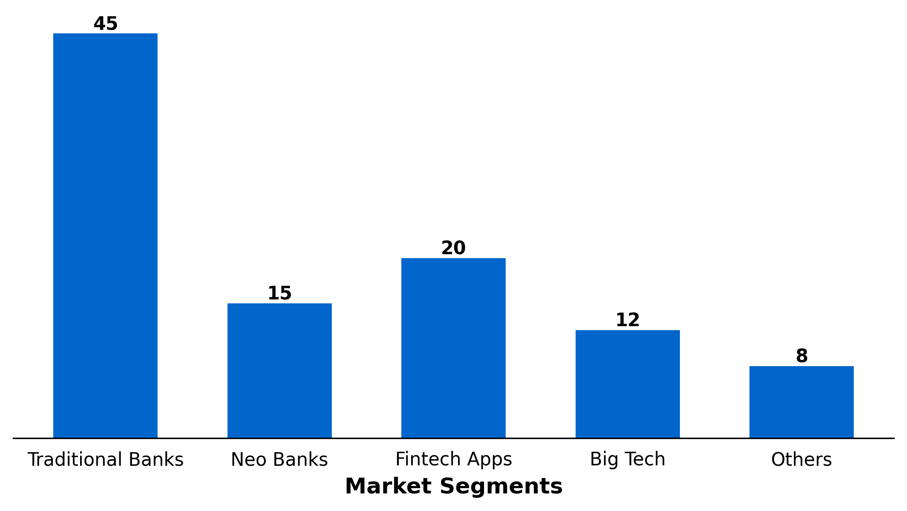
MARKET SHARE EVOLUTION
KEY INSIGHTS
• Traditional banks losing 2% share annually
• Neo banks growing at 45% CAGR
• Big Tech entry accelerating disruption
4

Slide 5
CUSTOMER EXPERIENCE COMPARISON
Traditional Banking
Digital-First Banking
Our Transformation
• Branch-centric model
• 5-7 days account opening
• Limited digital features
• 9am-5pm availability
• High operational costs
• Mobile-native experience
• 5-minute account opening
• AI-powered insights
• 24/7 instant support
• 70% lower cost-to-serve
• Hybrid optimal model
• Instant digital onboarding
• Personalized offerings
• Omnichannel excellence
• 50% cost reduction
5

Slide 6
DIGITAL TRANSFORMATION FRAMEWORK
TRANSFORM
• Core Banking
• Lending Platform
• Risk Systems
ACCELERATE
• Mobile Banking
• Payment Systems
• Analytics
Customer Value ↑
OPTIMIZE
• Branch Network
• Call Centers
• Back Office
INNOVATE
• AI Advisors
• Blockchain
• Open Banking
Digital Maturity →
6

Slide 7
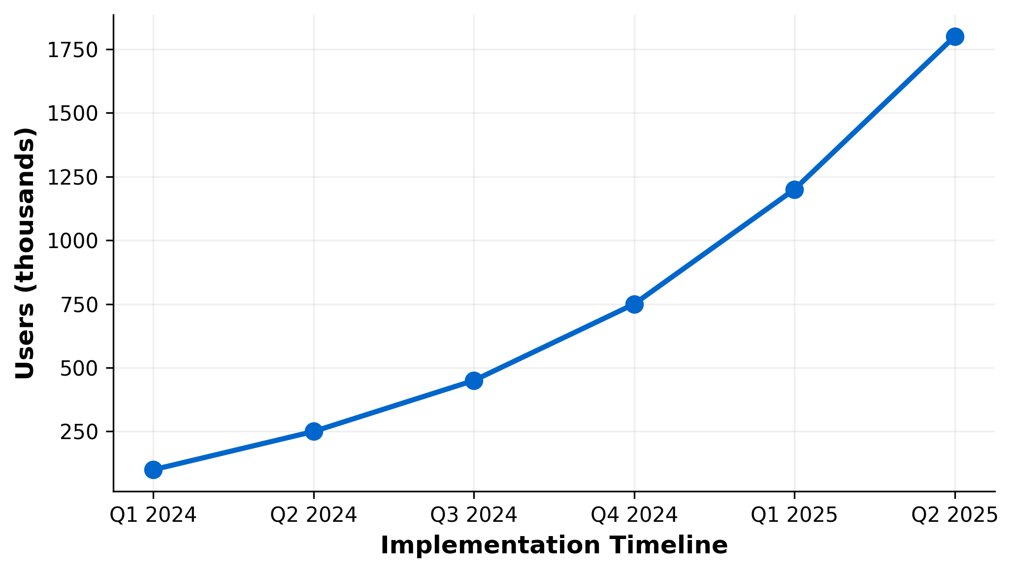
DIGITAL ADOPTION TRAJECTORY
KEY INSIGHTS
• Month 1-3: Foundation & pilot launch
• Month 4-6: Scale to 25% customers
• Month 7-12: Full rollout & optimization
7

Slide 8
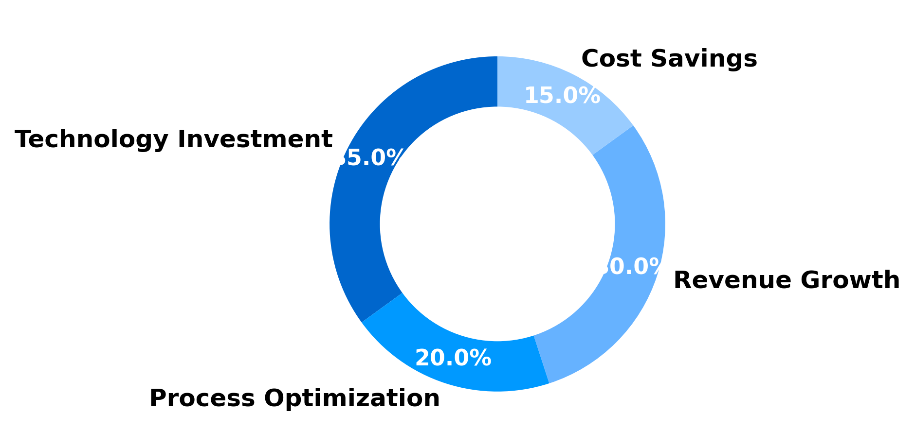
VALUE CREATION BREAKDOWN
KEY INSIGHTS
• $2.5B total value creation over 3 years
• 280% ROI with 14-month payback
• Break-even at Month 9
8

Slide 9
STRATEGIC RECOMMENDATIONS
1
Launch Digital Transformation Office
Establish dedicated team with C-suite sponsorship to drive end-to-end transformation
Impact: Accelerate delivery by 40%
2
Partner with Leading Fintech Platforms
Strategic partnerships for payments, lending, and wealth management capabilities
Impact: Reduce time-to-market by 18 months
3
Invest in Data & AI Capabilities
Build advanced analytics platform for personalization and risk management
Impact: Increase revenue per customer by 35%
IMPLEMENTATION TIMELINE
Phase 1 (0-6 months): Foundation | Phase 2 (6-12 months): Scale | Phase 3 (12-24 months): Optimize
9

Slide 10
KEY TAKEAWAYS
1. Digital transformation is existential - act now or lose relevance
2. $2.5B value creation opportunity with proven 280% ROI
3. Customer-centric approach with phased implementation ensures success
10

