Slide 1
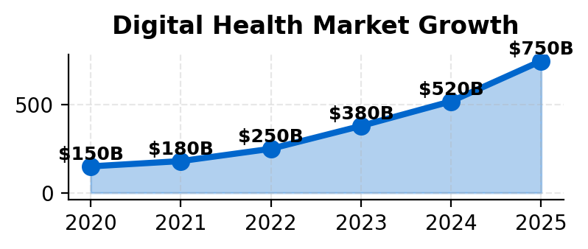
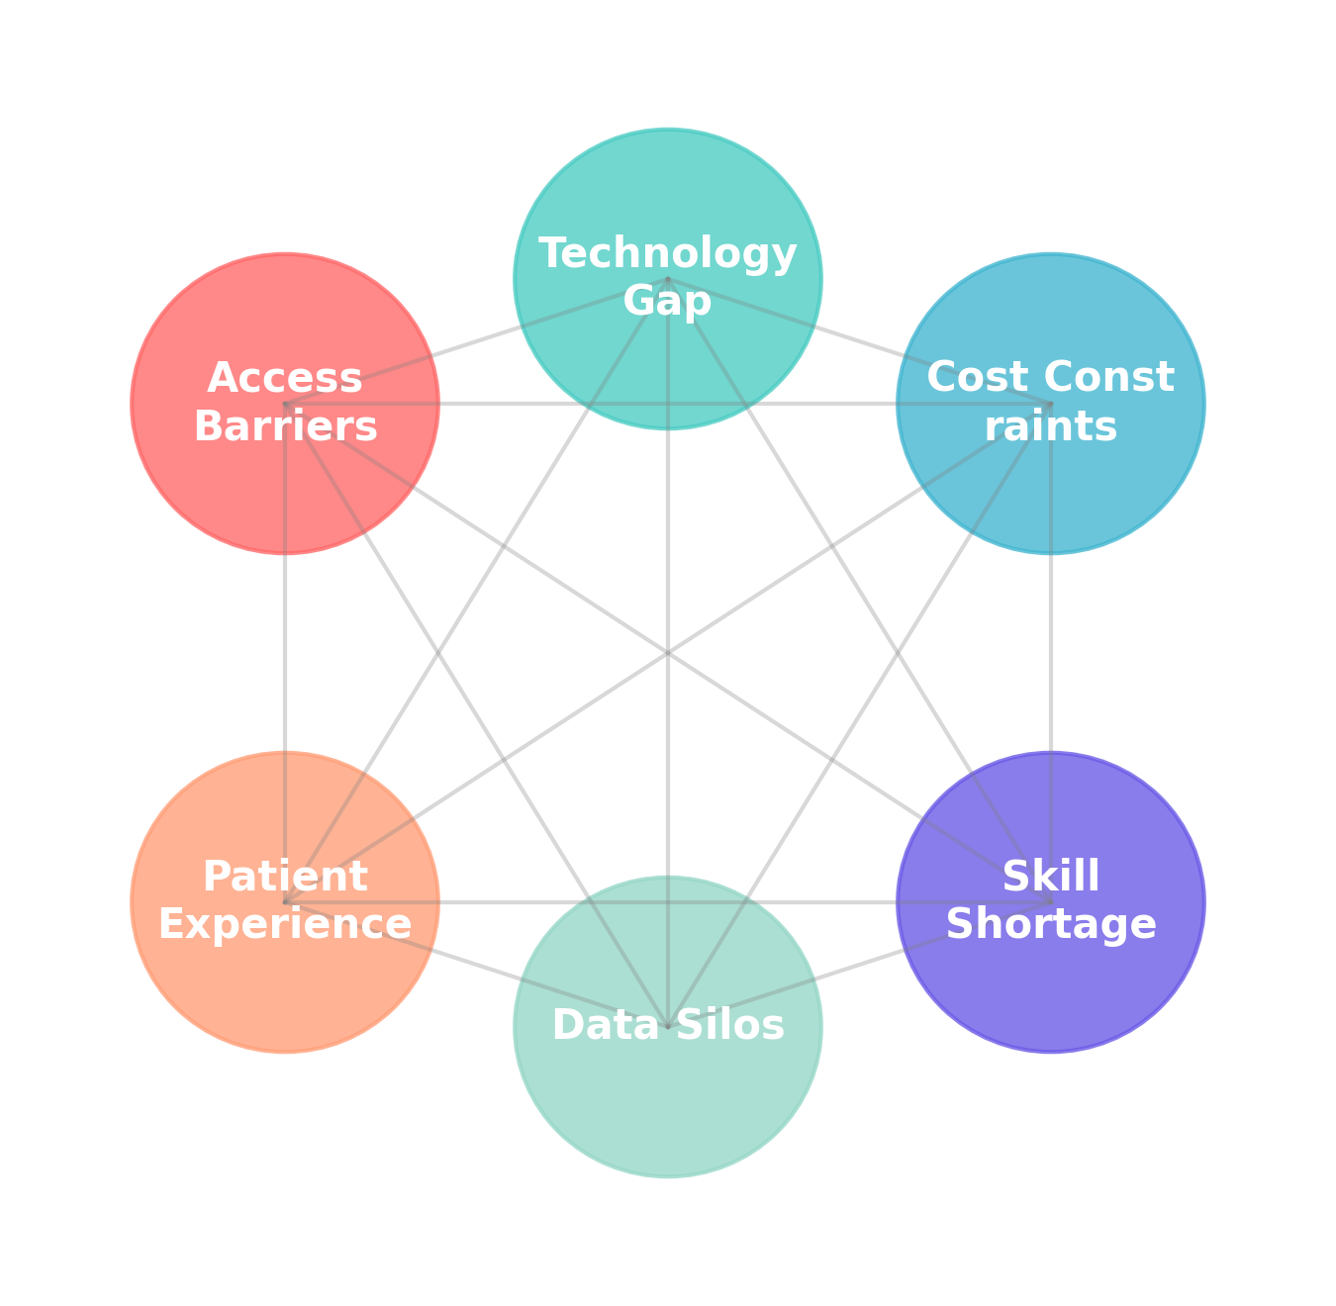
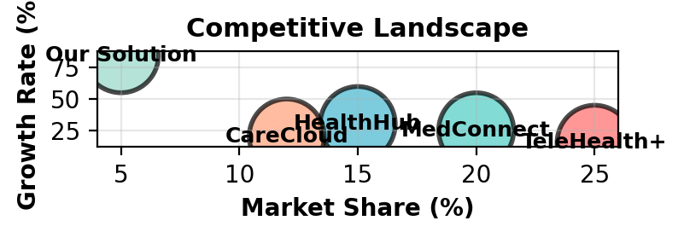
⚠ Healthcare Digital Divide Crisis - CRITICAL MARKET CHALLENGE
CORE PROBLEM
📊 MARKET DYNAMICS
BUSINESS IMPACT
💰 Revenue Loss
$500B
Annual healthcare inefficiency
⏱ Time Waste
4.2hrs
Average patient wait time
📉 Satisfaction
42%
Patient satisfaction score
⚠️ Error Rate
23%
Medical record errors
TAM
$750B
↗ +35%
CAGR
28.5%
↗ +5pp
Penetration
18%
↗ +7%
Adoption
2.5M
↗ +125%

Slide 2
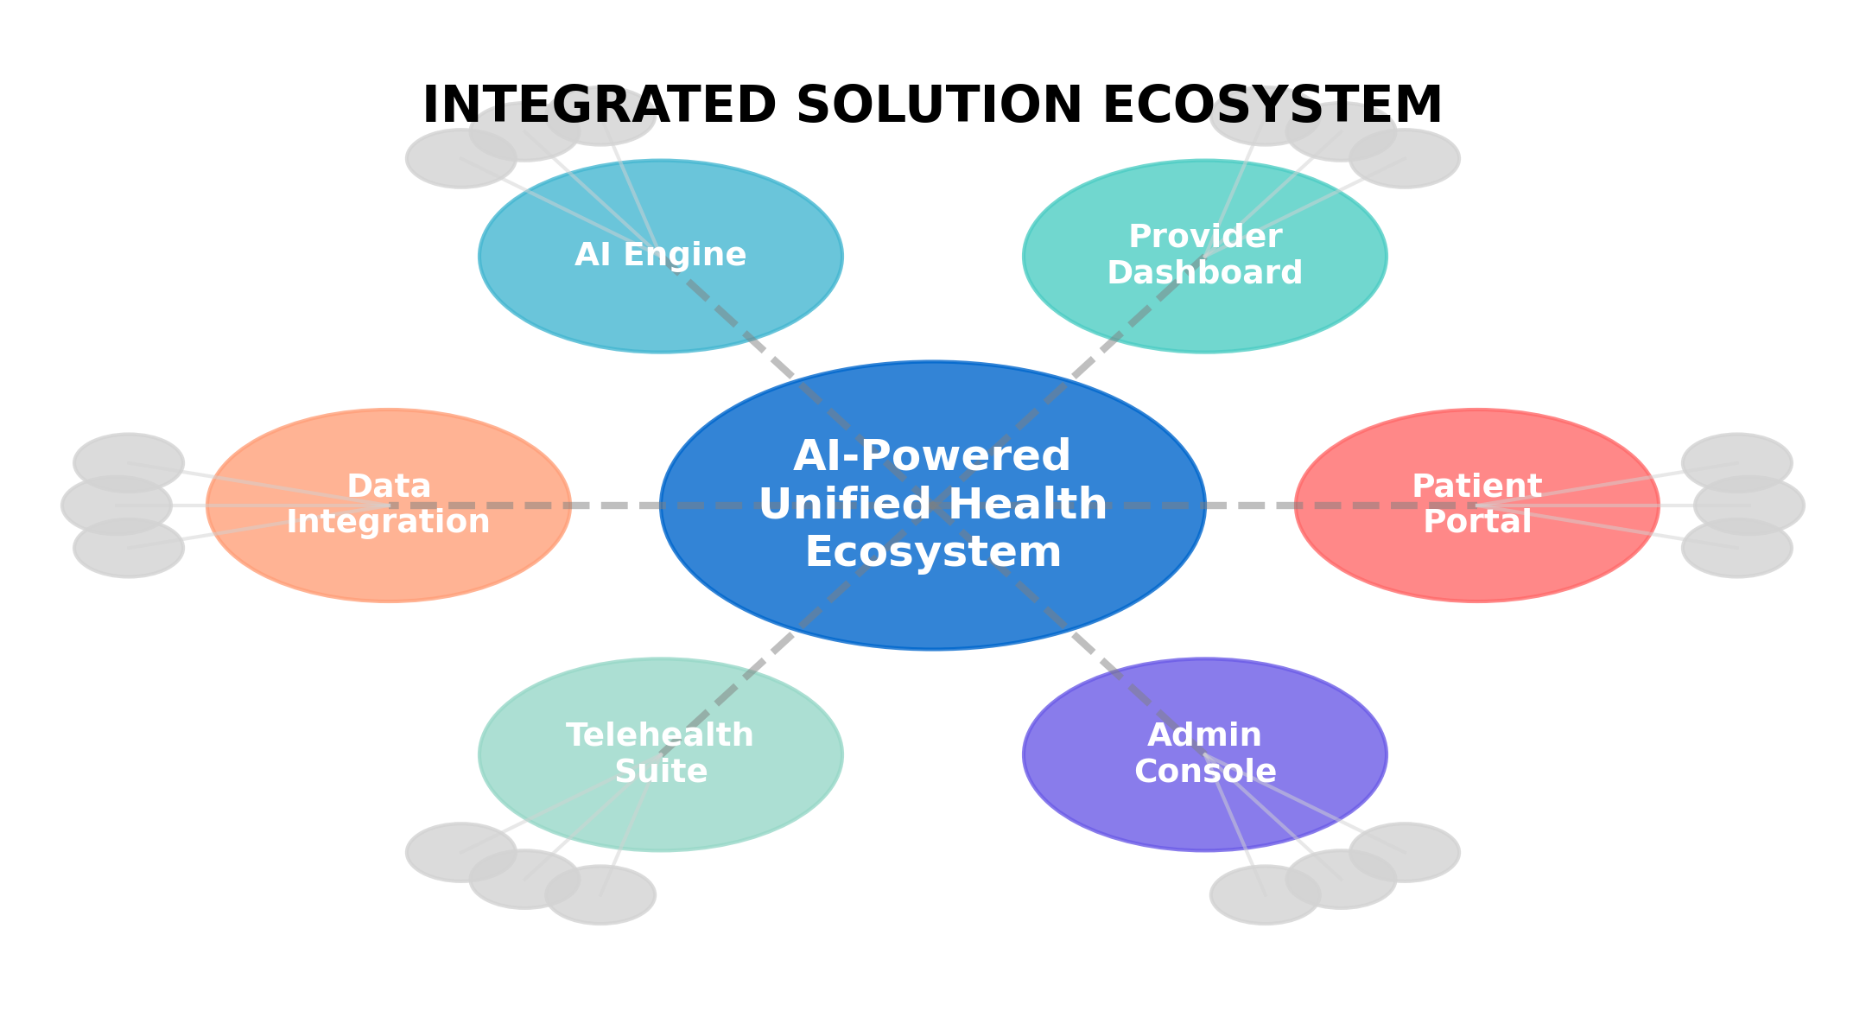
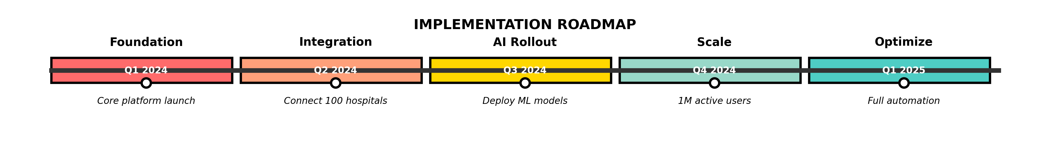
💡 HealthConnect AI Platform - COMPREHENSIVE SOLUTION ARCHITECTURE
🛠 TECH STACK
✨ KEY FEATURES
🏥 Instant Access
24/7 healthcare services
FRONTEND
React Native • Flutter • Progressive Web
🤖 AI Diagnosis
95% accuracy rate
BACKEND
Node.js • Python • GraphQL
💊 Smart Prescriptions
Automated refills
📱 Mobile First
Complete care on-the-go
AI/ML
TensorFlow • PyTorch • AutoML
🔐 Secure & Private
HIPAA compliant
INFRASTRUCTURE
AWS • Kubernetes • Terraform
SECURITY
OAuth2 • Blockchain • Zero Trust

Slide 3
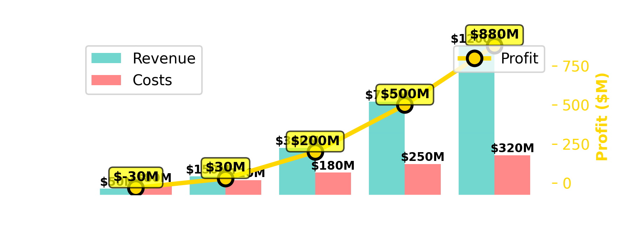
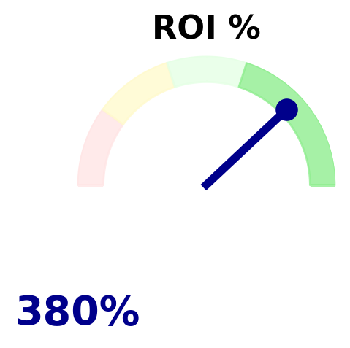
📈 PROJECTED IMPACT & ROI DASHBOARD
📈
Revenue Growth
+285%
vs. baseline
⏰
Wait Time
15 min
↘ -73%
😊
Satisfaction
94%
↗ +52pp
💰
Cost Savings
$125M
per hospital
SUCCESS METRICS
User Adoption
████████░░
850 / 1000
System Uptime
█████████░
99.8 / 99.9
AI Accuracy
█████████░
94 / 97
Cost Reduction
████████░░
28 / 35
Payback: 14 months
MVP Launch
Jan 2024
✓
First Hospital
Mar 2024
✓
100K Users
Jun 2024
◈
Series A
Sep 2024
○
National Scale
Dec 2024
○

