Slide 1
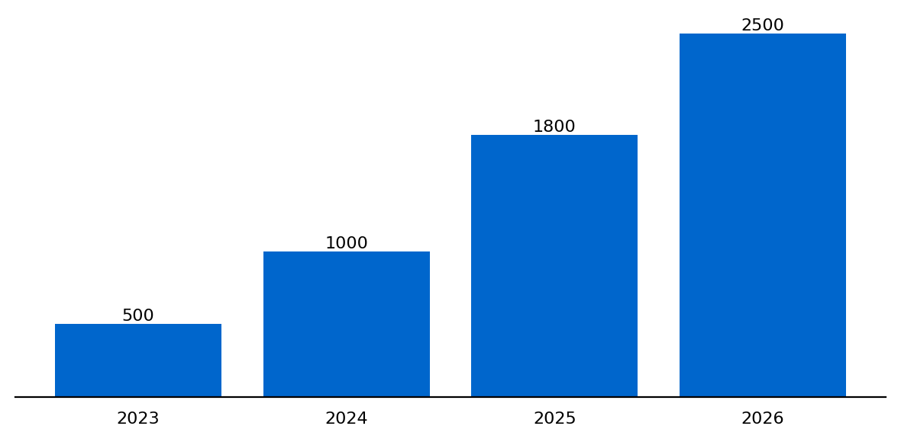
TechCorp India | Digital Transformation in Traditional Retail
PROBLEM
SOLUTION
IMPACT
CORE PROBLEM
Traditional retail losing 25% market share annually to e-commerce giants
Key Challenges:
• Legacy systems preventing omnichannel integration
• 70% of customer touchpoints remain offline
• Inventory visibility limited to 30%
Market Reality:
• $150B e-commerce market by 2025
• 45% CAGR in online retail
MARKET OPPORTUNITY
$2.5 BILLION
Growth Drivers:
✓ Smartphone penetration at 78%
✓ Digital payment adoption surge
✓ Post-COVID behavioral shift

Slide 2
STRATEGIC SOLUTION & FRAMEWORK
PROBLEM
SOLUTION
IMPACT
Unified Commerce Platform: Seamless integration of online & offline channels
DIGITAL CORE
• Cloud-native architecture
• Real-time inventory
• AI-powered analytics
• Mobile-first design
CUSTOMER EXPERIENCE
• Unified loyalty program
• 360° customer view
• Personalization engine
• Omnichannel support
OPERATIONS EXCELLENCE
• Supply chain optimization
• Smart warehousing
• Last-mile delivery
• Predictive maintenance

Slide 3
IMPLEMENTATION ROADMAP & EXPECTED IMPACT
PROBLEM
SOLUTION
IMPACT
EXPECTED IMPACT
ROI: 320%
Payback: 14 months
Foundation
Pilot
Scale
Optimize
0-3 months
3-6 months
6-12 months
12-18 months
Revenue Uplift
+45%
Cost Reduction
-30%
Customer NPS
+25pts
Market Share
+12%
KEY RECOMMENDATIONS: → Establish Digital Transformation Office | → Partner with leading tech providers | → Launch pilot in top 5 metros

