Slide 1
VERITRANSIT
AI-powered physical verification
for B2B commerce
A worker copilot that checks what physically arrived against the digital order — and writes the record itself.
?
Android + on-device AI
Kotlin backend
Ops agent
camera, NPU, works offline
reconciliation, audit chain
records, reports, alerts
Not a compliance tool. A faster pair of hands on the dock.

Slide 2
THE PREMISE
Every B2B transaction has two realities
One is structured, auditable and trusted by finance. The other is on a pallet, and gets confirmed by eye.
THE DIGITAL ORDER
THE PHYSICAL SHIPMENT
Exact, structured, already in the system
Counted by eye, written on paper
THE
GAP
Purchase order — 10 units, SKU, rate, PO line
Cartons that may be short, extra or swapped
Tax invoice — value, tax, payment terms
Labels that are missing, torn or unreadable
Manifest / delivery note — what was declared
Damage nobody logs until the customer calls
Machine-readable. Finance acts on it.
Opaque to every system downstream.
The mismatch between the two is discovered weeks later, in an invoice dispute — by people who never saw the cargo.
VeriTransit · AI verification for B2B commerce
2 / 19

Slide 3
THE PROBLEM · 1 OF 2
The frontline is already telling us this work should be automated
Warehouse associates and the leaders who staff them agree on the diagnosis.
What warehouse workers and leaders report
74%
of workers say they spend too much time on tasks a machine could do — while 69% of operations cannot find enough qualified staff to do them.
Where that time actually goes
Counting and checking cargo
by eye, carton by carton
Writing it on a tally sheet
then keying it into the ERP
Chasing what does not add up
days after the truck has gone
The demand is not for another system to update. It is for the checking itself to stop being manual.
Source: Zebra Technologies, Warehousing Vision Study 2025 (1,700+ warehouse associates and decision-makers).
VeriTransit · AI verification for B2B commerce
3 / 19

Slide 4
THE PROBLEM · 2 OF 2
Manual receiving creates the errors that finance pays for later
Two hand-offs, two chances to be wrong — and the bill arrives in accounts payable.
Goods arrive
Written on paper
Keyed into the ERP
Invoice arrives
Exception
checked by eye
error opportunity 1
error opportunity 2
matched against that record
AP chases the supplier
Invoices that hit an exception
2
Weeks
Nearly one invoice in five needs a human to reconcile it against what was actually received.
hand-offs between the dock and the ledger
until a short shipment surfaces
18.4%
The goods are recorded twice by hand before any system compares them to the order.
Typically at invoice matching or a payment dispute — long after the evidence is gone.
Sources: Ardent Partners, Accounts Payable Metrics that Matter 2025 (average invoice exception rate, 18.4%); Oracle, on paper-then-ERP receiving creating two separate opportunities for human error.
VeriTransit · AI verification for B2B commerce
4 / 19

Slide 5
WHY NOW
Three things just became true — and make this buildable
The demand, the hardware and the digital counterpart all arrived at the same time.
01
02
03
The market is buying frontline tech
The phone can now see
The digital side is machine-readable
82% of warehouse decision-makers say more technology in workers' hands is how they hit productivity targets. The budget line exists — it is labelled augmentation, not compliance.
A mid-range handset reads several codes at once and runs a vision model on its own NPU. No rugged scanner to buy, no bandwidth at the dock, no photo leaving the site.
POs, e-invoices and e-way bills are structured data. Once the physical side becomes structured too, comparing them is arithmetic — not paperwork.
82%
leaders backing frontline tech
0
new hardware per worker
1
missing half of the equation
Source: Zebra Technologies, Warehousing Vision Study 2025. Structural context: NITI Aayog on fragmented logistics, duplicate processes, manual handling and non-uniform documentation as efficiency constraints.
VeriTransit · AI verification for B2B commerce
5 / 19

Slide 6
THE GAP
Today's stack checks documents. Nothing checks the goods.
Each layer proves something real — and each one assumes the layer below it was honest.
SYSTEM IN PLACE TODAY
WHAT IT PROVES
WHAT IT CANNOT SEE
WMS / ERP
What should arrive
Has no idea what did
Barcode scanner
That a code was scanned
Not that the code matches the contents
AP 3-way match
Paper against paper
Trusts a goods receipt typed by hand
VeriTransit
What is physically there
Turns the cargo itself into structured data, at the moment a human is already standing in front of it.
We are not replacing the WMS, the scanner or the ledger. We are supplying the one input all three currently guess at.
VeriTransit · AI verification for B2B commerce
6 / 19

Slide 7
THE SOLUTION
Open the shipment. Point the phone. Done.
The worker's entire interaction. Everything else happens behind that.
1
Open the shipment
2
Point the phone
3
Done
The phone already knows the PO, the invoice and every carton expected. Nothing to type.
One camera pass over the pallet. Codes, labels, counts and condition are read together.
A verdict in seconds, and only the exceptions come back to the worker.
The worker should not be filling in forms while the AI watches.
Every screen we add is a screen someone has to tap through at 6am on a loading dock. The AI exists to remove the boring work — the counting, the tallying, the typing — not to supervise a human who is still doing it.
We do not replace the worker. We make the worker dramatically faster.
VeriTransit · AI verification for B2B commerce
7 / 19

Slide 8
UNDER THE HOOD
Four things happen in that single camera pass
Three independent readings of the same pallet, then one comparison against the order.
READ
READ
SEE
DECIDE
Scan every code at once
Read the digital order
Look at the cargo
Reconcile the two sides
Multiple QR and barcodes in one frame
PO, invoice, manifest or delivery note
Counts cartons and identifies products
Physical set vs declared set, line by line
+
+
+
Identifies the packages that already carry codes
Photographed and parsed on the device
Reads printed labels; flags damage and re-taping
Every unit attributed to a source of truth
No one-carton-at-a-time trigger pulling
Gives the pass something to be right about
Catches packages whose code is missing or unreadable
Anything unattributed becomes an exception
All four run on the device. A dock with no signal still gets an answer — and no photo of a customer's cargo leaves the site.
VeriTransit · AI verification for B2B commerce
8 / 19

Slide 9
THE CORE MECHANIC
Every unit is attributed — or it becomes an exception
A worked example: ten units on the PO, and what the pass resolves them to.
WHAT THE WORKER'S PHONE COMPUTES
Expected
10
QR identified
7
Vision identified
2
Unknown
1
1 package needs a look
Nine units are closed out automatically. The worker is handed one carton and a reason — not a list of ten to re-check.
The output is not a score or a probability. It is an attribution for every unit, which is what a goods receipt legally needs.
Worked example on PO ZD-4471; the same arithmetic runs on any line count.
VeriTransit · AI verification for B2B commerce
9 / 19

Slide 10
THE INTERFACE
The worker sees three outcomes, and acts on one of them
Attention is the scarce resource on a dock. We spend it only where a human is actually needed.
✓
MATCH
!
CHECK THIS ONE
✕
MISMATCH
Nothing to do
One carton, one question
Stop and record
Physical set equals the declared set. The goods receipt is already written by the time the worker looks up.
A code would not read, a count is ambiguous, packaging looks disturbed. The phone says which carton and why.
Wrong product, short count, or a package that does not belong to this shipment. Evidence is captured on the spot.
the overwhelming majority of cartons
the only thing the worker handles
escalated with photos attached
No dashboards, no scores, no confidence percentages. A worker on a dock needs a decision, and the reason behind it in one line.
VeriTransit · AI verification for B2B commerce
10 / 19

Slide 11
THE OUTPUT
The result becomes the record — nobody types it in again
This is the step that removes the second error opportunity, and the one finance actually cares about.
Goods receipt (GRN)
Evidence photos
Timestamp + location
Line by line, with the attribution behind every unit
The frames the decision was actually made from
When and where the check happened, from the device
Worker and site
Discrepancy report
Audit trail entry
Who stood in front of the cargo and signed it off
Generated only when there is something to report
Append-only, so a flagged scan cannot quietly disappear
Offline is the normal case, not the failure case.
Docks, basements and check posts have bad signal. Everything above is produced on the device and queued; when the connection returns it syncs and the server re-verifies it independently. The worker never waits for a network.
VeriTransit · AI verification for B2B commerce
11 / 19

Slide 12
THE COMMERCE LAYER
We make the physical side of a B2B transaction machine-readable
Not a payment system. The missing input to the 3-way match that every AP team already runs.
→ into the invoice match
Purchase order
Physical shipment
VeriTransit check
Goods receipt
what was agreed
what turned up
the two, compared
machine-generated
EVERYTHING AGREES
THEY DISAGREE
PO ✓ + Goods received ✓ + Invoice ✓
PO ✓ + Physical ✕
Straight through to normal AP processing. No AP clerk touches it, because the goods-receipt line was never a guess in the first place.
An exception is created at the dock, with the delta, the evidence photos and the carton it belongs to — hours after the truck arrives instead of weeks after the invoice.
We are not saying "our AI controls payments." We are saying the physical half of the transaction finally has evidence behind it.
VeriTransit · AI verification for B2B commerce
12 / 19

Slide 13
ARCHITECTURE
Deterministic checks decide; the model explains and routes
The AI agent sits after verification, never inside it — a misread can cost a supervisor a walk, never a wrong release.
INPUTS
PO / invoice / manifest
Signed package labels
The cargo itself
Site + worker identity
ON THE DEVICE — OFFLINE CAPABLE
Multi-code scanner
Document reader
Vision check
Reconciler
QR + barcode, many at once
on-device OCR
count, identify, damage
physical vs declared
SERVER — AUTHORITATIVE
Re-verification
Match engine
Audit chain
Ops agent
cross-device, cross-shift
PO · invoice · GRN
append-only, hash-linked
records, reports, alerts
Consumers: ERP / WMS · AP exception queue · Telegram for supervisors · dispute & insurance evidence packs
VeriTransit · AI verification for B2B commerce
13 / 19

Slide 14
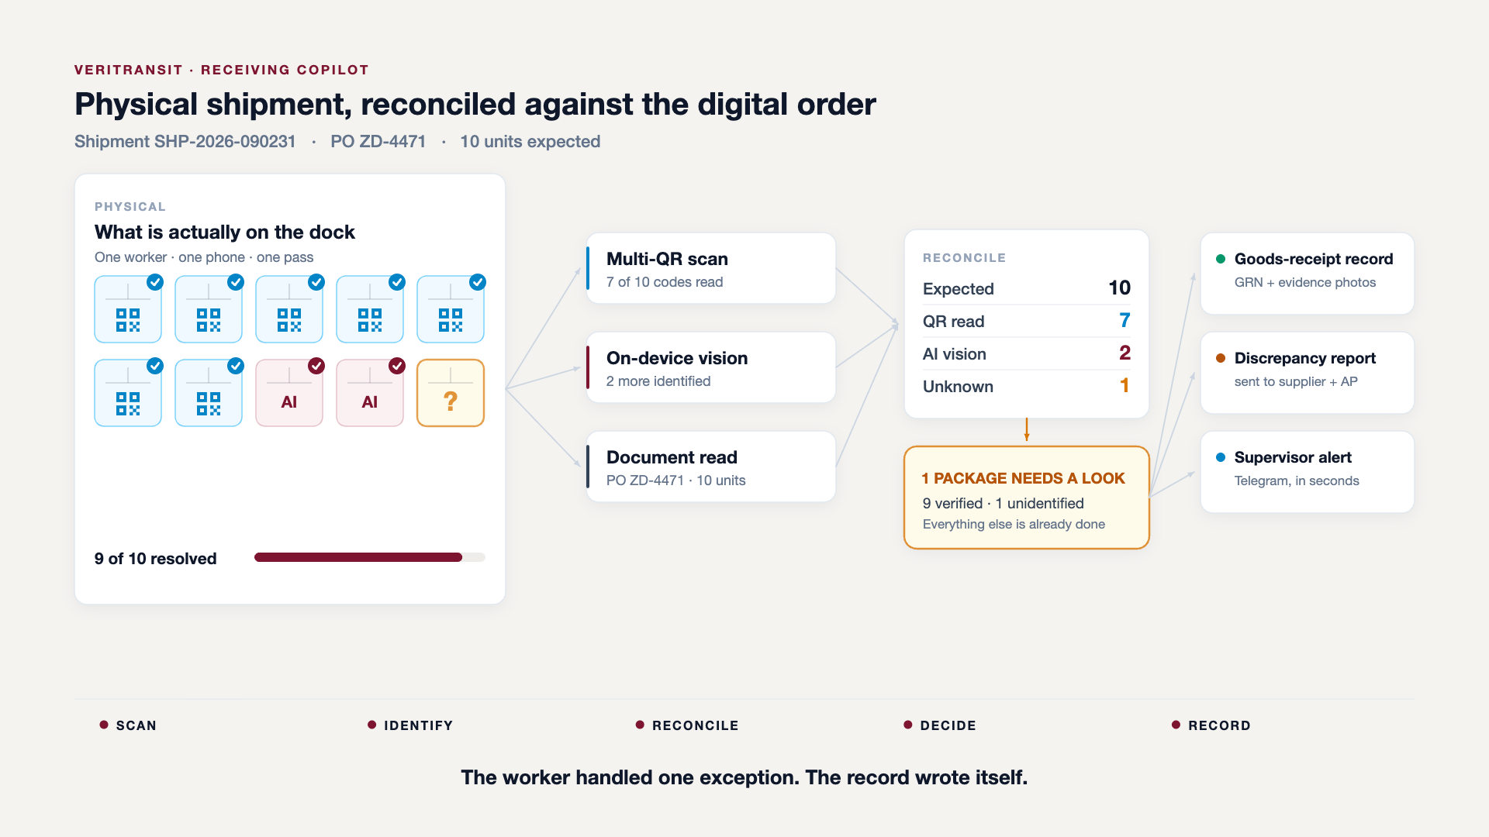
THE WORKFLOW, END TO END
One pass over ten cartons, from camera to goods receipt
15-second embedded clip — press play in slideshow. The final frame is the static diagram, so the slide reads correctly in print and PDF.
VeriTransit · AI verification for B2B commerce
14 / 19

Slide 15
THE AI OPERATIONS AGENT
The agent does not decide whether the cargo matches
It takes a structured, already-decided result and does the chores that follow it.
NOT THE AGENT'S JOB
WHAT IT ACTUALLY DOES, ONCE THE RESULT EXISTS
Judging the match
Updates the database
Generates the discrepancy report
Whether ten units are present is arithmetic over scans and vision output — rule-based, explainable, reproducible, and testable. A language model has no business in that decision, and putting one there is how a demo becomes an audit finding.
shipment, line items, goods-receipt state
supplier-ready, with evidence attached
Notifies the right person
Creates the GRN record
supervisor, supplier, AP — by role, not broadcast
in the format the ERP expects
Answers questions in Telegram
Queues everything offline
The model can raise a flag. It can never clear one on its own.
"status SHP-90231", "why was it held?"
and replays it when connectivity returns
Deterministic engines decide. The model explains, drafts and routes — inside a policy it cannot widen.
VeriTransit · AI verification for B2B commerce
15 / 19

Slide 16
THE DEMO
Thirty seconds, one mismatch, the whole story
Not ten screens. One shipment that is wrong, and what the phone does about it.
1
2
3
4
5
6
The order
The pass
The codes
The eyes
The verdict
The record
PO says 5 Dell monitors
Worker points the phone at 5 boxes
4 QR codes detected
Vision sees 4 monitors and 1 HP printer
MISMATCH — 1 item needs attention
Discrepancy report generated, database updated
›
›
›
›
›
5 × MONITOR-DELL-24
one camera sweep
4 / 5 resolved
1 × PRINTER-HP ← not on PO
MISMATCH
auto — no typing
The printer is the point.
A barcode scanner reports four good scans and moves on. Only something that looks at the cargo notices that the fifth box is a different product entirely — and that is exactly the error that surfaces six weeks later as an invoice dispute.
VeriTransit · AI verification for B2B commerce
16 / 19

Slide 17
EXPECTED IMPACT
The work shrinks; errors surface while evidence exists
Modelled on a 40-carton inbound. These are targets for the pilot to confirm, not measured results.
Minutes per inbound shipment
ILLUSTRATIVE
Where the error is caught (% of errors)
ILLUSTRATIVE
Catching a short shipment at the dock is a two-minute conversation. Catching it at invoice matching is a six-week receivable.
Illustrative model, not measured: manual = per-carton visual check, tally sheet and later ERP entry; VeriTransit = one camera pass plus exception handling. Editable in data/charts.json; to be replaced with pilot timings.
VeriTransit · AI verification for B2B commerce
17 / 19

Slide 18
WHERE WE ARE
The hard parts are built; the pilot is what is left
Kotlin end to end — one set of models shared by the app, the server, the console and the bot.
RUNNING TODAY
NEXT
Android app
Pilot on one inbound dock
Compose UI, field + warehouse + delivery flows, camera scanning
measure the numbers on slide 17 for real
On-device AI
vision and document reading on the phone's NPU, offline
ERP / WMS write-back
Backend
GRN straight into the customer's system
Kotlin/Ktor, Postgres, reconciliation and append-only audit chain
Admin console
Vendor scorecards
shipments, documents, discrepancy queue, evidence
Telegram agent surface
discrepancy history per supplier and route
query a shipment, receive alerts, approve in chat
Signed labels
Payment release signal
Ed25519 tokens verified on the device with no network
verified receipt as a gate, under finance policy
What we need from a pilot partner is one dock, one week, and access to the PO feed.
VeriTransit · AI verification for B2B commerce
18 / 19

Slide 19
THE POSITION
AI-powered physical verification for B2B commerce — built as a worker copilot, not another enterprise system.
We do not replace the worker.
We do not decide the money.
We do not need new hardware.
One camera pass replaces the counting, the tally sheet and the data entry.
We supply the physical evidence the three-way match has always been missing.
A phone the site already owns, working offline, on the dock.
VeriTransit
Every B2B transaction has two realities. We make them agree at the dock.

