Slide 1

AgriTrack
Remote farm monitoring & financial trust
A single place for owners and investors to watch operations
and trust what happens with money — from anywhere.
Powered by Sui · Pitch · April 2026
Presented by · Esther Nakungu
Solo project · AgriTrack

Slide 2
CHALLENGE
The problem
No live picture of what happens on the farm for people who are not on site.
Money is hard to prove when records are informal or easy to argue about.
Remote owners cannot verify day-to-day work or payments with confidence.

Slide 3
ANSWER
Our solution
Live activity — farmers log what happens as it happens.
Clear roles — farmer, trader, and admin each see what they should.
Verifiable payments — Sui for proof when it matters.
Monitor operations and trust the money trail from anywhere.
This is not just farm management — it is trusted, verifiable agricultural operations.

Slide 4
ARCHITECTURE
How it works
One connected flow from field to chain to oversight.
Login | → | Role identified
↓
Farmer • Input, farm logs & harvests • Stock updates | Trader • Sales & purchases • Payments on Sui | Admin • Live dashboard • Monitoring & alerts
↓
Blockchain transaction
↓
System updates → Alerts → Admin action

Slide 5
PRODUCT
What you get
Daily farm logs with optional photo proof.
One dashboard for stock, revenue, and alerts.
Sales and credit tracked in one place.
Payment verification on Sui when you need proof.

Slide 6
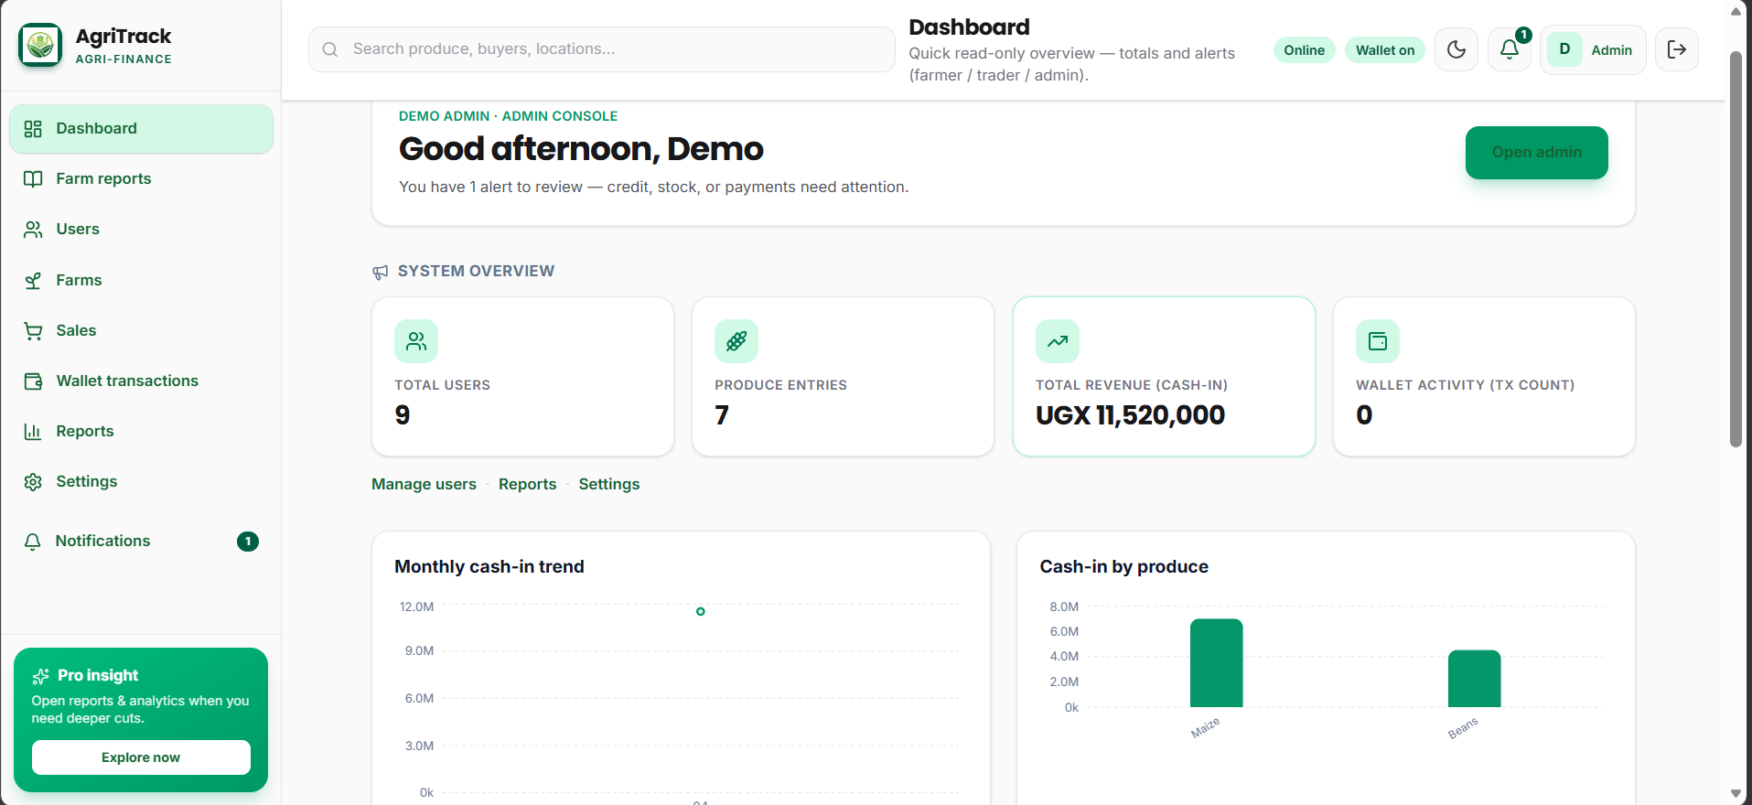
PRODUCT DEMO
Admin — full system view
Users, produce, revenue, and charts in one place for oversight.

Slide 7
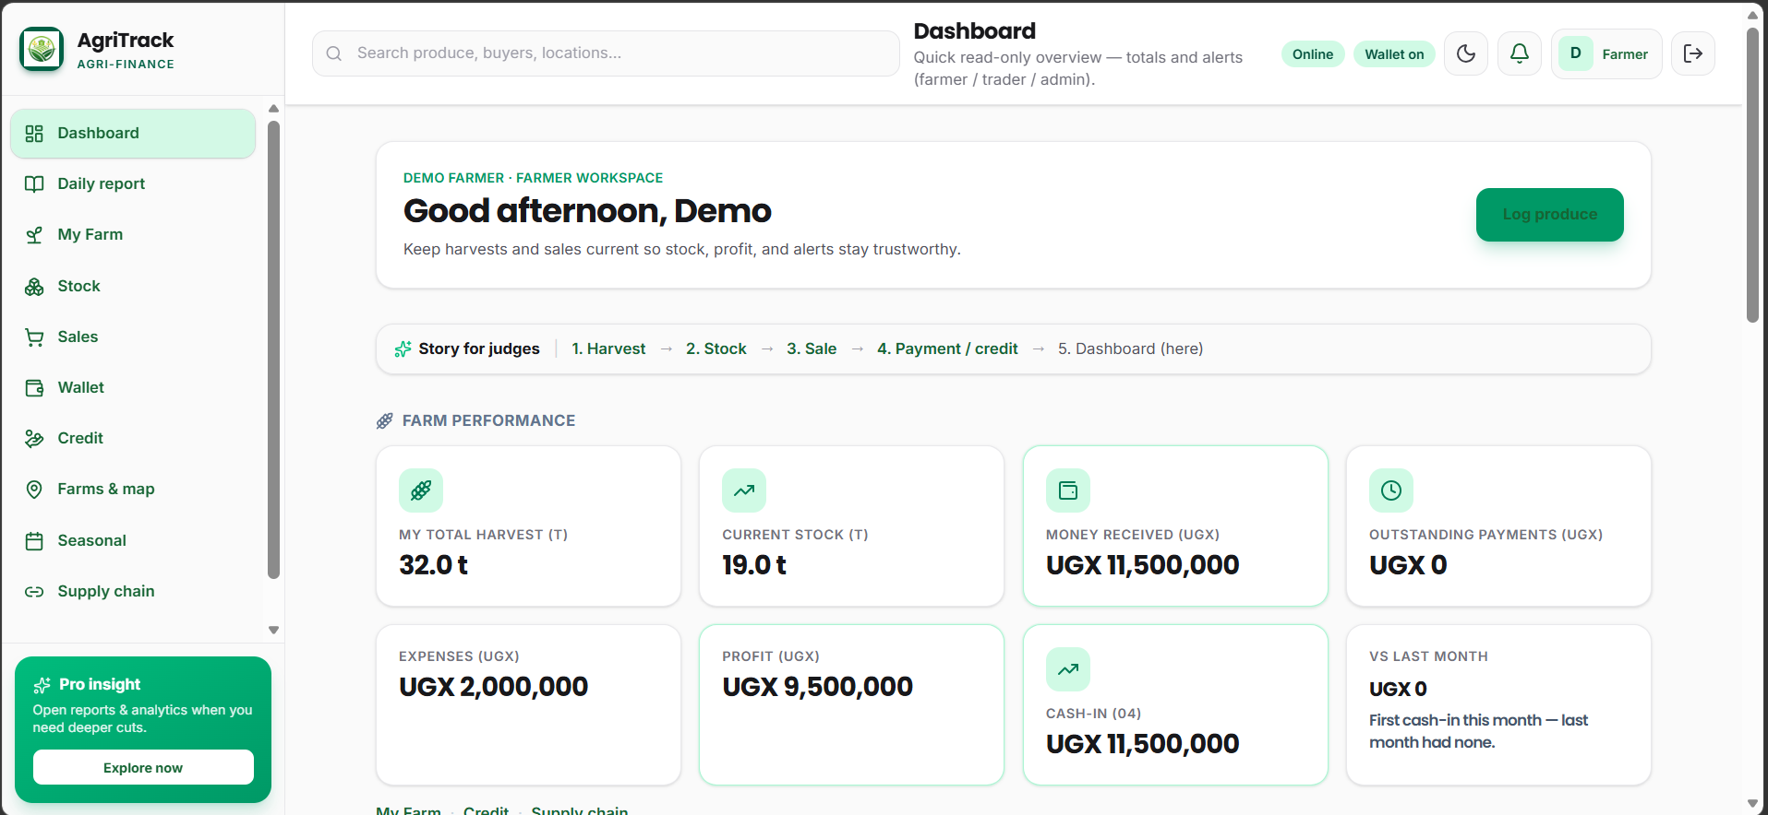
PRODUCT DEMO
Farmer — day-to-day operations
Harvests, stock, and money received — what happens on the farm.

Slide 8
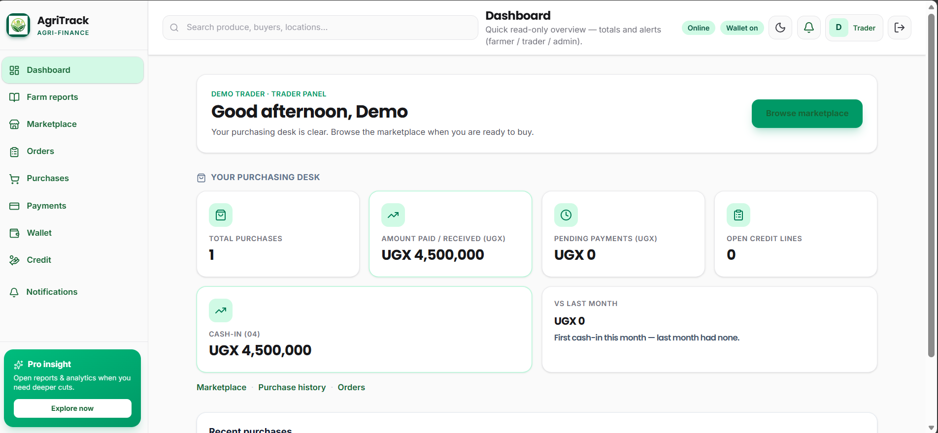
PRODUCT DEMO
Trader — sales & payments
Purchases, amounts in UGX, and a clear purchasing desk.

Slide 9
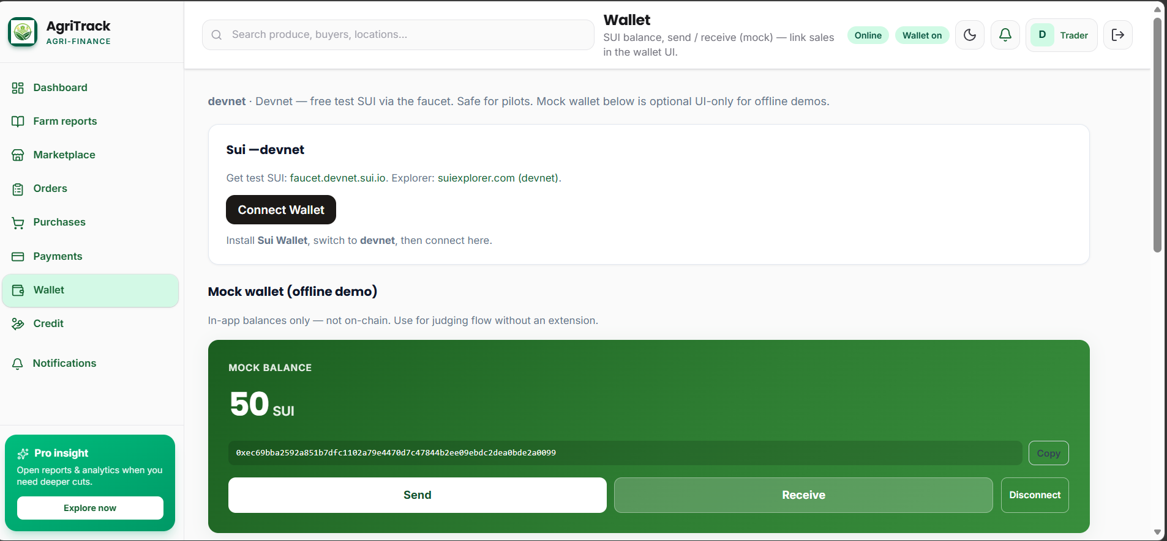
PAYMENTS & TRUST
Wallet on Sui
Connect a real wallet or use mock SUI for demos — same flow.

Slide 10
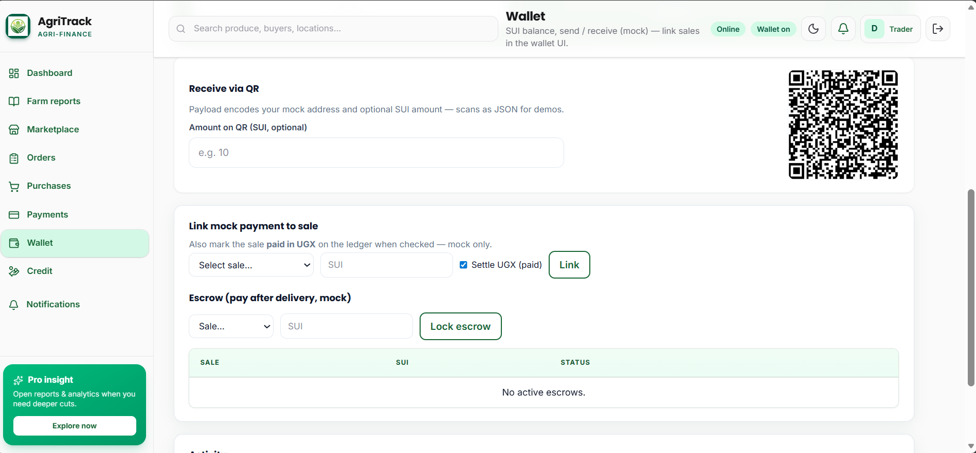
PAYMENTS & TRUST
From chain to ledger
QR receive, link a payment to a sale, optional escrow — proof end to end.

Slide 11
OUTCOMES
Impact
Farmers
Owners & investors
Agribusiness
Clearer accountability in the field.
Documented trail of work, stock, harvests.
Fewer disputes with buyers.
Stronger case for credit and support.
Confidence from a live picture.
Revenue, costs, alerts without waiting on reports.
Earlier signals when something drifts.
History for boards, donors, partners.
Scale without losing transparency.
One standard across farmers or sites.
Roles that match real teams.
Readiness for audits and pilots.

Slide 12
WHY NOW
Why it matters
Agriculture needs trust, not only effort.
Clear records reduce fraud and confusion around money.
Remote ownership only works with visibility and proof.

Slide 13
ROADMAP
Next steps
Mobile experience so daily input is effortless.
Stronger proof — location and media where it helps.
More payment rails alongside Sui.
First pilot — name your partner on this slide.

Slide 14
Thank you
Trust and transparency for the people who feed us.
Built & presented by · Esther Nakungu
Questions welcome · Thank you for your time

