Slide 1

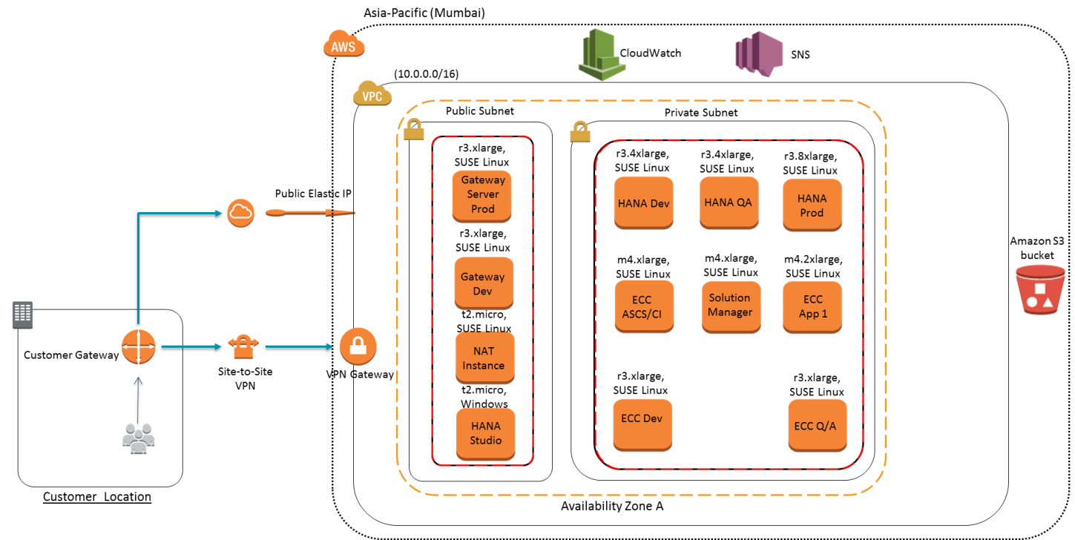
Case Study : SAP HANA
Business Insight
A renowned real-estate company wanted cost-effective solution to run SAP HANA without compromising the agility and performance expected out of it.
Business Challenges
Challenge #1
Challenge #2
To efficiently channelize the available workforce and capital in achieving maximum output
Required Servers in magnitude of 16 to 32 cores and 120 to 250 GB RAM which has a huge upfront cost
Solution
VPN Connectivity between Customer Location to AWS
Placement Group for high throughput
Cloud Formation Script for infrastructure provisioning
Cloud Formation Script for SAP HANA Installation

