Slide 1
Introduction of Information Retrieval and Text Mining Fall 2025
Chien Chin Chen
Department of Information Management
National Taiwan University

Slide 2
Course Information (1/5)
Instructor:
陳建錦 (Chien Chin Chen)
E-mail: patonchen@ntu.edu.tw
Office: Mgmt II 414.
Office hours: by appointment
Teaching assistant:
彭子承 d13725002@ntu.edu.tw
沈沁蓁 r13725021@ntu.edu.tw
張力升 r13725026@ntu.edu.tw
林佳穎 r13725061@ntu.edu.tw
Course website: NTU COOL

Slide 3
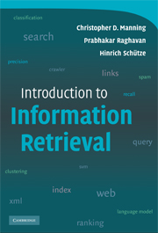
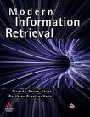
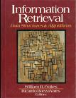
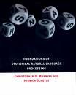
Course Information (2/5)
Text book:
Christopher D. Manning, Prabhakar Raghavan and Hinrich Schütze, Introduction to Information Retrieval, Cambridge University Press, 2008.
Available on http://nlp.stanford.edu/IR-book/
References:
Ricardo Baeza-Yates and Berthier Ribeiro-Neto, Modern Information Retrieval, Addison Wesley, 1999.
Gerard Salton, Automatic Text processing – The Transformation, Analysis, and Retrieval of Information by Computer, Addison Wesley, 1989.
William B. Frakes and Ricardo Baeza-Yates, Information Retrieval – Data Structures and Algorithms, Prentice Hall, 1992.
Christopher D. Manning and Hinrich Schütze, Foundations of Statistical Natural language Processing, The MIT Press, 1999.

Slide 4
Course Information (3/5)
This course is aimed at graduate students who are interested in information retrieval and text mining.
The first part of the course will cover the basics of information retrieval, including the manner of document representation, term weighting, and evaluation metrics used to compare information retrieval systems.
Then, research topics, such as text classification and clustering, will be discussed to provide a comprehensive study on information retrieval and text mining.

Slide 5
Course Information (4/5)
This course would cover the following contents:
Chapter 2: Term Vocabulary
Paper reference: PAT Tree and Chinese Keyword Extraction
Chapter 6, Term Weighting and Vector Space Model
Chapter 8, Evaluation in Information Retrieval
Chapter 9, Relevance Feedback and Query Expansion
Chapter 11, Probabilistic Information Retrieval
Chapter 12, Language Models for Information Retrieval
Word2Vec
Chapter 21 Link Analysis
Chapter 13, Text Classification and Naive Bayes
Chapter 14, Vector Space Classification
Chapter 16, Flat Clustering
Chapter 17, Hierarchical Clustering
Paper reference: Topic Detection and Tracking

Slide 6
Course Information (5/5)
Prerequisite:
Programming language (C++, Java, Python, …)
Data structure
Probability
Linear algebra
555
Grading:
Programming assignment (at least 4 assignments): 20%
Midterm: 30%, on 10/20/2025
Final: 30%, on 12/15/2025
Term project: 20%
Factored by 組內互評
If you do not like writing programs…
Please do not take this course!!
If you hate mathematics …
Please do not take this course!!

Slide 7
Programming Assignment Policy
Need to submit your source code, program outputs, and a brief note on COOL.
Format:
Plain A4 size page
≥ 2 pages
Font size: 12 point
Single column
Single space
Late homework would not get any credit!!
Students who copy (or copied) other's code will not get any credit!!

Slide 8
Term Project Policy (1/2)
Each team can have at most 5 members and no less than 4!!
Please prepare a one-page proposal and send it to TA on 11/10/2025 (font size: 12 point, single column, single space)
The name of your project
Members
A brief description your project and possible solutions
There will be a public workshop on 12/22/2025
Each team will have an 8-minute presentation to show your system
An 1-minute Q&A

Slide 9
Term Project Policy (2/3)
In addition, each team must submit a project report to TA before 12/29/2025.
Format: http://www.acm.org/sigs/publications/proceedings-templates
At least 4 pages
The purpose of your project
Your solution
System outcomes
Conclusions
References

Slide 10
Term Project Policy (3/3)
組內互評
每位組員需繳交一頁(A4)互評報告，說明:
自己負責部分與研究心得
為每位組員(自己除外)給予1~4分，並說明原因
Project組成績換算個人成績方式:
全得1分者組成績 * 0.3
平均低於2.25分(含)者組成績 * 0.6
得3個(含)以上4分之同學組成績 * 1.04
得2個4分之同學組成績 * 1.02
上述方式以5人一組為基礎，若少於5人的組別，上述計分人數扣1。優先權由上往下，如4人一組，A同學得到(4, 1, 1)，則同時滿足第二與第四項，以第二項為最後結算方式。

Slide 11
IRTM-related Conferences & Journals (1/5)
Journals:
ACM Transactions on Information Systems – TOIS (since 1983, SCI)
IEEE Transactions on Knowledge and Data Engineering – TKDE (since 1989, SCI)
Information Processing and Management – IPM (since 1975, SCI, SSCI)
Known as Information Storage and Retrieval since 1963
Journal of the American Society for Information Science and Technology – JASIST (since 2001, SCI, SSCI)
Known as Journal of the American Society for Information Science since 1970
Known as American Documentation since 1950
ACM Transactions on Knowledge Discovery from Data – TKDD (since 2007)
ACM Transactions on the Web – TWEB (since 2007)

Slide 12

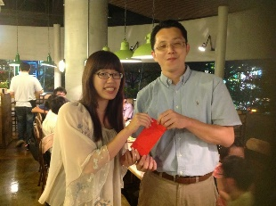
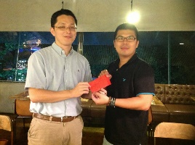
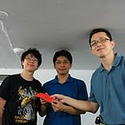

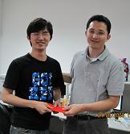
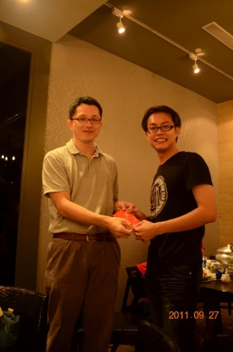
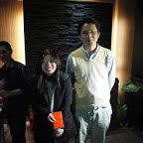
IRTM-related Conferences & Journals (2/5)
Conferences:
First-tier – accept rate: 16~20% (WEAL prize 30k)
ACM SIGIR (since 1971, CFP: Jan.)
ACM SIGKDD (since 1995, CFP: Feb.)
Intl Conf on Information and Knowledge Management – CIKM (since 1992, CFP: May)
IEEE Intl Conf on Data Mining – ICDM (since 2001, CFP: July)
World-Wide Web Conference – WWW (since 1994, CFP: Nov.)
Second-tier – accept rate: 18~30% (WEAL prize 20k)
European Conf on Information Retrieval – ECIR (since 1979, CFP: Oct.)
IEEE/WIC/ACM Intl Conf on Web Intelligence – WI (since 2001, CFP: July)
Intl Conf on Web Information Systems Engineering – WISE (since 2000, CFP: June)
European Conf on Machine Learning – ECML (since 1986, CFP: April)
ACM Web Search and Web Data Mining – WSDM (since 2008, CFP: Aug.,)
Others: (WEAL prize 10k)
Asia Information Retrieval Societies Conference – AIRS (since 2004)
ACM/IEEE-CS Joint Conference on Digital Libraries – JCDL (since 1995, CFP: Jan., rate: 20~40%)

Slide 13
IRTM-related Conferences & Journals (3/5)
While only (SCI) journal papers count for PhD students, I highly recommend students submitting conference papers.
Why?
Conference papers usually reflect the latest trends of research
Being able to meet other researchers
Sightseeing
You should have a road map of your paper submission!!

Slide 14
IRTM-related Conferences & Journals (4/5)
My map ... when I was a PhD student:
Jan.~Feb.
May~July
Sept.~Oct.
Hard time
(survey, fight with your advisor, write manuscript)
SIGIR
or
SIGKDD
CIKM
or
ICDM
ECML
or
WI
ECIR
Third-tier

Slide 15
IRTM-related Conferences & Journals (5/5)
When surveying papers … try your best to collect related works from top conferences and journals.
Citing high quality papers will make your paper convincible.
Missing an important reference will make yourself an outsider.
When thinking methodologies … aim your works at top conferences and journals.
That helps make your works solid.
Citation number is a metric to evaluate the quality of your works.
Papers of top conferences and journals earn more exposures; so as to increase the possibility of being cited.

