Slide 1

Nan San Fintech Project:
Team 3
Find Trend
Let's get the World Trend NOW!!!

Slide 2
Contents
Search the trending word to be the news title
Title news Summary for Keyword
Relatedwords from Knowledge Graph
Stock Price Trend Chat and CAPM Value

Slide 3
Search the trending word to be the news title
After selecting the most recently discussed words through Google trend, users can decide for themselves whether they want to query related news and topic summaries of popular words, or actively search for them.

Slide 4
Google Hot Words
Loki Episode 2
Tyler Glasnow
Nets
Lisa Banes
Nintendo E3
France vs Germany
Portugal vs Hungary
Southwest
Metroid Dread
MacKenzie Scott
Shelby Houlihan
Windows 11
Cristiano Ronaldo
California reopening
Jon Stewart
Shiba Inu coin
Mitch McConnell
Hitman's wife’s Bodyguard
Chuck Schumer
Girl Scout cookies

Slide 5
Title news Summary for Keyword
Crawl specific word news for keywords, and automatically generate a summary through a summary module to output a summary that can adjust the amount of articles.

Slide 6

Word Cloud of【Tesla】News

Slide 7
Summary of 【Tesla】Keyword News
(TSLA) Redwood Materials is setting up shop near the Tesla Gigafactory as part of broader expansion Gravity brings Tesla yellow taxis to NYC Tesla's Model S Plaid 'is a major step forward,': Oppenheimer Analyst Colin Rusch Storj Enables Free Decentralized, Automated Video Streaming and Management for Tesla Vehicle Footage Using Open Source Software and Storj DCS Win a Tesla: This Model S will hit 60 mph in 2.3 seconds Novavax, Tesla Rise Premarket; Lordstown Motors Slumps Tesla Revamps High-End Sedan With Model S Plaid German environmental groups file objection against Tesla gigafactory permit Musk Says Tesla Sold About 10% of Bitcoin Holdings Online car marketplace YesAuto reveals what the family car says about dad Farm Tech Startup Iron Ox Appoints Impossible Foods and Tesla Veteran Rachel Konrad as First Independent Board Member Tesla Rises Premarket; Chewy, Vertex Fall Bitcoin rises 9.8% to $39,035 Apple hires former BMW executive for car project- Bloomberg News Ukrainian police arrest multiple Clop ransomware gang suspects Bitcoin and other cryptos lose steam as summer lull sets in Stock Futures Are Off to Positive Start Ahead of Monday’s Session MicroStrategy to Sell $1B Worth of Stock to Buy Bitcoin 10 Penny Stocks Robinhood Traders are Buying in 2021 Polestar to make electric SUV at U.S. Volvo plant, starting in 2022 'Replaced' is a dystopian cyberpunk platformer for Xbox and Windows EV charging network ChargePoint launches fleet management solutions Watch Ubisoft's Forward event at E3 2021 in 12 minutes Extensive Demand and Trends for Electric Vehicles (EV) Market Size & Share Developments is Likely to Reach USD 700 Billion By 2026: Facts and Factors Watch the Xbox and Bethesda E3 showcase with us at 12:40PM ET WIMI Hologram is Facing a New Investment Opportunity of 100 Billion Yuan, Thanks to the First Year of Mass Production of LiDAR REFILE-Russia's new COVID-19 cases rise to highest since Feb. 13 4 Stocks to Ride China's Robust EV Market Crypto sees 2nd week of outflows; ether posts record outflowsCoinShares Bitcoin Fund Outflows Slow but Investors Start Exiting Ether Funds Lincoln is the latest car maker to promise an all-electric lineup by 2030 10 Major Companies That Accept Bitcoin Locked In: Bitcoin’s Taproot Upgrade Gets Its 90% Mandate Andreessen Horowitz Has Its Own Media: So Far That’s a Good Thing UK records another 7,490 COVID cases, 8 deaths G7 nations say they support Japan 2020 Olympics FOREX-Risk of Fed surprise keeps dollar well bid Macron says Brexit deal must be honoured Elon Musk's China Nemesis Survived Once, But He Has a Fight Ahead Aptinyx Stock Is Believed To Be Significantly Overvalued America's $2 Trillion Infrastructure Boom Could Send ESG Stocks Soaring China must provide access for COVID origin investigators-Biden Get the Latest and Greatest Fujifilm Gear at a Lower Price Invesco Office J-REIT, Inc.: Notice Concerning the Results of Tender Offer by Starwood Capital Group Confluent targets over $8 bln valuation in U.S. IPO Boston Beer Co Stock Gives Every Indication Of Being Significantly Overvalued 5 Places Families Can Enjoy Cheap Movies This Summer G7 demand action from Russia on cybercrimes and chemical weapon use China reports 35 new coronavirus cases on June 11 vs 22 day earlier Delisting of Certificates IMF says will explore options for re-allocating $100 bln in SDRs to poor countries U.S. regulators tell financial firms no reason to not move on from Libor IDT Stock Is Estimated To Be Significantly Overvalued U.S. attorney general vows to aggressively defend voting rights Media Advisory: Virtual Infrastructure Announcement in Charlottetown UK in talks with 6 firms to build gigafactories for EV batteriesFT 2 Cheap Stocks I’d Buy Now and Never Sell R-Zero, startup automating disinfecting born during pandemic raises $41.5 million WinTogether Kicks off its Clean Oceans Campaign, Launching New Global Partnerships and Platform S.Korea's Krafton receives preliminary approval for IPOKorea Exchange The Biggest Threat To Europe’s Battery Boom 3 Top Stocks From the Thriving Business Information Industry 'Metal Slug Tactics' resurrects a classic '90s franchise Time for Norway to tax luxury electric cars, IMF economists say Mexican president may seek consitutional change in power industry EU being excessively "purist" over post-Brexit trade with N.Ireland, says UK Buy-Back of Securities Russian court fines Facebook for failing to delete banned content 3 Things to Watch for Before Calling a Bitcoin Bottom Deutsche Bank appoints co-heads of equity capital markets in Americas These EV Stocks Could Explode Higher This Summer Nintendo is bringing remakes of 'Advance Wars' and its sequel to Switch 'The Legend of Zelda: Breath of the Wild' sequel will arrive in 2022 Danaos Stock Appears To Be Significantly Overvalued Biden not looking to lecture Johnson on N.Ireland, official says Florida Gov. DeSantis: Big Tech censorship 'doing damage to society' Archer's flying taxi makes splashy debut in heated market Vietnam approves Pfizer/Biontech COVID-19 vaccine for emergency use Zoom Gains As RBC Sees It Staying Part Of Work Life White House taps Lina Khan to chair Federal Trade Commissionsource The Inevitable Popping of the Lumber Bubble MicroStrategy to Sell Up to $1B in Stock, Use Part of Proceeds to Buy Yet More Bitcoin 'WarioWare: Get With It' slouches onto the Nintendo Switch September 10th Vale, BHP propose 1.2 bln reais DIP financing for Samarcocourt document White House says G7 rally around need to "counter and compete" with China New York governor lifts remaining COVID-19 restrictions Aramco Hires Morgan Stanley for Gas Pipeline Stake Sale 7 Money-Saving Summer Dates to Mark on Your Calendar Now German minister in talks with Tesla over sharing supercharger network 'This car crushes' Musk says, as Tesla launches faster Model S 'Plaid' Bitcoin tops $40000 after Musk says Tesla could use it again German environmental groups file objection against Tesla gigafactory permit Bitcoin jumps after Musk says Tesla could use it again Analysis: Why Tesla now has Volkswagen in its rear-view mirror Bitcoin jumps as Musk says Tesla could use again Tesla's fastest model yet aims to outpace rivals Volkswagen seeks partners for battery materials race Geely's EV brand Zeekr sells out of deliverable cars for this year EXCLUSIVE GM to boost spending on electric vehicles by 30% Polestar to make electric SUV at U.S. Volvo plant, starting in 2022 Archer's flying taxi makes splashy debut in heated market Bitcoin rises 9.8% to $39035 Toyota thanks shareholders for support after shares hit record high Dollar holds below one-month high as currency markets wait for Fed Fed uncertainty fuels cautious dollar trades Apple hires former BMW, Canoo executive for car project Crypto sees second week of outflows; ether posts record outflows CoinShares Who's in charge?

Slide 8
Relatedwords from Knowledge Graph
Crawling news of specific words for keywords, and then obtaining related related words through the knowledge graph model.

Slide 9
Related Words
Stocks
Model
says
Musk
Plaid
talks
minister
supercharger
file
permit
Stock
S
objection
network
jumps
could
sharing
environmental
gigafactory
Bitcoin
'
groups
German
'Plaid
use

Slide 10
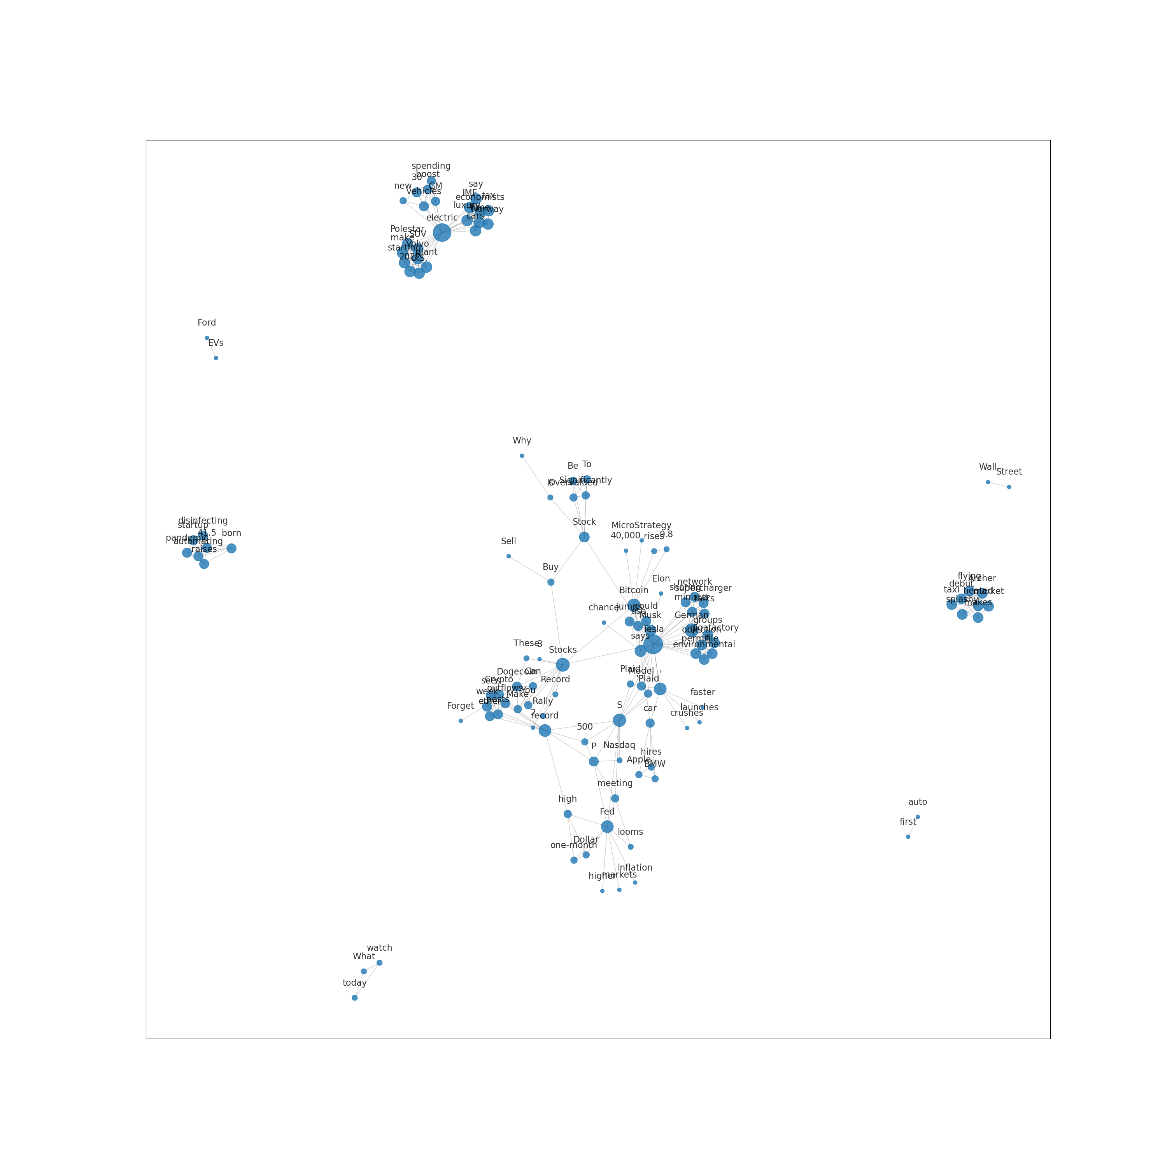
Knowledge Graph of 【Tesla】News

Slide 11
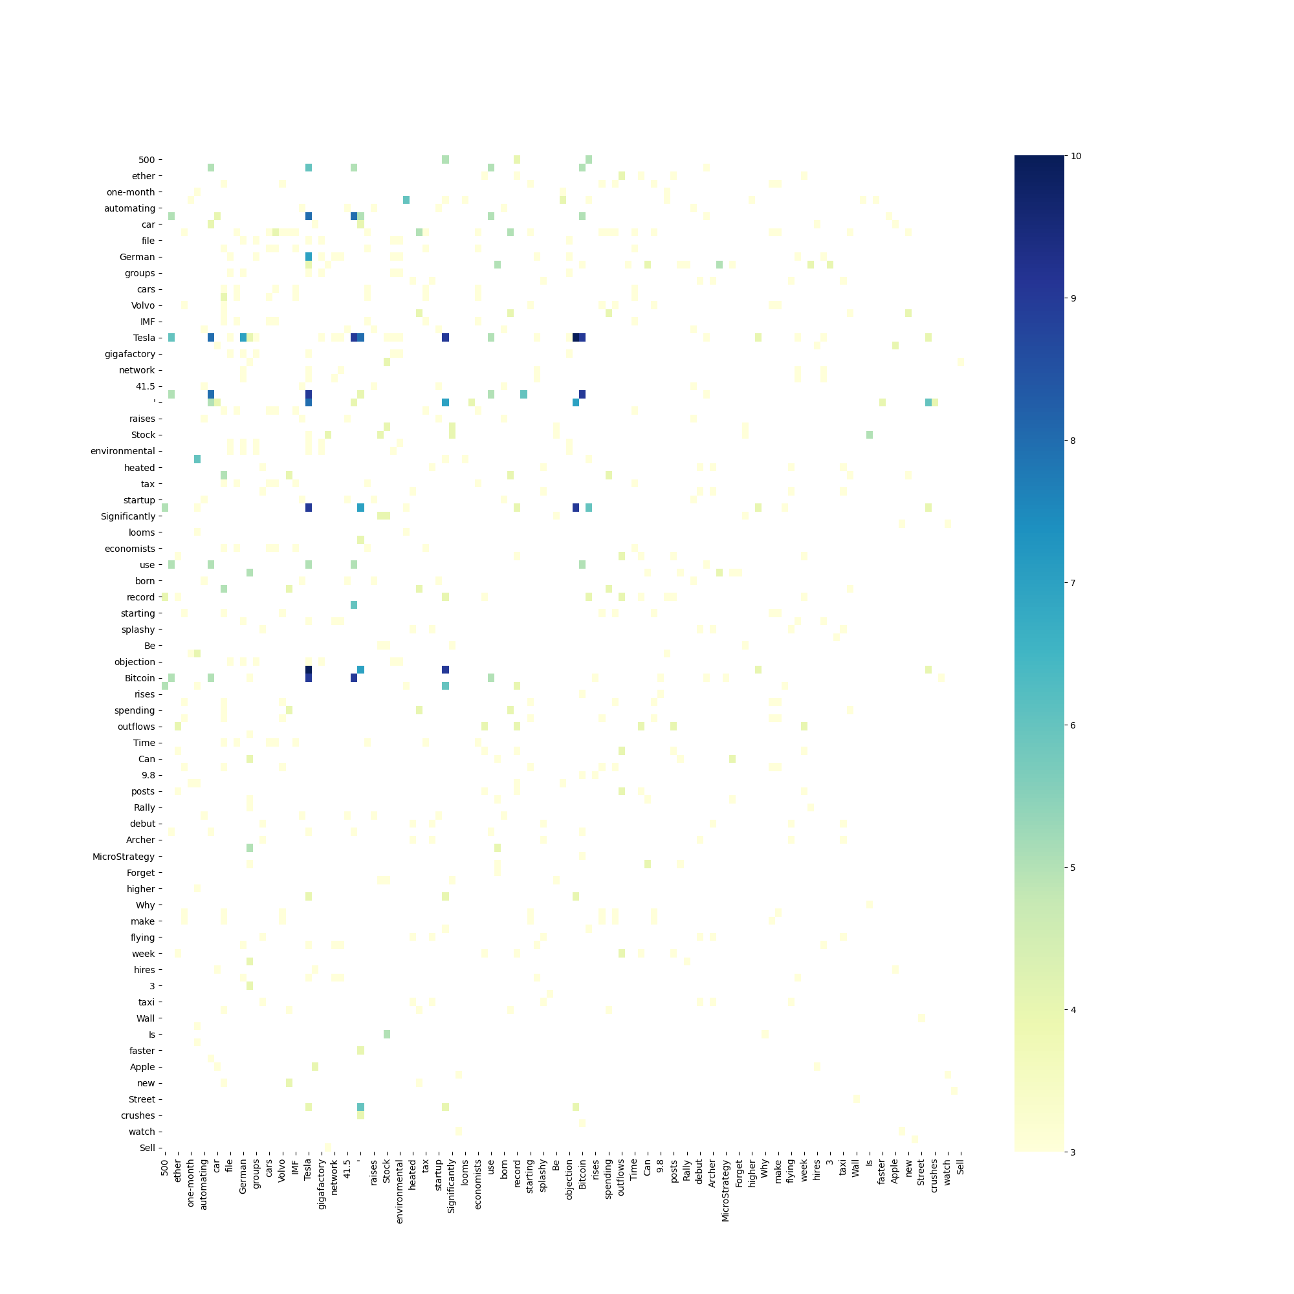
Co-occurence matrix of 【Tesla】News

Slide 12
Stock Price Trend Chat and CAPM Value
Draw the stock price trend graph of each stock price and use the yield of the U.S. 1-year Treasury bond as the risk-free rate of return to calculate the expected one-year rate of return for CAPM.

Slide 13
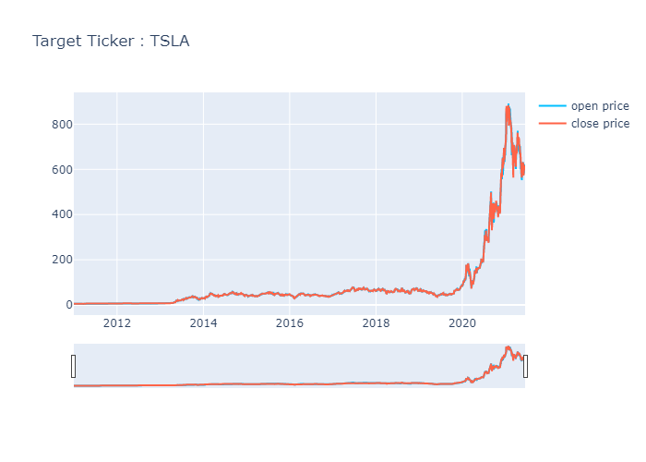
【TSLA】Price Trend Chart

Slide 14
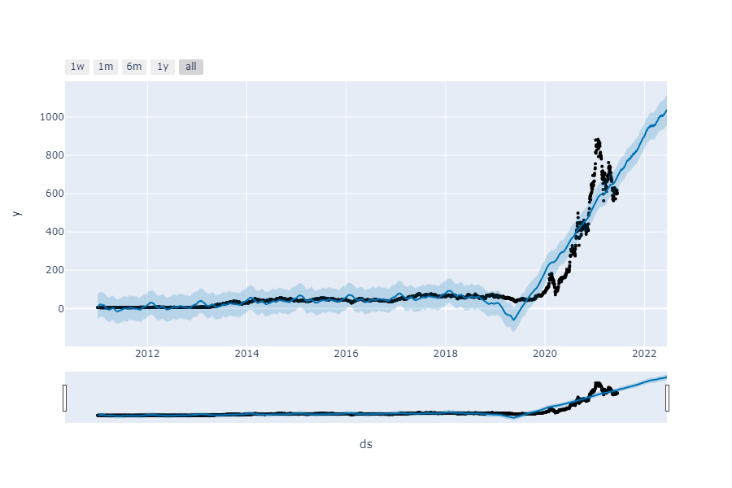
【TSLA】Price Prediction Trend Chat

Slide 15
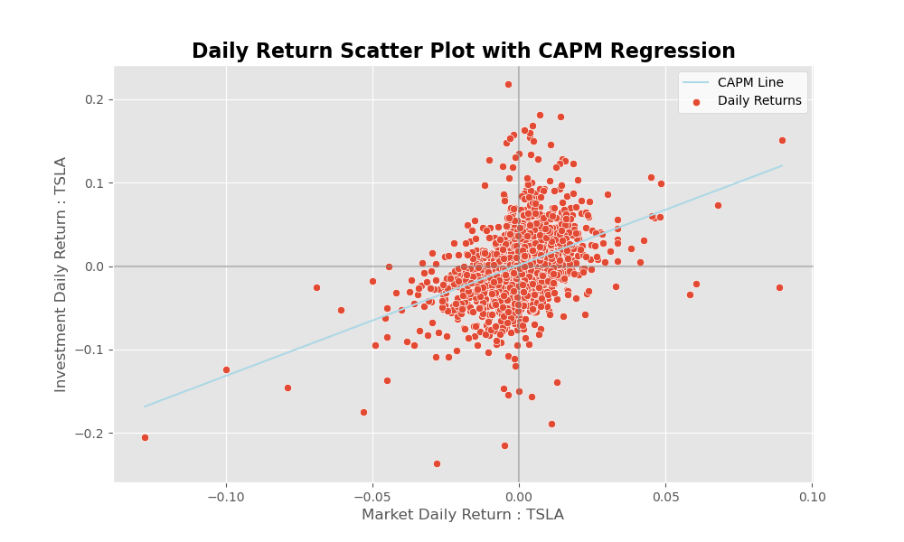
【TSLA】CAPM Value
Beta：1.33
Alpha：0.0
Risk-Free Rate：0.0
CAPM Value：22.08%

