Slide 1
CivicPulse: Smart Governance Portal
Bridging Citizens and Municipal Administration Through Full-Stack Automation
Presented by: Nalam Sri Lakshmi Gayathri Anusha

Slide 2



Problem Statement & Solution
Traditional Challenges
Our Solution
No Transparency
Centralized Digital Platform
Lack of transparency in municipal processes leaves citizens in the dark.
Instant issue reporting accessible to every citizen, anytime.
Heavy Paperwork
Real-Time Visibility
Manual workflows slow down every step of civic administration.
Clear progress workflows so citizens always know where things stand.
Delayed Responses
Slow municipal response times erode public trust and satisfaction.
Secure Certificate Management
Digital certificate handling with instant, secure downloads.

Slide 3



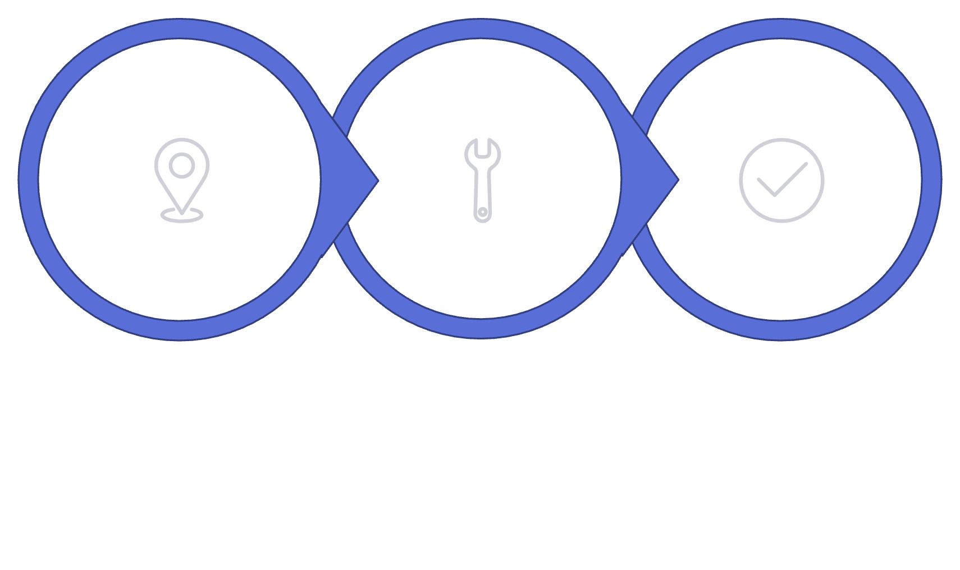
Core Features & User Interface
Live Feed & Tracking
GPS-Enabled Grievance Filing
Digital Certificate Services
Real-time municipal feeds with transparent updates. A clear 3-step progress workflow — Open/Pending → In Progress → Resolved — keeps every stakeholder informed.
Citizens can file grievances with precise GPS location tagging and photo attachments for accurate, evidence-backed reporting.
Seamless digital certificate applications with instant downloads — no queues, no paperwork, no delays.
Open / Pending
In Progress
Resolved

Slide 4


Administrative Operations & Welfare Schemes
ADMINISTRATION
WELFARE SCHEMES
Secure Role-Based Access
Centralized Welfare Listings
Municipal authorities operate within a secure, role-gated environment — ensuring only authorized personnel can review, update, and manage grievances.
All active government welfare initiatives are listed in one place — clear, accessible, and up to date.
Review & Track
Regional Analytics
Efficiently manage all citizen grievances from a unified dashboard.
Performance dashboards with regional insights for data-driven decisions.
Eligibility Guidelines
Application Tracking
Clear criteria so citizens know exactly which schemes apply to them.
End-to-end visibility on welfare application status and progress.

Slide 5
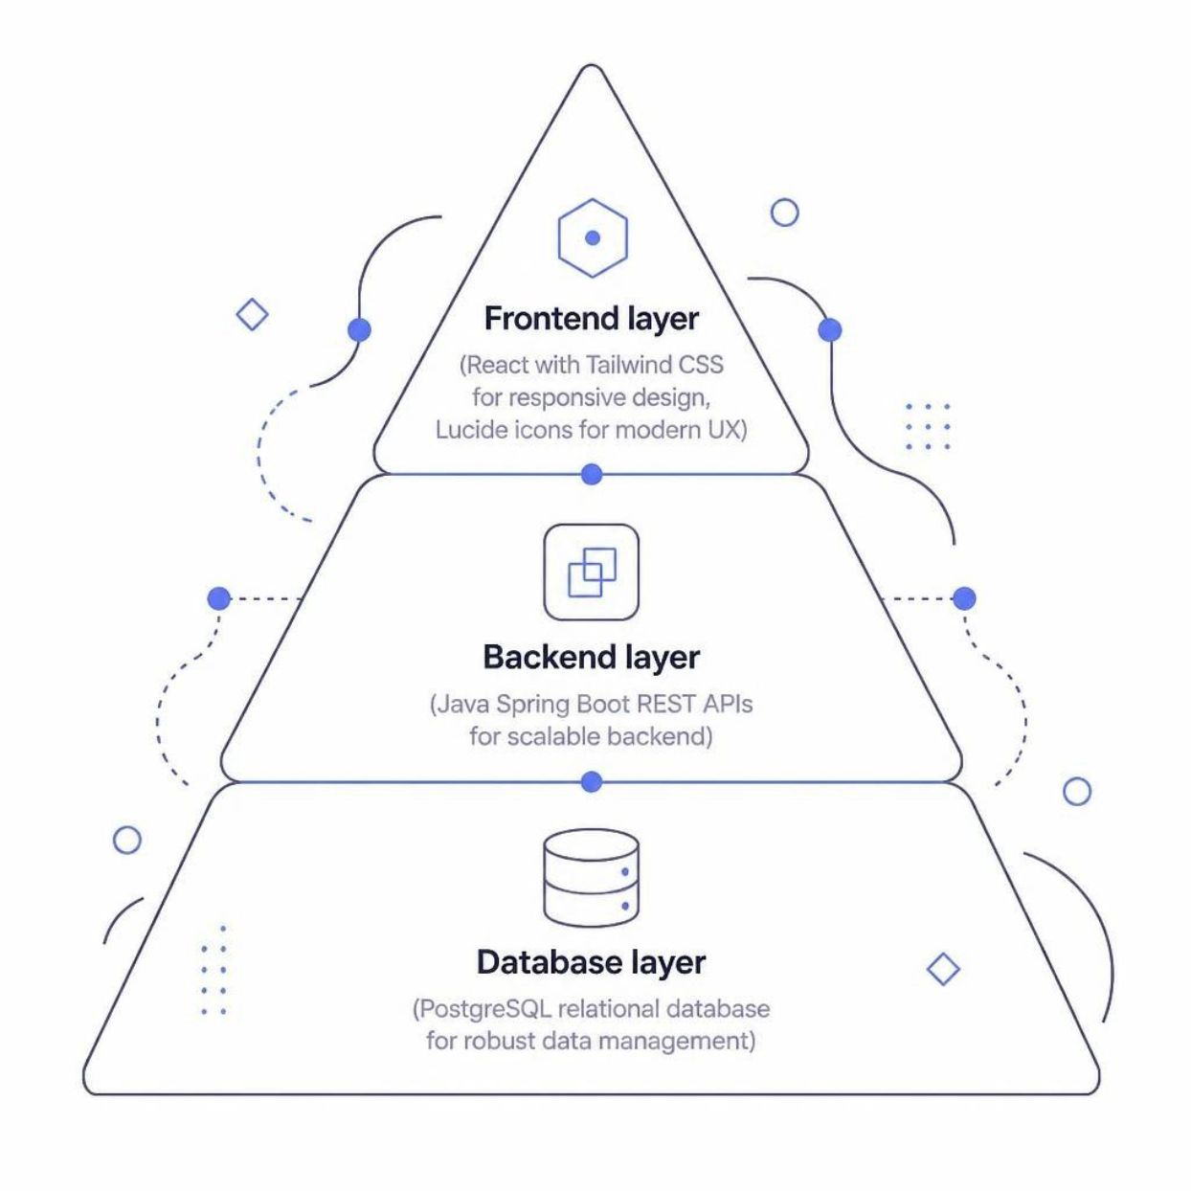
Technical Architecture & Security
TECH STACK
01
Frontend
React with Tailwind CSS for responsive design; Lucide icons for a modern, intuitive user experience.
02
Backend & Database
Java Spring Boot REST APIs for a scalable backend; PostgreSQL relational database for robust data management.
03
Security & Validation
Strict inline validations for 10-digit mobile numbers. Secure password policies: minimum 8 characters, uppercase, and special character requirements. Show/hide eye-icon for password visibility control.

Slide 6
Thank You!
Empowering Smarter and Transparent Municipal Communities
Transparent
Efficient
Real-time visibility for every citizen
Automated workflows, zero paperwork
Secure
Inclusive
Role-based access and strict validation
Welfare schemes accessible to all
CivicPulse — Built with React · Spring Boot · PostgreSQL

