Slide 1
Big Data Hadoop
©2015 ITC Infotech. All Rights Reserved.

Slide 2
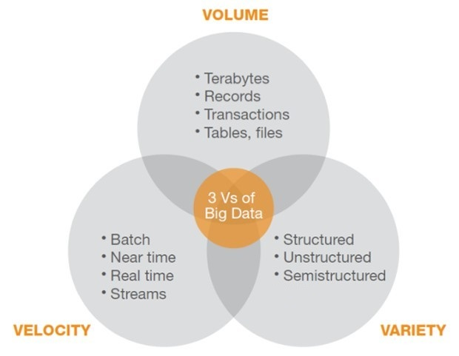
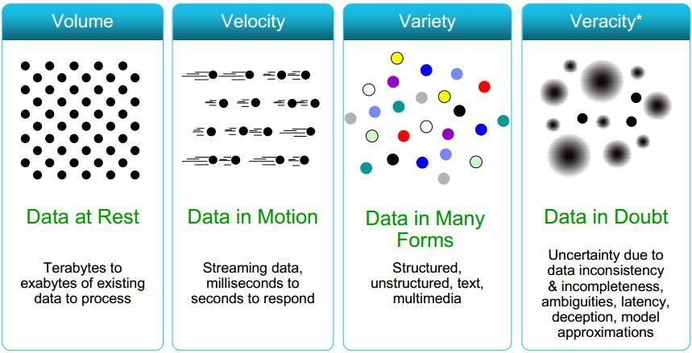
What is Big Data?
In general Big Data is the term for a collection of data sets which are so large and complex that it becomes difficult to process using traditional data processing applications.
Features of Big Data

Slide 3
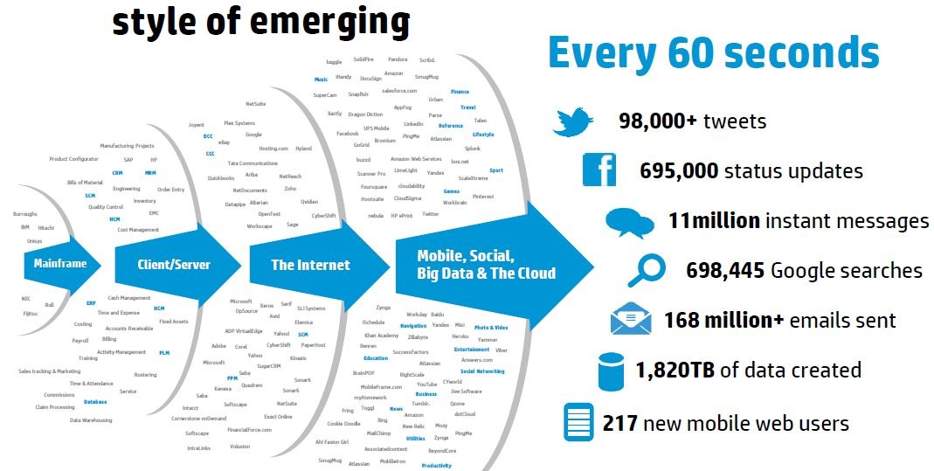
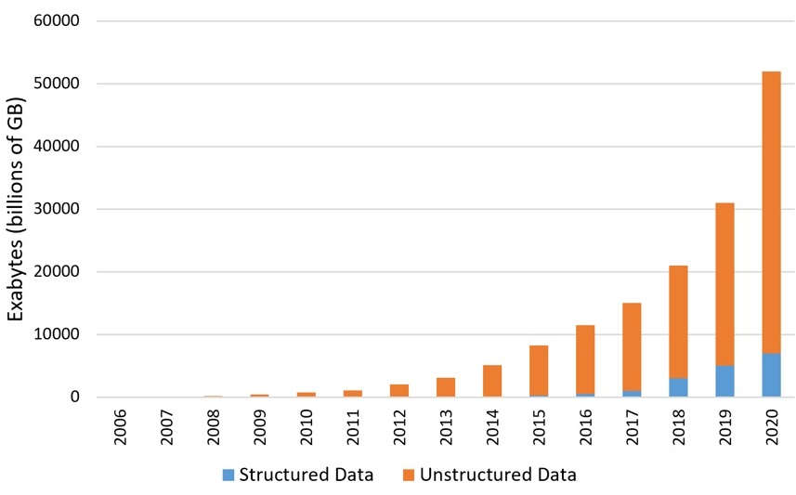
Problems in Traditional RDBMS
    The traditional storage vendor solutions were too expensive.
    The architectures and processing models were not designed to process the semi-structured and unstructured data coming from social media, machine sensors.
    Reducing business data latency was needed.
    Unable to deal with extremely wide variety of data types.
    RDBMSs have inflexible schemas.

Slide 4
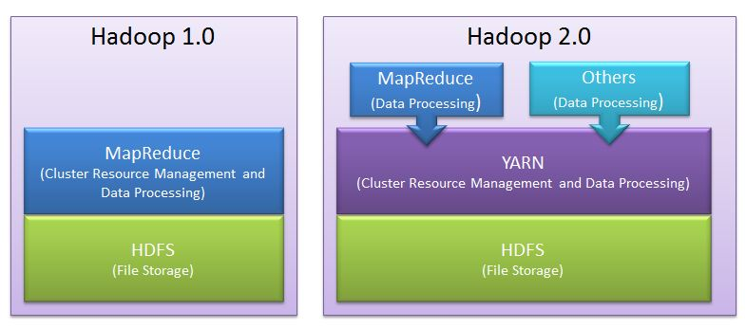
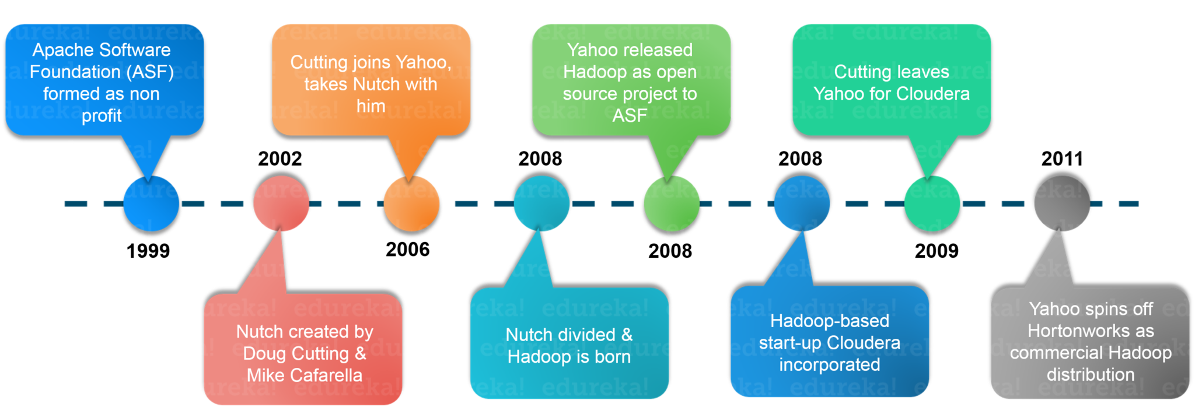
A Brief History of Apache Hadoop
Hadoop is an open-source framework that allows to store and process big data in a distributed environment across clusters of computers using simple programming models. Hadoop was created by Doug Cutting.
“HADOOP” The name Hadoop is not an acronym, it’s a made-up name.
Basic layers of Hadoop

Slide 5
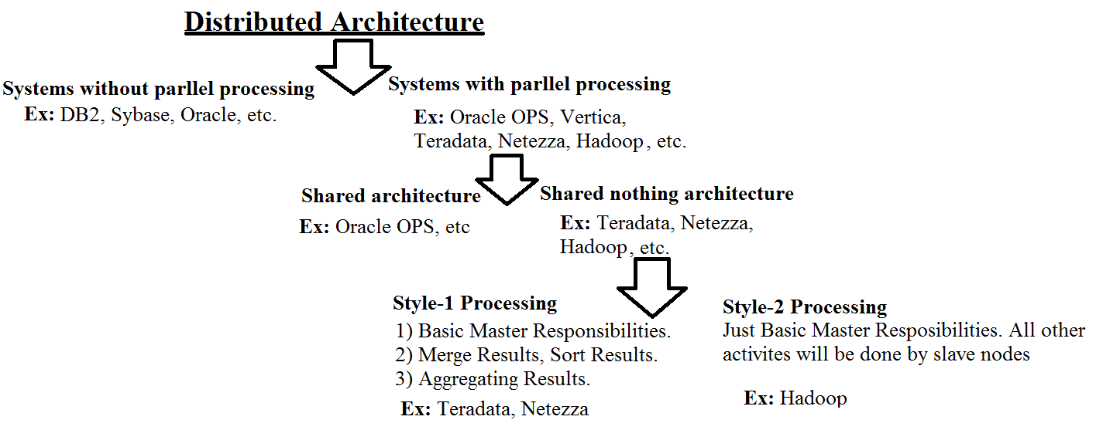
Distributed Architecture
What hadoop offers?
    Unlimited Storage.
    Distributed File System
    Parallel Processing.
    Scalability (Horizontal).
    High Throughput (Bigger Block Size).
    Fault Tolerance (Replication Factor).
    Data Locality.
    Speculative Execution.

Slide 6
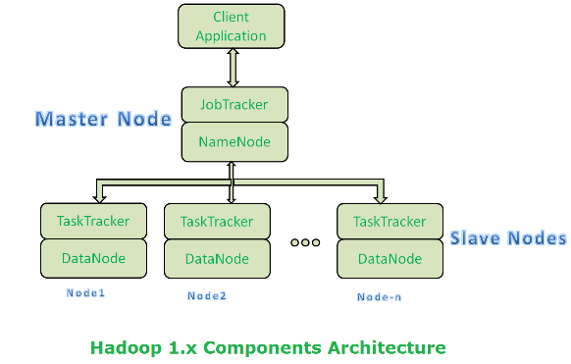
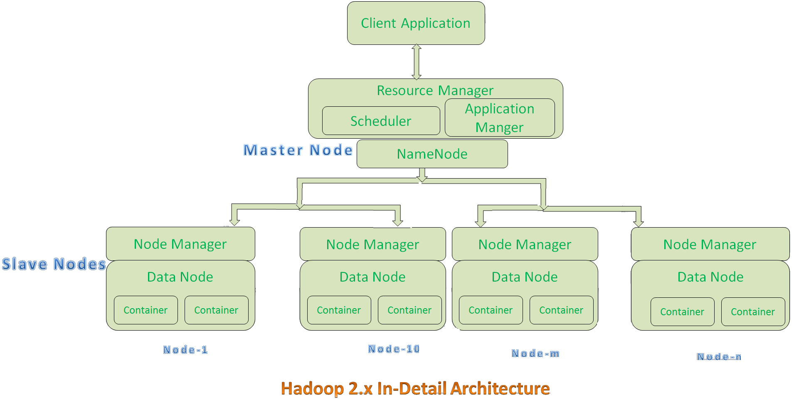
Architecture of Hadoop
Master/slave architecture

Slide 7
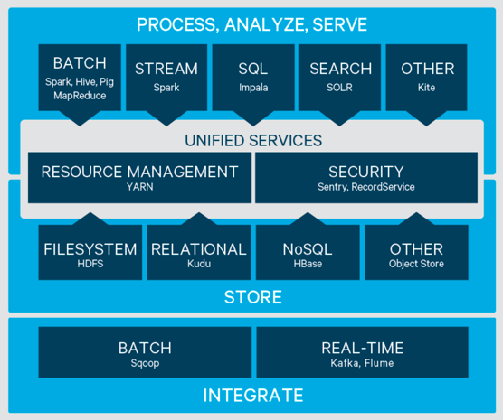
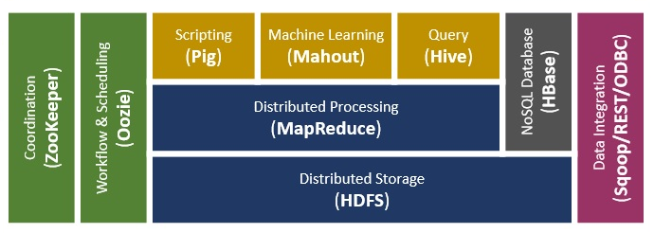
Hadoop Eco-System
Latest Hadoop Eco-System
Old Hadoop Eco-System

Slide 8
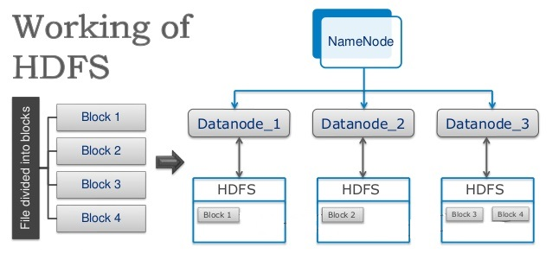
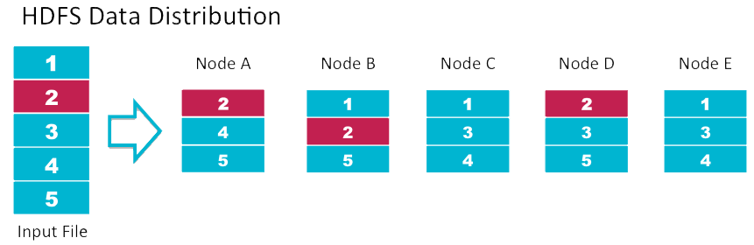
HDFS
Storage & Task assignment hierarchy in hadoop
High Configuration.
Nearest Location.
Free Space/ Free Node.
Healthy.
IF all the above qualities are matching.
    Random (For storage).
    If all nodes are busy then non-localized processing (For Processing).

Slide 9
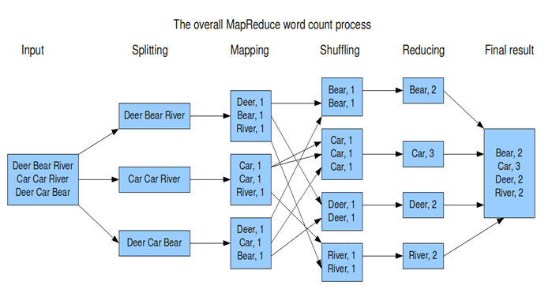
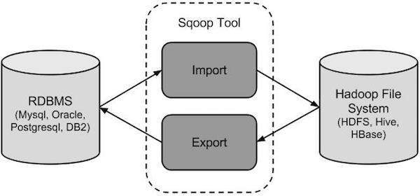
Eco-Systems
MapReduce
MapReduce is a core component of the Apache Hadoop software framework.
MapReduce is a programming model to process huge amounts of data, in parallel, on large clusters of commodity hardware in a reliable manner.
It is a programming model for distributed computing based on java.
Sqoop
Sqoop: “SQL to Hadoop and Hadoop to SQL”
Sqoop is a tool designed to transfer data between Hadoop and relational database servers.

Slide 10
Eco-Systems cont..
Apache Hive
Hive is a data warehouse infrastructure tool to process structured data in Hadoop.
Initially Hive was developed by Facebook, later the Apache Software Foundation took it up and developed it further as an open source under the name Apache Hive.
Features of Hive
It is designed for OLAP.
It provides SQL type language for querying called HiveQL or HQL.
It is familiar, fast, scalable, and extensible.
Apache Pig
Pig is a high level scripting language that is used with Apache Hadoop.
Pig enables data workers to write complex data transformations without knowing Java.
Pig’s simple SQL-like scripting language is called Pig Latin

