Slide 1
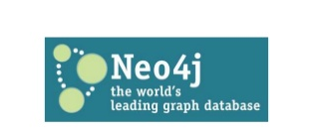
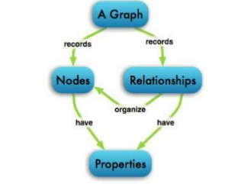

Slide 2
Use cases of Graph Databases:
Real-Time Recommendation Engines
Master Data Management Solutions
Fraud Detection
Empowering Network and IT Operations
Identity & Access Management

Slide 3
Real-Time Recommendation Engines:
Steps Involved:
Ingest data from multiple sources into neo4j DB.
Apply cypher queries or use Spark ML lib to generate recommendations.
Apply real time analytics using Spark Graphx or cypher queries for processing.

Slide 4
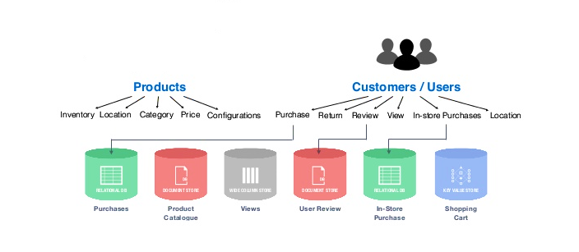
silos & polyglot persistence

Slide 5
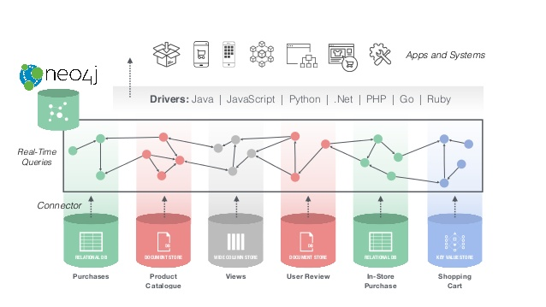
Data ingestion from multiple sources into Neo4j DB:

Slide 6
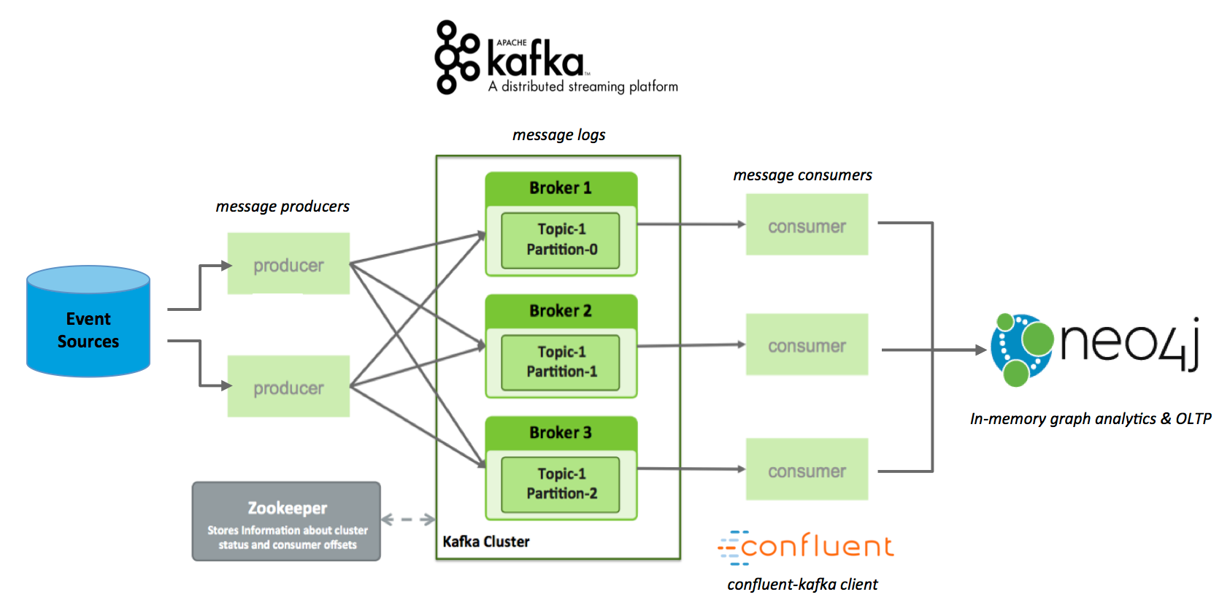
Neo4j Real-Time Graph Analytics with Kafka:

Slide 7
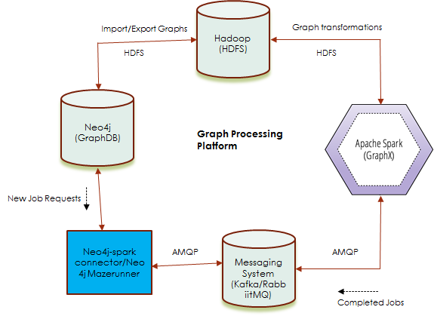
Data Flow between Neo4j and Spark:

Slide 8
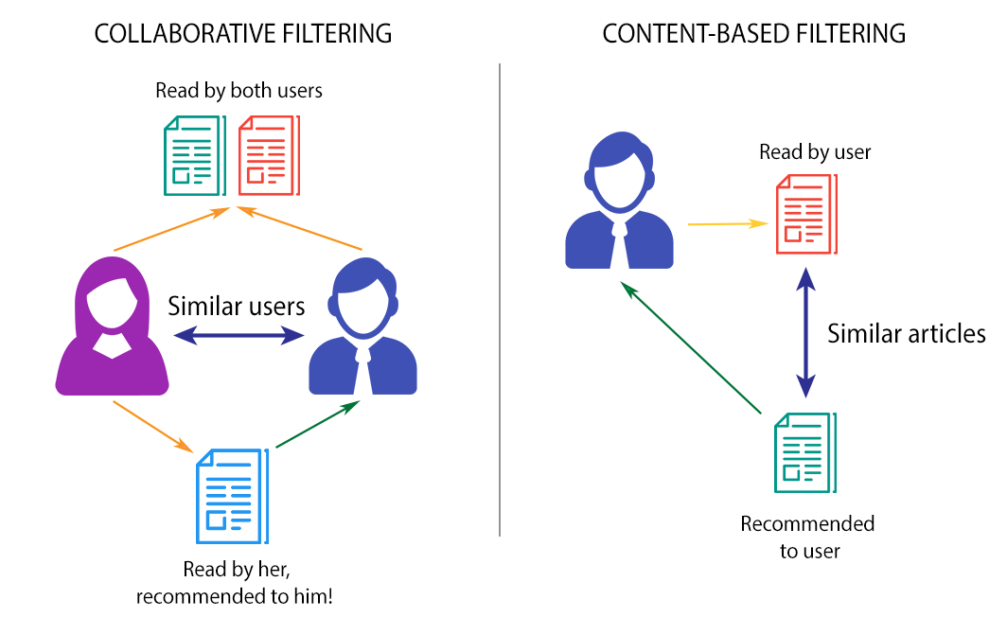
Real-time Recommendation systems:

Slide 9
Master Data Management Solutions:
A 360° view can be created either by managing all our master data
(customer, product, supplier) inside a single repository or by creating
a shared metadata repository to support activities ranging from ecommerce to customer support.

Slide 10
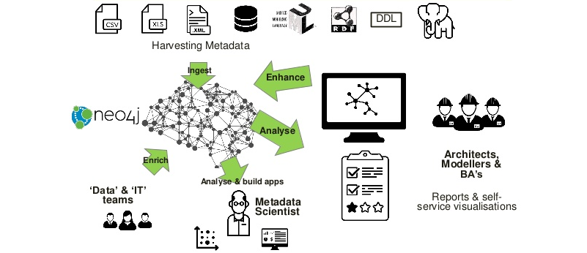
Neo based Metadata Lake:

Slide 11
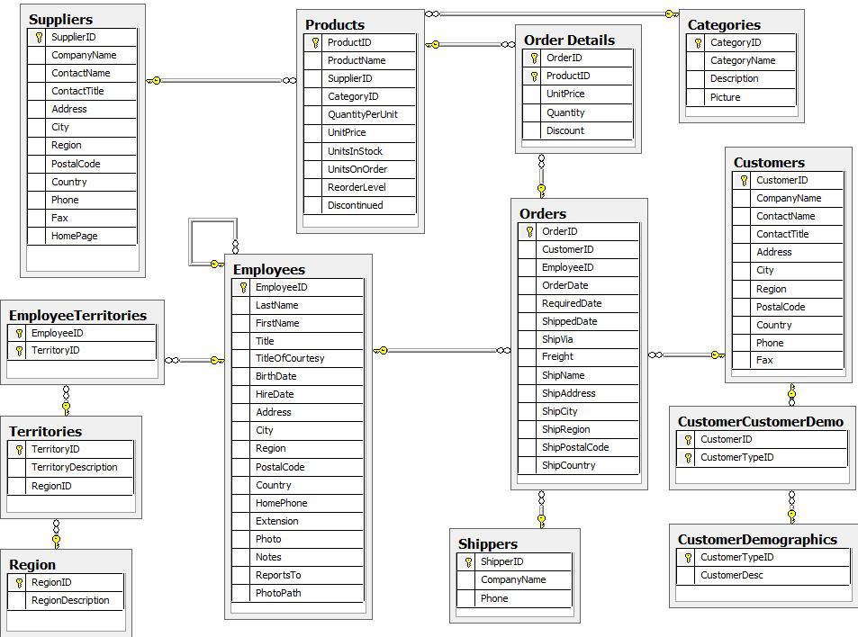
Data Model:

Slide 12
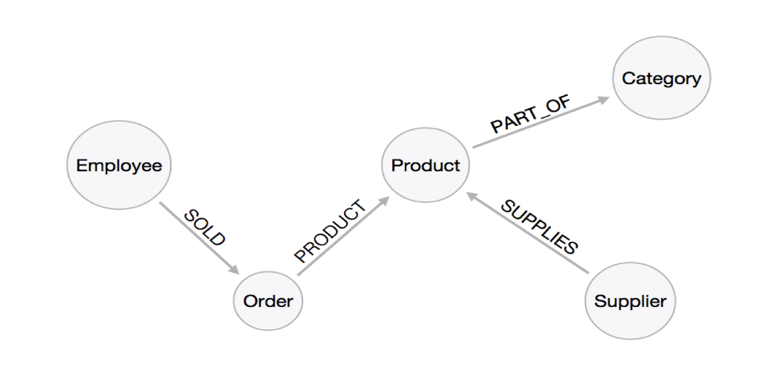
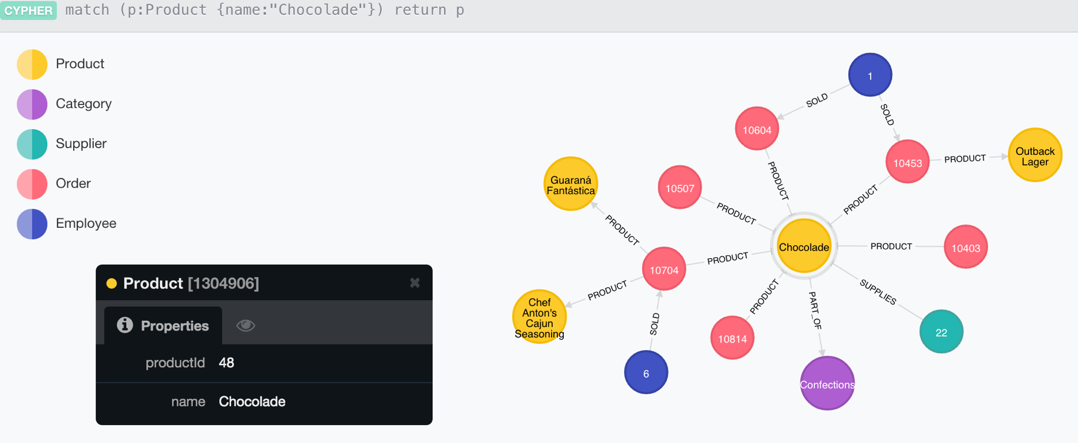
Graph Model:
Querying The Graph:

