Slide 1
StreamSets Data Collector (SDC)
©2015 ITC Infotech. All Rights Reserved.

Slide 2
Overview of StreamSets
Data flow tool for ingesting data from outside world to HDFS and many more systems.
Ingestion of streaming and batch data into big data stores using a drag and drop UI within an IDE.
SDC allows you to design, test, deploy, operate, and maintain pipelines that flow streaming and batch data.
Deploys both on edge or into your Cloudera cluster via Cloudera Manager.
core software is developed in Java, the web interface is developed in JavaScript/Angular JS, D3.js, HTML and CSS.
100% open source, based on the Apache 2.0 license.
Founded in 2014 by Girish Pancha, former chief product officer of Informatica, and Arvind Prabhakar, an early employee and engineering leader at Cloudera

Slide 3
Cont…
How is StreamSets different from legacy ETL systems?
The regular ETL systems are.
Reliance on schema definitions i.e. pipelines break if anything in the schemas changes.
Reliance on hand-coding that is required to create ETL pipelines.
Difficult to monitor and time-consuming to troubleshoot.
StreamSets conquers dataflow chaos.
Data Sprawl → living data map
Data Drift → Smart pipelines
Data Urgency

Slide 4
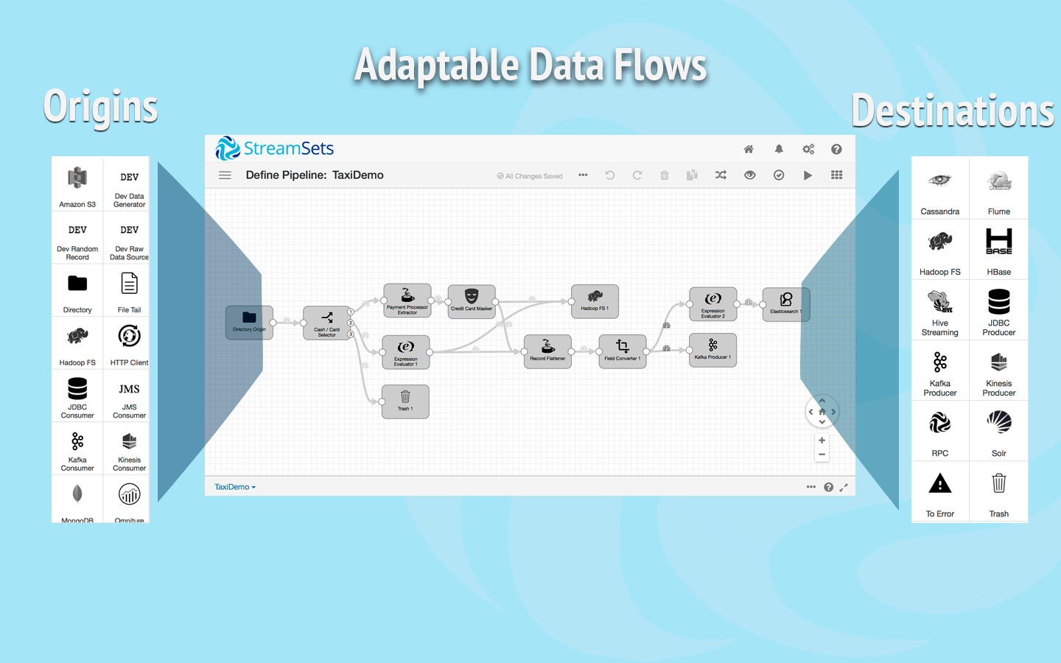
Features
Adaptable Flows for Efficiency
  Graphical IDE
  Consumption-ready data
  Batch and streaming
  Flexible deployment
Dataflow KPIs for Visibility
  Customizable runtime metrics
  Data drift handling
  Real-time early warning
Containerized Architecture for Agility
  100% in-memory
  Zero-downtime upgrade
Connector Details
https://streamsets.com/connectors

Slide 5
Customizations and Use Cases.
Customize the StreamSets Data Collector?
Java Expression Language (EL)
Jython or JavaScript
Best use cases for StreamSets Data Collector ?
Continual Hadoop ingest
IoT Ingest
Search ingest – capturing data from various sources and loading into distributed search systems like Cloudera Search.
Log shipping – collecting, aggregating and delivering consumption-ready log data from diverse set of sources.
Apache Kafka enablement – loading data into and draining data from Kafka clusters into the storage tier.

Slide 6
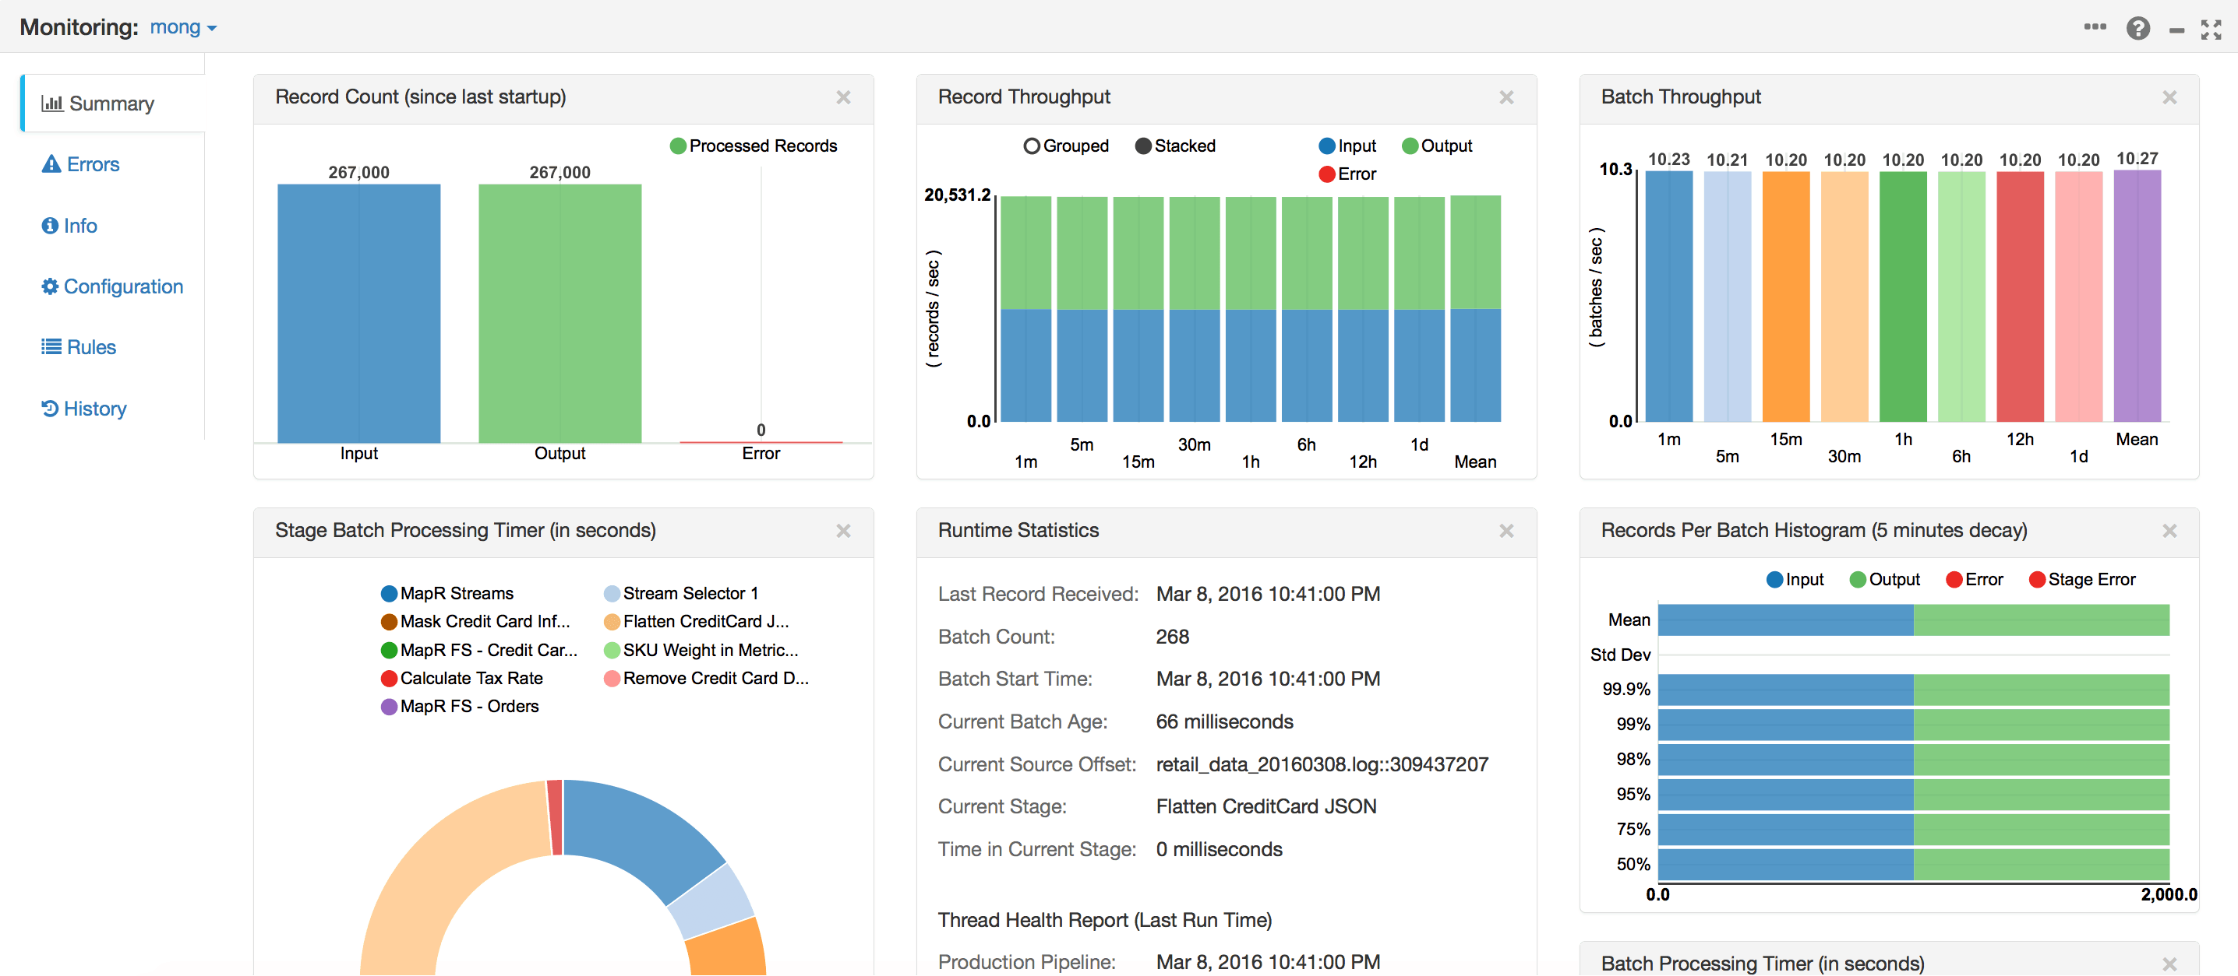
Flow Monitoring

Slide 7
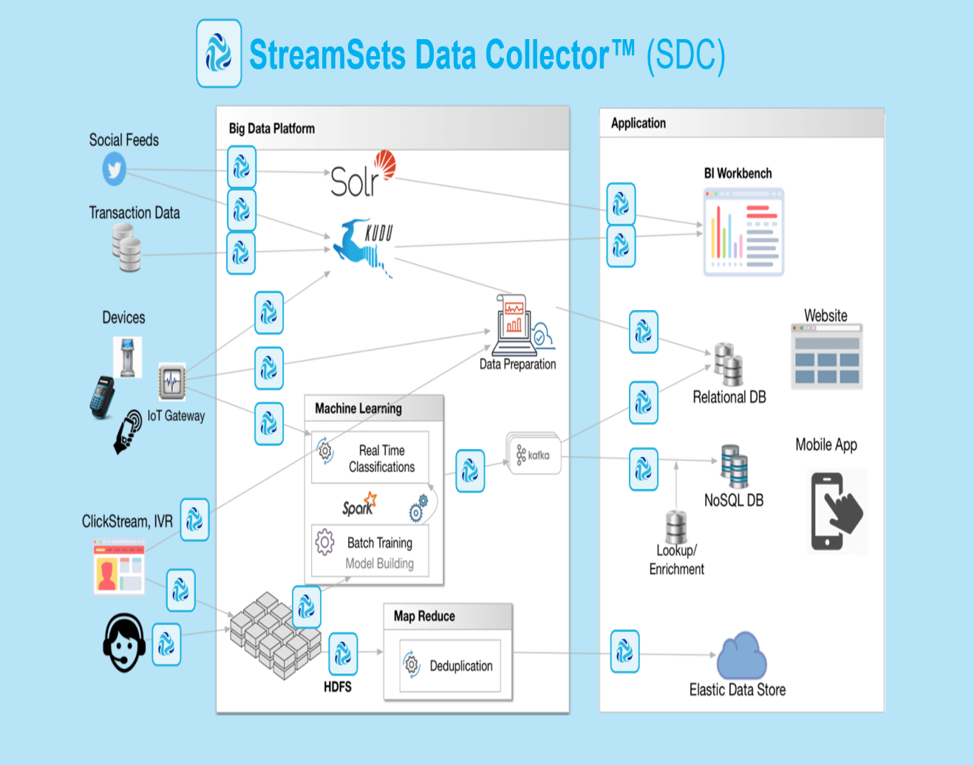
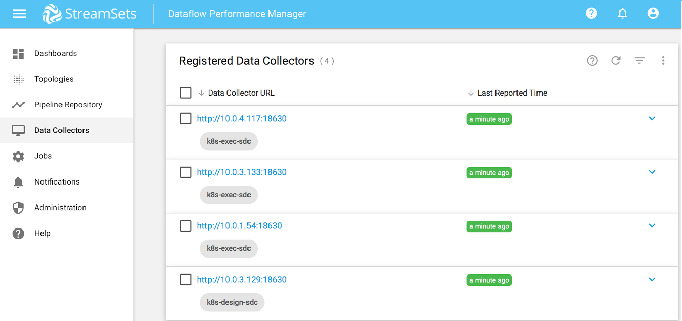
Dataflow Performance Manager
DPM is a management console for data in motion.
Map multiple dataflows in a single visual topology and track changes to the dataflows over time.
real-time statistics to measure dataflow performance from end-to-end or point-to-point.

Slide 8
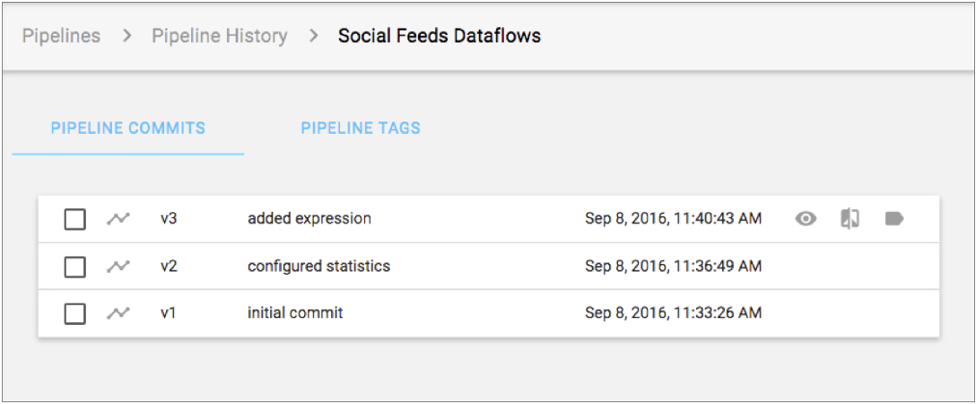
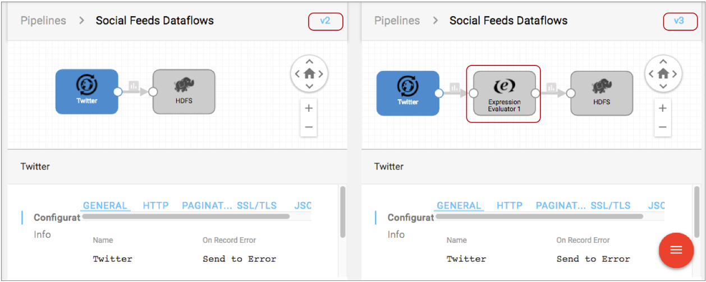
Cont..
Manage the Pipeline Repository

Slide 9
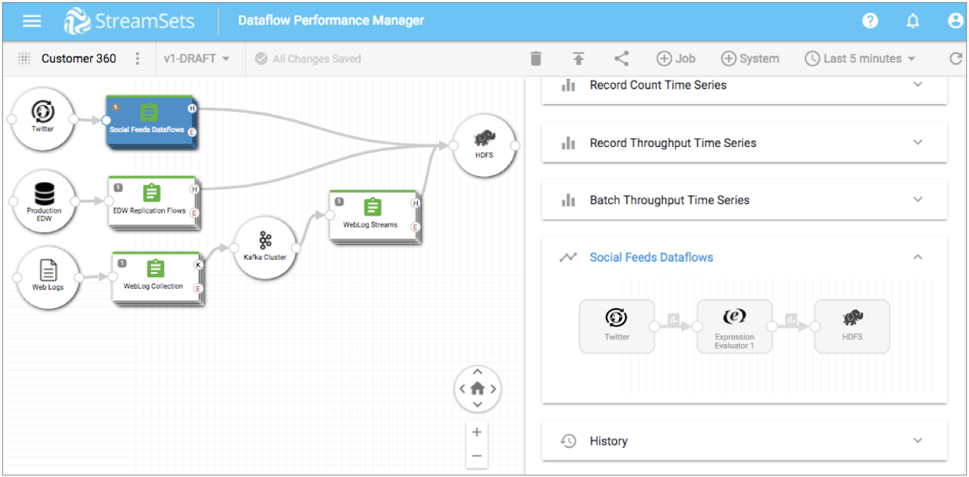
Cont..
Map Jobs into a Topology

Slide 10
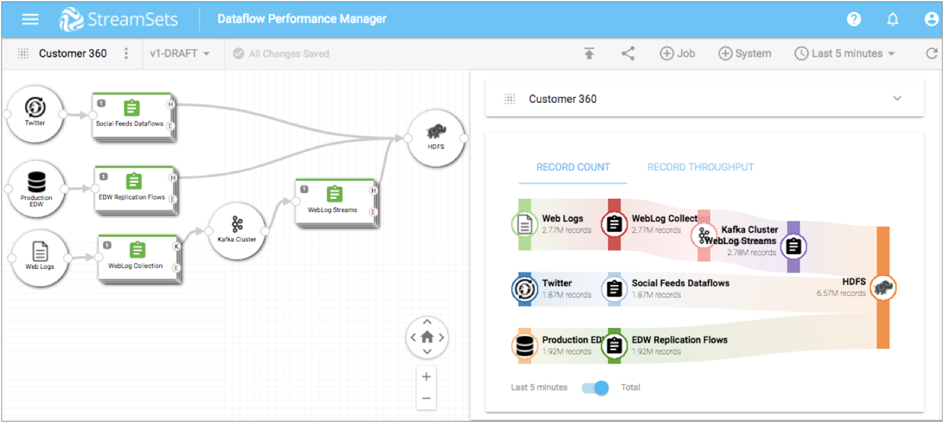
Cont..
Measure Dataflow Quality

Slide 11
Drawbacks of StreamSets
It is not clear from its documentation what guarantees it provides for reliability, delivery semantics and fault-tolerance.
Inbuilt pipeline scheduling is not available.
commercial license is required for its management (DPM).
Service and Support?
Free support is available via the community.
Developer and Gold subscription via (https://streamsets.com/subscriptions/)

