Slide 1

Apache Kylin

Slide 2
Agenda
About Apache Kylin
Feature Highlights
Tech Highlights
BI With Apache Kylin
REST API With Apache Kylin

Slide 3
@ApacheKylin
Extreme OLAP Engine for Big Data
Kylin is an open source Distributed Analytics Engine, contributed by
eBay Inc., provides SQL interface and multi-dimensional analysis
(OLAP) on Hadoop supporting extremely large data sets.

Slide 4
Feature Highlights
Extremely Fast OLAP Engine at scale
Seamless Integration with BI Tools, like Tableau
Interactive Query Capability
MOLAP Cube
Job Management and Monitoring
User friendly Web GUI for manage, build, monitor and query cubes
Support LDAP Integration

Slide 5
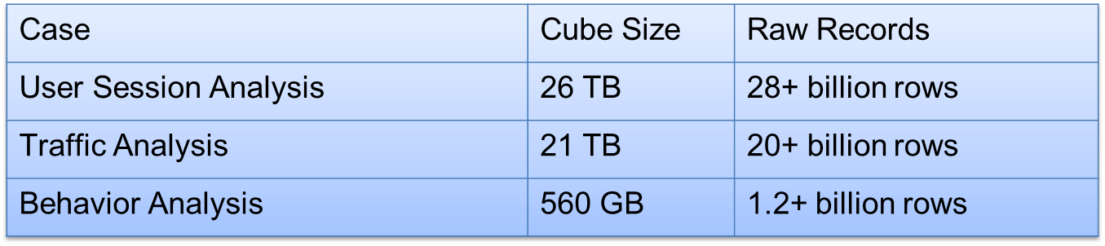
Who are using Kylin?
EBay
EBay uses Apache Kylin for behavior analytics, traffic analysis & reporting and Streaming Dashboard.
MiningLAMP
MiningLAMP uses Apache Kylin for Big Data Analytics that offers OLAP capability for customers from
Banking, Finance and others industries
Many other Proof of Concepts
DreamSoft, Bloomberg Law, British GAS, JD.com, NetEase, StubHub, Tableau and many others.

Slide 6

Kylin Ecosystem
Kylin Core: Fundamental framework of Kylin OLAP Engine to run the entire stack.
Extensions: Plugins to support additional functions and features.
Integration: Lifecycle Management Support to integrate with Job Scheduler, ETL, Monitoring and Alerting Systems.
User Interface: Allows third party users to build customized user-interface at the top Kylin core .
Drivers: ODBC and JDBC drivers to support different tools and products, such as Tableau.
Integration
ODBC Driver
ETL
SparkSQL
Extension
Security
Redis Storage
Spark Engine
Kylin OLAP
Core
Interface
Web Console
Customized BI
Ambari Plugin

Slide 7


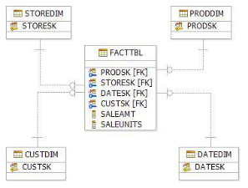


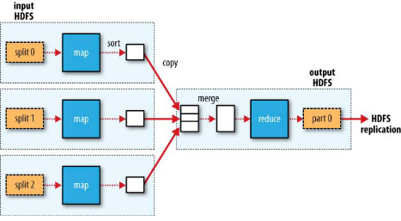
How ?
BI Tools, Web App…
ANSI SQL
Kylin
Map Reduce

Slide 8
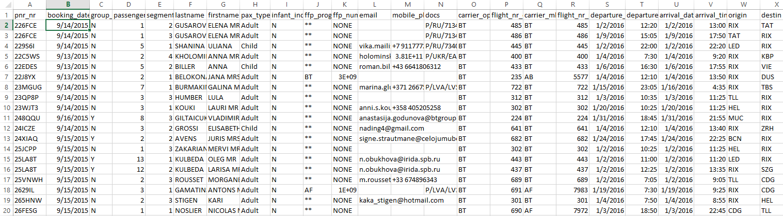
Sample Data used in Kylin
Airline data in the format of flat file was imported in Kylin using Hive, further analysis has been done through that.

Slide 9
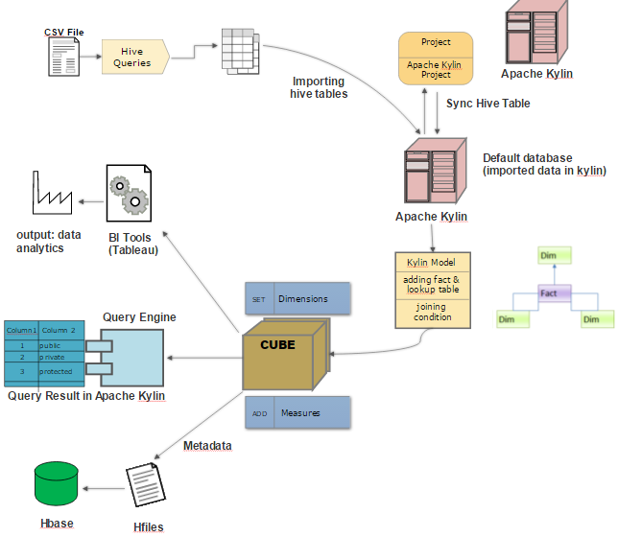
DATA FLOW DIAGRAM

Slide 10
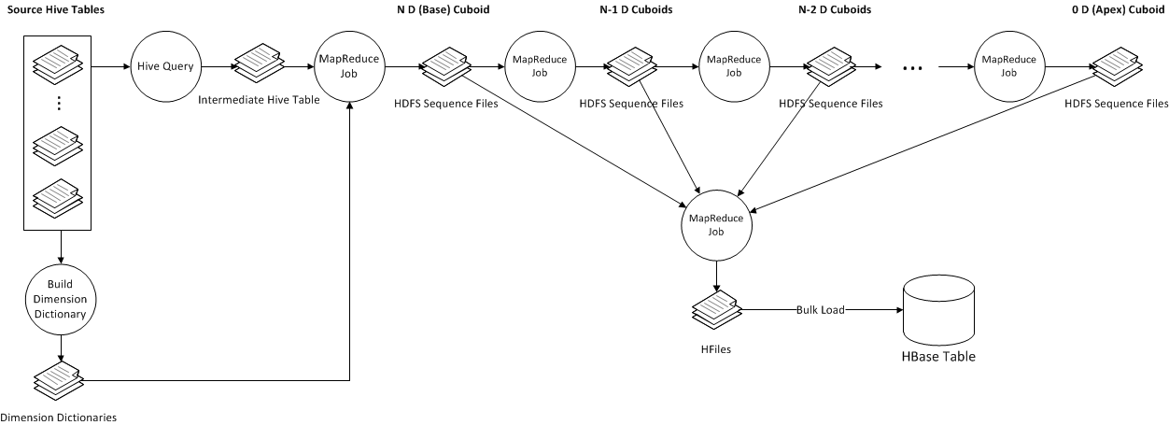
Cube Build Job Flow

Slide 11
Kylin Evolution Roadmap
2013-14
2014-15
2015-16
2016-17
Future
TBD
Nov, 2016
Oct, 2014
Next Gen
Advanced OLAP Functions
In-Memory Analysis (TBD)
Hybrid OLAP
Lambda Architecture
Capacity Management
Spark & more
Streaming OLAP
Streaming OLAP
JDBC Driver
New UI
Excel
SparkSQL & more
Jan, 2014
MOLAP
Incremental Refresh
ANSI SQL
ODBC Driver
Web GUI
Tableau
Open Source
Prototype for MOLAP
Basic end to end POC
Sep, 2013
Initial

Slide 12
BUISNESS INTELLIGENCE
WITH
APACHE KYLIN

Slide 13
Insight
Apache Kylin provides an option of integrating it with business intelligence tools like Tableau
and Microsoft Power BI.
These BI softwares helps to analyze the data , generate reports and produce interactive
visualizations.
The business intelligence softwares can be connected to Apache Kylin via an ODBC Driver.

Slide 14
Use Cases
Our use case is the analysis of 400+ thousand source records generating 15+ GB cubes.
Now, our use cases target business users, who can access analytics and get results through the
Tableau dashboard very easily.
CASE 1: Number of passengers travelling from a particular origin to destination in a month.
CASE 2: What is the tax collected (in Euro), surcharge incurred (in Euro) and number of passengers
travelled for a particular airline in a particular time interval.
CASE 3: Which are the countries where the particular sales channel has:
The total number of passengers preferring to that sales channel.
The total surcharge incurring for the sales channel.
Analyzing and Visualizing AIRLINE DATA :

Slide 15
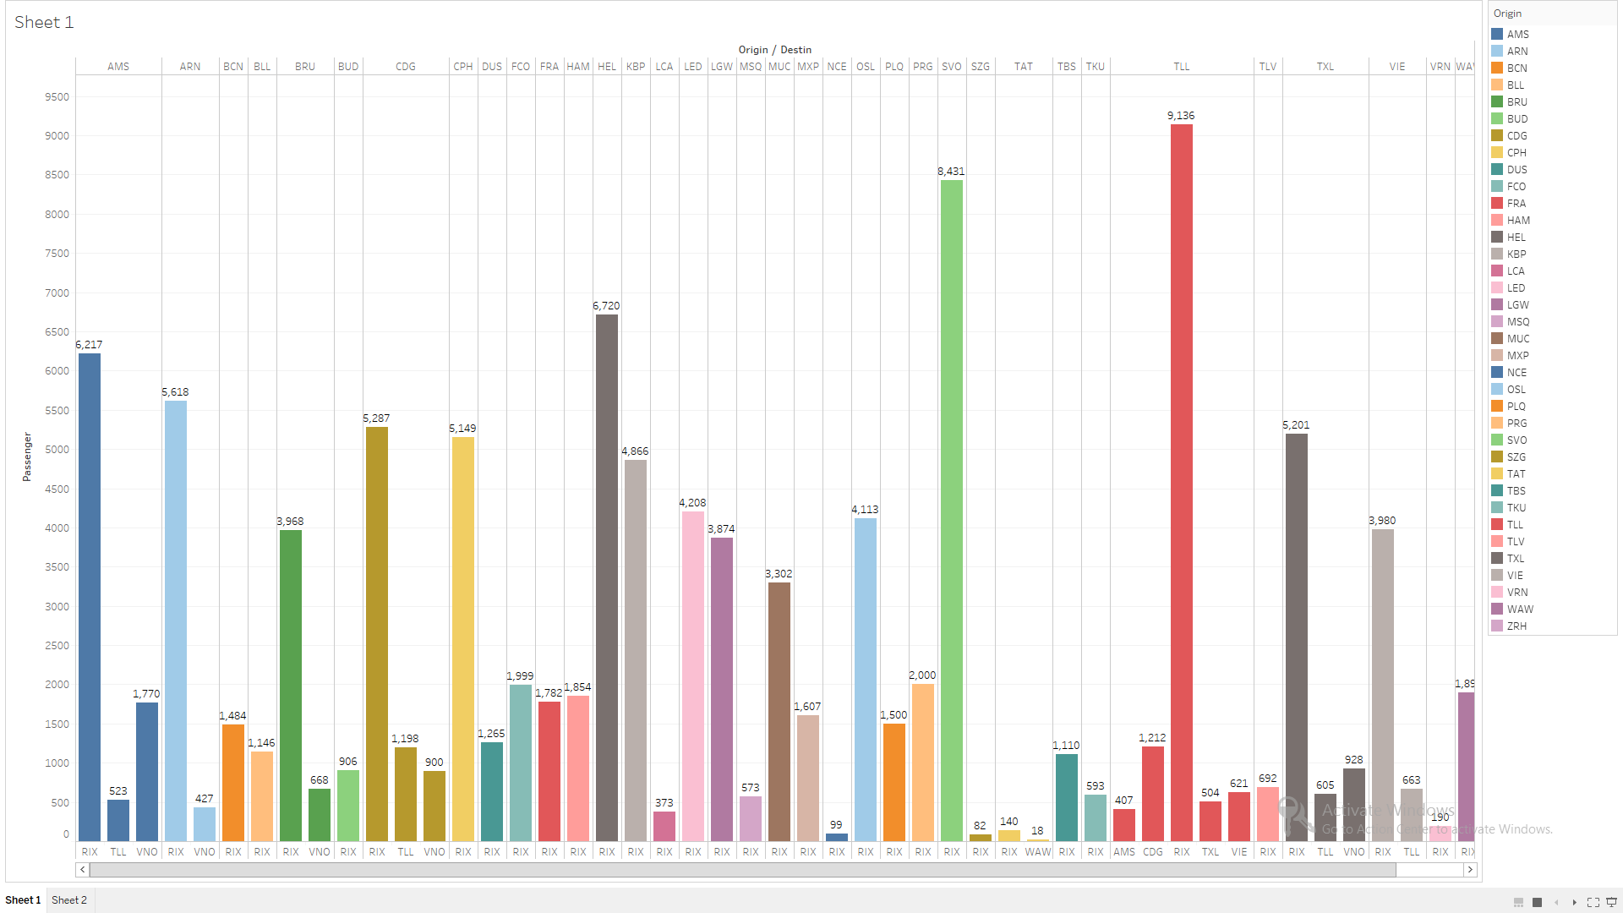
Origin, Destination Vs. No. Of Passengers

Slide 16
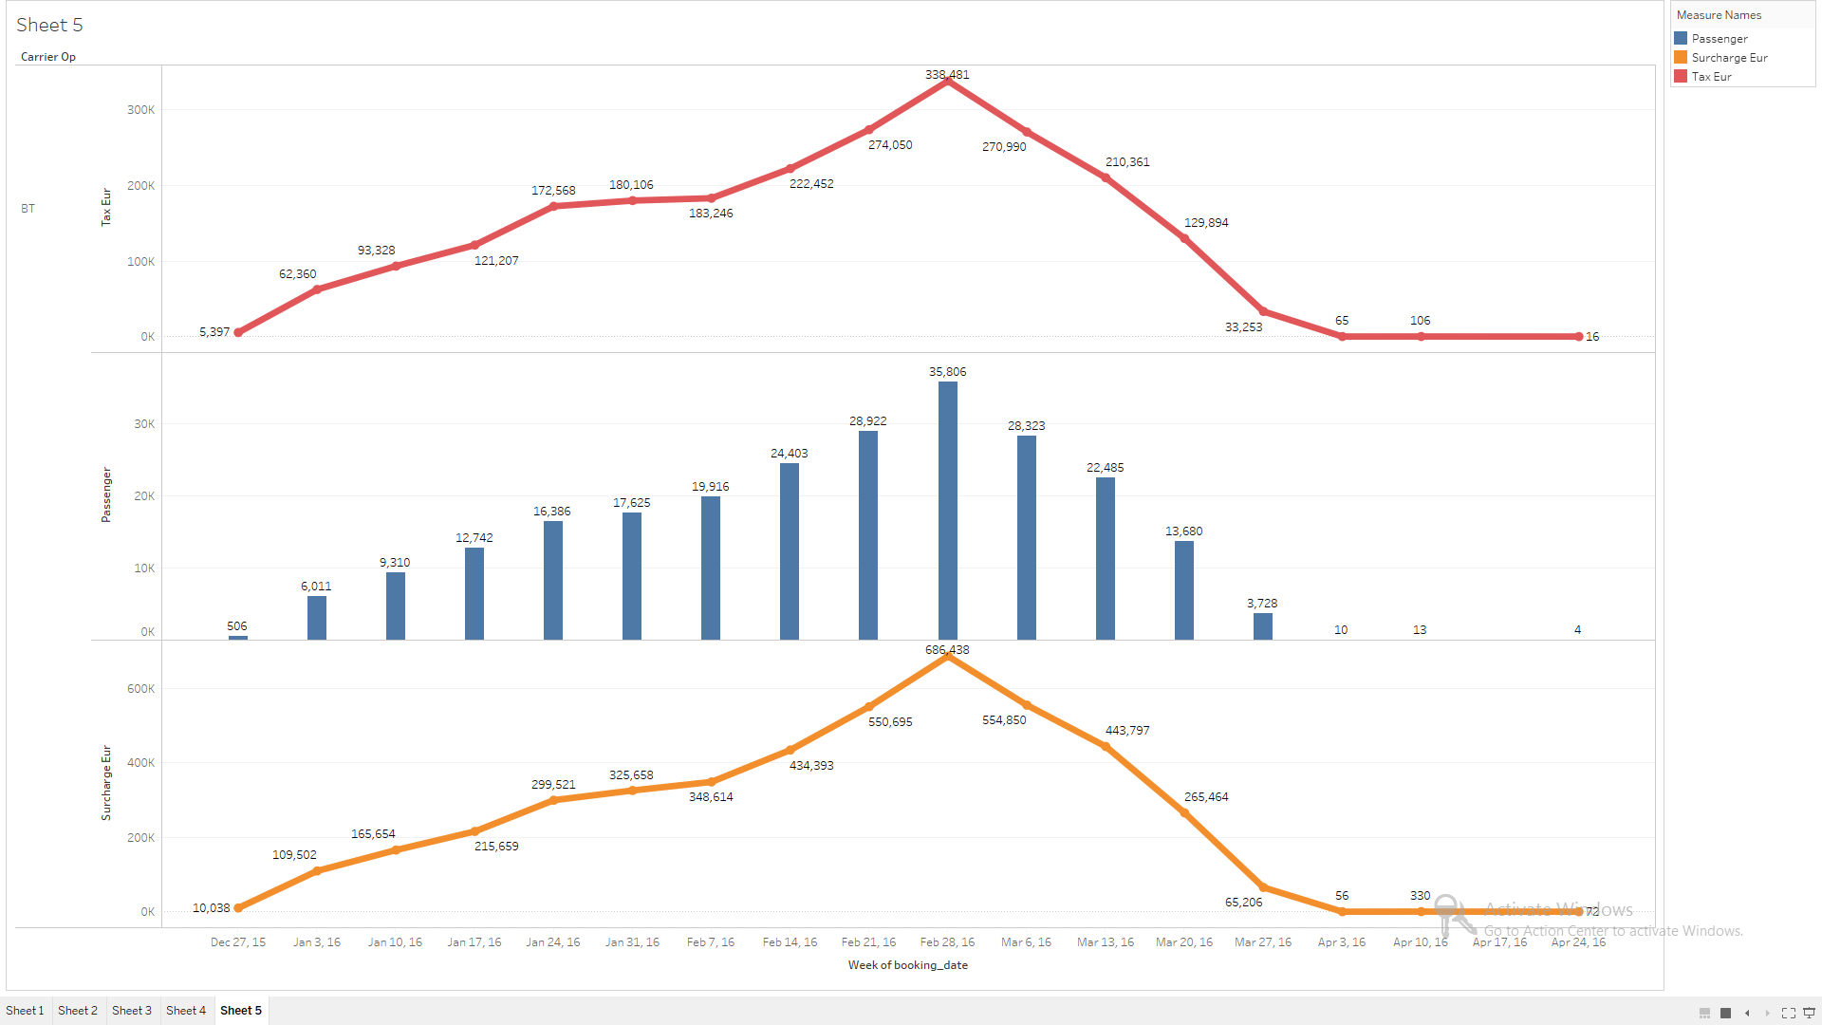
No. Of Passengers , Surcharge_Eur , Tax_Eur
Vs. Booking_date

Slide 17
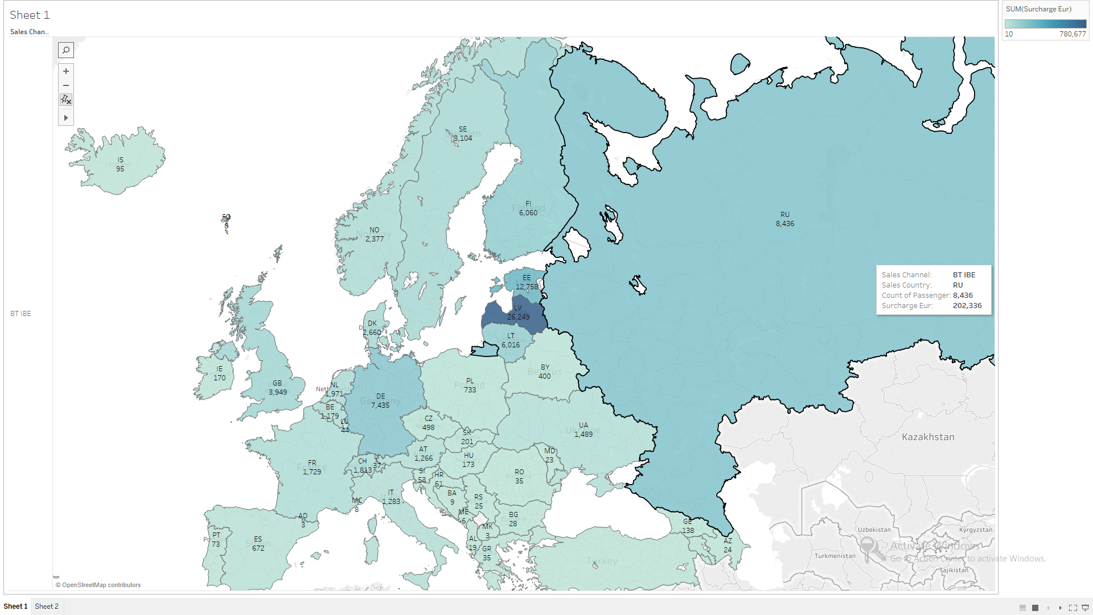
Sales Channel Vs. Sales Country

Slide 18
REST API
WITH
APACHE KYLIN

Slide 19
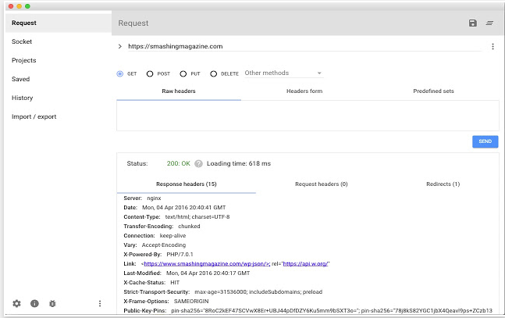
REST Client

Slide 20
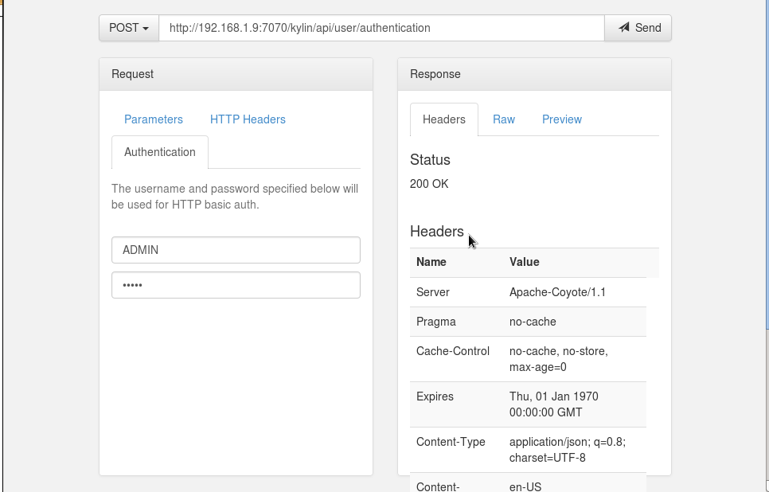
Authentication

Slide 21
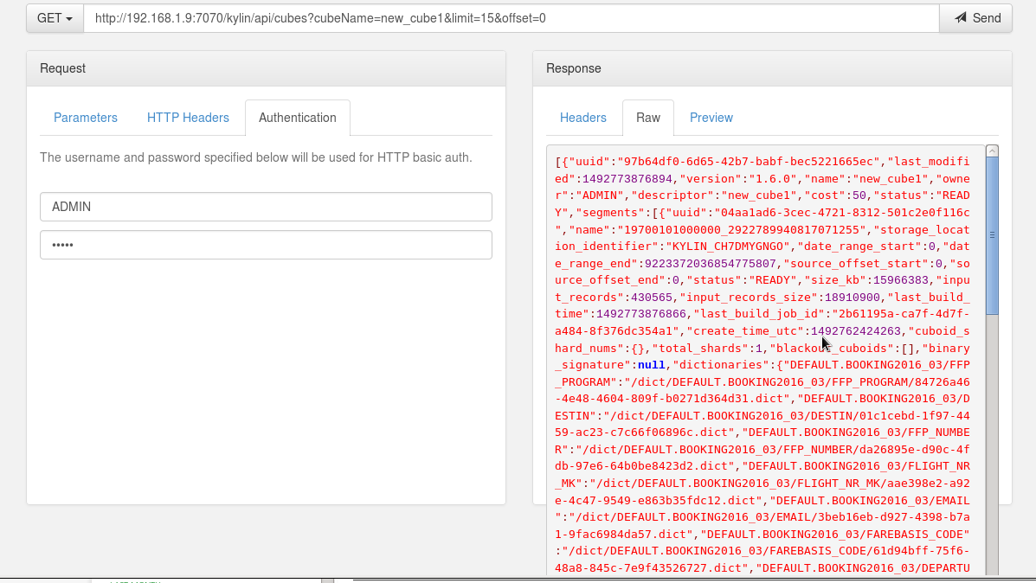
Cube Access

Slide 22
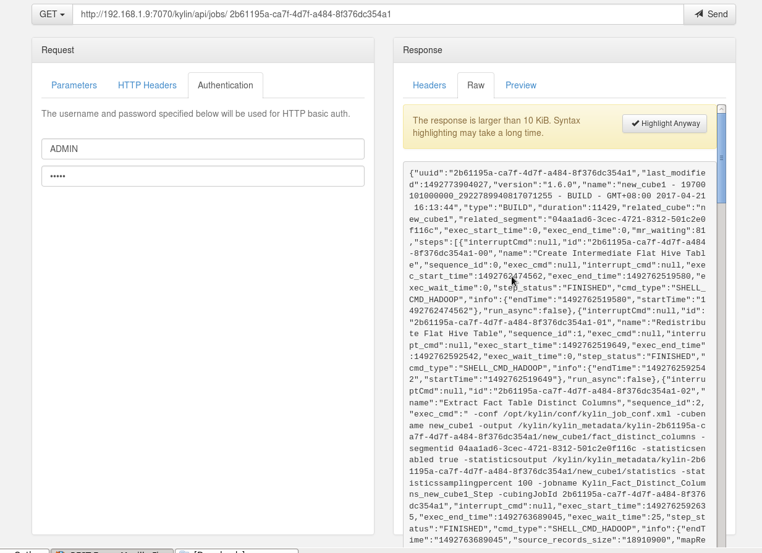
Job Tracking

Slide 23
Recommendation
Kylin has demonstrated great performance benefits and has proved to be a better way for analysts to leverage data on Hadoop with a more convenient approach using their favorite tool like tableau or Excel, In addition to open-sourcing Kylin, is also a part of Apache Incubator project.
On the basis of the used cases we recommend Kylin as a BI tool for use with Hadoop.
Tool Limitations with current version of Kylin
Kylin provides ANSI SQL interface, so we can query the Hive tables in the same way we used to.
One limitation however is Kylin provides only aggregated results, or in other word, SQL should contain a "group by“ clause to yield correct result.
Simple measures only (counts, max, min and sum).Aggregation group rules doesn’t works for
e.g. DESC , ASC, etc.
No Ambari view is available for Apache Kylin.
Kylin will treat empty STRING as NULL by default

Slide 24
Backup Slides

Slide 25



Data Modeling
End User
Cube Modeler
Admin
Cube: …
Fact Table: …
Dimensions: …
Measures: …
Storage(HBase): …
Dim
Row Key
Column
row A
Val 1
row B
Val 2
Fact
row C
Val 3
Dim
Dim
Column Family
Source
Star Schema
Mapping
Cube Metadata
Target
HBase Storage

Slide 26
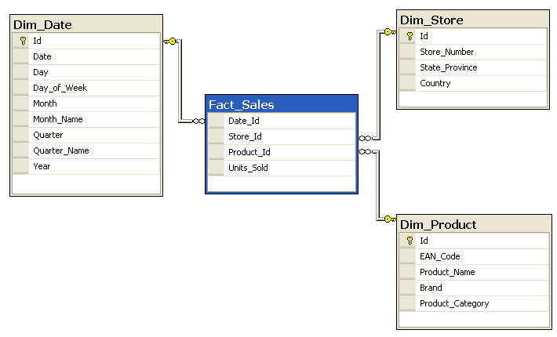
What Is Star Schema ?
A star schema is the simplest form of a dimensional model, in which data is organized into facts and dimensions.
There can be one or more fact tables referencing multiple dimension tables.
A fact is an event that is counted or measured, e.g. in the figure below fact is shown by fact_sales.
A dimension contains reference information about the fact, e.g. in the figure below dimensions are shown by
Dim_Store , Dim_Date and Dim_Product.

Slide 27
Cube Metadata
Apache Kylin stores the cube meta data in the form of hierarchy file system.
The meta data consists of cube descriptions like measures, dimensions and
attributes , cube instances , jobs , tables and dictionaries.
Rather than using a normal file system , Kylin uses HBase to store cube metadata.

Slide 28
HBase Storage
Kylin stores its cube data in the HFiles . These HFiles are then stored in the HBase table.
There is a separate HBase table for every cube build in Apache Kylin. These tables present in HBase
consists of billions of rows having millions of columns.
HBase is an open-source, column-oriented , distributed database system in Hadoop environment.
It is a NoSQL build on top of HDFS.

Slide 29
THANK YOU

