Slide 1

Visvesvaraya National Institute of Technology, Nagpur
Electronics and Communication Engineering Department
M.TECH. IN APPLIED AI-C2S4 2025-26 (Summer 2026)
Second Evaluation-Phase 2 (19/04/2026)
Design and Development of an Agentic AI-Powered
HR Assistant for Employee Support
Presented by
Nalam Venkata Yugandhar Gupta (MT24AAI057)
Under the supervision of
Dr. Praveen Pawar
ECE Dept. VNIT Nagpur

Slide 2
Introduction & Problem Statement:
HR teams spend significant time on repetitive queries:
HR polices related questions
Reimbursement policies
Resolving Payroll related queries
Applying Leave and Checking the balanced leaves
Employees face delays in getting information.
Need for AI agent that automates support, reduces workload, and improves employee experience.
Manual HR support → slow, resource-intensive.
Goal: Build an agentic AI system that can understand queries & Retrieve relevant information from employee data.

Slide 3
Flow of the Agent:
Policy Queries
Policy
Policy Agent
Holiday Info
Holiday Queries
Tax Exemptions Info
Tax Related Queries
Supervisor Agent
Payroll Agent
Payroll DB
Payroll Queries
Employee Tools
Employee Related
LMS Actions
LMS Agent
Manager Tools
Manager Related
LMS Actions

Slide 4
Multi Agent Architecture: (Phase-2)
Policy Agent
Tool
Policy Related Queries
Multi Agent
Leave Management System
MCP powered Action Agent
Actions on LMS
Input Query
LLM (Groq)
Model: openai/gpt-oss-20b
Payroll Agent
Tool
Payroll Related Queries
Output response
4

Slide 5
RAG Model:
RAG Model
LLM (Groq)
Model: openai/gpt-oss-20b
Employee Policies
Get the context from Vector Store
Prompt + Context
Output response
Data Ingestion (Lang chain Loaders)
Chunking & Embedding Hugging face
Open-source model
(all-MiniLM-L6-v2)
Vector Store (CHROMA DB)
RAG Model
Employee Policies
Convert query to chunks
Input Query

Slide 6
SQL AGENT Model:
Table Schema + Prompt
Pay roll data
SQL Agent
DB
Output response
SQL Query
LLM (Groq)
Model: openai/gpt-oss-20b
SQL Result + Prompt
Input Query

Slide 7

MCP (Modal Context Protocol) Client-Server Architecture:
MCP Server 1
Application-1
Rest API
MCP Client 1
MCP Client 2
MCP Server 2
Application-2
Rest API
MCP Client 3
MCP Sever 3
Application-1 & 2
Rest API

Slide 8
HR Agent using MCP Modal:
Apply Leave
Leave Balance
All Employee
Employee Specific API Integrated
MCP Server
Employee Specific MCP Client
Action on Leave
All Leaves
Pending Leaves
Employee Specific API Integration
MCP Server
Manager Specific MCP Client

Slide 9
MCP Agent Flow:
LLM
MCP Client
JSON-RPC call
MCP Server
Tool selection will be happened based
on the description we provided for the tool
Lang-chain tools schema handling
Tool Calling
Tool Execution
Http request to API
Application

Slide 10
Data Requirement :
HR Documents: Leave policy, reimbursement rules, holiday list.
Holiday Calendar: JSON/CSV format with official holidays.
Employee Data (anonymized for testing):
Leave balance records
Reimbursement requests
Tools using currently :
NLP / LLMs: Grok-openai/gpt-oss-20b & GPT-4o(open-source).
Agent Framework: LangChain
Context Search: Sentence-transformers/all-MiniLM-l6-v2.
Database: MySql
Frontend: Streamlit

Slide 11
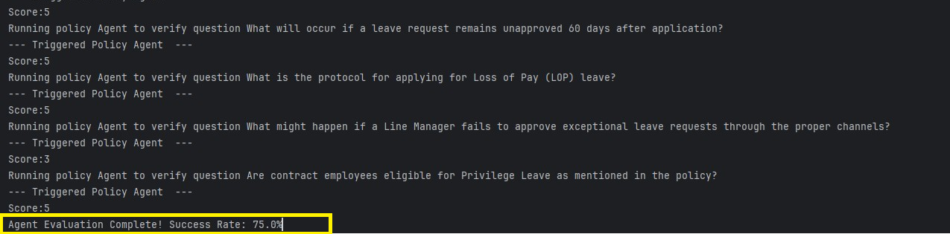
Agent Evaluation:
Agent Evaluation is doing based on the pre-defined questions and scoring for faithful answers
The pre-defined questions and answers are loaded from the JSON file and comparing the results of questions with actual answers. Based on the matching criteria taking

Slide 12
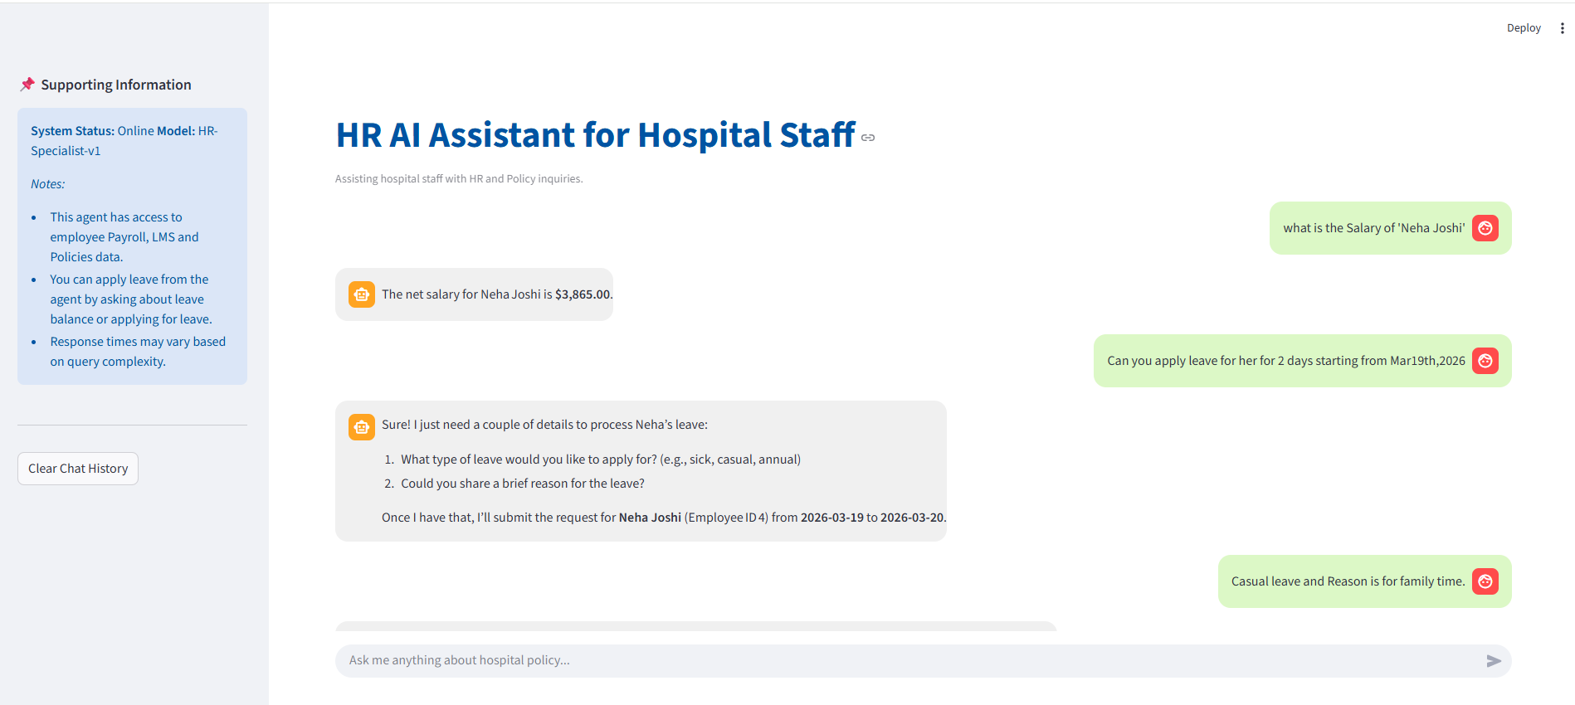
Agent Responses:

Slide 13
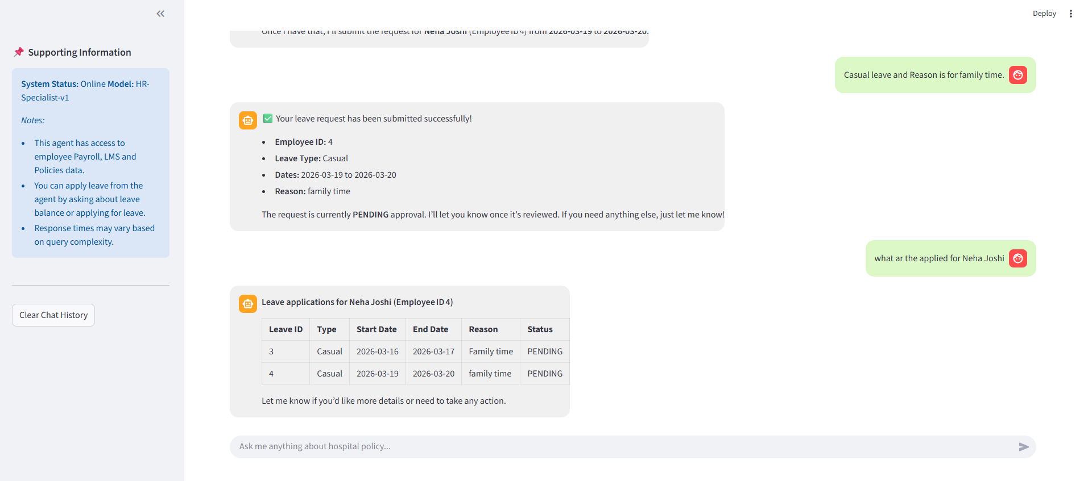
Agent Responses:

Slide 14
Expected Outcomes:
Scalable to other domains (Finance, IT Helpdesk).
Employees can query HR assistant anytime.
Automated responses reduce HR workload by 30–40%.
Personalized responses based on memory of past queries.

Slide 15
Progress:
Employee data creation in DB and Policy data conversion
Implementing task specific agents like Payroll Agent, Policy Agent, Holiday Agent
Orchestration of the Agent and Model Evaluation
Creation of Chat bot user interface
Creation of LMS portal using microservice concept
Creation on MCP Client-Server modal to perform agentic actions on the LMS portal
Improvisations in all child agent responses with respective of the user queries
Creation of the Manager specific API MCP client
Creation of user level authentication and restrict information based person role

Slide 16
References:
HR‐MultiWOZ: A Task Oriented Dialogue (TOD) Dataset for HR LLM Agent (https://arxiv.org/html/2410.11239v1)
Model Context Protocol (MCP) Tool Descriptions Are Smelly! Towards Improving AI Agent Efficiency with Augmented MCP Tool Descriptions (https://arxiv.org/html/2602.14878v1 )
Integrating AI and Large Language Models for Automated Data Quality Enhancement in Data Integration Systems (https://discovery.researcher.life/article/integrating-ai-and-large-language-models-for-automated-data-quality-enhancement-in-data-integration-systems/bf2746490e803ed3a6747d21c6b21f6c )

Slide 17


Slide 18


