Slide 1
Twitter Sentiment Analysis
Find Out What The World Is Thinking

Slide 2
Application Concept
To find out what the world is thinking:
We use the Twitter API to pull current comments on trending topics around the world
Then we analyze those tweets with a sentiment analysis API to get individual user’s thoughts on that topic
Using the average of these sentiments we can find out what the world thinks about trending topics

Slide 3
Design Process
Started researching APIs related to Twitter and sentiment analysis
We discovered the official Twitter API and the Text Sentiment Analysis Method API
LEARNING MOMENT: Do not assume that all large APIs are well-written or have correct documentation
As a team, we divided up the work between two front-end developers and two back-end developers
Nalease and Jared worked on the front-end
Rob and David worked on the back-end

Slide 4
Technologies Used
Node.js
Javascript
Firebase
Bootstrap
Twitter for Websites
Twitter API
Yahoo Query Language
Text Sentiment Analysis Method API

Slide 5
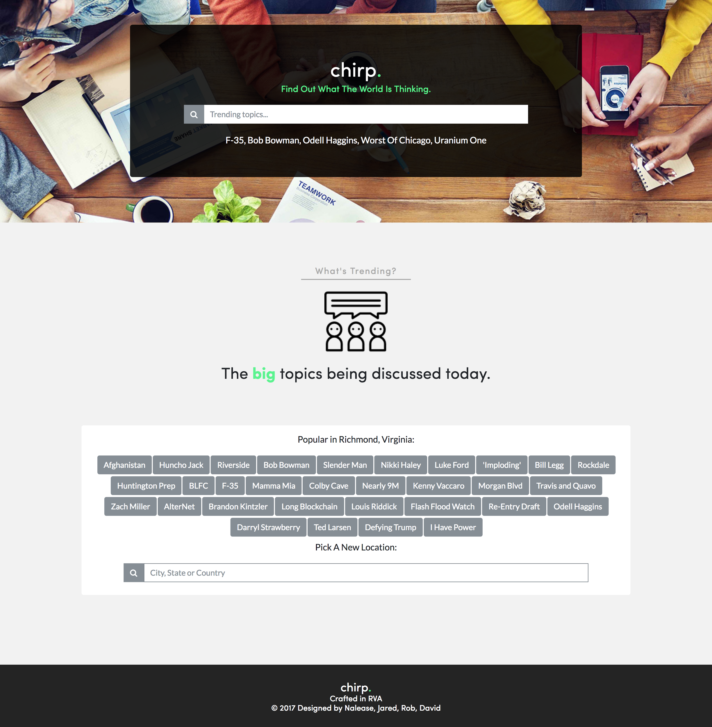
Live Demonstration...

Slide 6
Future Development
Add the ability to implement and analyze other social media platforms
Use Twitter Premium API to expand features and search capability
If on mobile, use geolocation to find nearby trending topics
Compare other sentiment APIs for more in-depth analysis of results
Use a Sentiment API that could possibly run faster (possibly locally hosted)
Look for an API that provides the confidence (percentage of certainty) in results.
Ability to graph sentiment over time
Ability to select enhanced location
Translate other languages

