Slide 1
Course: CSN-371 Assignment: Part of speech (POS) tagging for the BNC corpus
Instructor: Raksha Sharma
Team Members:
Anmol Thakur (18116014)
Annapareddy Nalin Prabhath (18116015)
Burri Vishnu Vardhan Reddy (18116024)

Slide 2
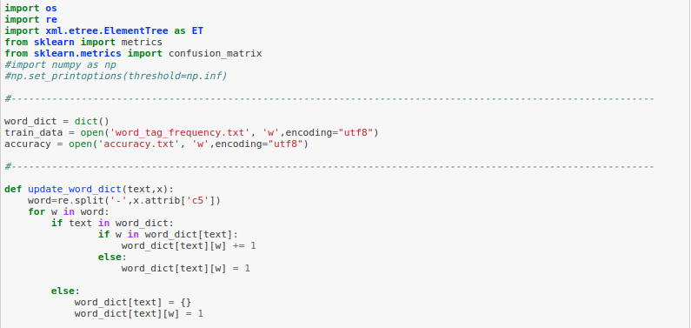
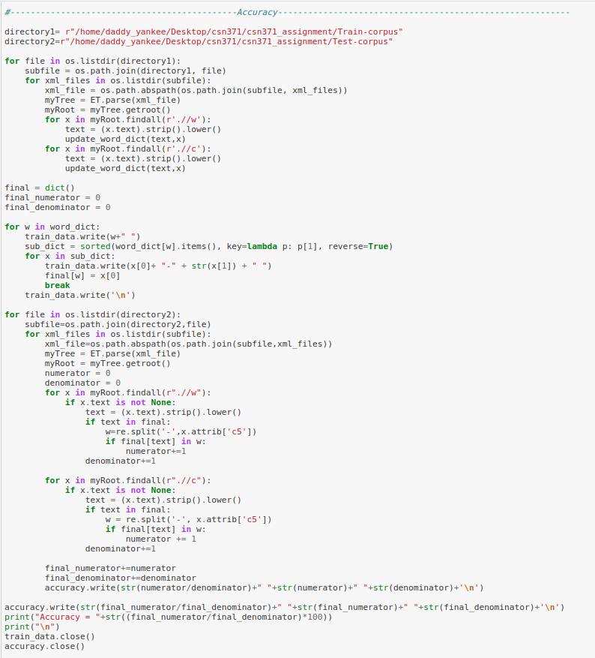
Screenshot of the main function of the code which generates a model that gives the best tag for given word:

Slide 3
The overall accuracy of the model on test data:

Slide 4
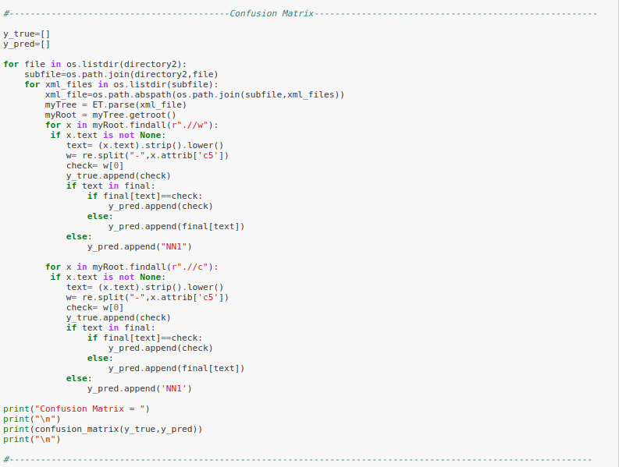
The confusion matrix for the tags in the tag-set:

Slide 5
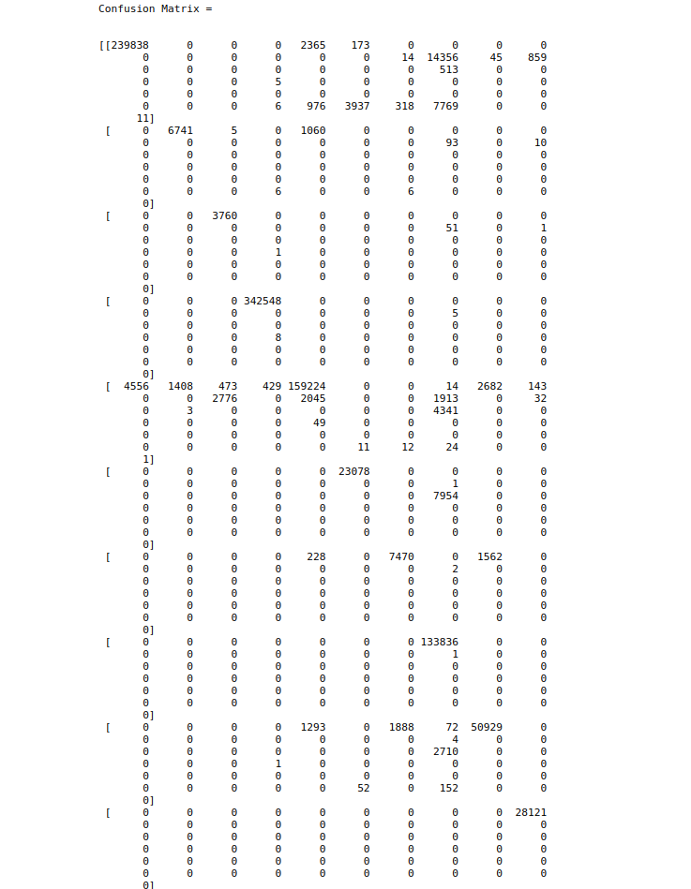
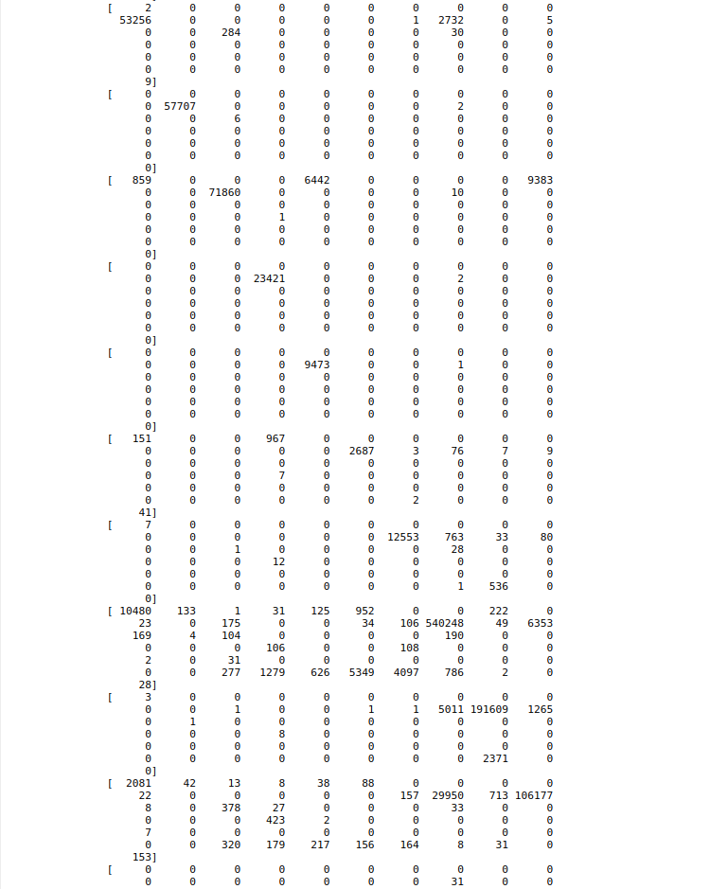
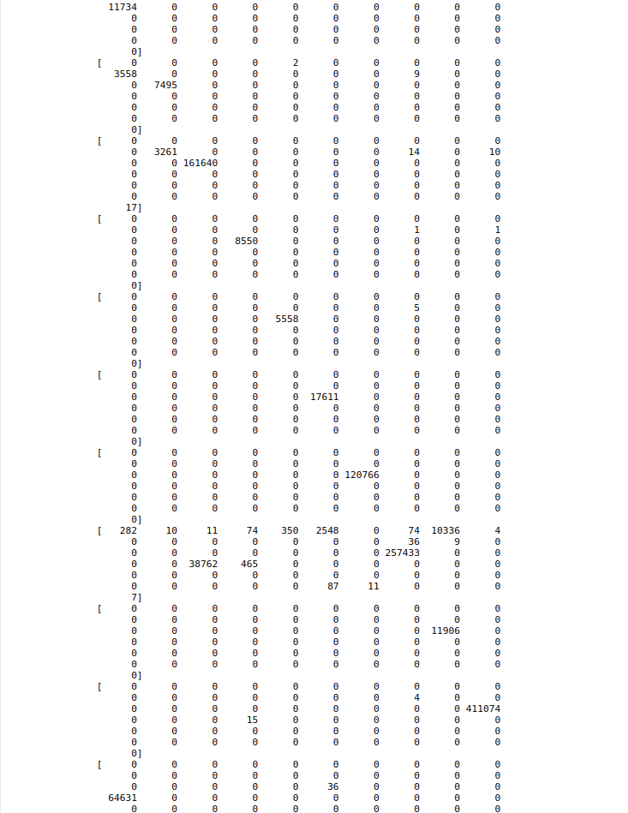
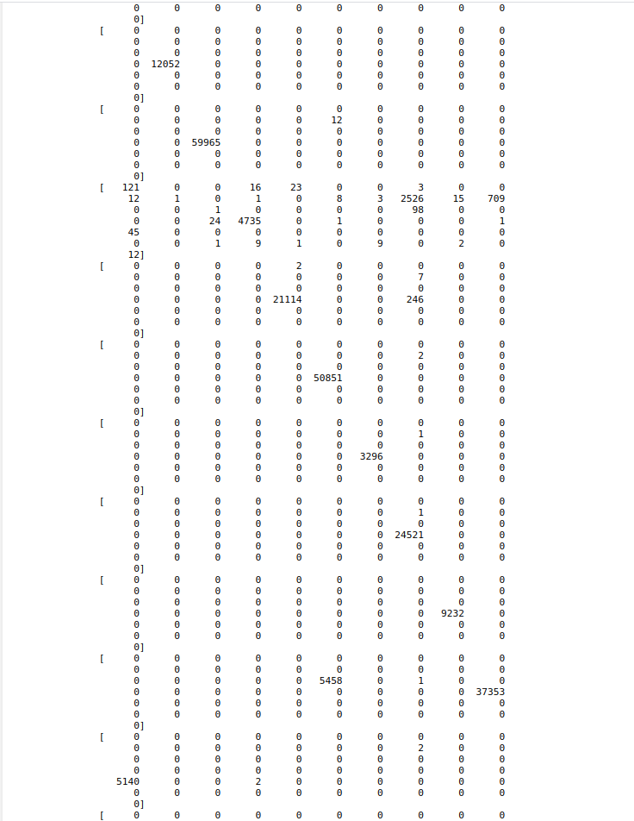
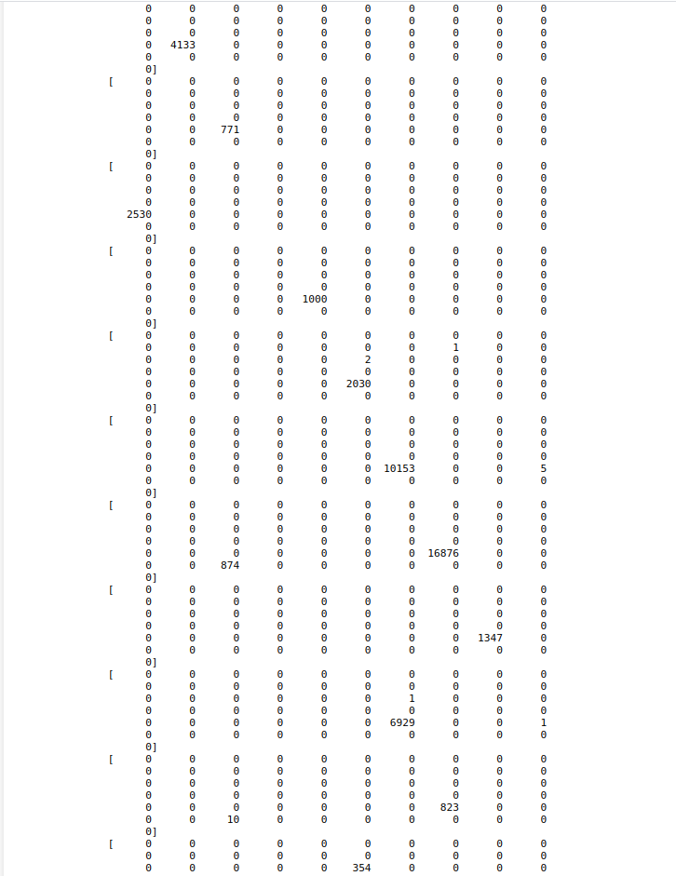
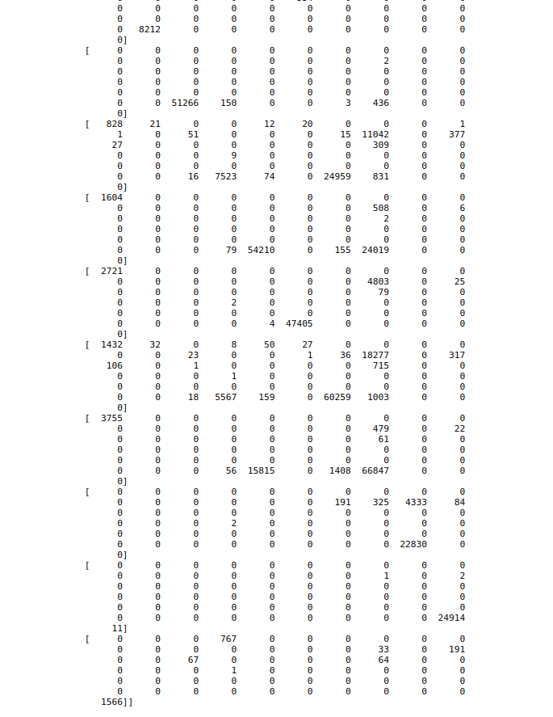
1.)
2.)
3.)
4.)
5.)
6.)

Slide 6
Analysis of the system:
We implemented a classification model for generating the best tag for the given word. The frequency count of all the tags associated with a single word was calculated and the max frequency tag was selected as the best tag for the given word.
The accuracy was found using the actual tag values from the test corpus and the predicted tag values from the finalized train corpus for the same word. The predicted tag values were calculated using the above model.
For better insights regarding the performance of the model, we also calculated the confusion matrix for the above model by using the true values and the scikit-learn library.
The confusion matrix shown on the previous slide resembles to an approximate diagonal matrix which confirms the high accuracy of the model.

