Slide 1
Course: CSN-371 Assignment: Part of speech (POS) tagging for the BNC corpus
Instructor: Raksha Sharma
Team Members:
Anmol Thakur (18116014)
Annapareddy Nalin Prabhath (18116015)
Burri Vishnu Vardhan Reddy (18116024)

Slide 2
The accuracy for the tag prediction using the HMM model with Viterbi algorithm:
Accuracy = 94.35621

Slide 3
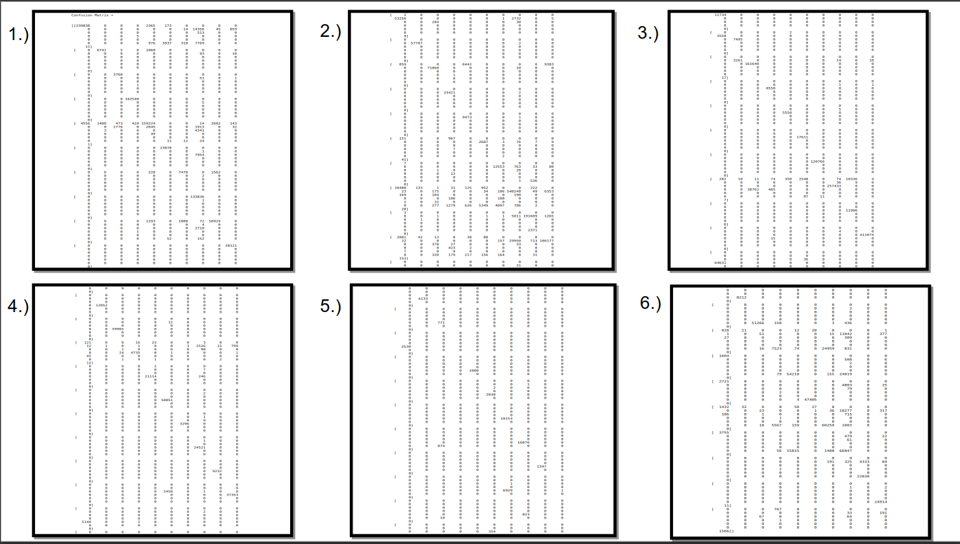
The confusion matrix for the tag prediction using the HMM model with Viterbi algorithm:

Slide 4
Features that could help in improving the overall performance of the system:
While implementing the Hidden Markov Model with Viterbi algorithm, we included a likelihood estimator which calculated the value at a particular stage and stored it. These stored values are later used to calculate the optimal path by selecting the maximum value. It works just like dynamic programming and also helps in reducing the number of paths that the model has to explore.
A very slight increase in overall performance of the system can also be brought by considering the case when the word to be tagged is present in test corpus but not in train corpus. In such a situation, we can explicitly assign the value for such words by using the regular expression python module.

