Slide 1
DeepOCR
PROJECT PRESENTATION
Deep Learning-Based Intelligent OCR System for Handwritten and Complex Document Recognition
5 recognition models
Consensus voting
Review studio
October 2026
Notes:
DeepOCR is an end-to-end OCR system for handwritten and complex documents. It cleans the page, finds every text line, reads it with deep-learning models, rebuilds the layout and lets a person review the result. Its key idea is that five different models vote on every word.

Slide 2
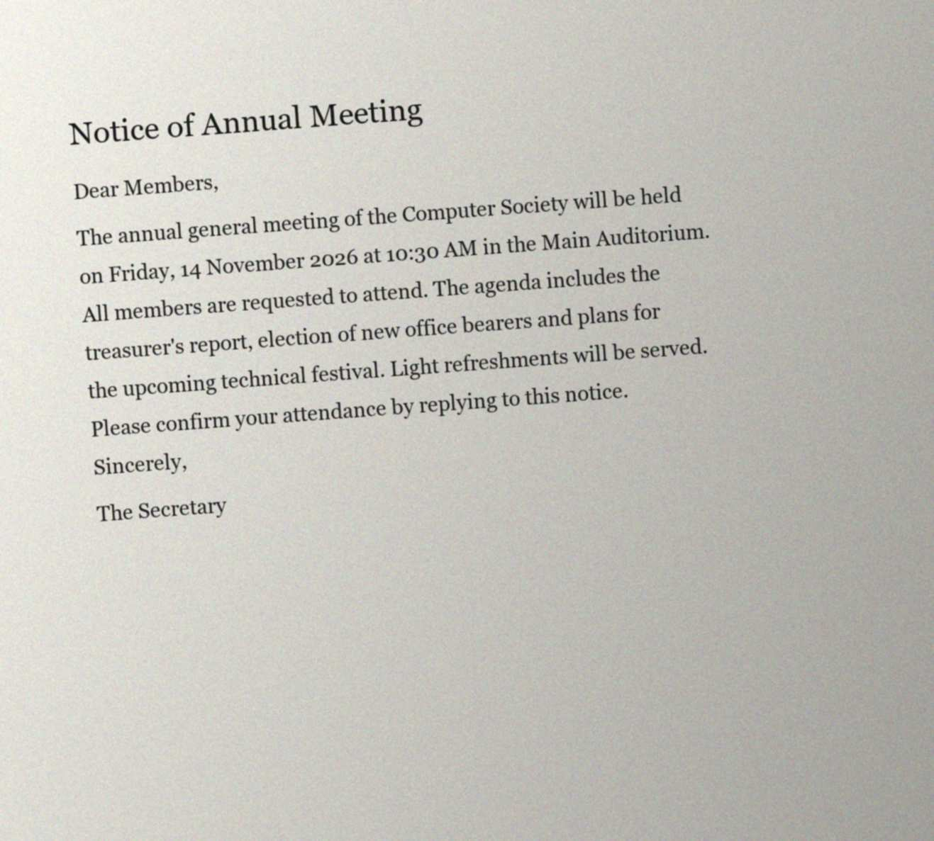




Why OCR still fails on real documents
Clean printed pages are easy. Real documents are not.
Handwriting
Poor scans
Every writer is different; letters touch and slant.
Noise, blur, shadows, low contrast and faint ink.
Skew and layout
No sense of doubt
Tilted pages, tables, forms, checkboxes, columns.
Tools never say which words may be wrong.
A test input: 4° skew, noise and uneven lighting
Notes:
Commercial OCR handles clean print well. It struggles with handwriting, poor scans, tilted pages and structured layouts such as forms and tables. It also gives no hint about which words might be wrong, so users must re-read everything.

Slide 3
Objectives from the project proposal
1
Extract text from document images
2
Recognise handwritten and printed text
3
Clean noisy, blurred and skewed images
4
Detect text regions in complex documents
5
Analyse the document layout
6
Compare deep-learning recognition models
7
Evaluate with standard metrics (CER, WER)
8
Build a user-friendly interface
Notes:
These are the eight objectives from the project proposal. The rest of the presentation shows how each one was met, from preprocessing and detection to the model comparison and the user interface.

Slide 4








System overview: an eight-stage pipeline
From an uploaded file to reviewed, structured text
Input
Clean up
Detect lines
Recognise
Vote
Layout
Correct
Review
PDF or image, up to 100 pages
Deskew, denoise, CLAHE contrast
DBNet finds every text line
CNN‑BiLSTM, CRNN or TrOCR
Five models vote on each word
Headings, tables, checkboxes
Fix 0/O, 1/l and spelling
Overlays, review queue, export
Only the Consensus engine runs the vote; single models go straight from recognition to layout.
Built with Python · PyTorch · OpenCV · Hugging Face Transformers · PaddleOCR · FastAPI · React + TypeScript
Notes:
A document passes through eight stages. The page is cleaned, DBNet finds every text line, and a recognition model reads each line. With the consensus engine, all five models read every line and vote word by word. Then the layout is rebuilt, typical OCR errors are corrected, and the result is shown for review.

Slide 5
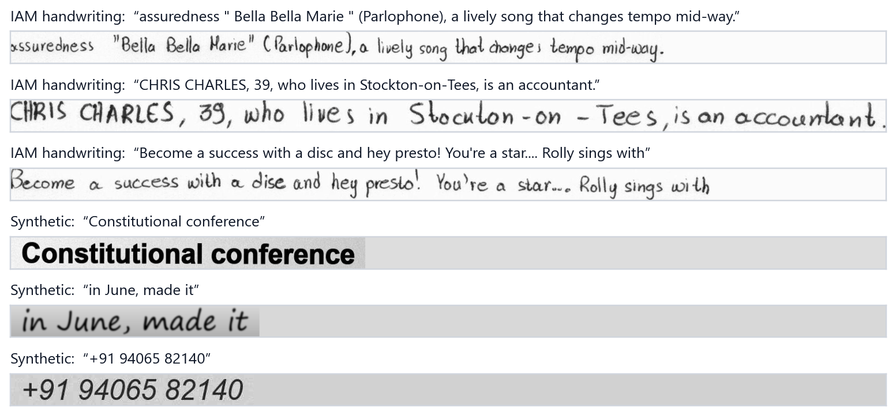
Data: real handwriting plus synthetic print
10,373
IAM handwriting lines · 657 writers
Train 6,482 · Val 976 · Test 2,915
6,500
Writer-independent split: test writers never appear in training.
Augmentation: rotation, scaling, noise, blur, brightness, perspective.
Synthetic printed and script lines · 32 fonts
Train 5,005 · Val 520 · Test 975
Notes:
The models learn from the IAM handwriting database, using its official split so that test writers are never seen in training, plus a synthetic dataset of printed and script-font lines created for this project with realistic degradations. Training images are augmented on the fly.

Slide 6
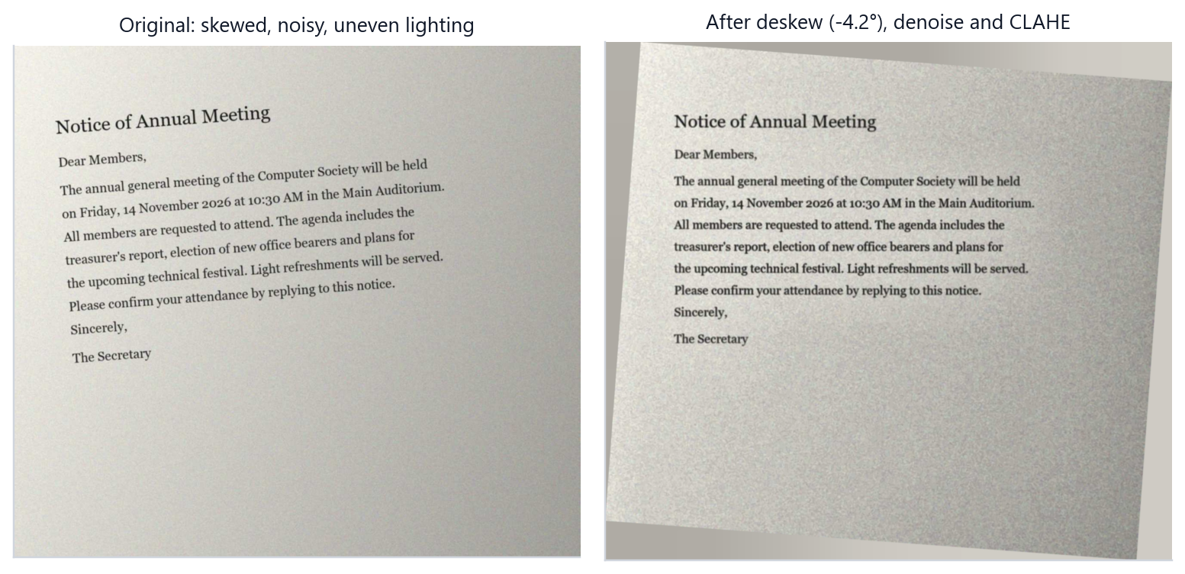




Cleaning the page before reading it
Deskew
Projection profile finds the tilt (±12°) and straightens the page
Denoise
Gaussian and median filtering remove speckle
Contrast
CLAHE lifts faint ink without boosting noise
65.5% → 18.9%
CER of the CNN‑BiLSTM on lines tilted by 8°, without and with our deskew step
Binarise
Adaptive threshold evens out phone-photo lighting
Notes:
Before recognition the page is cleaned. Deskewing uses a projection profile: the angle that gives the sharpest row profile aligns the text. Here a 4.2-degree tilt is found and corrected. The robustness study shows why this matters: at an 8-degree tilt the baseline's error rises to 65.5 percent, and deskewing brings it back to 18.9 percent.

Slide 7



Three models, from baseline to Transformer
BASELINE
MODEL 2
ADVANCED
CNN‑BiLSTM
CRNN
TrOCR (fine‑tuned)
4 conv blocks + 2-layer BiLSTM + CTC
7-layer VGG CNN + BiLSTM + CTC (Shi et al.)
Vision Transformer encoder + text decoder
Parameters
Parameters
Parameters
2.39 M
2.78 M
61.6 M
Input
Input
Input
32 × 512 grey
32 × 512 grey
384 × 384 RGB
Training
Training
Training
From scratch, 124 min on CPU
From scratch, 130 min on CPU
Pretrained, fine‑tuned 44 min
Speed
Speed
Speed
12 ms per line
16 ms per line
415 ms per line
Also compared: PaddleOCR (industrial PP-OCR) as a reference, and the Consensus vote of all five
Notes:
Three model families from the proposal. The baseline CNN-BiLSTM and the CRNN were built and trained from scratch on a laptop CPU in about two hours each. The advanced model is TrOCR, a Vision Transformer with a text decoder, used through transfer learning: we fine-tuned the pretrained model on our data in 44 minutes.

Slide 8
Training and fine-tuning on a laptop CPU
CNN‑BiLSTM · best val CER 11.8%
CRNN · best val CER 12.2%
TrOCR fine‑tuning · 300 steps · 44 min
20.37% → 2.59%
printed-text test CER, before → after fine‑tuning
handwriting unchanged: 6.97% → 6.73%
Notes:
Both CTC models converge within a few epochs; the best validation CERs are 11.8 and 12.2 percent on the mixed validation set. Fine-tuning TrOCR mainly fixed its weakness on printed text: test CER fell from 20.4 to 2.6 percent, while its handwriting accuracy stayed the same.

Slide 9

Key idea: let five models vote on every word
1
Every model reads each text line
Real example from the test page: “Tin ___ Alley”
TrOCR (fine‑tuned) (weight 3)
fan
2
The readings are aligned word by word
CRNN (weight 1)
fan
TrOCR (pretrained) (weight 3)
Pan
3
Each word is decided by a weighted vote: model weight × confidence
PaddleOCR (weight 2)
Pan
CNN‑BiLSTM (weight 2)
Pan
Pan
66%
Words without a majority are flagged
so the reviewer checks only the uncertain ones
fan
34%
Result: “Tin Pan Alley”, which is correct
Notes:
This is the main idea of the project. Different models make different mistakes. If several independent models read a word the same way, it is probably right. On this real line, two models read 'fan' and three read 'Pan'. Weighted by each model's reliability and confidence, 'Pan' wins with 66 percent of the vote, and it is correct. Words that win no majority are flagged for review.

Slide 10
Results on 600 held-out lines per test set
5.74%
CER on handwriting from unseen writers (Consensus)
2.35%
CER on printed and degraded text (Consensus)
12 ms
per line with CNN‑BiLSTM, our fastest model
Notes:
These are the results on 600 held-out lines per test set. Transformers dominate handwriting at about 7 percent CER, while our small CTC models are strong on print. The Consensus vote is the most accurate engine on both: 5.74 percent CER on handwriting from unseen writers and 2.35 percent on printed text. The trade-off is speed.

Slide 11
Voting removes errors even the best model makes
5.74%
5.86%
11 of 125
handwriting CER: 15% fewer errors than the best single model (6.73%)
printed-text WER: 46% fewer word errors than the best single model (10.81%)
words flagged as disputed on the handwritten demo page, where most errors are
Weights tuned by cross‑validation
TrOCR-ft 3 · TrOCR 3 · PaddleOCR 2 · CNN‑BiLSTM 2 · CRNN 1
Cost
About 1 s per line, because every model runs
Notes:
Compared with the best single model on the same lines, voting removes 15 percent of the errors on handwriting and 46 percent of the word errors on printed text. The oracle shows the best possible combination if we knew the answer. The weights were tuned with cross-validation, so the scores are not measured on the tuning data.

Slide 12

Robust to noise, and deskewing fixes rotation
Tilt breaks CTC models
CNN‑BiLSTM: 19.6% → 65.5% CER at 8°
Deskew restores accuracy
18.9% at 8° with our preprocessing
Noise barely matters
Heavy noise, 15% contrast or JPEG quality 8 change CER by under 0.2 points
TrOCR is most tilt-robust
6.5% at 8°, but most blur-sensitive
Notes:
We re-read 80 test lines under controlled noise, blur, rotation, low contrast and JPEG compression. Noise and compression barely matter thanks to augmentation, but rotation breaks the CTC models and PaddleOCR. With our deskew step in front, the error returns almost to the clean value.

Slide 13
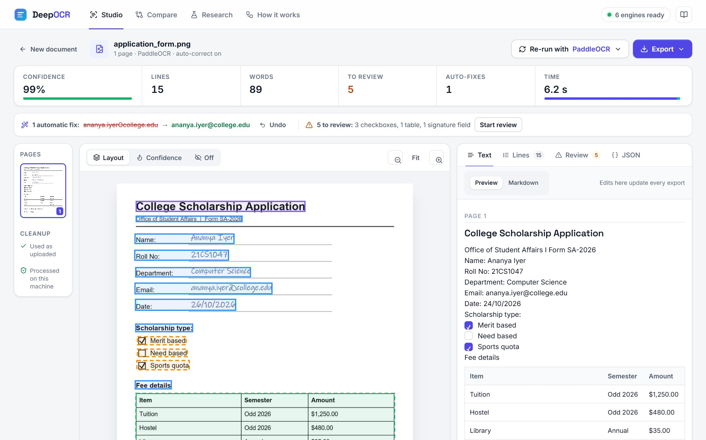
Layout analysis: from page image to structure
Titles and headings
found from line height and stroke width
Text and key–value rows
kept in reading order, column by column
Ruled tables
rebuilt as Markdown tables
Checkboxes
checked, empty or unsure
Signature fields
from a printed label (not verification)
Low-confidence lines
sent to the review queue
Notes:
After recognition, the layout is rebuilt from the detected lines and the page image. On this application form the system finds the title, the fields, the checkboxes and their state, the ruled table and the signature field, and writes them out as structured Markdown.

Slide 14
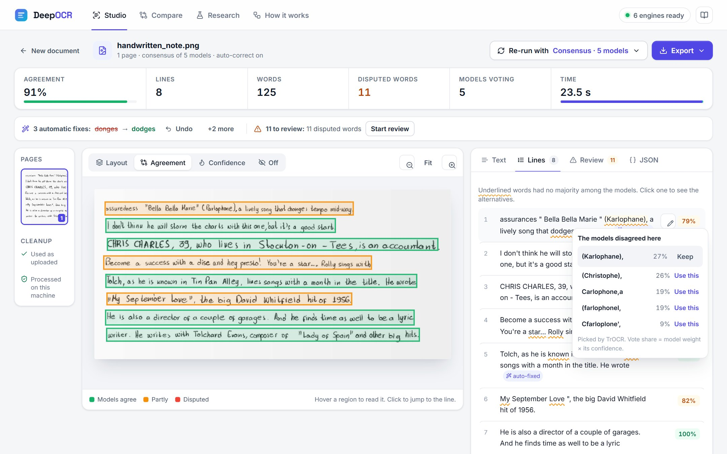


The DeepOCR studio: review instead of retyping
Live progress
Every stage and every model, with cancel
Disputed words
One click swaps in another model's reading
Review queue
Unclear lines, tables, checkboxes, signatures
Export
Markdown, plain text or JSON with coordinates
Also: Compare engines side by side, the Research results page, and a phone layout
Notes:
This is the results workspace. The page shows each line coloured by how much the models agreed. Clicking an underlined word shows what the other models read and their share of the vote, and one click replaces it. Every automatic fix can be undone, and the result exports as Markdown, text or JSON. This is a good point for the live demo.

Slide 15
Conclusion and future work
All eight proposal objectives met
Two CTC models trained from scratch on a CPU; TrOCR fine‑tuned (print CER 20.4% → 2.6%)
Consensus vote: best accuracy (5.74% / 2.35% CER) and a guide for human review
Complete pipeline and web studio, covered by 135 automated tests
Thank you
Future work
Hindi & multilingual
Learned layout (LayoutLM)
Questions?
Faster, parallel voting
Mobile camera OCR
Notes:
To conclude: all eight objectives of the proposal were met. The most effective improvement did not come from a bigger model but from letting the existing models vote, which both reduces errors and shows the reviewer where the remaining errors are likely to be. Future work includes Hindi and multilingual recognition, learned layout analysis, faster voting and a mobile app. Thank you.

